Slide 1
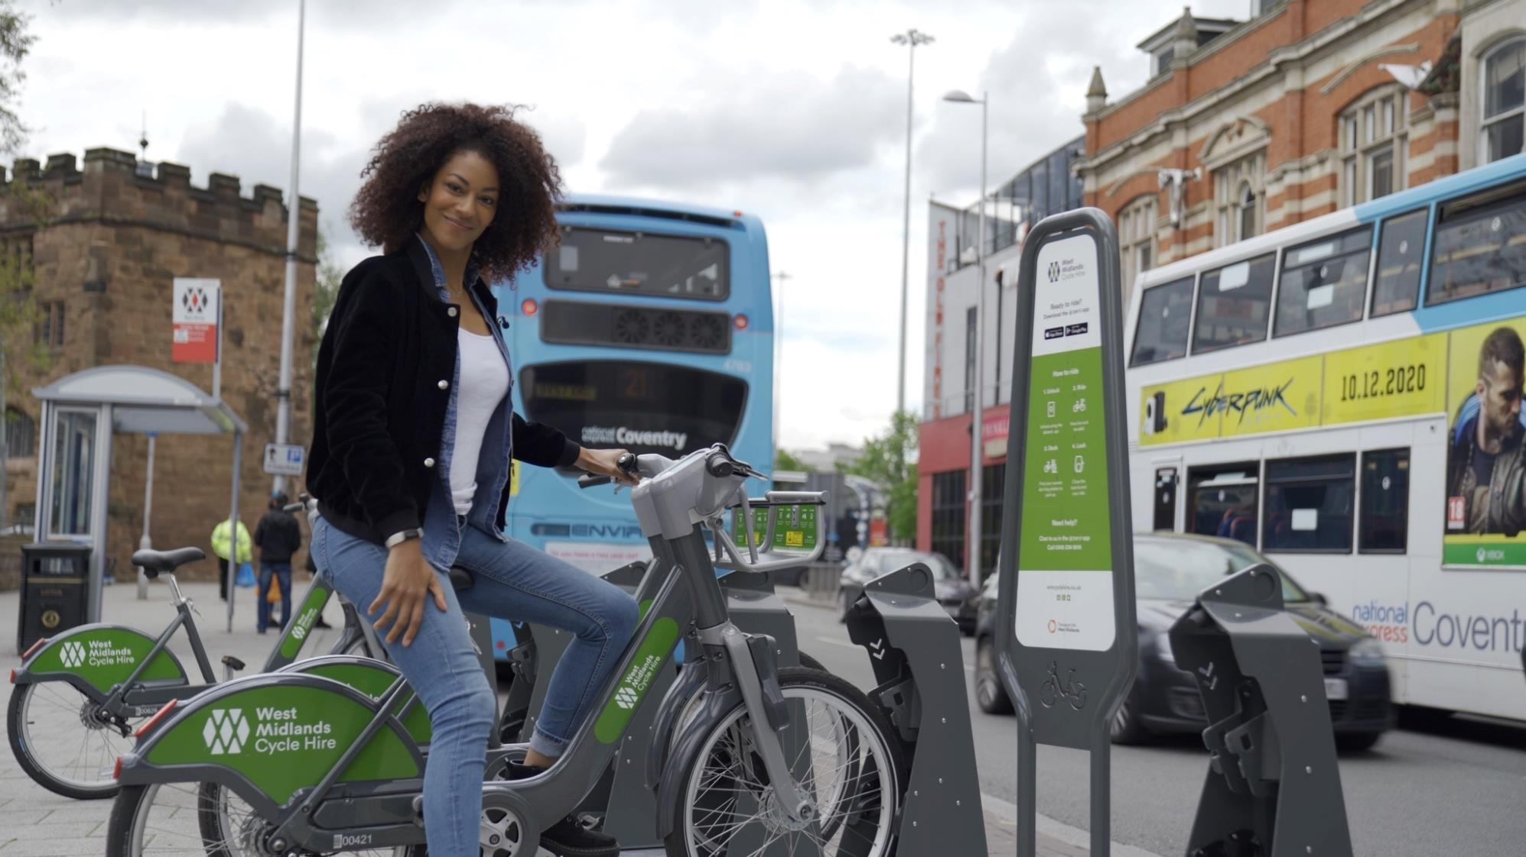
Let's Ride Back Better
www.coventry.gov.uk/cycling

Slide 2
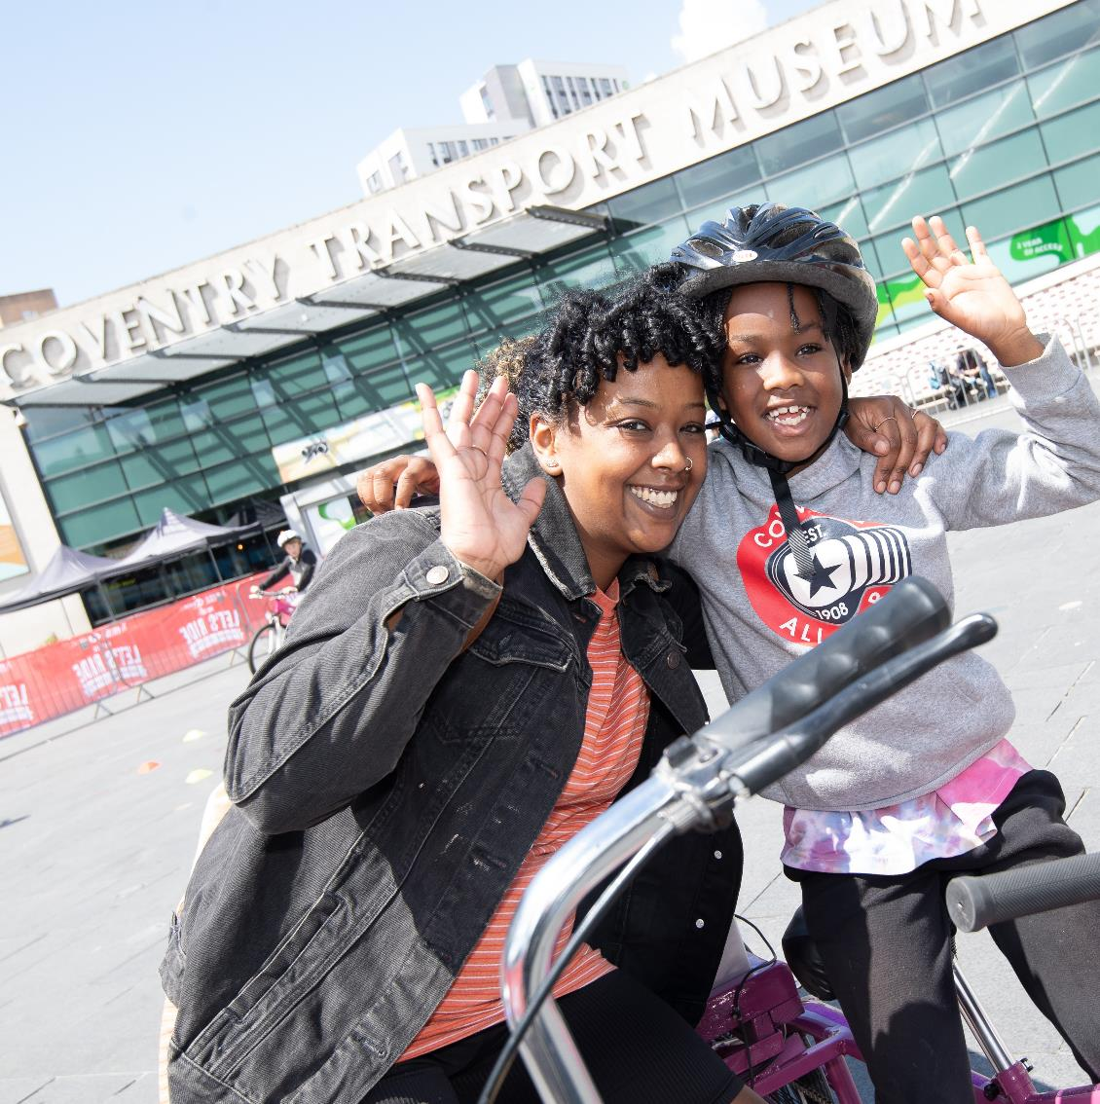
What are the health benefits of active travel?
greater fitness
Improved mental health,
lower risk of obesity,
heart disease
lung disease.
Active travel reduces traffic congestion, itself a major cause of air pollution.
www.gov.uk/government/publications/clean-air-strategy-2019

Slide 3
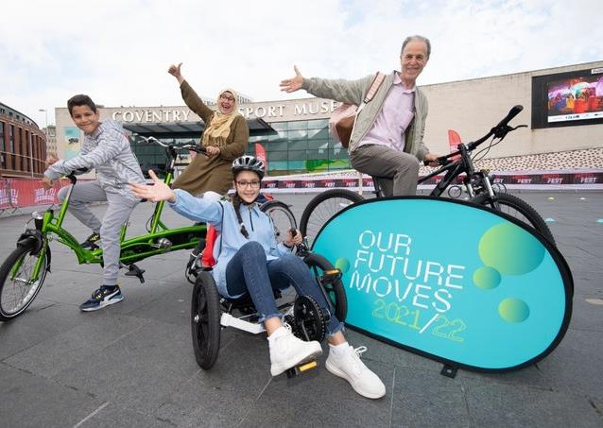
Health benefits of active travel:
greater fitness
Improved mental health,
lower risk of obesity, heart disease and lung disease.
Active travel reduces traffic congestion, itself a major cause of air pollution.
www.gov.uk/government/publications/clean-air-strategy-2019

Slide 4
Investing in Infrastructure: Coundon Cycleway
2.75km segregated route to city centre
Priority at side roads
Traffic signal controlled crossings
Supporting activity
Bike Library
Cycle training for adults and children
Guided rides
Local Cycling & Walking Infrastructure Plan
Opportunity for employers and employees to input ideas

Slide 5
Promoting Cycling
Free cycle training for adults and children
Cycle parking at public events
Event journey planner
Cycle parking as part of new developments
Guided rides
Major events….

Slide 6
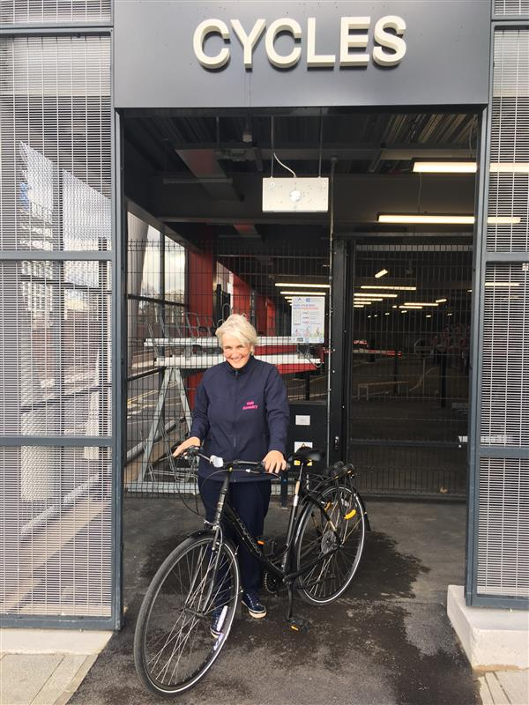
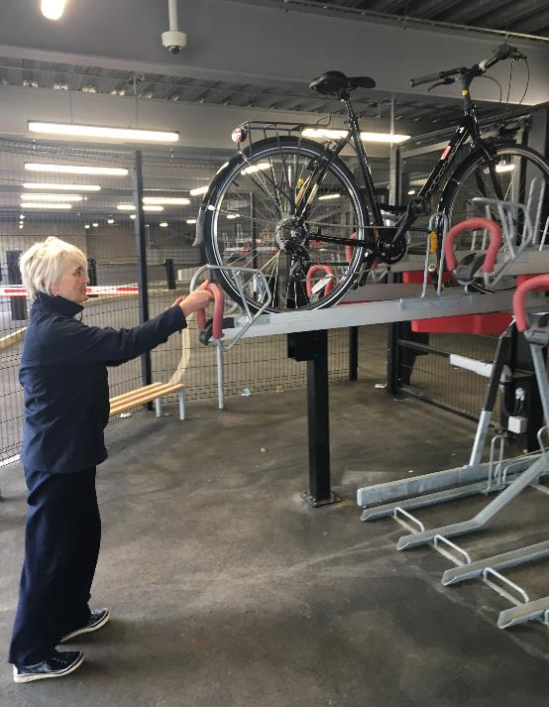
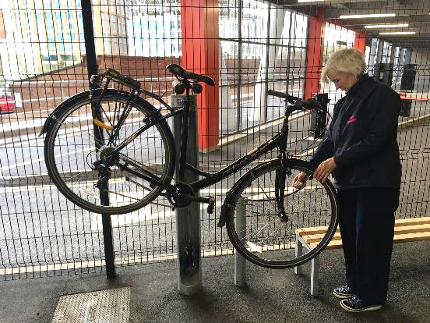
New Station Cycle Parking
Double decker racks
Cargo Bike Parking
Bike maintenance stand
Access via the Movatic App

Slide 7
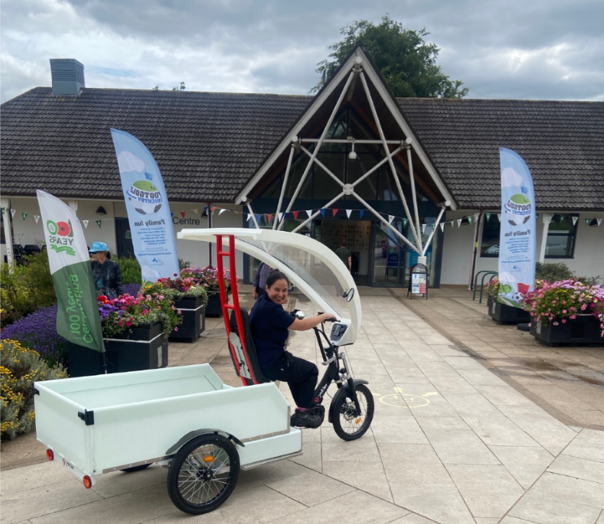
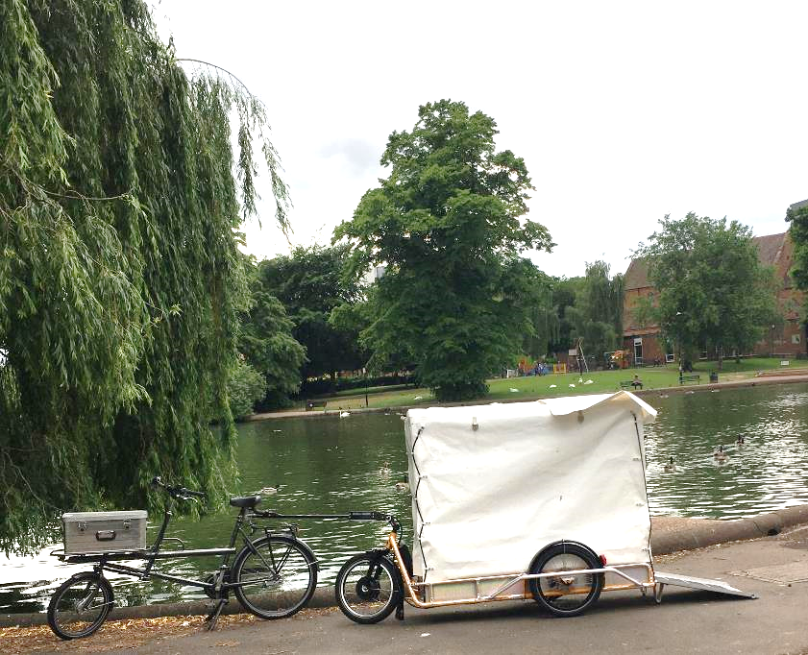
Electrifying Business Travel
E-cargo Trailer for grounds maintenance
E-cargo Trike for catering deliveries
E-cargo Trike for leaflet distribution
E-cargo pick up for events

Slide 8
West Midlands Cycle Hire
Pedal bikes and E-bikes made by Pashley in Stratford
Scheme is most popular in Coventry
Why?
Compact, relatively flat city
Young population and lots of residents in the city centre
High density of docks
Competitive prices from 5p/minute
2 rides free every day during Commonwealth Games

Slide 9
Supporting Coventry Employers
New 6km Binley cycleway to Binley Business Park and University Hospital under construction
Travel planning support
Dr Bikes
Cycle Training
Grants for Coventry businesses to provide cycle facilities for staff
www.coventry.gov.uk/cycling

Slide 10
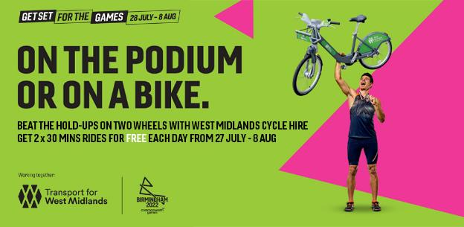
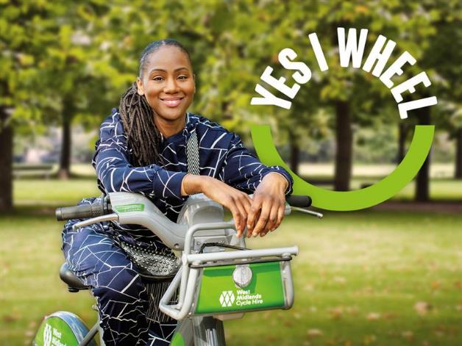
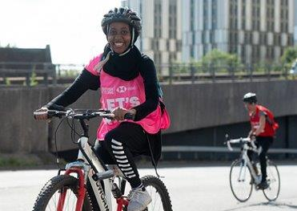
Actions:
Try West Midlands Cycle Hire for free during Commonwealth Games
www.wmcyclehire.co.uk
Staff in certain wards in West Midlands can apply for more free minutes
www.tfwm.org.uk/c4ecyclehire
Coventry Businesses to apply for a cycling facilities grant
Contact bryn.lewis@coventry.gov.uk
Sign up for the Coventry Cycle Newsletter for upcoming training & events
www.coventry.gov.uk/cycling
www.coventry.gov.uk/cycling

