Slide 1
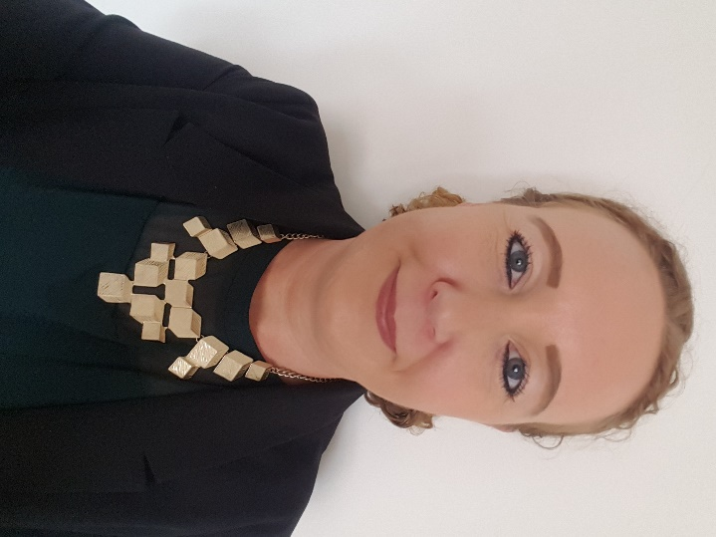
Green Business Programme
Bernie McCullagh
Business Energy Advisor:
Coventry City Council

Slide 2
Agenda
The energy context
Achievements to date
Funding scheme & eligibility
Other environmental support
Q&A

Slide 3
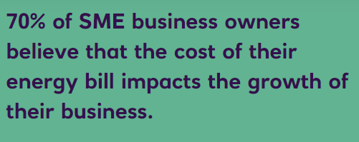
Energy crisis
Concerns over rising energy costs and future-proofing business premises & jobs.
SME’s already economically damaged from Covid.
Govt campaigns from business groups to support SMEs (via business rates/energy price cap?)

Slide 4
Green Business Programme
Green Business Programme is part of
SMEs engaged in the programme experience a variety of benefits, namely:
Started in
2016
Reduced energy bills and maintenance costs
Reduced carbon emissions
Reduced waste disposal costs
Improved working conditions
Increased competitiveness, profitability,
and efficiency
ERDF funded scheme

Slide 5
What we offer
COVENTRY & WARWICKSHIRE
GREEN BUSINESS
PROGRAMME
Lighting
LED, controls, sensors
We may be able to offer eligible businesses grants of between £1k and
£20k to fund up to 40% of the cost of installing energy efficiency measures.
Recycling and waste
compactors, balers
and crushers
Ventilation
fans, distribution
Insulation
Heating
Replacement boilers/ burners, install heat pumps
Free of charge energy audit, worth £840
Renewable
technologies
Less than
1 year left!!
Refrigeration
Compressors

Slide 6
Eligibility criteria
COVENTRY & WARWICKSHIRE
GREEN BUSINESS
PROGRAMME
Are you eligible to access the Green Business Programme? What you need:
50%
12
Trading minimum 12 months
B2B
‹€50
Have an annual turnover of less than €50m
Have at least 50% of sales through business to business
(can be flexible)
Received no more than 200,000 euros of De Minimis public aid over a three year period
Employ fewer than 250 people
Operation not under a franchise business model
Located within Coventry & Warwickshire

Slide 7
What happens during
COVENTRY & WARWICKSHIRE
GREEN BUSINESS
an audit
PROGRAMME
We attend:
a site visit is conducted at your business premises by one of our Business Advisors
We discuss:
operating hours, number of staff, age of building etc
We review:
your energy bills for the last 12 months
We identify:
areas or items where efficiency improvements can be made: heating, lighting, insulation, machinery etc.
We explain:
how the programme works, how to claim, etc
We deliver:
an energy audit report which includes analysis of current energy use alongside energy efficiency recommendations; the report and also identifies grant value and payback periods for each recommendation.
We support you:
your allocated Business Advisor will offer support and advice throughout the whole process

Slide 8
Application process
COVENTRY & WARWICKSHIRE
GREEN BUSINESS
PROGRAMME
40%
1
2
3
4
5
6
7
Desire to become more sustainable
Complete SME registration form
Check eligibility criteria
Arrange Resource efficiency and Energy audit
Review recommendations, complete and submit
application
Receipt of offer letter with
Following competition of
confirmation of works, claim up to
grant and date to 40% of confirmed
commence
Project costs

Slide 9
Achievements
Started in
To date: we’ve
2016
offered support to
288
We’ve paid over
£2,788,332
grant claims
Carbon saving:
13,595
businesses
At least 60 jobs directly created because of energy-efficient machinery part-funded by the programme.
tonnes / per year
1,950
Since 2018,
30 events have been hosted by the programme
members in the network

Slide 10
Tel: 02476 972 026
Email: businesssustain@coventry.gov.uk
www.coventry.gov.uk/businesssustain
We help our clients with:
Bespoke environmental management advice
Registers of environmental and health and safety legislation
Legal compliance audits
Support to maintain accreditations such as; ISO14001, ISO45001 & ISO9001 certification
Since 2018,
30 events have been hosted by the programme

Slide 11
Contact details:
Coventry & Warwickshire Green Business Programme:
greenbusiness@coventry.gov.uk
Since 2018,
30 events have been hosted by the programme

Slide 12
Any questions?
Since 2018,
30 events have been hosted by the programme

