Slide 1
Green Business Network
Maria Covlea
Marketing and Events Co-Ordinator
Green Business Programme

Slide 2
Green Business Network
What is it?
How can I use it to promote my business?
Certificates
Directory
Newsletter – we saved this space for your business
Podcast – we want to hear your story?
Social media
Webinars
Examples

Slide 3
Green Business Network
1. What is it?
The Green Business Network allows businesses to come together, share ideas and promote energy, resource, waste and water efficiency as well as engage on low carbon, environmental and green sustainability initiatives. The network is free to join and open to any business, community organisation, social enterprise, charity or individual.

Slide 4
Green Business Network
2. How can I use it to promote my business?
The Green Business Network can promote your case studies, your Net Zero journey as well as any other achievements related to sustainability.
Simply get in touch with us about your story and we will use our network (currently 2030 members) and its channels to promote it.

Slide 5
Green Business Network
3. Certificates
We offer our members certificates which can help you improve your green credentials.
Please note the certificates are not sent automatically, you will have to request one. If you are a member or have recently became one and you would like to receive a certificate, please let me know.
Once you’ve received your certificate please share it on your social media and tag us in!

Slide 6
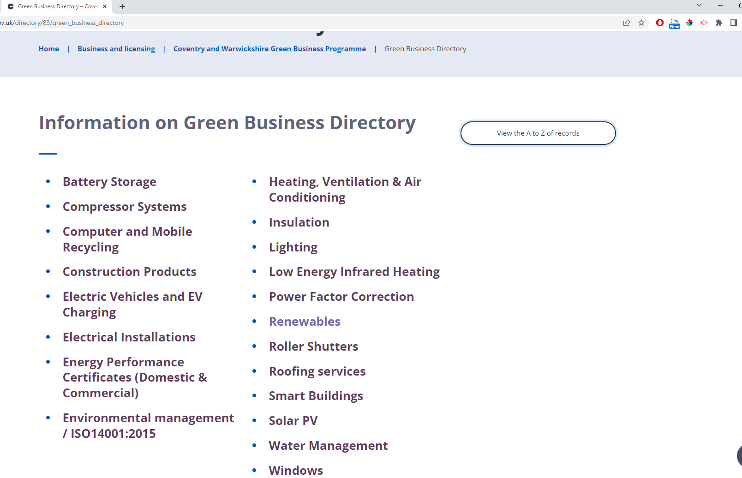
Green Business Network
4. Directory

Slide 7
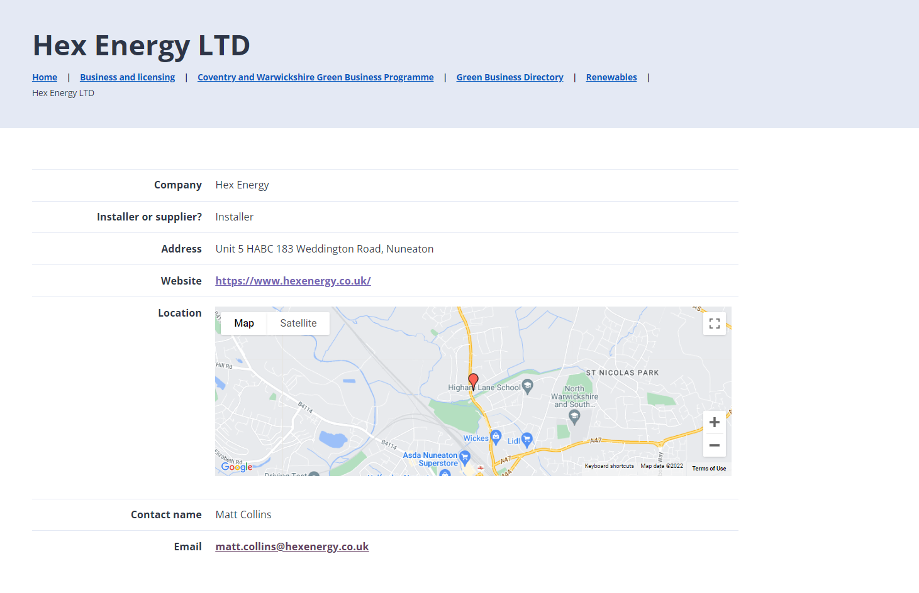
Green Business Network

Slide 8
Green Business Network
4. Directory – why it matters?
We refer people to the directory when they ask us to recommend a business who can complete the work needed to improve energy efficiency.
Backlinks can help you improve the authority of your website / can help your business rank higher on Google. Search engines like Google see backlinks as votes of confidence.

Slide 9
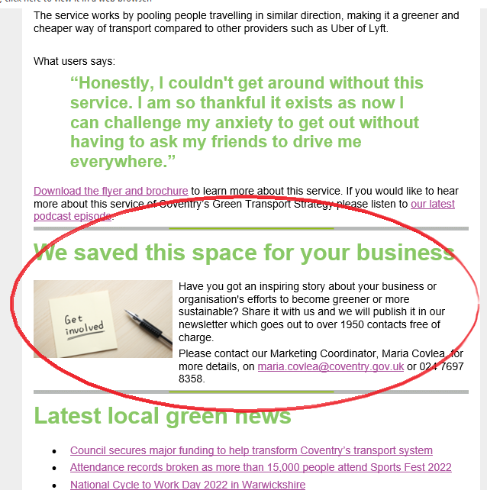
Green Business Network
5. Newsletter – we saved this space for your business

Slide 10
Green Business Network
5. Podcast – we want to hear your story
Our newly launched podcast channel has been featuring companies who have started their net zero journey or other companies or organisations who can help us learn more about interesting green topics such as Solar PV and heat pumps.

Slide 11
Green Business Network

Slide 12
Green Business Network
6. Social media
We can help you share your green stories on our social media channels:
LinkedIn – 646 followers
Twitter – 775 followers

Slide 13
Green Business Network
7. Webinars
If you have a green inspiring story you could join one of our webinars where you could share with others your challenges and solutions.
Our webinars usually have 100 people registered to attend.

Slide 14
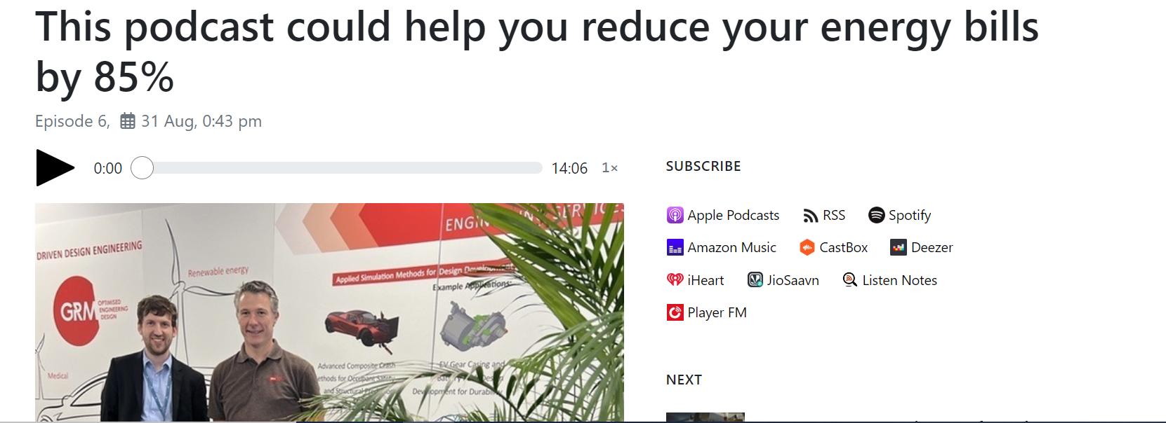
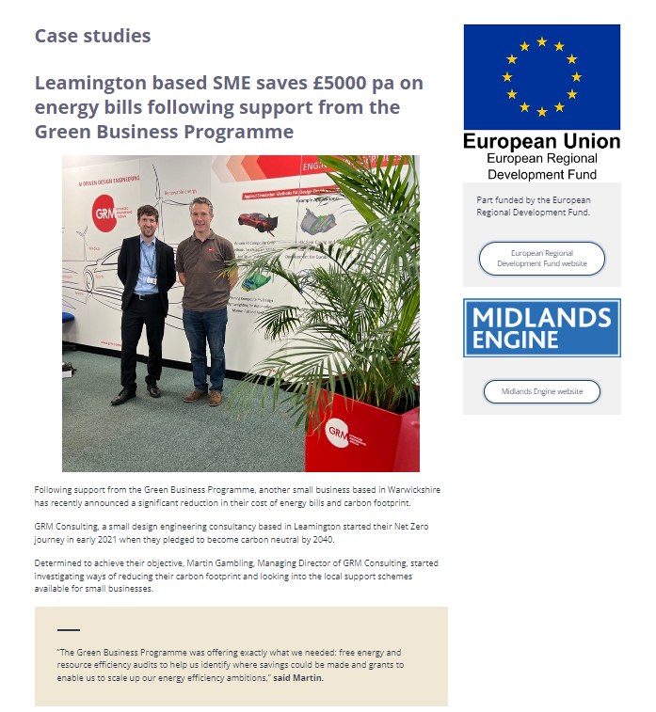
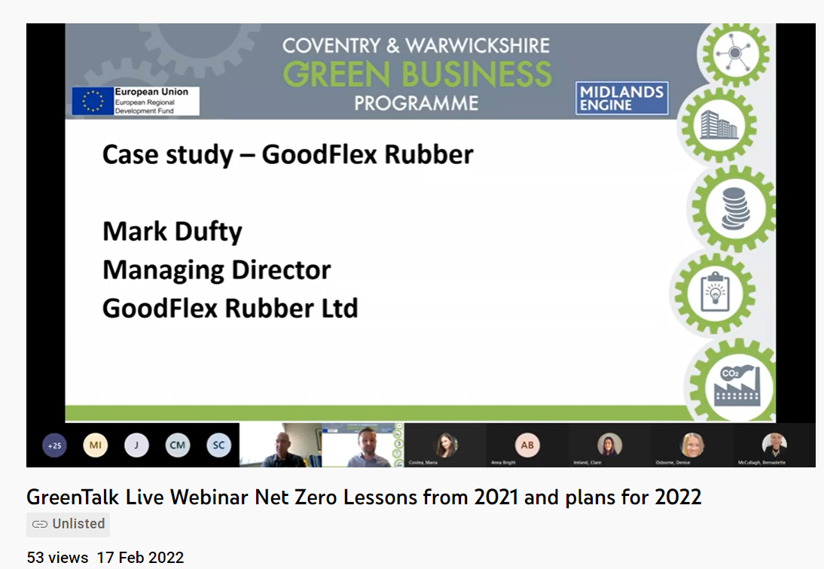
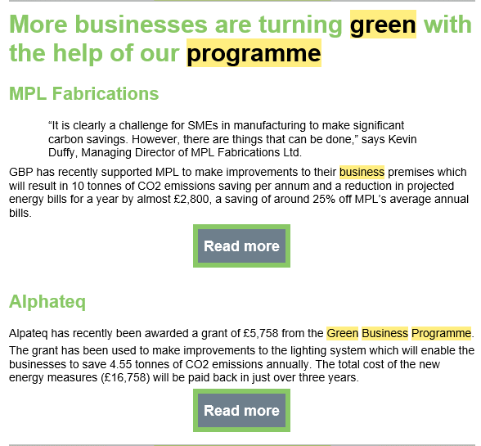
Green Business Network
8. Examples

Slide 15
Green Business Network
Any questions?
Coventry & Warwickshire Green Business Programme:
greenbusiness@coventry.gov.uk
Or
maria.covlea@coventry.gov.uk
Since 2018,
30 events have been hosted by the programme

