Slide 1
Climate change overview
and direction at Warwickshire
County Council
Matt Whitehead
Climate change programme manager
Notes:
I’m delighted to have been invited to talk to you about the strategic direction on climate change at Warwickshire county council.
I’m Matt Whitehead and as programme manager for climate change I over see a range of related projects and am currently leading the development of the councils sustainability strategy.
I’m not just here to talk to you about climate change though. Sustainability crosses over so many areas including our work on health, inequalities, economic growth and infrastructure.

Slide 2
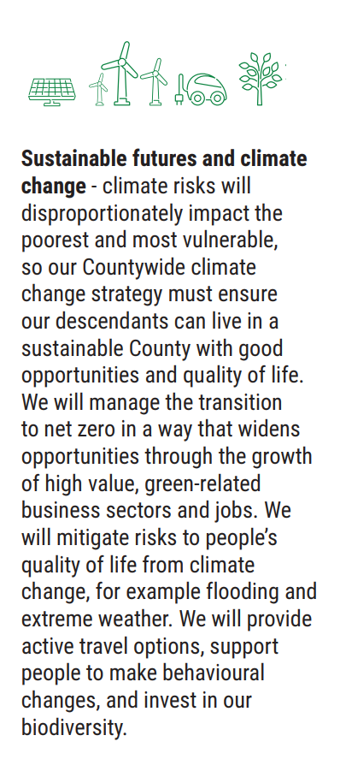
A Top Priority in our Council Plan: Sustainable Futures
We want to make Warwickshire the best it can be, sustainable now and for future generations
Council level: Reduce the Council’s carbon footprint to net zero by 2030
At a County level: Work with all our partners and residents in Warwickshire to support the County to do the same no later than 2050.
Biodiversity: Promoting Biodiversity and the safeguarding of natural species, habitats and areas in our County
Sustainability: Supporting the UN Sustainable Development Goals by embedding those areas relevant to us in our Climate Action Plan and tracking our progress.

Slide 3
Areas of focus
Tackle climate change, promote biodiversity and deliver on our commitment to Net Zero
Produce a costed plan and trajectory to be net zero no later than 2050
Embedding our plans to develop a sustainable economy by promoting local shopping, active travel and sustainable transport systems.
Becoming a net zero Council by 2030, focusing particularly on our buildings and fleet.
Funding and facilitating infrastructure and new technologies, required for decarbonization such as electric vehicles and renewables.
Minimising waste, increasing re-use and recycling

Slide 4
Areas of focus
Promote inclusive, sustainable economic growth, successful businesses, good quality jobs and future skills
Creating the conditions and helping support new businesses to start, scale and grow to power the Warwickshire economy
Maintaining forward momentum to support future economic shifts and build on opportunities such as the move to green technologies, developments in automation and anticipating future societal trends
Working with our partners and businesses to transition towards a goal of decarbonising the Warwickshire economy
Creating the conditions to ensure there are well-paid jobs in the County and developing the future skills that our priority sectors need to be successful.
£140 million Warwickshire Recovery and Investment Fund
Notes:
Its important that we work to enable business to survive and thrive in Warwickshire.
Many businesses are well on the way to transforming their operations to adapt to the green economy. We will be maintaining this momentum and support future economic shifts especially those relating to green technologies.
Increasingly we’ll be working with our partners and businesses to transition towards a goal of decarbonising the Warwickshire economy, especially important for succeeding in meeting our net zero carbon targets for the council and also for…
Creating the conditions to ensure there are well-paid, high skilled jobs in the County.
Recently we established our £140 million Warwickshire Recovery and Investment Fund. There is a dedicated pot of £10m for SME’s and debt finance of £90m for medium and large business. This is targeted at supporting investment, sustainable growth and future employment opportunities in the county

Slide 5
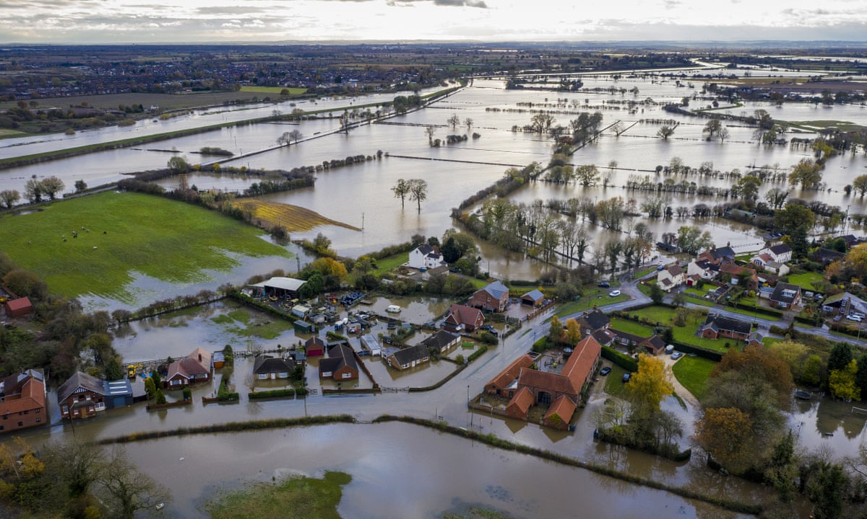
Context
Climate change crisis
Global effects: earth warming, rising sea levels, changing rainfall patterns.
Primary impacts include: flooding, temperature rises
Secondary impacts: loss of life, habitat, economic consequences
Biodiversity crisis
Declining at the fastest rate in human history and accelerating
Humanity has caused 83% loss of wild mammal biomass
50% of plants
Cost of living crisis
Fuelling and heating
Petrol and diesel
Widening inequalities
Notes:
For a while now we have been working to develop our sustainable futures strategy.
This is in the context of the two largest threats to humanity and the backdrop of the cost of living crisis many are facing right now.
The effects of climate change are here and are apparent. – points 1-3,
As important is the need to protect and enhance the biodiversity of our natural world. It provides the foundations for life on earth and supports the provision of ecosystem services and socio-ecological resilience for humans. Unfortunately the numbers don’t read well…
We need to reverse this trend.
The cost of living crisis for some is not new but is particularly acute for an increasing proportion of the population in Warwickshire and will be exacerbated due to the effects of climate change in the future
The effects of all of these crises is likely to result in widening inequalities in the absence of targeted support.

Slide 6
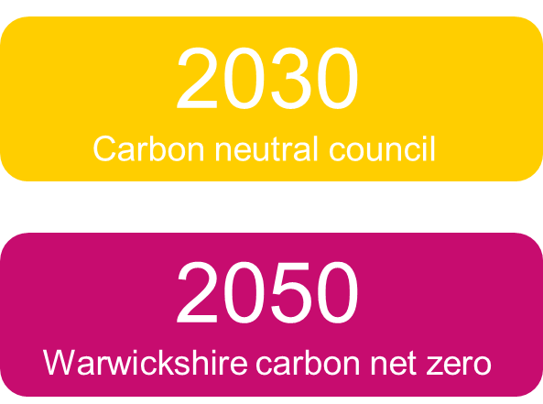
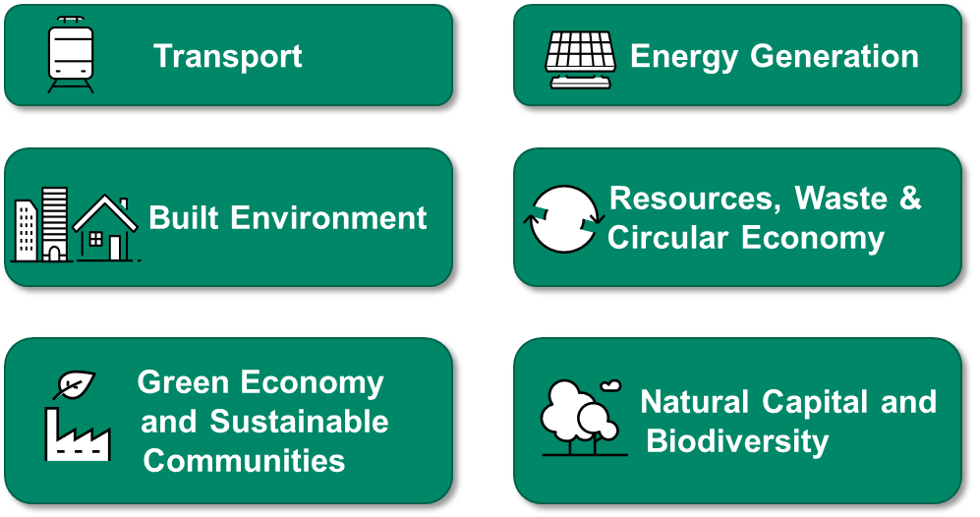
Sustainable futures… not simply net zero carbon
6 Strategic themes
Green Economy
By 2050 we want to have a County that is measured by prosperity and health, where people have the skills and access to new green jobs and where all industries contribute to sustainable, equitable and healthy communities
Notes:
So our sustainabke futures strategy is not just about net zero carbon although
Mention its in draft
_____________________
For illustration, we have defined a green economy in a way that is
broader than a low carbon economy; it aligns to the wider context of the UN Sustainable development goals.
Its an approach to sustainable economic growth with a central focus on reducing societal and environmental risks and ecological scarcities. It embeds climate adaptation into its construct. It transitions from the current ‘growth-based’ approach to investments, employment, and skills towards growth without degrading the environment, and the wellbeing and prosperity of citizens.

Slide 7
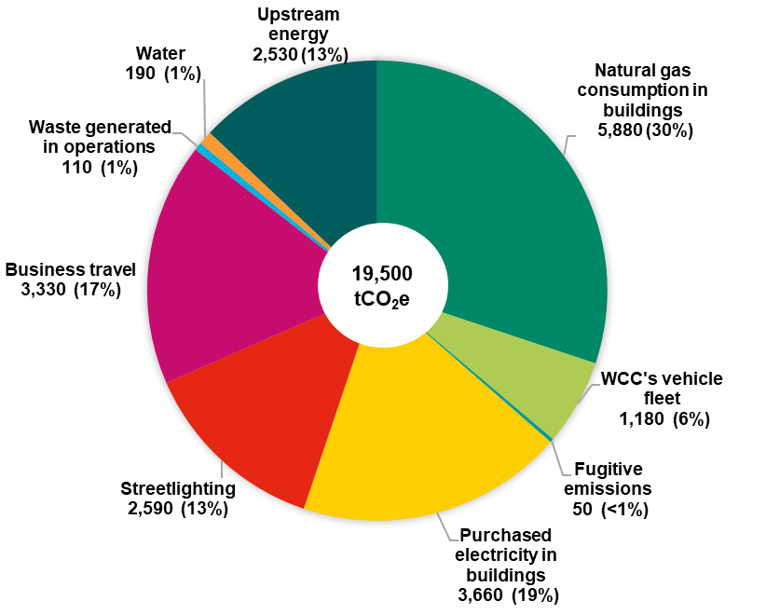
The challenge: council estate
63% reduction in emissions between 2014 and 2020.
replacement of sodium bulbs in streetlights with LED
Decarbonisation of grid electricity
19,500 tCO2e in 2019
29% by 2026
46% by 2030 as a minimum
Externalities will help
Decarbonisation of grid
Ban on new petrol and diesel cars
Offsetting
Notes:
Significant challenges if we are to decarbonise our council estate
30% of our carbon footprint is made up of natural gas in buildings
Electricity in buildings + streetlighting = 32%
Staff Business travel 17%
We are undertaking an ambitious tree planting scheme which will provide a level of offsets but will need to do more.

Slide 8
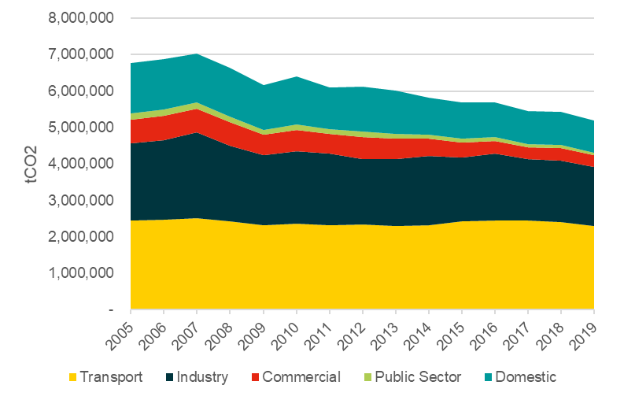
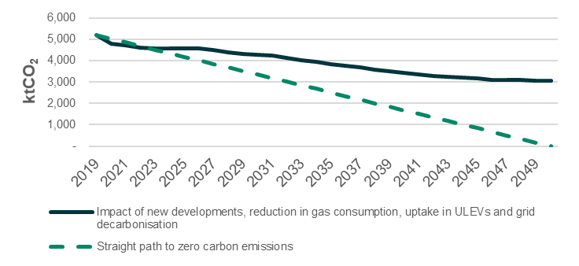
The Warwickshire challenge
24% reduction 2005 to 2019
Notes:
The Warwickshire challenge is far greater. There's been a 24% carbon reduction in the county between 2005 and 2019. Emissions from transport make up a significant proportion and have hardly moved. Over the same period we’ve seen modest reductions in the industrial and commercial sector.
Its likely that a lot of this has also been due to progressive decarbonisation of the electricity grid.
The solid line on the graph to the right illustrates where we would get to through further electricity decabonisation and agreed policies relating to vehicle emissions, heating and housing.
Without further intervention this will lead to a very large gap that would need to be offset.
To fully decarbonise we will need to be following a much steeper path.

Slide 9
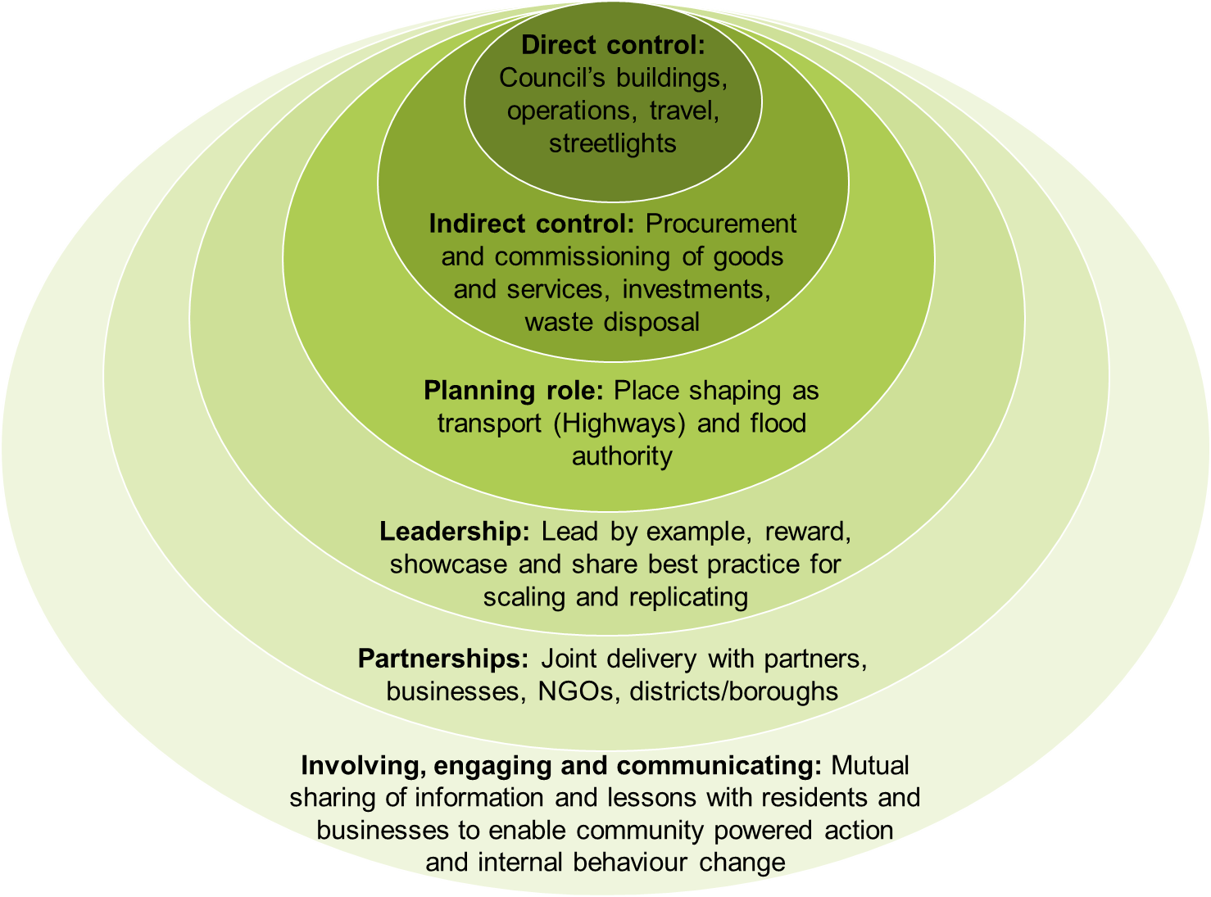
We can only do so much
Able to influence 31% (LGA figures)
Direct Actions: actions WCC can take that will directly reduce emissions, particularly significant in areas where we have direct control such as Council buildings
Enabling Actions: actions that WCC can take that will allow others to directly reduce emissions that they have control over
Influencing Actions: actions WCC can take as a leader in the region and working with our partnerships
Notes:
We’ll be working to enact significant changes but we can only do so much.
Direct actions will not lead to significant reductions.
We’ll be working to strengthen our procurement standards which will lead to reductions through Indirect means.
Enabling Actions:
Planning role – Local transport plan.
Electric vehicle charging points
grant support is an example of this
Influencing
actions WCC can take as a leader in the region and working with our partnerships

Slide 10
Engagement and communication will be key
Direct communications, working with our neighbours, partnerships with external organisations and engaging with our stakeholders to support sustainable changes
We commit to:
Involving interest groups and a diverse, representative selection of the community in our activities under each theme
Actively looking for opportunities to partner with our Districts/Boroughs and neighbours
Sharing progress with stakeholders through various communication methods including our website, Warwickshire Climate Emergency
We aim to:
Be easy to engage with
Be a dependable partner
Be proactive in reaching out and convening forums
Create an environment of confidence in our ability to deliver on our actions and commitments
Notes:
Fundamental to this success of our sustainable futures strategy is engaging and communicating.
You’ll see us working with our neighbours, forming further partnerships and engaging with stakeholders including businesses to support our sustainable strategies.
And we’lll Create an environment of confidence in our ability to deliver on our actions and commitments
And will continue to share our progress through various communication methods including through our website – Warwickshire climate emergency

Slide 11
Next steps
We are already taking action in a range of areas
The strategy action plan maps out those needed to accelerate progress
October draft
Stakeholder engagement in Q3 / Q4
We’d like you to join us on this journey
Notes:
So what next?
We are already taking action in a range of areas. Last year we were recognised the in Local authority sustainability west midlands benchmark as leaders in xxx and xx overallxxx.
We will be taking a range of further actions and the strategy plan maps out those we need to take to accelerate progress, although we have a great challenge to secure funding to deliver many of these.
Dialogue is key and we want to listen to what you have to say. We’d like you to join us on making your business more sustainable so tell us what you need to accelerate your progress.
Thanks for listening.

