Slide 1





Using the GBP to become greener and reduce costs
Mark Dufty, Managing Director, GoodFlex Rubber

Slide 2
ABOUT THE
COMPANY
Goodflex Rubber Company is a global manufacturer and supplier of bespoke rubber hoses, mouldings & assemblies.
As a leading supplier to the EV and alternative fuel sectors it is important that we demonstrate how we are reducing our carbon footprint and developing sustainable business practices.
As internal combustion powertrains continue to make way for electric and hydrogen our success depends on continually investing in a greener Goodflex future.

Slide 3

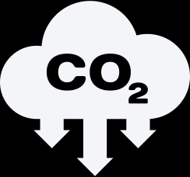
Working with the GBP has enabled us to:
kWh
cut our CO₂ emissions by nearly 134 tonnes p.a
reduce our energy consumption by over 542,000 kWh annually
Notes:
We discovered the Green Business Programme through our engagement with the Coventry & Warwickshire Growth Hub and Jim Clark
We were considering a project to move our operations base to a larger facility and were keen to take the opportunity, if possible, to improve the building’s efficiency before moving in. This is both in terms of financial efficiency and minimising our impact on the environment.
The level of investment required at the time of moving was bringing into question the whole project, however the support afforded by the Green Business Programme enabled us to make these investments before we took occupation. Doing it this way ensured the installation cost of the improvements was as low as possible as there was no operational business in place to work around.

Slide 4
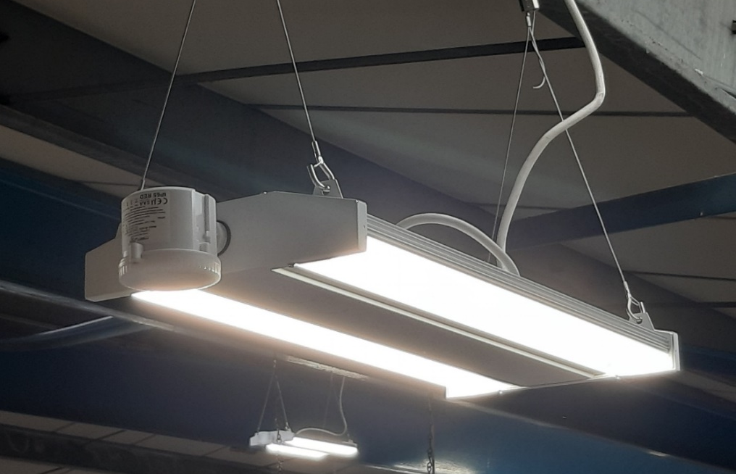
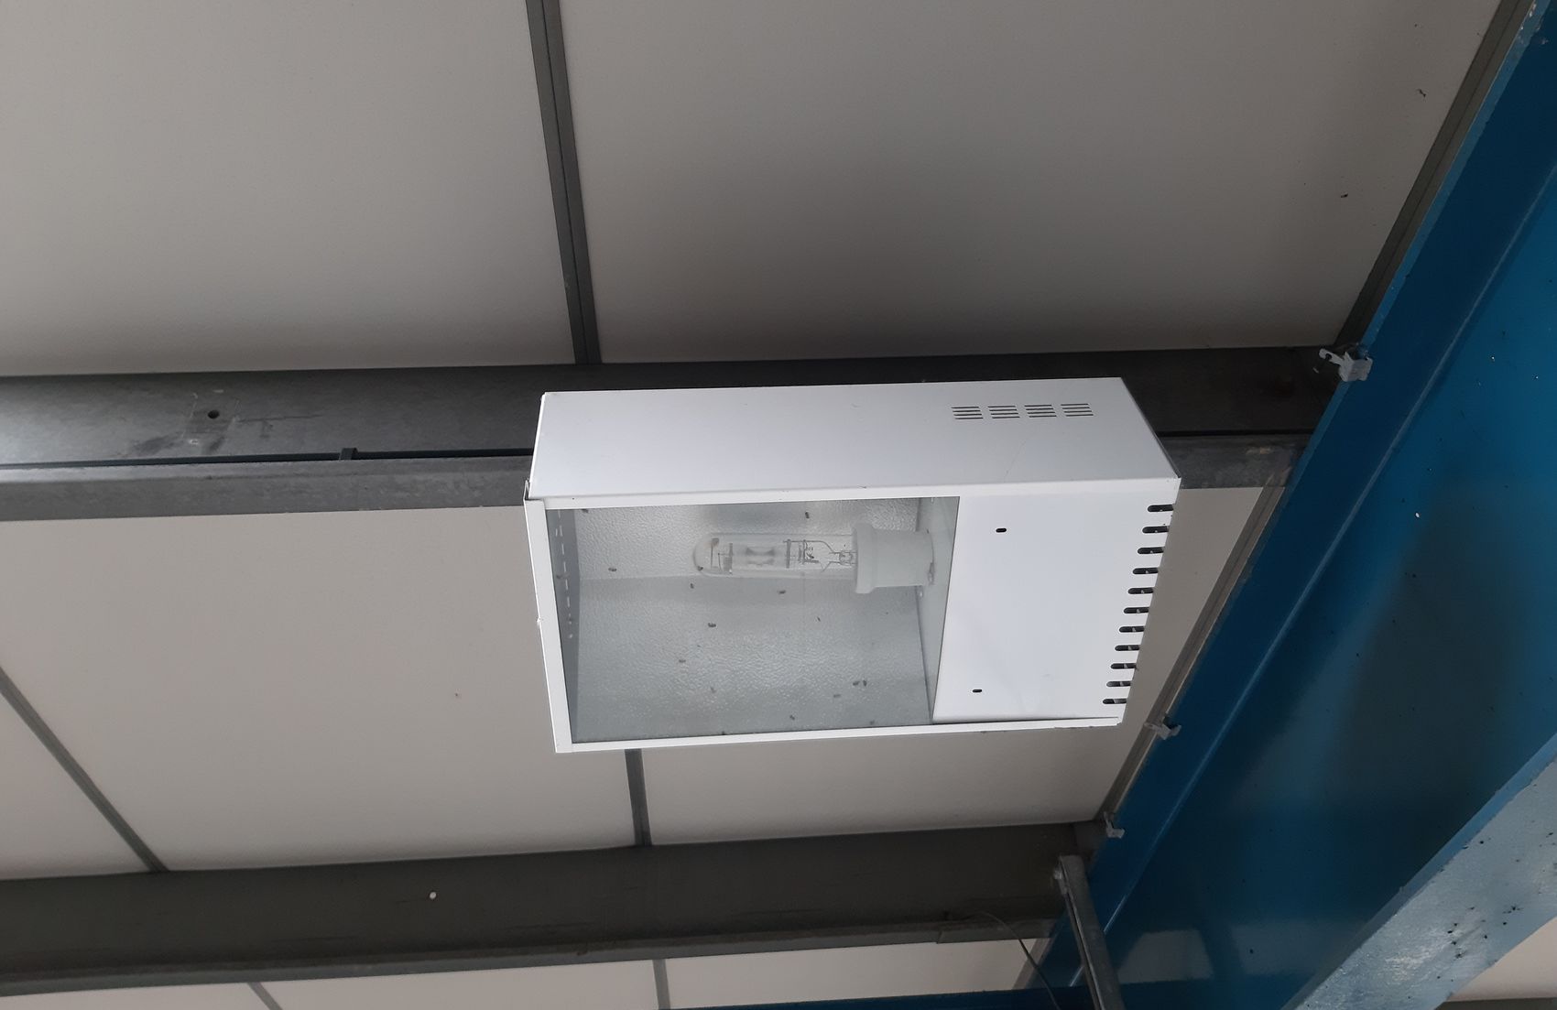
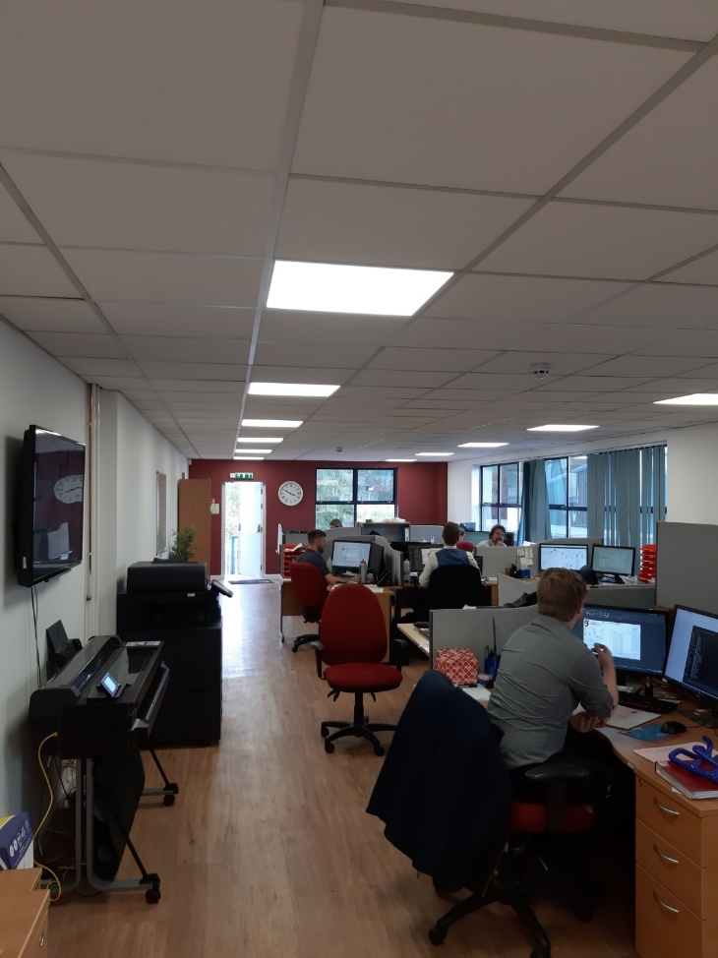
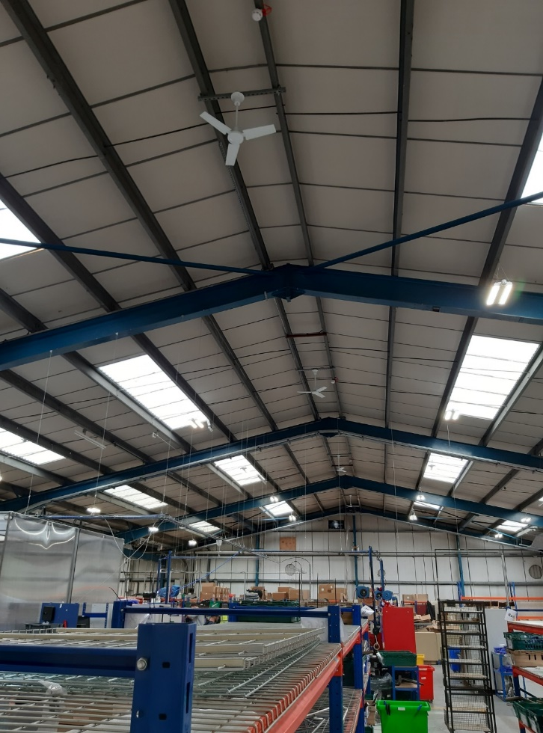
IMPROVEMENTS MADE
Replacement of 72 metal halide 400w lights with new intelligent LED fittings.
Replacement of fluorescent office lights with LED fittings.
Installation of destratification fans in the factory to help heat retention.

Slide 5
IMPROVEMENTS MADE
  Installation of Heating, Ventilation and Air Conditioning systems in the factory, office and reception areas, replacing large oil boilers and providing heating and cooling
  Replacement of an old inefficient air compressor unsuitable to meet the demands of the new larger facility
Notes:
Besides the financial benefits I have already discussed, the reduction in our environmental impact is both ethically and morally the right thing to do. It also has the benefit of enhancing Goodflex Rubber’s reputation as a contentious business that cares.

Slide 6
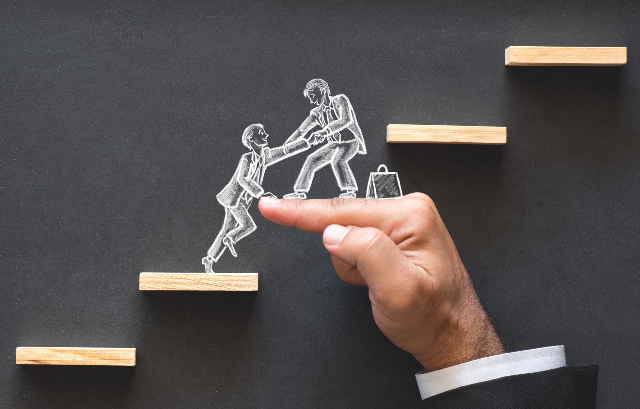
GRANT VALUE
£19,588
PROJECT COST
£48,970
Notes:
The application process was relatively painless, and was made far easier by the support we received from the Green Business Programme. Our timescales for making the decision whether to move or not were accelerated by the emergence of an opportunity to move into an ideally-suited location, and the response from the team was very helpful. Whilst there is an unavoidable overhead in pulling the application together, the guidance and advice from the team made this as easy as it could be.
In terms of elapsed time, from our initial engagement with the team through to receipt of the grant offer letter took a little under 8 weeks.

Slide 7
QUESTIONS WILL BE ANSWERED DURING THE Q&A SESSION
If you would like to contact me, my details are:
Tel. 01386 841480
Email: mark@goodflexrubber.com

