Slide 1
ROUTE to NET ZERO
TRANSFORMING INDUSTRY FOR A SUSTAINABLE WORLD
Marie Wells
7th December 2022

Slide 2
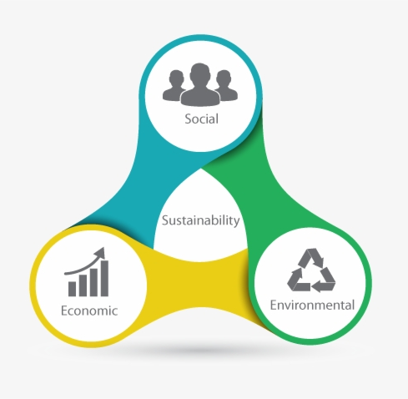
“Sustainability focuses on meeting the needs of the present without compromising the ability of future generations to meet their needs.”
World Commission on Environment and Development, 1987

Slide 3
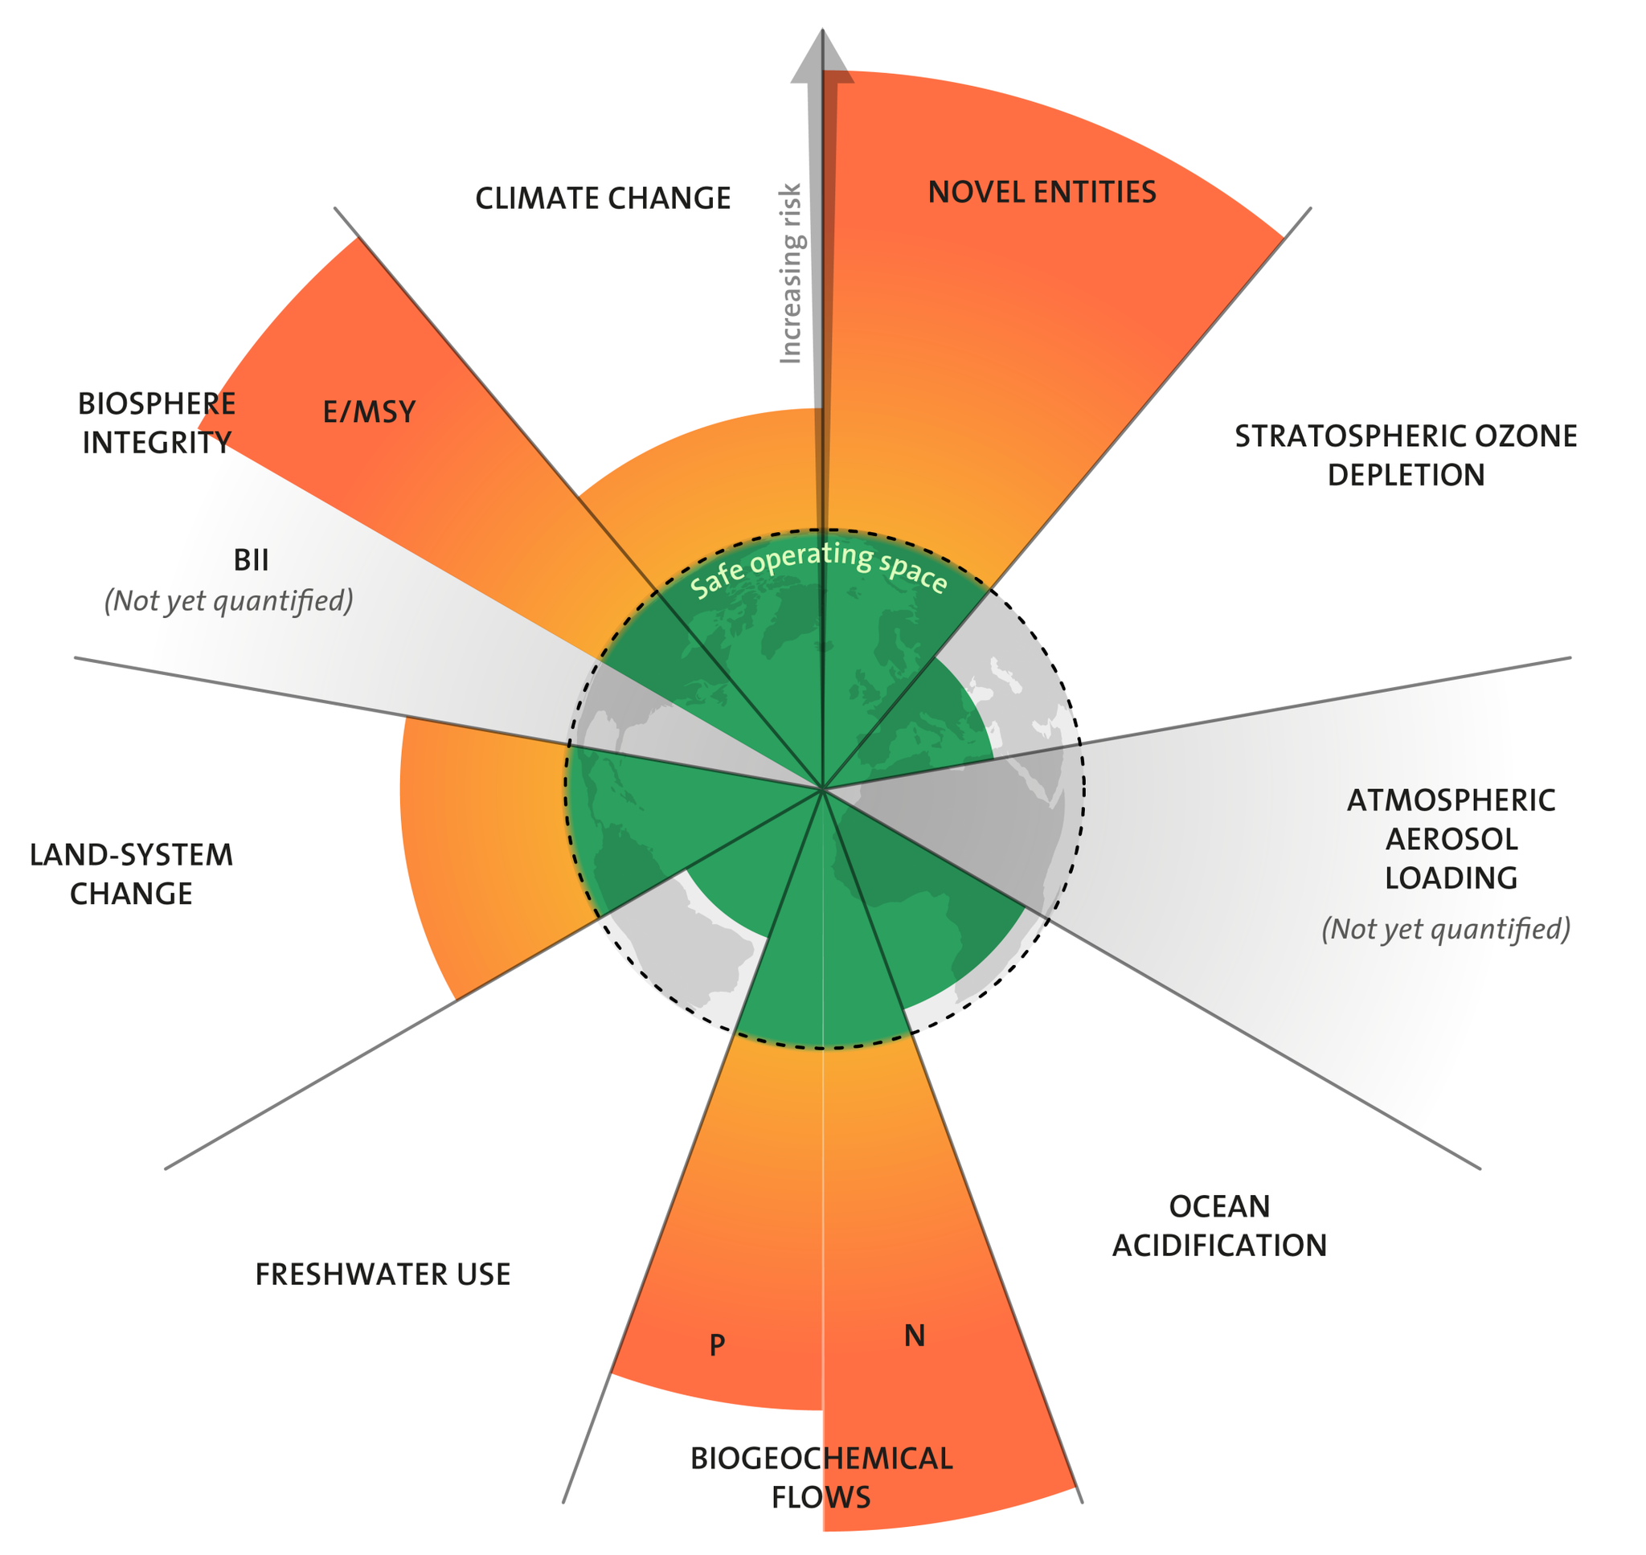
What?
  Planetary Boundaries
Net zero
  Scope 1 – Direct Emissions
  Scope 2 – Indirect Emissions
  Scope 3 – Supply chain
Biodiversity & land use
  Best use of space (Built vs Rural environment)
  Re-wilding
  Regenerative farming
Nitrogen & Phosphorus loading
  Reliance on chemical means of land nourishment
Novel Entities
  Waste Management
Water
  Water Footprint
Reference: Planetary boundaries - Stockholm Resilience Centre

Slide 4
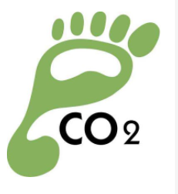





Internal
Carbon Footprint (tCO₂e) | Water Footprint (m³) | Projects with sustainable impact (%) | Social value (£ charity) | Biodiversity | Waste Intensity (tonnes)
Benchmark current performance
Define the Baseline
  Identify gaps in understanding / data
  Define Metrics
  Independent Assessment

Slide 5
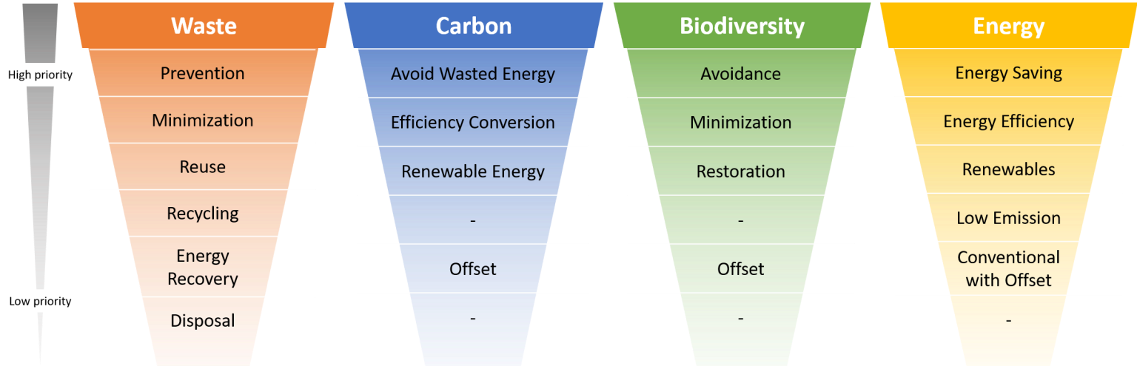
Opportunities
Reference: Carbon Offset: Why Are Companies Ignoring The Carbon Mitigation Hierarchy? | Your Green Wealth
Notes:
1. Listen and learn – understand where we are in terms of current internal perspective
2. Over-communicate, connect, establish trust and open the “virtual door.”
3. Slow down to speed up.
4. Establish a parallel plan for product and market learning - Benchmark externally with learning from internal stakeholders
5. Integrate into the cadence of company
6. React to mission critical situations

Slide 6
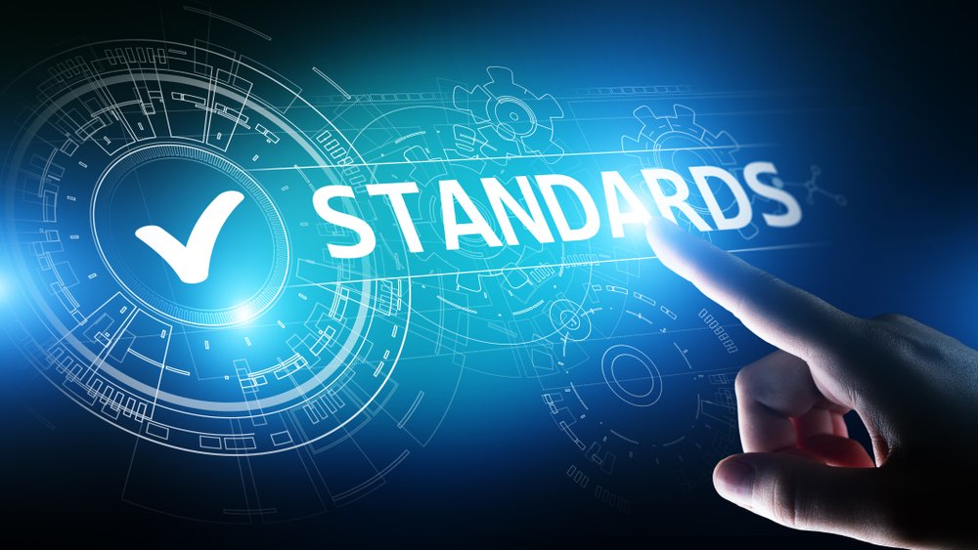
Standards & Reporting
Carbon Neutrality
Includes Scope 1 & 2
PAS 2050
PAS 2060
PAS 2080
Net Zero
Includes Scope 1 2 & 3
GHG Protocol
  Considering signing up to Science Based Targets
    Regularly independently assessed
  Net Zero Plan & Carbon footprint assessment
    Carbon Trust (March 2022)
Current requirements for MTC
ESG (environmental, Social, Governance)
  Assessment by PWC (Jan 2022)
SECR
ESOS
Notes:
.
Scope 1 – All Direct Emissions from the activities of an organisation or under their control. Including fuel combustion on site such as gas boilers, fleet vehicles and air-conditioning leaks.
Scope 2 – Indirect Emissions from electricity purchased and used by the organisation. Emissions are created during the production of the energy and eventually used by the organisation.
Scope 3 – All Other Indirect Emissions from activities of the organisation, occuring from sources that they do not own or control. These are usually the greatest share of the carbon footprint, covering emissions associated with business travel, procurement, waste and water.
Define key metrics
Resource use – Waste Hierarchy
CO2e – Water, Waste, energy for scope 1 – 3 emissions
Project metrics (Drive reduction in scope 3 )
Roadmaps against key boundaries - Climate / biodiversity / land use
The role requires engagement across varying functions, initially this will be focused on internal change to benchmark our current position and enable our transition embedding sustainability in to the MTC, this will require the role holder to:
Engage with the wider community of colleagues to affect behavioural change enabling our journey to become a sustainable business through initiatives such as the environmental working group
Work with varying functions such as estates and continuous improvement to drive a transition within the MTC to sustainable / net zero practices in line with policy and legislation, including the way our projects are delivered;
To provide input to the future skills team to creating a training framework around sustainable capability gaps for AMTC and to tie into university partners. To allow the development of internal and external training materials to create the next generation of sustainable engineers;
Form links with relevant bodies such as the Ellen MacArthur foundation, WRAP etc. to ensure our sustainability metrics align with industry recognised methodology and form useful collaborations;
Engage with events management to ensure that MTC events are held in a sustainably way and demonstrate the MTC’s commitment to sustainable practice

Slide 7
Internal
2023
2030
2041
2050
Carbon Neutral
Net Zero WM pledge
Net Zero Required
MTC 2021
Emissions included
Scope 1
Scope 2
Scope 1
Scope 2
Scope 3
Milestones
MTC Grand Challenge
MTC Net Zero stretch Goal
West Midlands Net Zero Business Pledge (wmca.org.uk)
Government
requirement

Slide 8
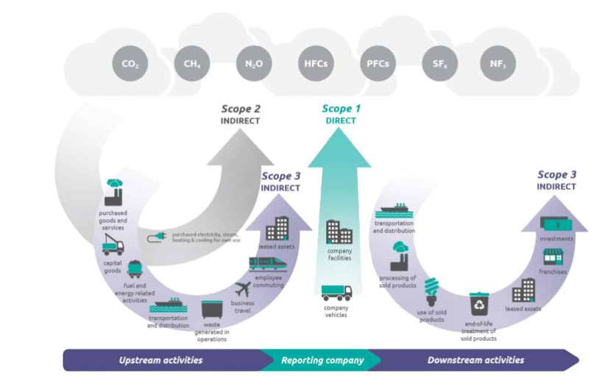
Scopes of Emission
Notes:
.
Scope 1 – All Direct Emissions from the activities of an organisation or under their control. Including fuel combustion on site such as gas boilers, fleet vehicles and air-conditioning leaks.
Scope 2 – Indirect Emissions from electricity purchased and used by the organisation. Emissions are created during the production of the energy and eventually used by the organisation.
Scope 3 – All Other Indirect Emissions from activities of the organisation, occuring from sources that they do not own or control. These are usually the greatest share of the carbon footprint, covering emissions associated with business travel, procurement, waste and water.
Define key metrics
Resource use – Waste Hierarchy
CO2e – Water, Waste, energy for scope 1 – 3 emissions
Project metrics (Drive reduction in scope 3 )
Roadmaps against key boundaries - Climate / biodiversity / land use
The role requires engagement across varying functions, initially this will be focused on internal change to benchmark our current position and enable our transition embedding sustainability in to the MTC, this will require the role holder to:
Engage with the wider community of colleagues to affect behavioural change enabling our journey to become a sustainable business through initiatives such as the environmental working group
Work with varying functions such as estates and continuous improvement to drive a transition within the MTC to sustainable / net zero practices in line with policy and legislation, including the way our projects are delivered;
To provide input to the future skills team to creating a training framework around sustainable capability gaps for AMTC and to tie into university partners. To allow the development of internal and external training materials to create the next generation of sustainable engineers;
Form links with relevant bodies such as the Ellen MacArthur foundation, WRAP etc. to ensure our sustainability metrics align with industry recognised methodology and form useful collaborations;
Engage with events management to ensure that MTC events are held in a sustainably way and demonstrate the MTC’s commitment to sustainable practice

Slide 9
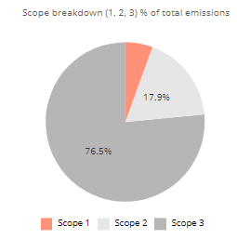
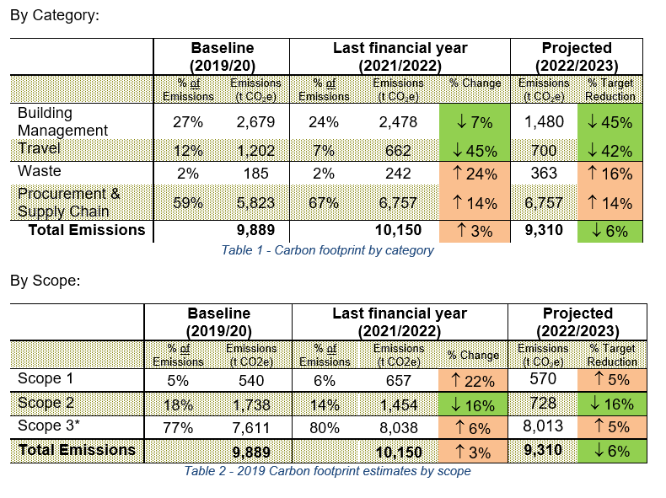
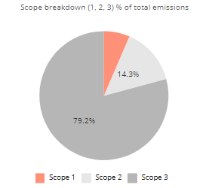
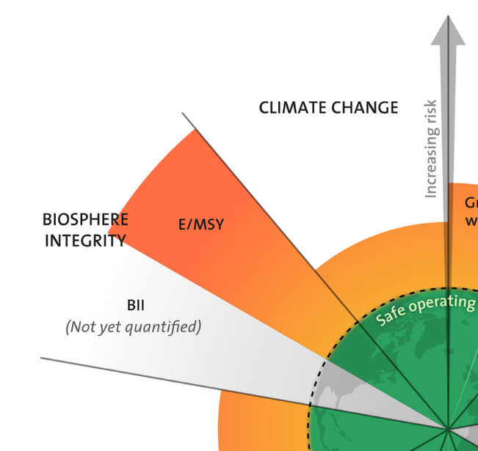
Carbon Footprint Summary
Baseline Year
FY 2021 - 2022

Slide 10
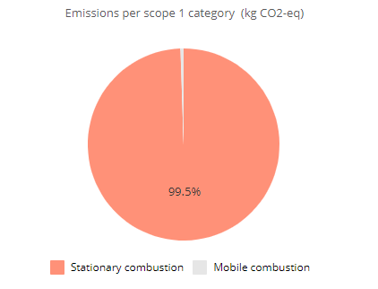
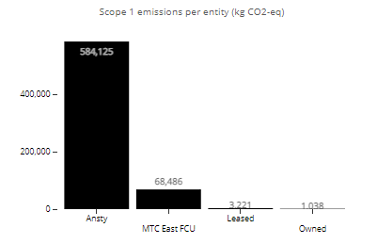
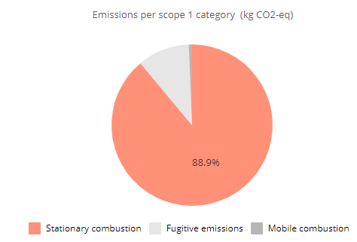
Scope 1
Notes:
*These are the figures for 2021 – 2022 from the carbon footprint tool
Currently collating the benchmark year and first quarter then will be quarterly reporting from that point
Processes need to be developed to more efficiently gather this data as it currently very labour intensive
Baseline Year
(540 tCO₂e)
Benchmark Year
FY 2021 – 2022
(657 tCO₂e)

Slide 11
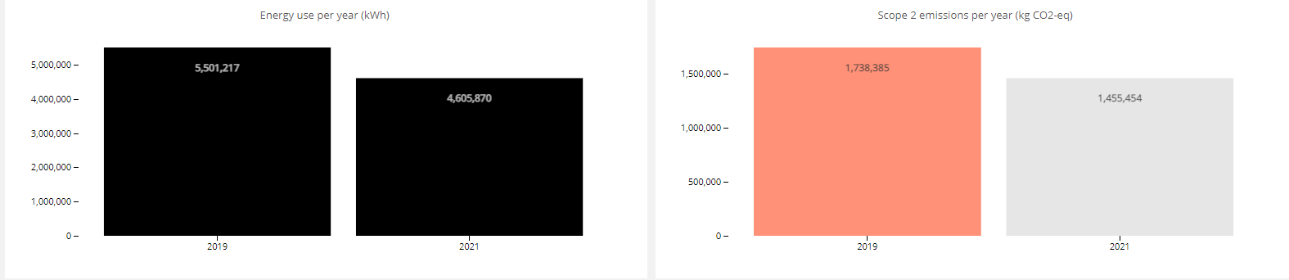
Scope 1
Notes:
*These are the figures from the carbon footprint tool
Q1 & Q2 = 560 tCO₂e u
2022 – 2023 projection - 672 tCO₂e
  Post Oct 1st supply is fully renewable obligation so can be assumed 0 tCO₂e is added after that point if using market based analysis
  Using UK conversion factors est. 823.2 tCO₂e (16% less than 2021-22)
2022 – 2023 projection kWh - 4,252,000
  7% less than 2021 -2022 from sustained behaviour change
Electricity demand may increase as we move away from gas usage to reach carbon neutral
Next Steps
  Increased control through integration of state of the art systems
  Assess & reduce our base load
  Address small power, screens , lightboxes for marketing and none digitally controlled lighting
  Identify deep-dive areas
Benchmark Year
Baseline Year
(1,738 tCO₂e)
FY 2021 – 2022
(1,455 tCO₂e)

Slide 12
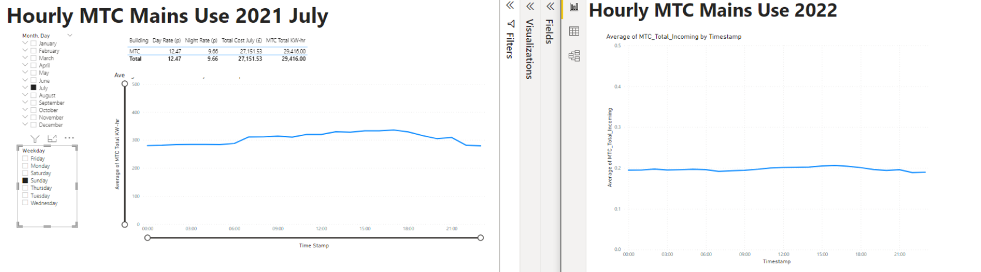
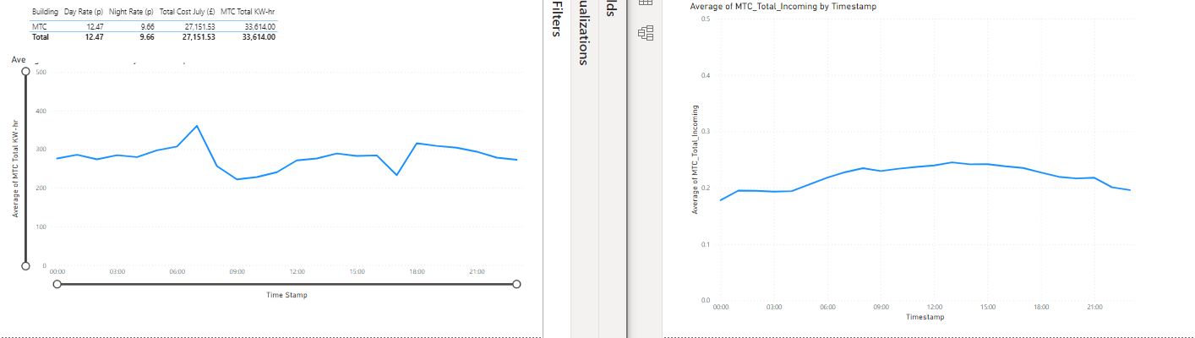
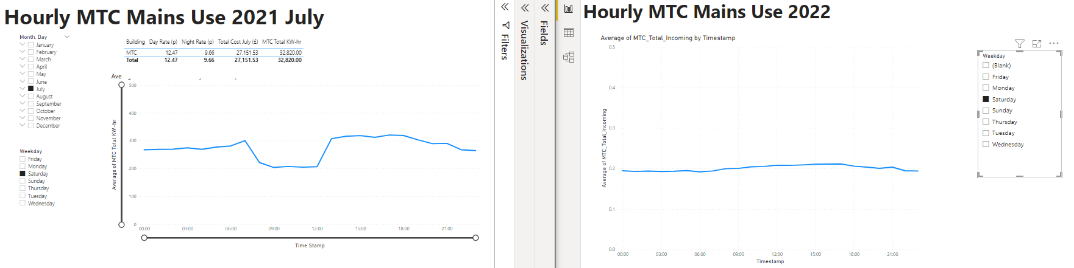
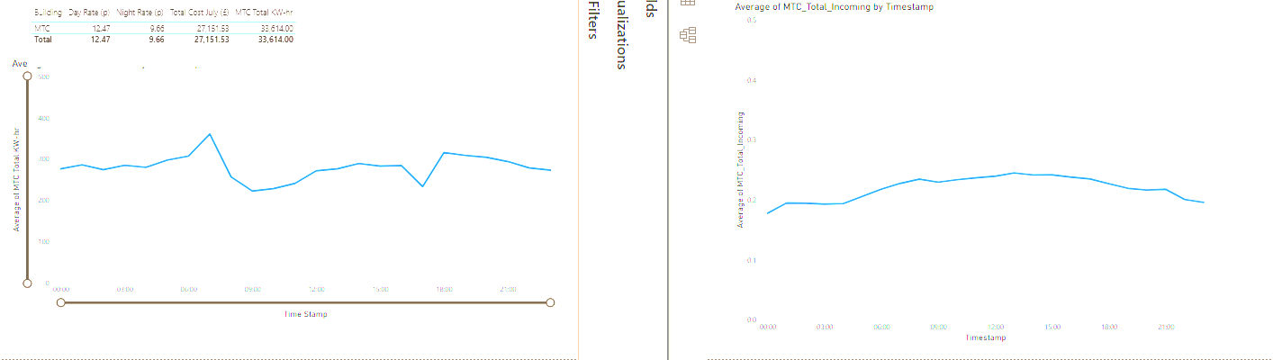
Energy Efficiency
Friday Saturday Sunday
Benchmark Year
Notes:
    July 2021 – pre-shutdown
    July 2022 – Post process change
Reaching a baseline now at the weekends in MTC building
Need to achieve the same in the other buildings (challenges with data to assess)

Slide 13
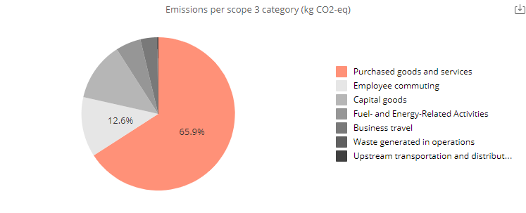
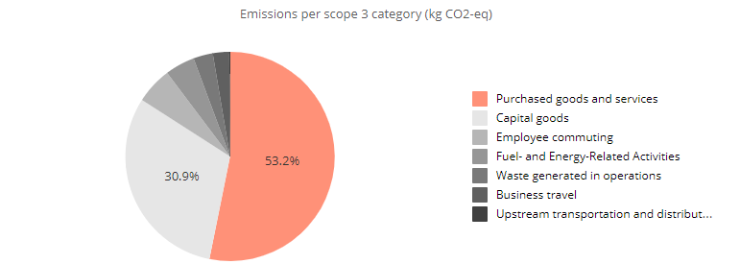
Scope 3
Notes:
*These are the figures from the carbon footprint tool
Next Steps
  Set targets with relevant teams to increase data clarity where required and set a reduction target
  Include home working in the figures (39 tCO₂e)
  Understand why water is not shown
  Better classify purchases as believe none goods related purchases are being classified as goods and general purchases as capital goods (consultancy will still have a carbon footprint but may be lower)
Baseline Year
(3,675 tCO₂e)
Benchmark Year
FY 2021 – 2022
(3,977 tCO₂e)

Slide 14
MTC Strategy
Scope 1
Requires change of technology or offset
  Heat pump technology
  Thermal generation & storage
  None fossil fuel vehicles
  Electrification
  Hydrogen
Scope 2
Generate from none fossil fuel alternatives & reduce demand
  Supplier commitment (REGOs)
  Install of renewable generation onsite
  Install of Battery storage
  Replace building management to allow better control & data
  Behavioral change
Notes:
UK Fires project done by a conglomerate of universities including Cambridge has found that in the UK we need to decrease energy demand by 30% to ensure that we are within the energy supply available from renewables in 2050 at current predictions of renewable adoption and growth rates

Slide 15
MTC Strategy
Scope 3
Influencing behaviours & targets for supply chain
Procurement
  Asset register tied to procurement procedure
  Incentivise reuse / remanufacture over procure
  Use of secondary material over raw
  Asking for commitment to a Net Zero plan from supply chain
Travel
  Policy change on business travel
  Fully flexible working week decreased employee commuting
  Access to charging points increase uptake of low carbon vehicles
  Employee scheme for salary sacrifice cars
  Cycle to work & car sharing schemes
Other Factors
  Engagement with the employees' key as culture is a huge part of a sustainably business

Slide 16
THANK YOU
ANY QUESTIONS?

Slide 17
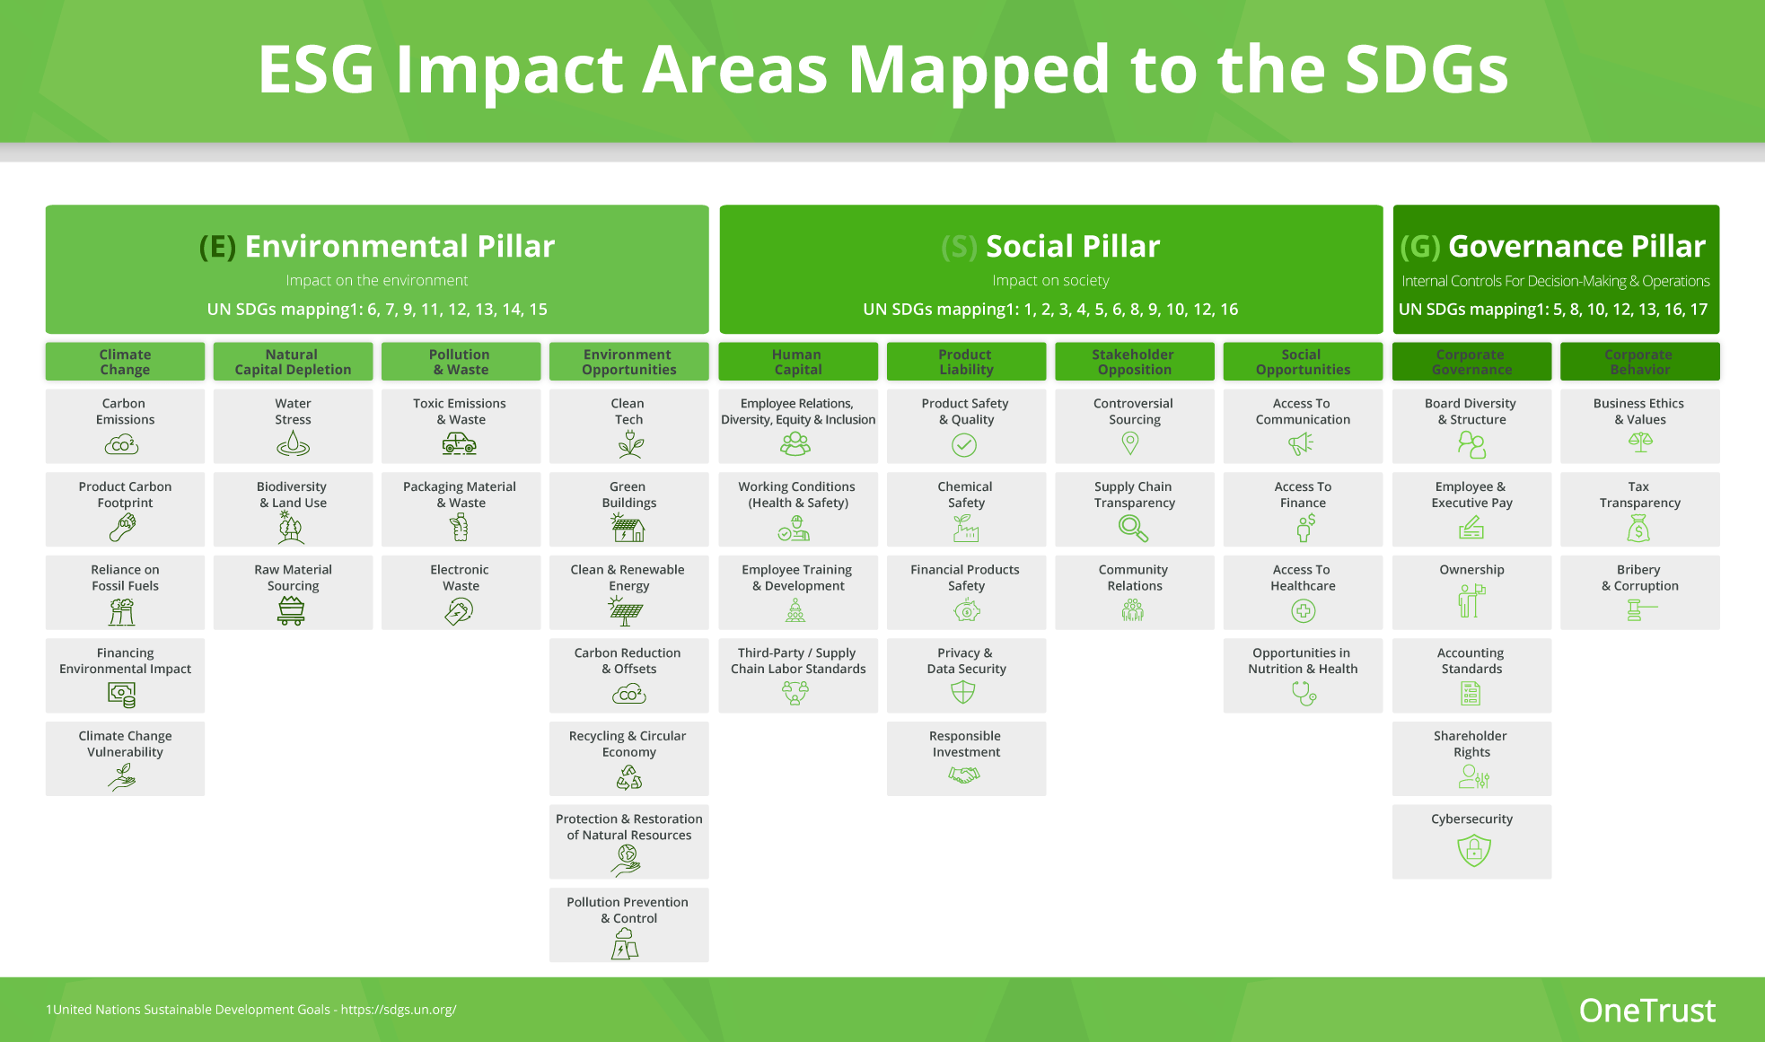
What is ESG?
Notes:
MTC are behind
UK usage at the rate of 3 earths for everyone to live at the same level
1.5 degrees will cause population displacement, economic disruption and even if we mitigate we are unlikely to avoid getting to 1.5° - we are currently projecting to 3° for perspective the ice age was only 3 degrees cooler.
Sustainability is not new, the term was coined in 1987.
If the MTC can’t change what chance does industry have?

Slide 18
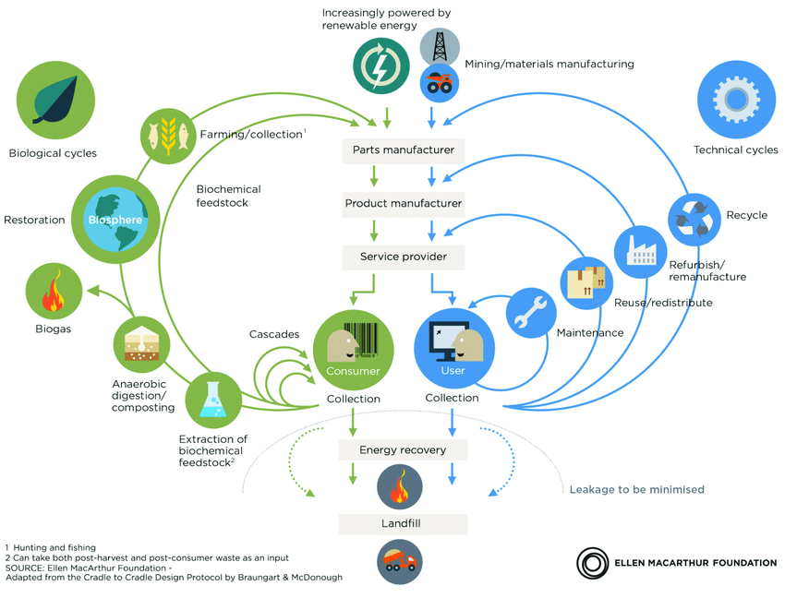
Circular Economy
Ref: Ellen Macarthur Foundation
Notes:
1. Listen and learn – understand where we are in terms of current internal perspective
2. Over-communicate, connect, establish trust and open the “virtual door.”
3. Slow down to speed up.
4. Establish a parallel plan for product and market learning - Benchmark externally with learning from internal stakeholders
5. Integrate into the cadence of company
6. React to mission critical situations

Slide 19
Current Work Programs
 |  | Affects | Description
 | LED Lighting | Scope 2 Demand reduction | More efficient lighting that decreases electricity use
 | Control, metering & integration elements | Measurement Demand reduction | Allows timing control on infrastructure elements to decrease electricity use & mobile metering to allow targeted measurement
 | Car Charging infrastructure | Scope 3 Behaviour change | Enable more staff to use electric vehicles
 | Timing Sockets & Smart Plugs for Small power management | Scope 2 Demand reduction | Allow small power elements to be turned off without relying on individuals
 | Upgrading Airconditioning | Scope 1 | Aircon leaks are currently highly warming F-gases. A new system will use less environmentally damaging refrigerants
 | Electricity Storage | Scope 2 Demand reduction | Storage for energy balancing (buy @ night rate, use in day) & storage of any future surplus
 | New Building management system | Measurement Demand reduction
 | Thermal Storage – seasonal & short term | Demand reduction
 | Wind power – micro to large scale | Scope 2
 | Solar – Thermal & PV | Scope 1 & 2
 | Heat Pump technology | Scope 1 | Repurposing of existing equipment and scoping of integration of new systems

Slide 20
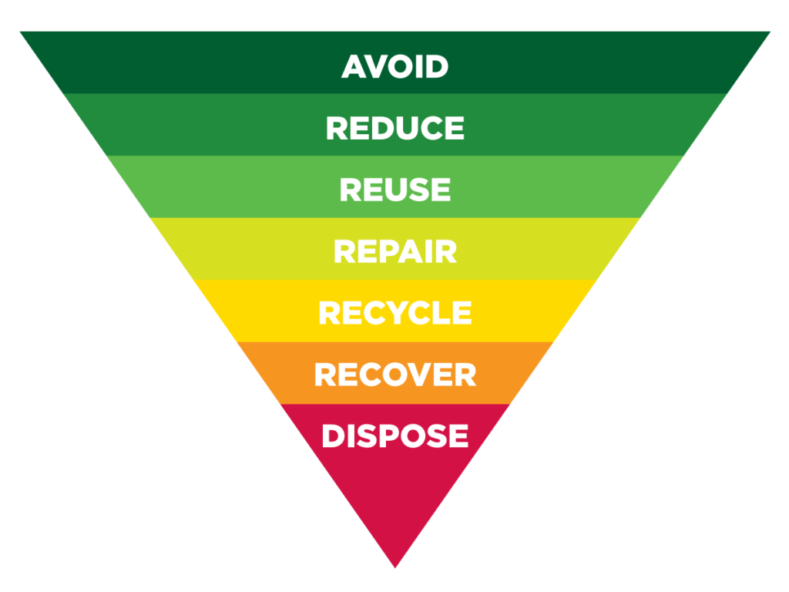
Understand
How do we measure
Waste
Gas usage
Water usage
Energy usage
Produced GHGs
CO₂e of Procured assets
Travel (commuting / business)
Notes:
Remanufacturing is commonly known as “a series of manufacturing steps acting on an end-of-life part or product in order to return it to like-new or better performance, with warranty to match” (APRSG, 2014). This can be confused with other characteristics within circular economy such as; reconditioning, refurbishment, and repair. However, the European Association of Automotive Suppliers quote “Remanufacturing is a standardized industrial process* by which cores are returned to same-as-new, or better, condition and performance. The process is in line with specific technical specifications, including engineering, quality and testing standards. The process yields fully warranted products.” (CLEPA, 2016). The differing definitions above suggest that a common definition is not used within the remanufacturing industry, as a result, potentially causing limitations to future remanufacturing growth
Repair - to restore by replacing a part or putting together what is torn or broken
Refurbishment - the process of repairing and cleaning equipment so that its condition is like new

Slide 21
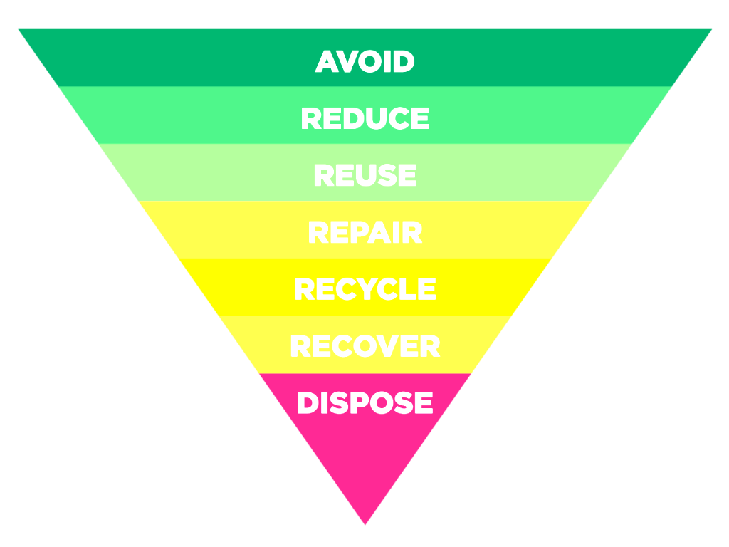
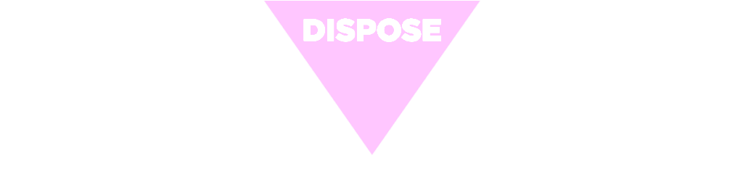
Efficiency / Mitigation
Efficiency of Site
Waste creation / reduction / redistribution
Potential for re-use / use of secondary materials
Minimise Travel / prioritisation of low carbon fuel types
Avoiding GHG sources for energy that could be generated through green methods
Notes:
1. Listen and learn – understand where we are in terms of current internal perspective
2. Over-communicate, connect, establish trust and open the “virtual door.”
3. Slow down to speed up.
4. Establish a parallel plan for product and market learning - Benchmark externally with learning from internal stakeholders
5. Integrate into the cadence of company
6. React to mission critical situations

Slide 22
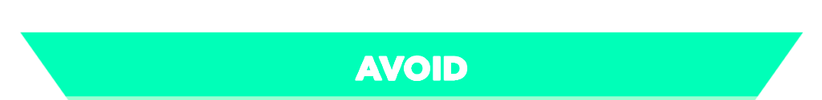
Longevity
Re-use strategy
Remanufacture
Reconditioning
  Repair
  Refurbishment
Asset register tied to procurement procedure
Use of recycled materials rather than raw
Opportunities for industrial symbiosis
Notes:
Remanufacturing is commonly known as “a series of manufacturing steps acting on an end-of-life part or product in order to return it to like-new or better performance, with warranty to match” (APRSG, 2014). This can be confused with other characteristics within circular economy such as; reconditioning, refurbishment, and repair. However, the European Association of Automotive Suppliers quote “Remanufacturing is a standardized industrial process* by which cores are returned to same-as-new, or better, condition and performance. The process is in line with specific technical specifications, including engineering, quality and testing standards. The process yields fully warranted products.” (CLEPA, 2016). The differing definitions above suggest that a common definition is not used within the remanufacturing industry, as a result, potentially causing limitations to future remanufacturing growth
Repair - to restore by replacing a part or putting together what is torn or broken
Refurbishment - the process of repairing and cleaning equipment so that its condition is like new

Slide 23
Recovery
Re-use internally
Re-use across businesses
Commitment to waste management prioritising recycling / waste to energy
Commitment defined in work proposals
Development of expertise in:
Design for disassembly
Automated disassembly techniques
Separation of complex loads

Slide 24
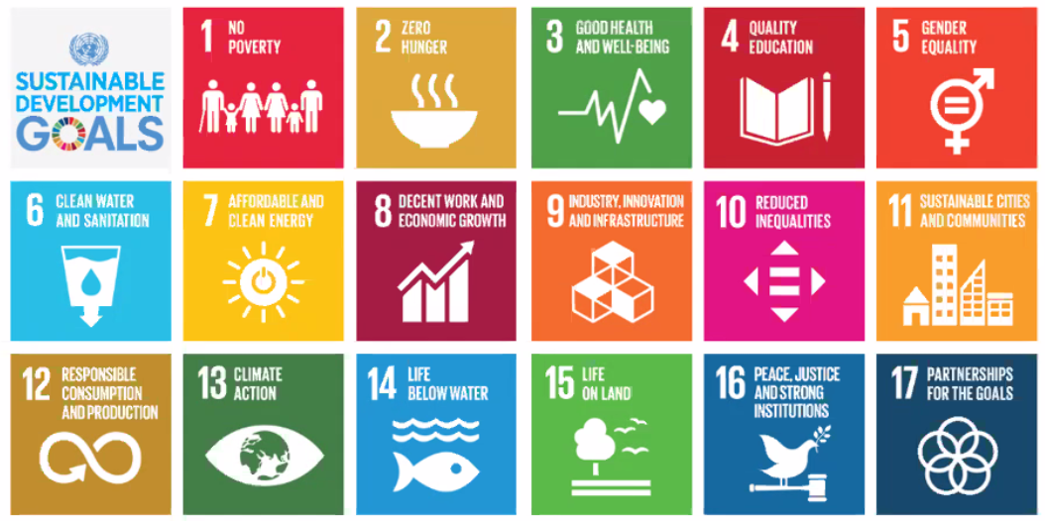
Sustainable Development Goals

