Slide 1
Severn Trent Services
Green Business Programme Winter Event - Coventry
7 December 2022
Agenda
Severn Trent PLC
Severn Trent Services
Water Consumption, Leakage and Waste Reduction
Net Zero Heating
EurIng Karl Drage FIMechE
Head of Growth
karl.drage@stservices.co.uk
07989 739040

Slide 2
Severn Trent Introduction
Severn Trent PLC
  FTSE 100 company with annual revenues exceeding £1.8 billion
  Our vision: to be the most trusted water company, delivering outstanding customer experience, best value service and environmental leadership
  Our purpose: to serve our customers and communities and build a lasting water legacy
  Headquarters in Coventry City Centre
Severn Trent Water
  The water company serving 8 million customers in the Midlands
  Regulated drinking water and wastewater treatment
Commercial Businesses within the Severn Trent Group
  Green Power – the largest producer of renewable energy from food waste in the UK
  Severn Trent Services
  Property Services
EurIng Karl Drage FIMechE
Head of Growth
karl.drage@stservices.co.uk
07989 739040

Slide 3


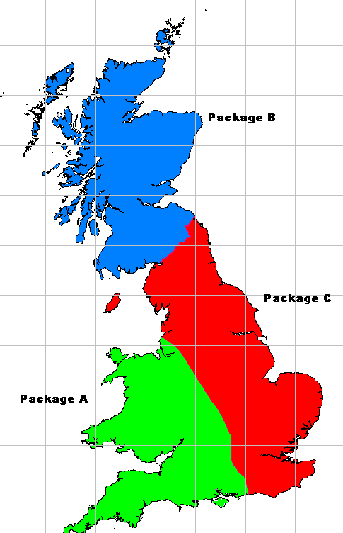



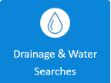
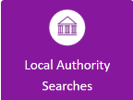
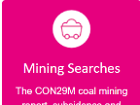


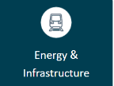
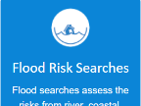
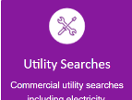
Severn Trent Services
  Operates private assets owned by public and private sector customers
    MOD’s water expert, Aquatrine Package C:
      water supply
      wastewater treatment
      asset management
      estate investment
      water quality
      leakage reduction
      environmental protection
      call-centre service
      continuous improvement
Working with the Coal Authority
  more than 80 mine water treatment schemes
Severn Trent Retail and Utility Services
  offering insurance options for home owners and landlords through HomeServe
Severn Trent Searches – Property Searches

Slide 4
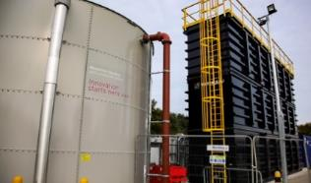
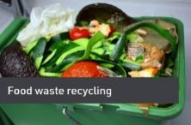
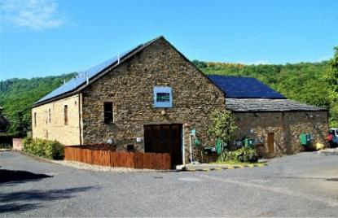
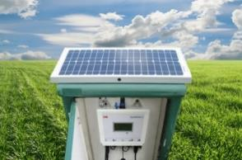
Renewable Energy & Sustainability
Our Commitment
Severn Trent’s Commitment
  100% Renewable Power – currently at 53%
  Investment in generating energy from wastewater and wind
  A growing business in AD energy from food waste – ST Greenpower
Severn Trent Services’ Commitment
  We’ve funded and installed PV cells at Water Treatment Works
  We use PV powered water meters where we can
  We look to source renewable energy
  Potential to develop mine water heat recovery projects
  Potential to service Ground source heat pump networks
  Active engagement in client Climate Change & Sustainability workshops
An efficient business is a sustainable business
  We’re measuring and monitoring our carbon footprint
  looking at Carbon Accounting
  We’re keen to contribute to client’s sustainability goals
Food Waste AD Plant
Water Treatment Works PV Cells
Opportunity:
Food waste disposal options
Ground source heat pump technology
Solar Powered Water Meters

Slide 5




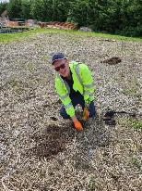
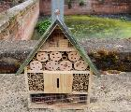
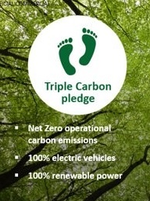
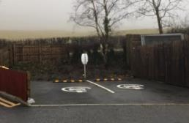
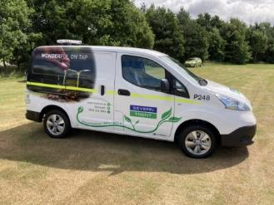
Biodiversity & Sequestration
Our Commitment
Group Commitment:
  We take care of one of life’s essentials
  The resilience of our business is intrinsically linked to the environment
  Planting 1.3 million trees by 2025
  Working with suppliers and business sustainability ratings
Severn Trent Services:
  Tree Planting and Wild Flower Meadows at client sites
  Disused assets used to improve local biodiversity:
    e.g. redundant assets refurbished to create wetlands
  Provide access to Lessons Learnt on Net Zero and Innovation
  Client Open Days and education to promote water saving, waste reduction and environmental protection
Electric Vehicles
  Triple Carbon Pledge – Our commitment to operational Net Zero by 2030
  100% EVs by 2030 for operational vehicles wherever practicable
  Scheme extends to private vehicles
  Currently trialling Electric Vans
  Installation of charging points at Water Treatment Works
  Scheduling optimises and minimises travel

Slide 6
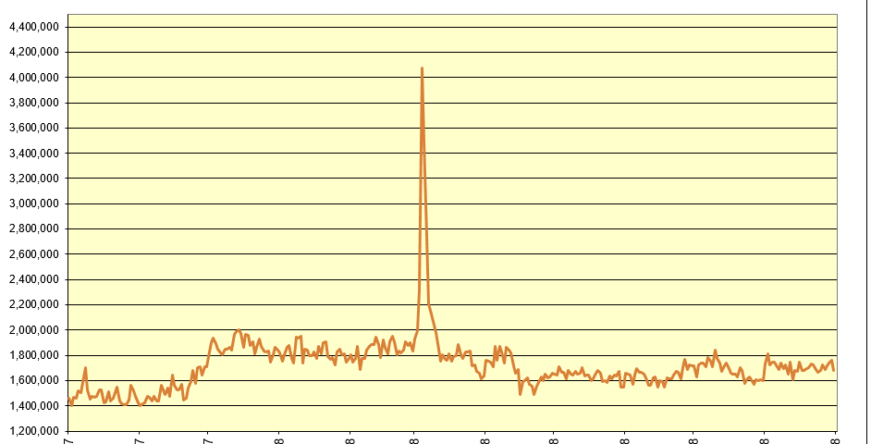
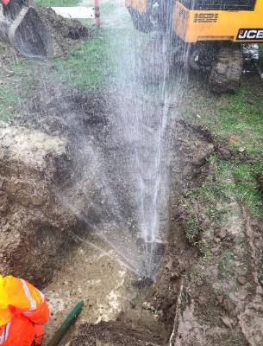
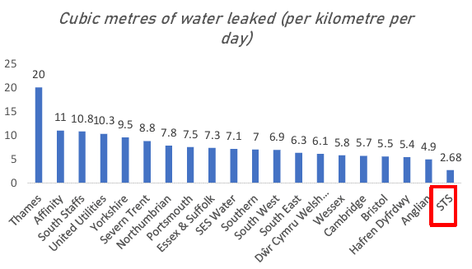
Water Consumption, Leakage & Wastage Reduction
Meter Assets:
  3,500 across client estates
Leakage from the External Network:
  STS Service Provider responsibility and cost risk
  Leakage Trends
    <18% holistic target at Leeming
    Average water industry ca. 21% ¹
Internal Wastage Trends:
    Meter data provided to support Water Efficiency Management (WEMs)
10 incidents reported during 2021:
    Peak 3.2m³/hr average 1.6m³/hr
Proactive Water Leakage & Wastage Monitoring
External Leak Detected & Fixed
Opportunities:
Rainwater and Greywater harvesting
Further metering and data to support reduction targeting
Data analysis to support targeting of network and internal wastage
Rapid find and fix service
Wastewater and Service Water innovation
Water Resources:
  A growing Climate Change issue
  Analysis & management of consumption and leakage is key
  Carbon Reduction Benefit – 0.421 kg CO₂e/m³
External Water Main Leak Detection & Repair
Leakage Comparisons
1 – Water UK – A leakage route map to 2025 - 2022

Slide 7
Net Zero Heating

Slide 8

Presentation for
Qatar 2022 Supreme Committee
Monday, 20 February 2013

Slide 9

Early thoughts on Qatar Stadia Solutions
Presentation for
Qatar 2022 Supreme Committee
20 February 2013
Net Zero or Carbon Neutral
Photo Voltaic and Solar Thermal
Absorption Chillers
Innovative Water Source and Ground Source elements to minimise installation cost and maximise performance
Innovative Ground Thermal buffer to reduce plant size and extend operating envelope
Integrated controls for validated operational performance
Continuous monitoring for active performance and carbon management

Slide 10
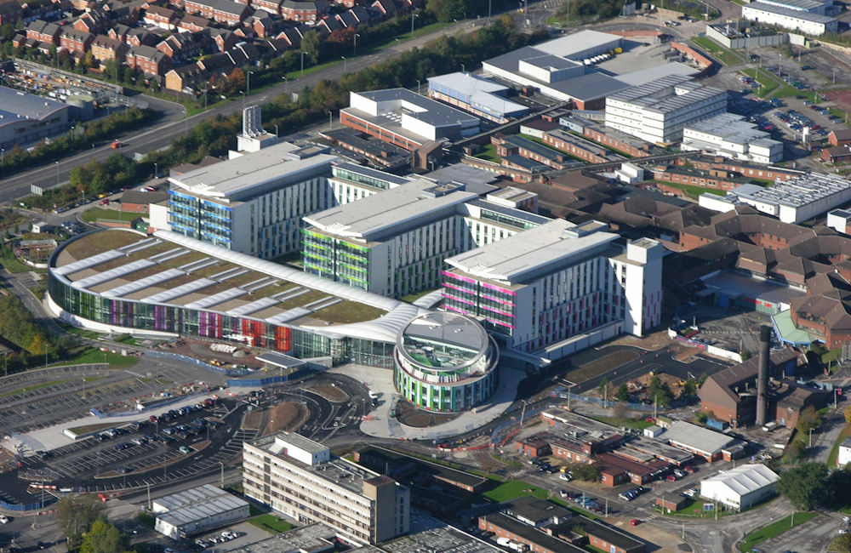

Large Hospital Campus – King’s Mill Hospital
Acute Care Hospital
Energy solution generates savings over £100k per annum
Provides renewable cooling and heating for the entire hospital
Uses the large reservoir adjacent to the hospital as the cool and heat source
Innovative Solution
Largest Sustainable Cooling System in Europe

Slide 11
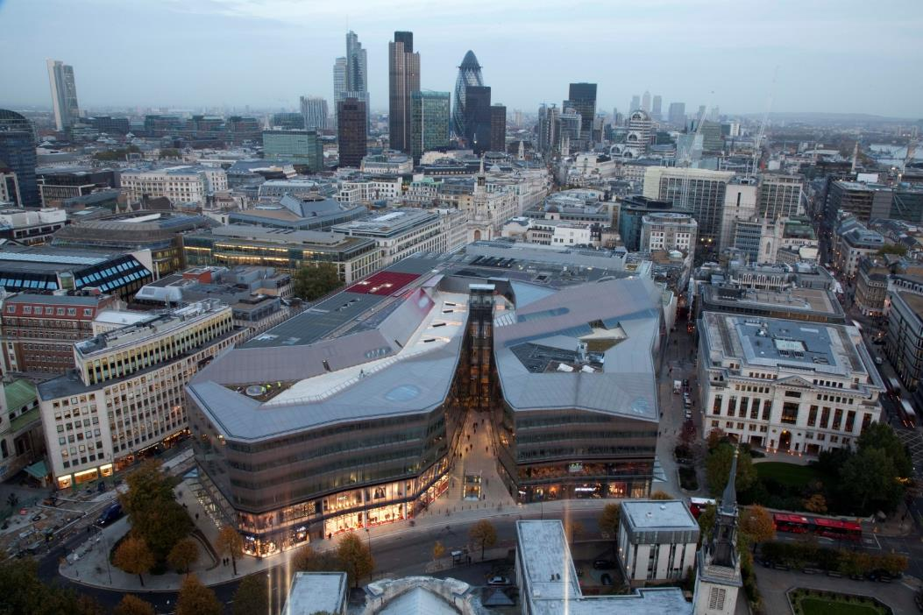





City Centre Retail and Commercial – One New Change
Large Retail and Commercial development
Energy solution generates savings over £100k per annum
Provides renewable cooling and heating for the entire building
Innovative Solution uses the structural piles and the sub-surface aquifer as a heat and cool source
Intelligent, optimising control system
Largest Inner City Sustainable Cooling System providing over 2MW of Low Carbon Cooling

Slide 12
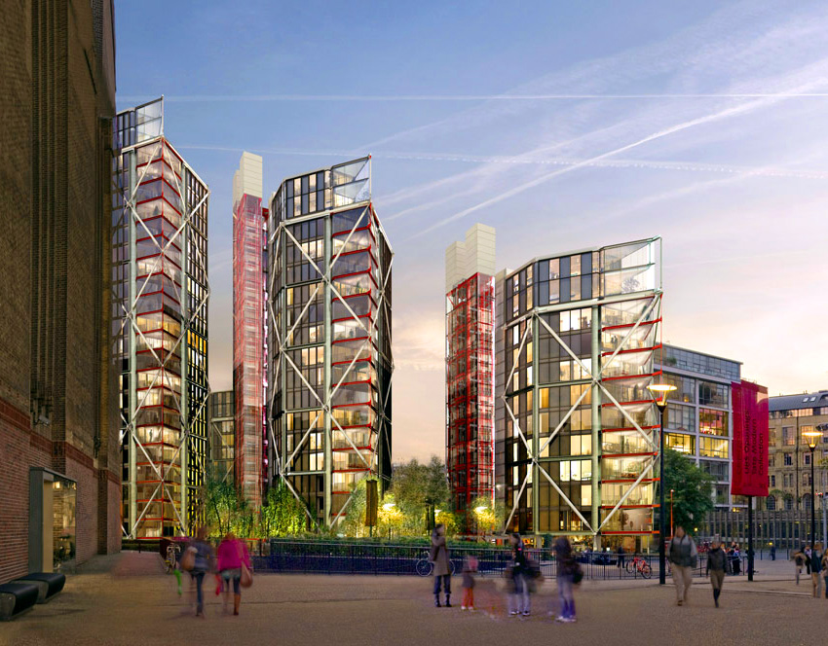

High Rise Modern Architecture – Neo Bankside
Luxury City Centre Apartments
Energy solution provides renewable heating and cooling for the entire development
Uses the structural building piles as the heat source

Slide 13
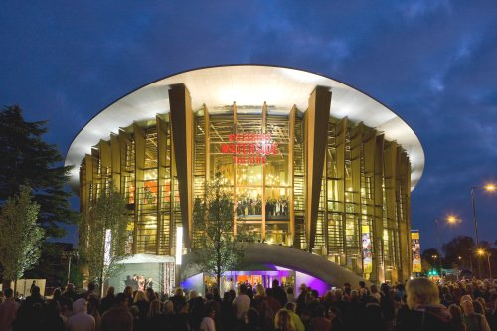

Public Entertainment – Aylesbury Theatre
Large Municipal Theatre
Energy solution provides sustainable Heating and Cooling
Heat is transferred with the ground beneath the adjacent public spaces

Slide 14
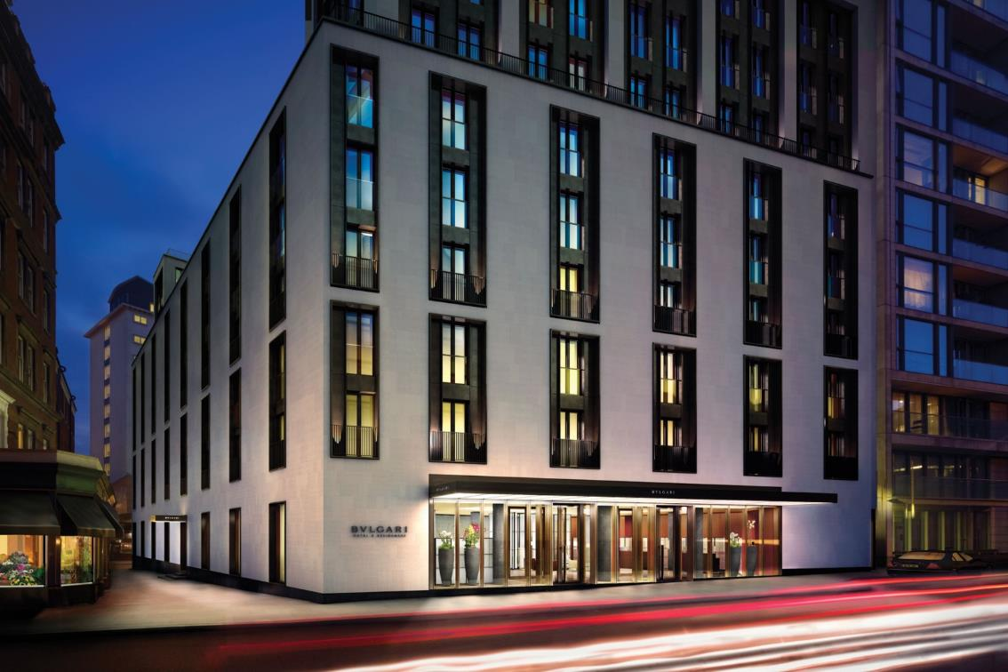

Hotels: Bvlgari, Knightsbridge
Innovative central London sustainable Heating and Cooling scheme
Energy solution utilises the deep basement foundations as part of the heat source

Slide 15
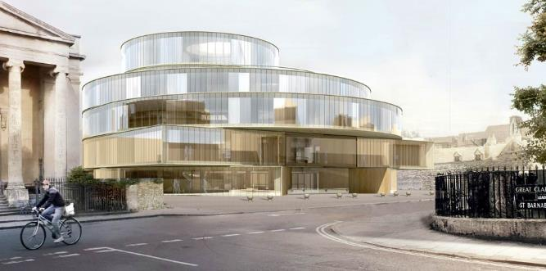
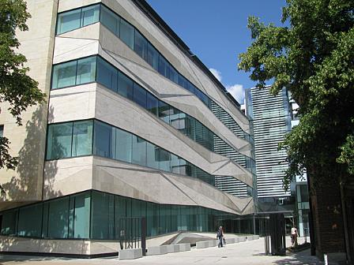
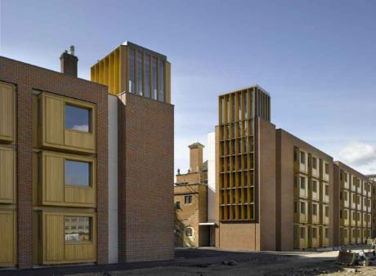
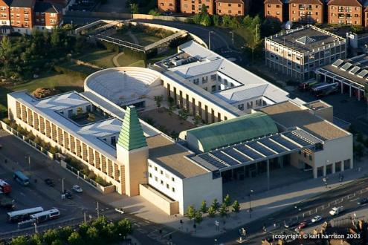

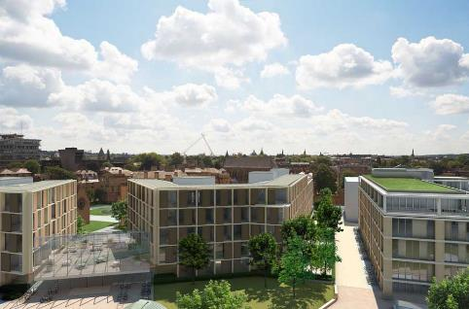
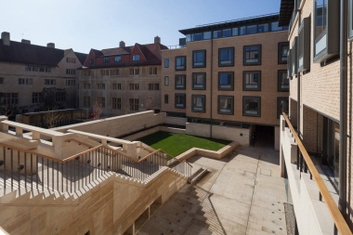


Oxford University
The renovation of the Royal Observatory Quarter at Oxford University has featured a number of large, integrated Energy Solutions
Intelligent Controls have enabled ongoing monitoring, performance improvement and optimisation
A number of highly innovative, landmark projects

Slide 16
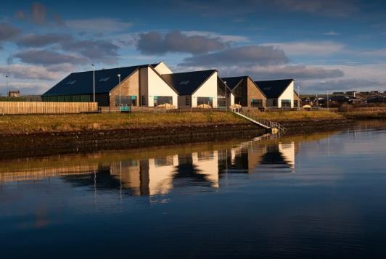
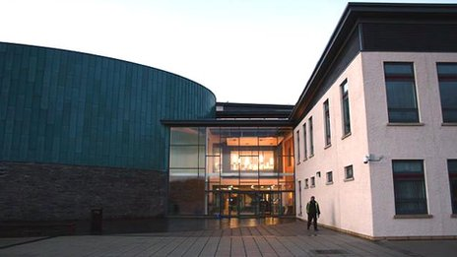
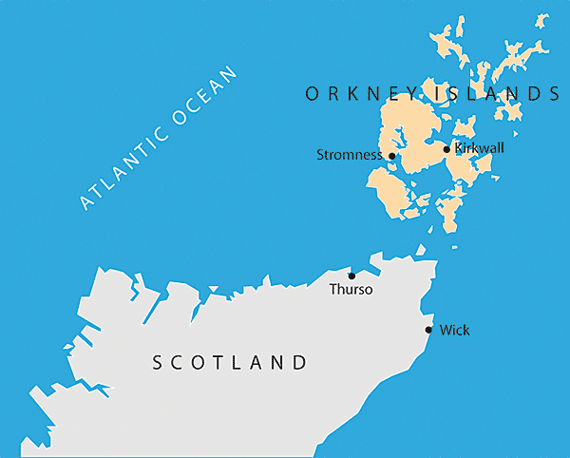
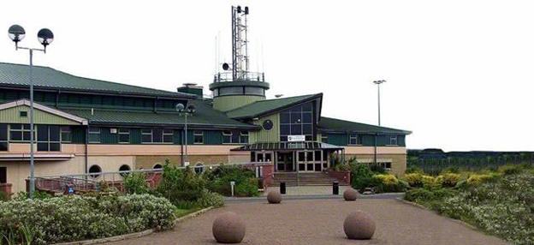
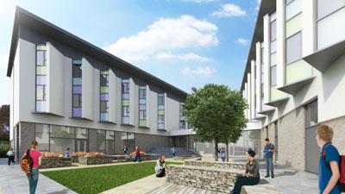
Orkney Schools
Schools, Halls of Residence, Sports and Leisure Complex
Remote monitoring and performance logging enables remote maintenance

Slide 17
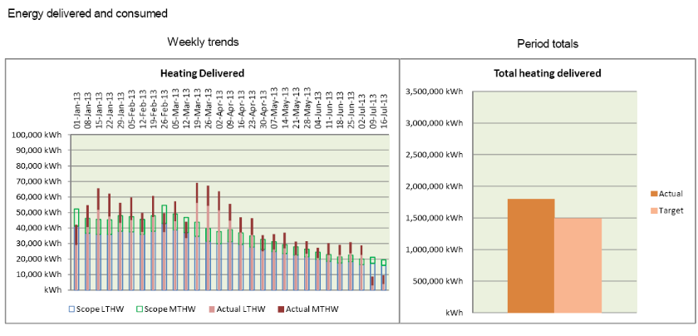
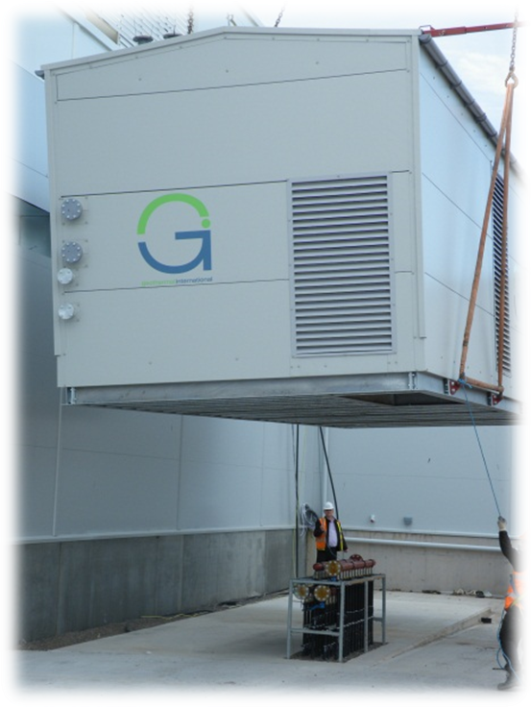
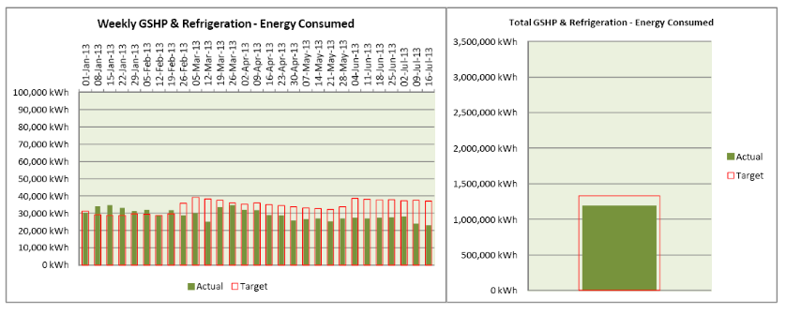
Retail Solutions - Sainsbury's
Modular solution
Saves 40% of total store Energy Consumption
Funded over 25 years
Innovation in Refrigeration Cooling

Slide 18
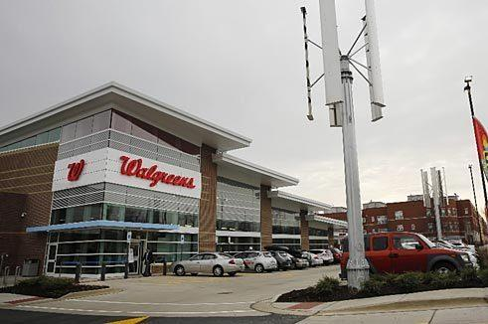
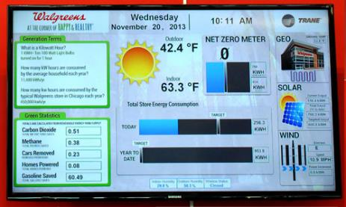
Retail Solutions: Walgreens
Optimised refrigeration and heating solution
Innovations in CO2 refrigeration
Net-zero store

Slide 19
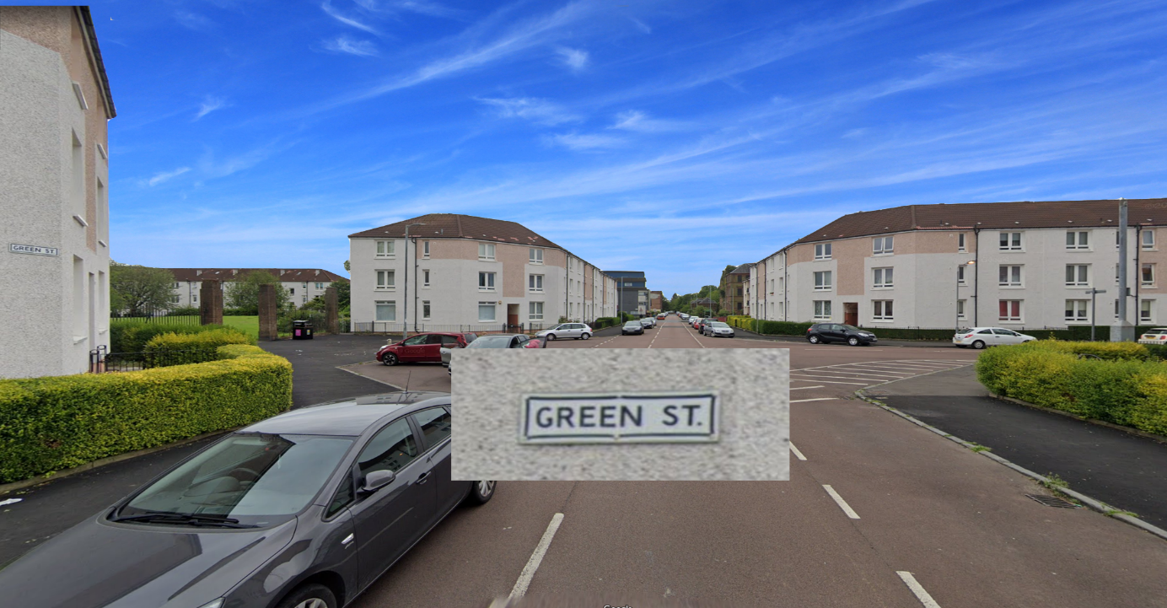



Welcome to
Green Street
A Virtual Street Map to
Zero-Carbon Urban Energy
CIBSE Technical Symposium, April 2022
EurIng Karl Drage FIMechE

Slide 20
Ambient Heat Networks

Slide 21

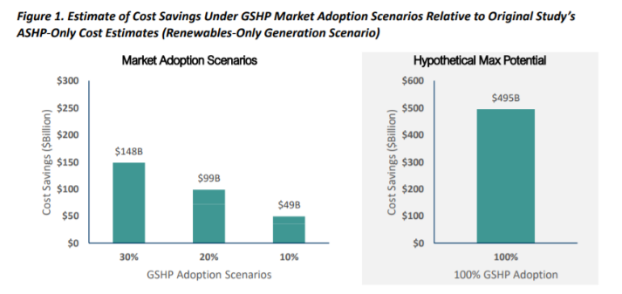
Existing Research
Aurora Energy Research study concluded:
“in scenarios with greater deployment of network heat pumps we expect energy system costs to be lower by around £1bn a year on average to 2050, which is roughly 2% of total system costs”
A detailed study in Canada was published last year.
"the least expensive option from the customer perspective is one of the most expensive options from a total resource perspective, while the least expensive total resource cost option is the most expensive customer option. An economically rational customer would choose the system that creates more resource costs in total."

Slide 22
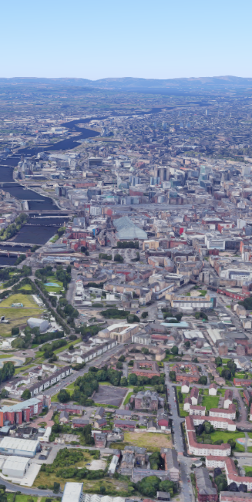
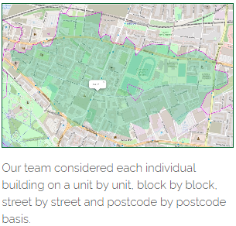
GREEN STREET
A collective vision for enacting net zero heat and energy in a real, local community, today
COP26
GREEN STREET

Slide 23
GREEN STREET
A collective vision for enacting net zero heat and energy in a real, local community, today
COP26
WHERE:
  2.5 miles away from COP 26
  In the Calton Area of Glasgow
WHY
  Typical city district, facing challenges with poverty and deprivation: income, employment, health, education, skills & training and housing
  Climate Change is usually far from the pressing agenda
  75% of tenants on housing benefit
WHAT
  A new housing development; A tenement block refurbishment; A school renovation; upgrade of existing housing and flats
  Understanding the needs of Local Residents and their Housing Association
  Demonstrate a practicable and affordable Net Zero solution for the residents of Green Street
GREEN STREET

Slide 24
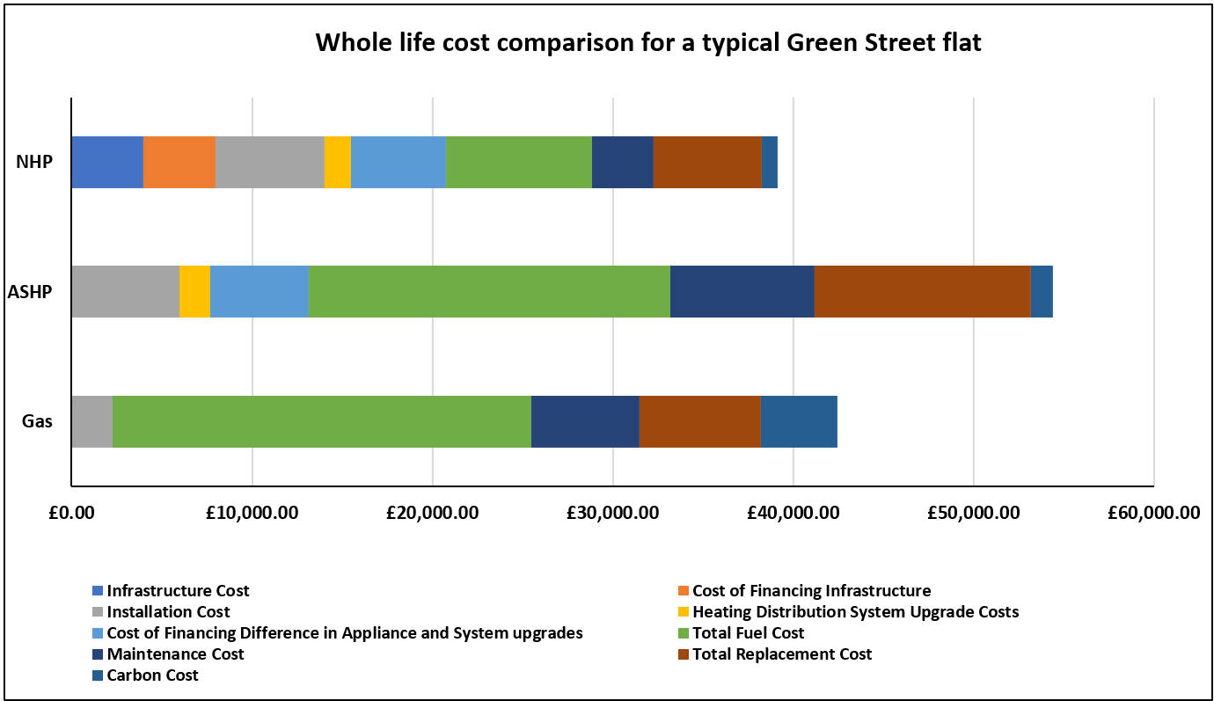
GREEN STREET
Counterfactual Analysis

Slide 25
Severn Trent Services
Green Business Programme Winter Event - Coventry
7 December 2022
Agenda
Severn Trent PLC
Severn Trent Services
Water Consumption, Leakage and Waste Reduction
Net Zero Heating
EurIng Karl Drage FIMechE
Head of Growth
karl.drage@stservices.co.uk
07989 739040

