Slide 1
Sustainability West Midlands Green Business Program Winter Event Support available
07 December 2022
Nat Weaver
Nathaniel.weaver@swm.org.uk
@SWMtweet​

Slide 2
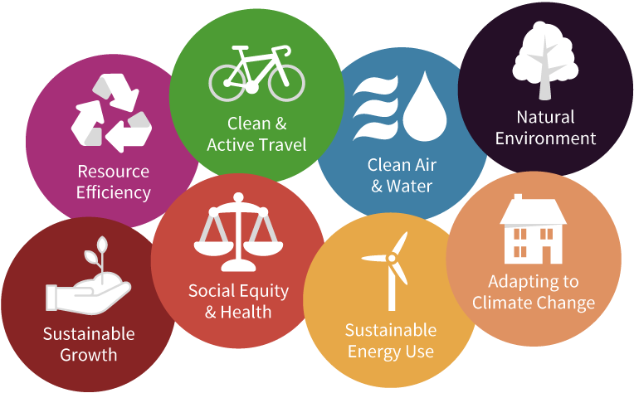
About Us
Sustainability adviser for leaders of the West Midlands
Established 20 years
Independent, not-for-profit company working across all sectors
Our vision: The West Midlands is leading in contributing to the national target of net zero greenhouse gas emissions by 2050 whilst addressing health inequality and driving inclusive growth
Coordinate and monitor the only existing regional Sustainability Roadmap; a framework to 2030

Slide 3
About Us
Three main areas of work:
Membership:
We are a cross-sector membership organisation with a difference; we connect, promote, and prioritise our members throughout everything we do.
Consultancy:
We provide trusted independent, expert advice across all sectors and areas of sustainability.
Engagement:
We use the power of storytelling and sharing of best practice to inspire action on sustainability. We use our communications, events and networks as platforms for engagement.

Slide 4
West Midlands Sustainability Roadmap to 2030
Our Vision: The West Midlands is leading in contributing to the national target of net zero greenhouse gas emissions by 2050 whilst addressing health inequality and driving inclusive growth. Find out more here.
Notes:
Thank you all for coming.
I’ll be sharing our annual benchmarking of the West Midlands and your feedback on how we’re doing.
I’ll also share some of our highlights this year

Slide 5
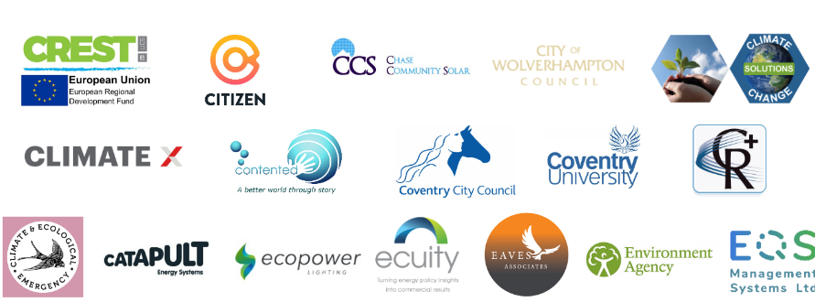
Our members

Slide 8
What’s involved?​
The benefits​
Working with others
Commitment to reducing carbon emissions
Becoming an ambassador
Sharing your business challenges in relation to the pledge
Free support and guidance from SWM
Exclusive networking meetings and contacts​
Reduce operational costs, mitigate against future energy and carbon pricing
Improve PR by positioning your business as a leader in the Net Zero carbon economy
Prepare your business for climate change impacts

Slide 11
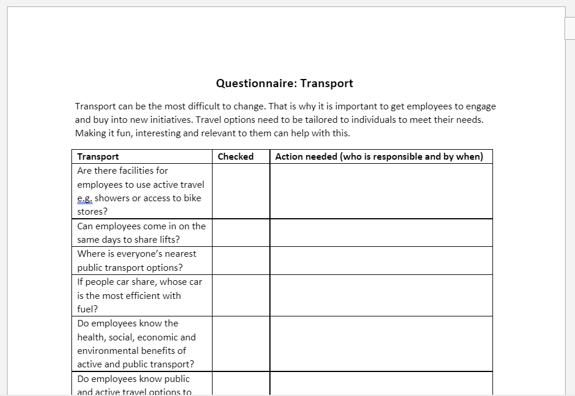
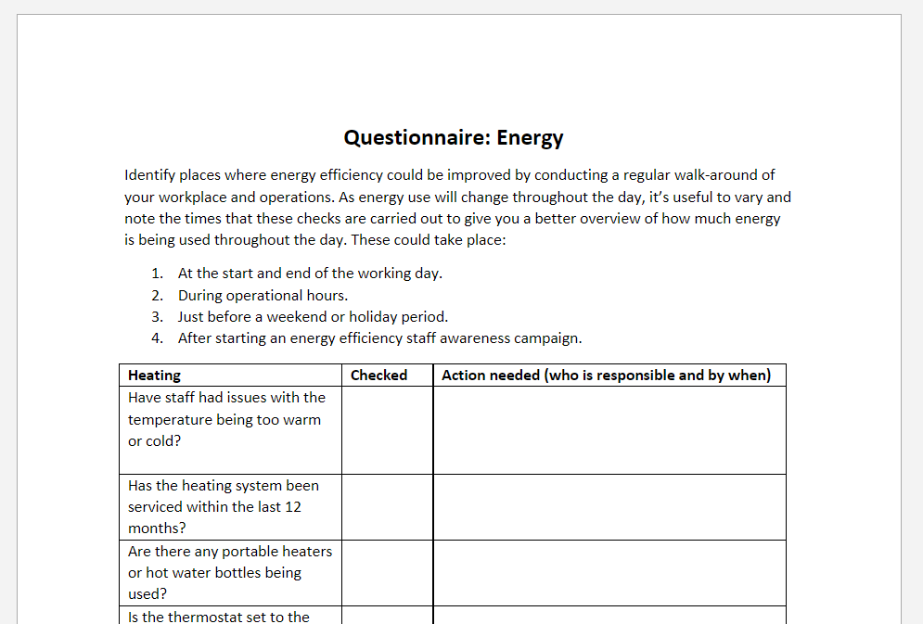
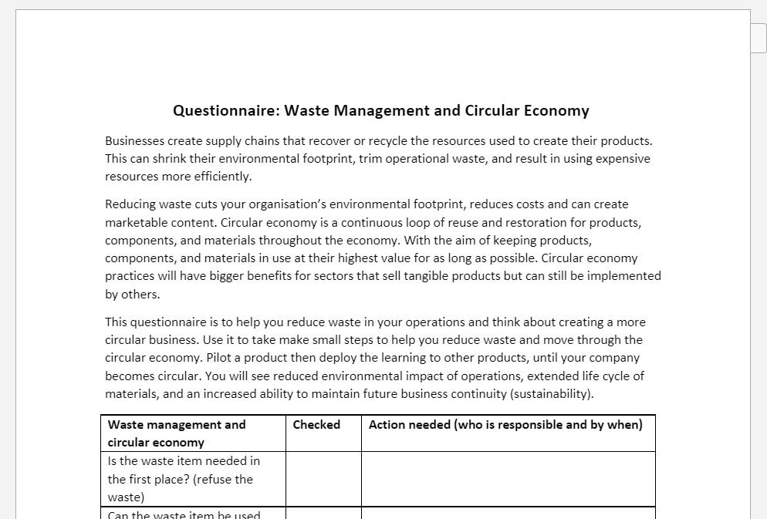

Slide 12
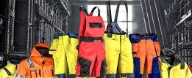
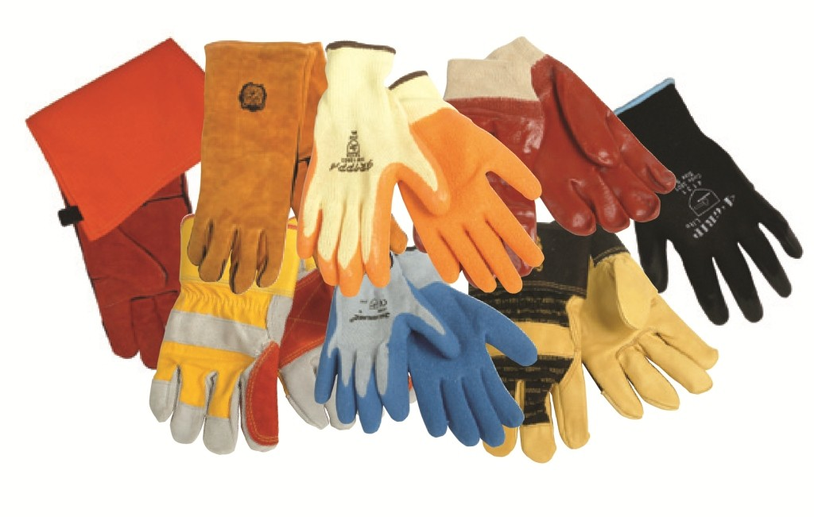
Staysafe PPE
Working in Partnership
for a sustainable environment
Staysafe PPE Ltd. - A Sustainability and Circular Economy Solution Provider

Slide 13
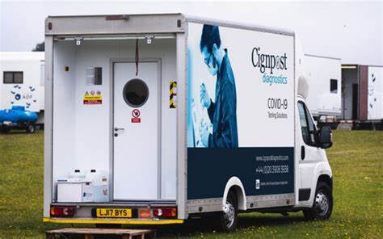
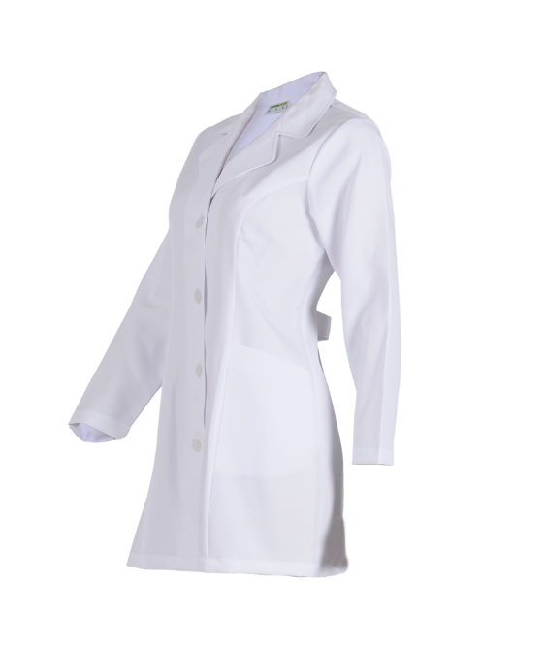
Case Study: Workwear
Cignpost Diagnostics
Mobile covid testing sites across UK (airports, film studios, universities and technology centres)
Lab coats - cost £25
All sent for weekly incineration before our intervention
Now washed, sterilized, repaired and returned
At the peak of the pandemic, up to 200 per day at £5 each, saving £20 each plus disposal costs
Cost Saving: £208,000 last year
Waste Saving: 13 tonnes
Carbon Saving: 192 tonnes scope 3 CO2e

Slide 14
Useful resources
Monthly Newsletter
Website
@SWMtweet
LinkedIn
Various events & webinars

Slide 15
Sustainability West Midlands Green Business Program Winter Event Support available
07 December 2022
Nat Weaver
Nathaniel.weaver@swm.org.uk
@SWMtweet​

