Slide 1
How can NICE guidance support evidence-informed Social Work practice
A West Midlands resource for frontline staff

Slide 2
Contents
What does NICE do? 3
What is Evidence Informed Practice
and Why is it relevant? 7
How is NICE used? 8
How can NICE be used? 11
Searching and browsing the NICE website 17

Slide 3
What does NICE do?
Clinical practice
guidance
Public Health
guidance
Social Care guidance
NICE
Quality standards
New Drugs
Advice
Medical technology guidance
Best Evidence

Slide 4
Role of NICE
The national point of reference for advice on safe, effective and cost effective practice in health and social care, providing guidance, advice and standards aligned to the needs of its users and the demands of a resource constrained system
Evidence
Guidance
Improved outcomes
Quality standards
Systematic review of a range of evidence
Considered by committees of experts
(including providers and people using services and their carers)

Slide 5
Why use NICE guidelines?
Improve health and wellbeing outcomes for service users and carers
Ensure that care provided is effective and makes efficient use of resources
Increase national consistency of care provision
Reduce inequalities and unwarranted variation
Supports and prioritises quality improvement activities
Can help address incidents (action plans)
Demonstrates quality to commissioners and to service users & their families
Help answer questions on quality from CQC
Support discussions with patients, carer or service users
Support professional decision-making and continuous development
Support the case for investment (value for money)

Slide 6
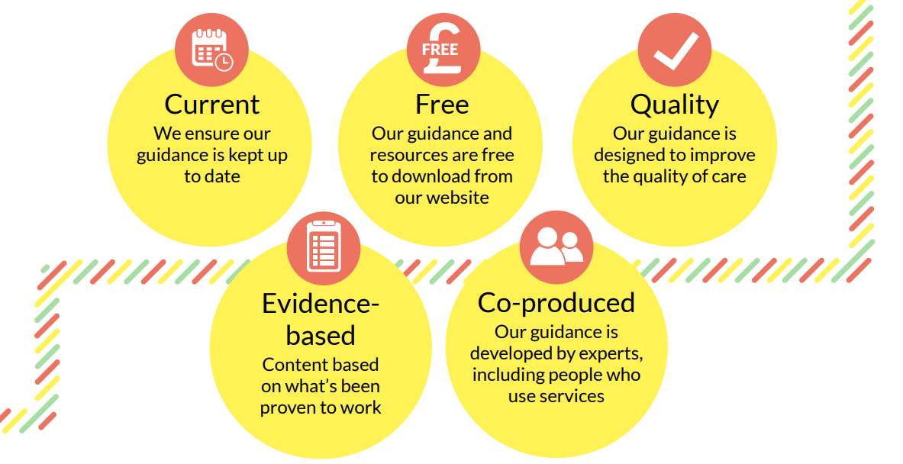
Benefits of using NICE guidance
Notes:
Our social care guidelines make evidence-based recommendations on the effectiveness and cost-effectiveness of approaches and services. Co-produced with social care experts
Helpful to know how our guidance is produced:
Developed by experts but
all our social care guidance is co-produced with people who have lived experience of using social care. 8 of 16 committee members for “peoples experience of adult social care” were people with lived experience
We look at research studies and evaluate them – but where there isn’t a lot of research evidence, we call out for evidence from experts
And we take on board the comments from those who are impacted by our guidance (practitioners, service users, professional bodies etc) when we consult on the draft recs
All free
And kept up to date – we review regularly to ensure our recs align with current evidence base, policy and legislation

Slide 7
3 main components of evidence informed practice
Professional input
Best research evidence
Person’s values and preferences
EIP
Notes:
This model, from Sackett, is based on a model of how evidence is used in health but, it is relevant to SW practice too
Practice wisdom, expertise of colleagues is very valuable it’s also important to use a range of information to support the people we work with and to guide how decisions are made. This slide explains what we mean by evidence informed practice:
asking about a person’s values and preferences is key. We may also look at their case records and any advance care plans to find out about what’s important to them.
it’s also important to think about the best available evidence. This could be a range of reports about the person and relevant case law. It could also be evidence-based guidance which explains what s works best in practice. NICE guidance could be one source of information for a social worker to consider.
It’s important to use professional judgement to appraise all of the relevant information and to support decision-making.
For example, a 14-year-old girl, has a history of self-harm. She has recently been admitted to an inpatient mental health unit following an overdose. She lives with her dad who works night shifts and relies on public transport. He complains to her social worker that he has not been involved in any care planning discussions since she has been admitted. The social worker uses guidance on transition between inpatient mental health settings and community or care home settings to show staff on the ward the importance of supporting and involving families. The social worker is able to persuade the psychiatric team to arrange meetings at different times to fit with Jakob’s working pattern and reliance on public transport
In this example using a neutral national guideline, based on evidence, informs what is in the best interest of the person and informs the social worker with knowledge to make the right decision and advocate for the person they are working with.
Taking an evidence informed approach is a way of checking your thinking, particularly when there are professional disputes about standards of care.
REFLECT on your practice are you using research evidence?

Slide 8
How are Social Workers using NICE guidance?
Within social work education
To empower social work practice in relation to rights based and value informed practice
To inform critical thinking and to clarify points, such as in safeguarding enquiries and supporting report writing
To understand how to work in health and social care settings
To request funding and drive strategic change and improvement
To inform local policy and procedures: Transition from children’s to adult services for young people using health or social care services (NG43) rec 1.2.5 for a named worker

Slide 9
How are Social Care organisations using NICE guidance?
Coventry City Council Adult Services as part of their policy governance have an approach to ensuring social care takes account of NICE Guidance to inform its own policies, procedures, guidance and public information
This involves a process whereby relevant NICE guidance is subject to a baseline assessment regarding compliance, identifying areas where they may be partially/unmet recommendations with decisions made as to whether actions will or will not be taken to move towards compliance
Read more about these approaches …
Driving quality through the implementation of NICE guidance in a local authority
https://www.nice.org.uk/sharedlearning/driving-quality-through-the-implementation-of-nice-guidance-in-a-local-authority
NG108: Using NICE guidance to inform an audit of Mental Capacity Act assessment
https://www.nice.org.uk/sharedlearning/ng108-using-nice-guidance-to-inform-an-audit-of-mental-capacity-act-assessment
For more information, contact: andrew.errington@coventry.gov.uk

Slide 10
Using NICE guidance to empower social work practice in hospital discharges
Services for older people
Scenario: discharging people from hospital
During supervision, a hospital social worker discusses the pressure they are feeling to discharge people to care homes when those people may not have the capacity to make a decision about where they live. The social worker feels this potentially conflicts with the Mental Capacity Act 2005, particularly the principle of seeking the least restrictive option
Action
The supervisor advises the social worker to use specific recommendations from guidance on transition between inpatient hospital settings and home and decision-making and mental capacity, to strengthen their professional power when discussing discharge planning with health colleagues, including informing best interest meetings.
More information
NICE guidance:
Transition between inpatient hospital settings and community or care home settings for adults with social care needs (NG27) rec 1.5.11
Decision-making and mental capacity guideline (NG108) rec 1.5

Slide 11
How to use NICE guidance
How to use NICE guidance
www.nice.org.uk

Slide 12
Scenario: 38 year old Male, with ADHD, Bipolar and opioid dependency
Summary: known to a community mental health trust (CMHT) since an adolescent and substance services for approx. 11 years. Limit effect of medication to manage mental health symptoms and was disillusioned with CMHT as felt he was not listened to.
Opiate dependency treatment in place with holistic support and some lapses. Lost sense of self and pride and mental health deteriorated rapidly. Expressing thoughts of suicide and harming others but as not just MH thoughts/symptoms but as a real situation had no emotional support from CMHT. Police involved and after numerous calls did find him with a noose in his bag with a clear plan. Not admitted.
NICE guidance
Coexisting severe mental illness and substance misuse: community health and social care services (NG58) rec 1.4 Partnership working; rec 1.6.4 Recognise trauma and homelessness; rec 1.1 First contact
Coexisting severe mental illness (psychosis) and substance misuse: assessment and management in healthcare settings (CG120) rec 1.4.3 Do not exclude because of substance misuse
Service user experience in adult mental health: improving the experience of care for people using adult mental health services (CG136) rec 1.5.9 Crisis assessment

Slide 13
Scenario: 38 year old Male, with ADHD, Bipolar and opioid dependency
How could NICE have been used?
To open conversation with MH services about not allocating a care manager but also how to jointly manage support and risk assessment.
Accepting that there are complex problems alongside MH and SM and preparing the individual for them. Male only seen in out-patients MH services even after numerous requests to be considered for care co-ordination. At contact could have highlighted guidance to respond to holistic needs especially of housing. To support application prior to crisis point for full MH assessment and support due to complex MH behaviours. To take into account level of distress and vulnerability
Learning points
NICE Guidelines on developing joint learning between services and commissioners, using guidance to ensure appropriate service delivery.
In complex scenarios are Social Workers going to be able to quickly find the relevant guidance or will it be more of a reflective tool; in planned work sessions; to challenge decisions of other services, or show your own working practices and why?

Slide 14
NICE mapping
Drug overdoses during pregnancy
History of mental health concerns but refused assessment as likely to be drug related
Mental health support services separate from drug services
History of DV and own childhood trauma (ACEs) homelessness
Pregnancy and complex social factors: a model for service provision for pregnant women with complex social factors (CG110) rec 1.2 pathway for pregnancy care
Coexisting severe mental illness (psychosis) and substance misuse: assessment and management in healthcare settings (CG120) rec 1.4.3 Mental health cannot exclude due to substance use
Coexisting severe mental illness and substance misuse: community health and social care services (NG58) Mental health and substance use partnership working
Coexisting severe mental illness and substance misuse: community health and social care services (NG58) rec 1.6.4 trauma and homelessness

Slide 15
Key NICE guidance
Supporting adult carers (NG150)
People’s experience in adult social care services: improving the experience of care and support for people using adult social care services (NG86)
Older people with social care needs and multiple long-term conditions (NG22)
Care and support of people growing older with learning disabilities (NG96)
Older people: independence and mental wellbeing (NG32)
Home care: delivering personal care and practical support to older people living in their own homes (NG21)
End of Life care for adults: service delivery (NG142)
Community engagement (NG44)
Transition from children’s to adults’ services for young people using health and social care services (NG43)
Transition between inpatient mental health settings and community or care home settings (NG53)
Safeguarding adults in care homes (NG189)
Decision making and mental capacity (NG108)
Social work with adults experiencing complex needs (NG216)

Slide 16
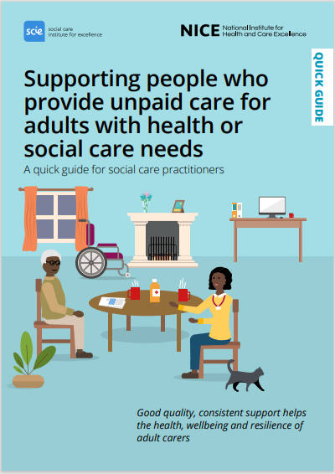
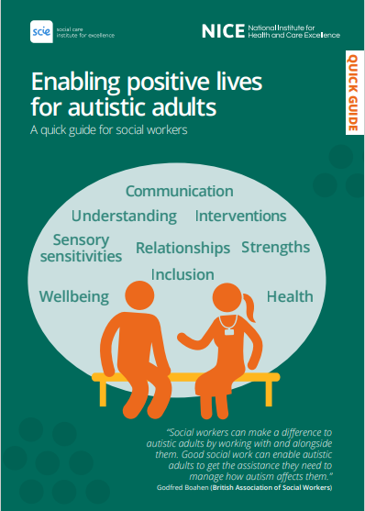
Quick guides: a quick, easy way to access key information from NICE on social care topics

Slide 17
Over to you!
Open a new page on the internet and type in the NICE website address www.nice.org.uk
(We will still be in the meeting to speak and hear you)
Is everyone on the NICE website?
Make sure you’re on mute but keep the meeting running and explore a topic of your choice on the NICE website.

Slide 18
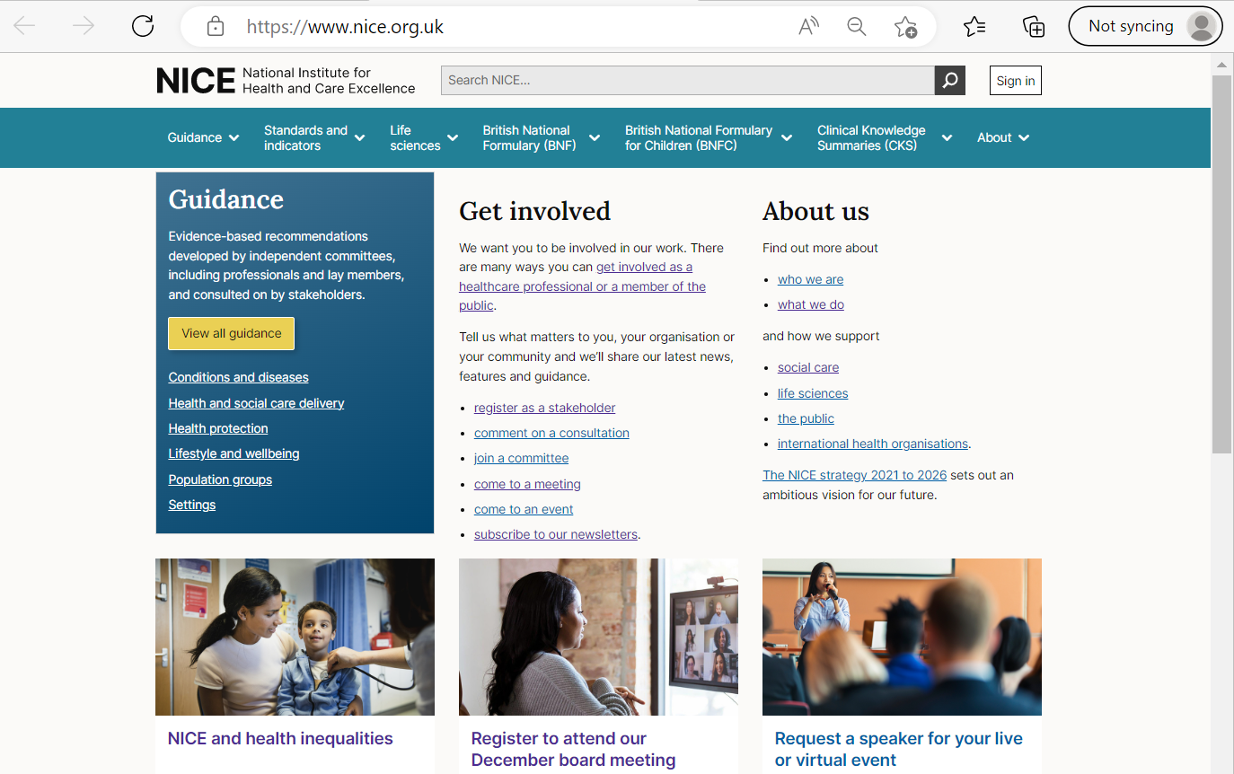
The NICE website

Slide 19
Browsing and searching the NICE website
Searching Searching can be quicker, especially if you have the correct terms. Keep your searches simple.
Q: What does NICE say about mental capacity issues?
Search: ‘mental capacity’ or ‘decision making’
Results page: NG108, QS194, Shared learning example
Guidance: NG108 – check overview, scope – for 16 yrs and older, lacking capacity now or in the future (all the recommendations are here)
Explore the topic guidance tool bar – use NG108

Slide 20
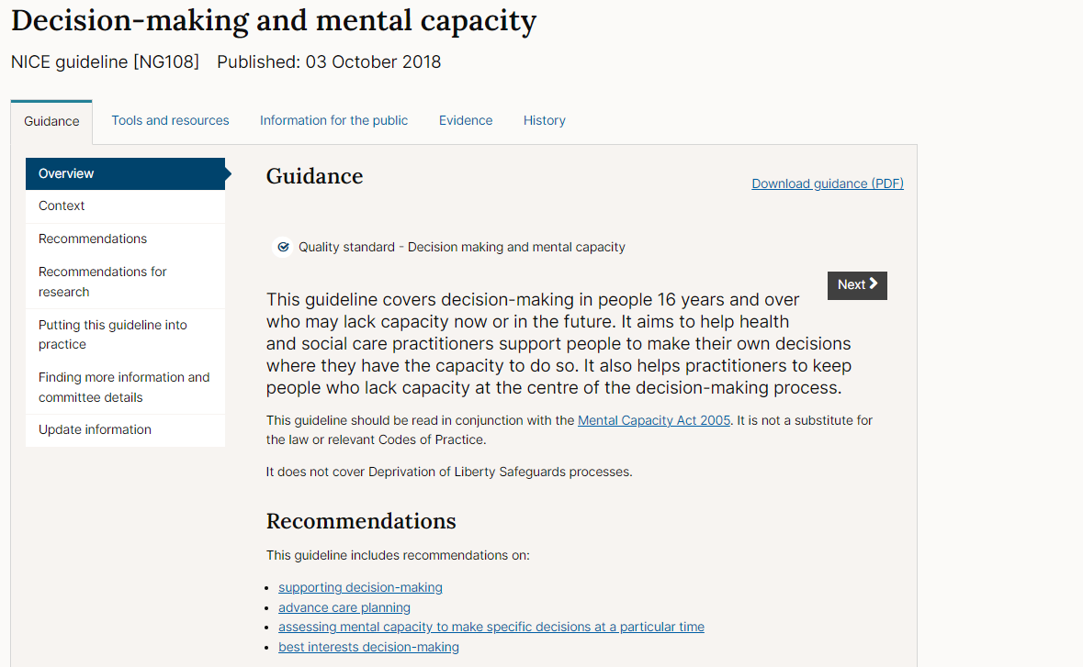
Decision making and mental capacity NICE guideline

Slide 21
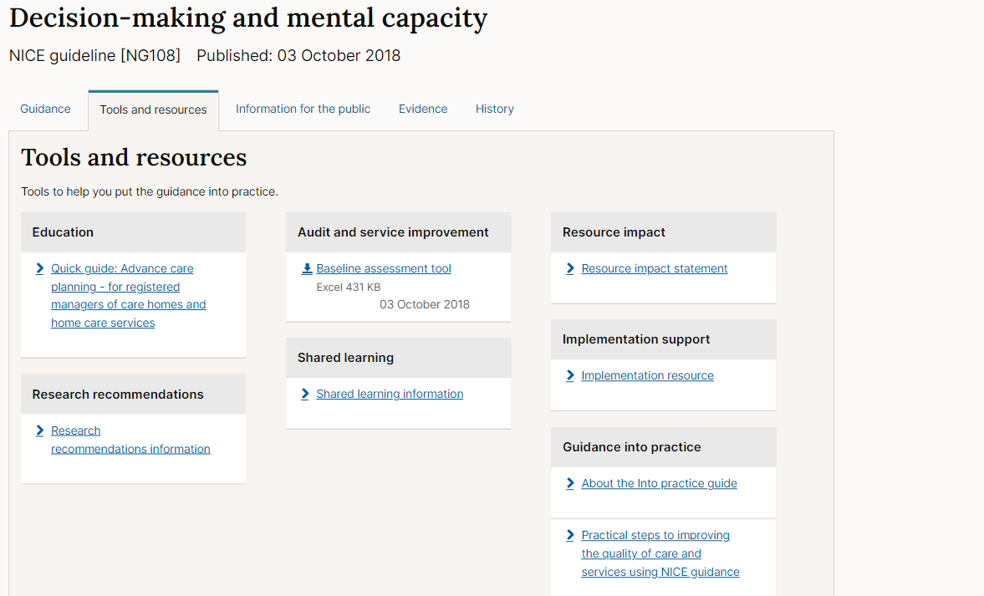
Tools and resources

Slide 22
Browsing and searching the NICE website
Q: What kind of support do people with complex needs require?
Search: ‘complex needs’
Results page: NG216, NG213, QS, quick guides
Guidance: NG216 Social work with adults experiencing complex needs
NG213 Disabled children and young people up to 25 with severe complex needs
Explore the topic guidance tool bar, tools and resources

Slide 23
Homework
Access the NICE website for at least two cases either to prepare you for starting work OR to consider a current case and how the guidelines could help.
Read a shared learning experience and think about how this influences you.
Consider recording this as a CPD reflect for SWE?

Slide 24
Join our audience insight community
Join our audience insight community
We want those working within the health and care sector to join our insight community and have their voice heard. Your views will influence the continual development of our products and services.
Members of the community have already helped us to:
better understand how health and care staff use our guidance and recommendations
improve the way we present our resources
develop our implementation strategy
gain insights into our guidance users’ perceptions of NICE.
We run different activities depending on what we’re trying to find out. This can vary from a quick online survey to an all-day workshop. There's no obligation to take part - just help if you can.
Our community is made up of over 1,700 healthcare, social care and public health professionals as well as academics, charities, patients and carers.
Join them to have your say!
Click the link above
Focus groups
& workshops
Depth
interviews
User
testing
Surveys
Learn more about the community and join - https://www.nice.org.uk/get-involved/help-us-improve

Slide 25
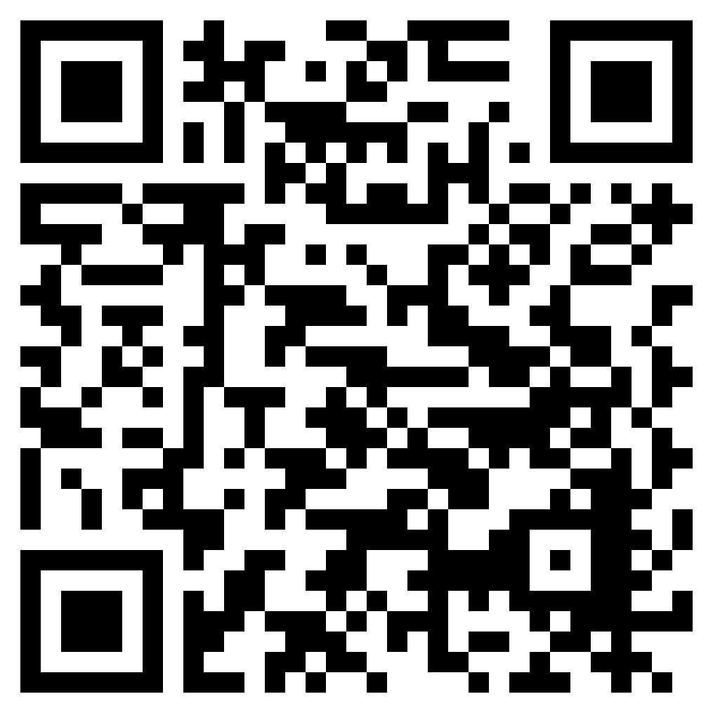
Staying up to date
Visit our website www.nice.org.uk
Sign up for our monthly newsletters using the QR code
Contact our enquiry team nice@nice.org.uk
Contact the field team joanne.mccormack@nice.org.uk
Visit our social channels - Twitter, Facebook, LinkedIn, YouTube and Instagram
25

Slide 26
Q&A Thanks for joining us

