Slide 1
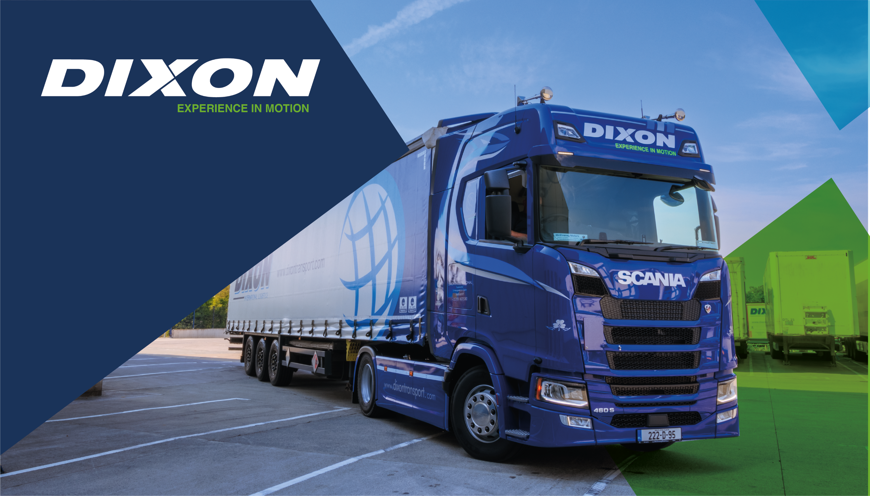
COVENTRY CITY COUNCIL
GREEN NETWORKING EVENT
Terry bleeks
Business Integration Manager

Slide 2
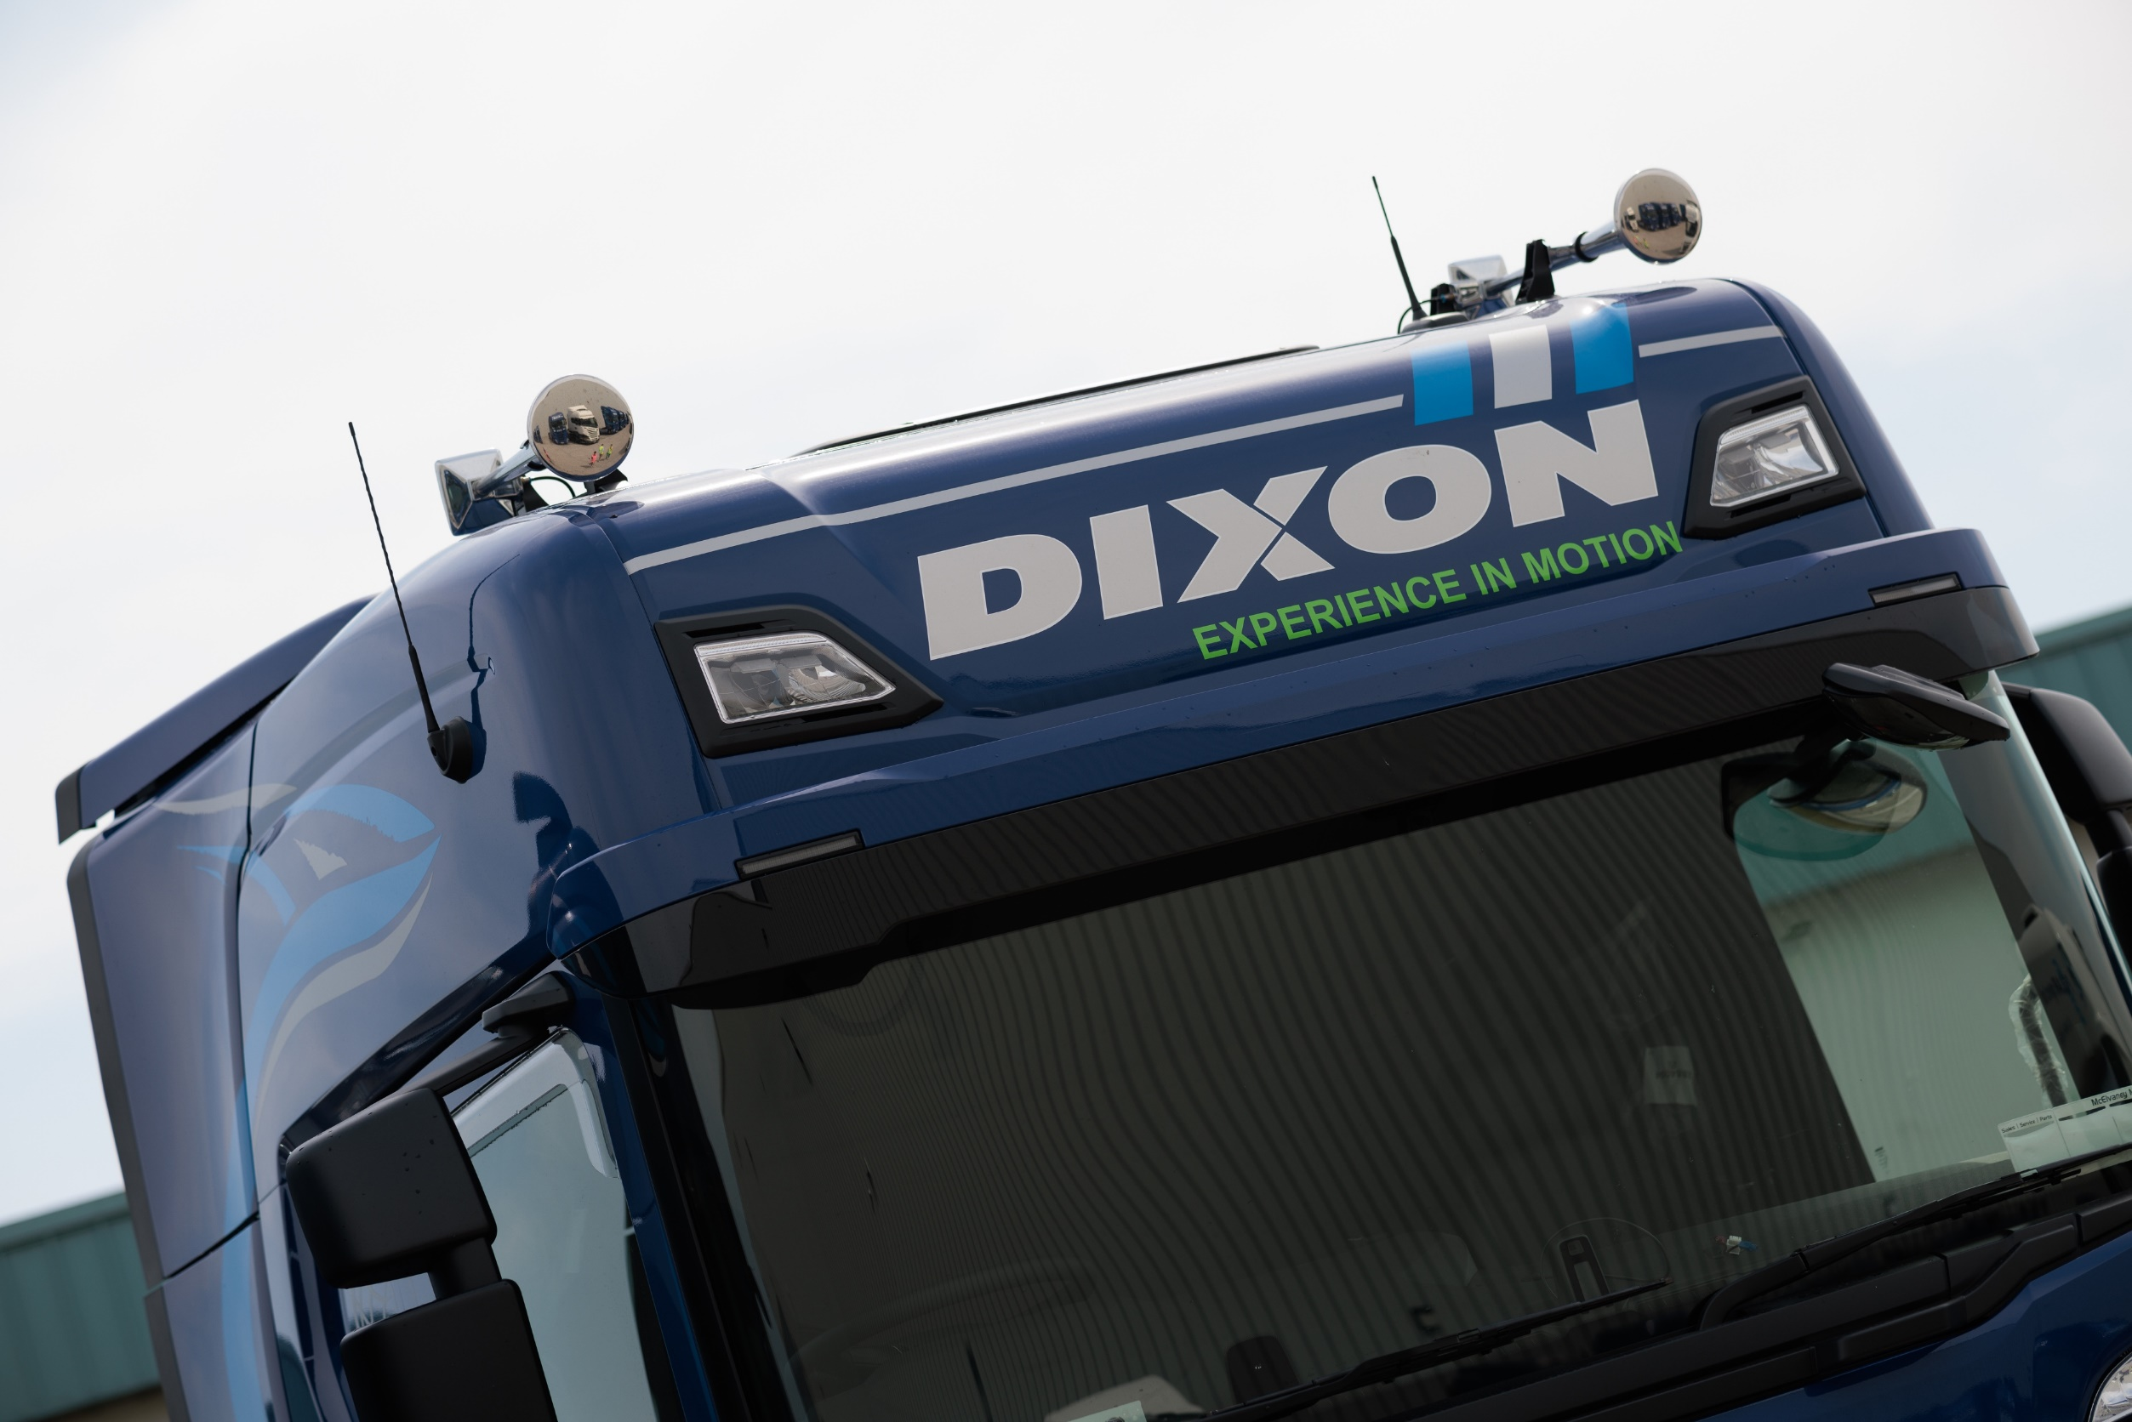

Who we are
Who we are
Temperature Controlled Transport and Warehousing company based in Dublin, Ireland and Coventry, UK.
Specialise in Pharmaceutical and Food transport throughout UK, Ireland and Mainland Europe.
Company fleet of over 310 trucks and 540 temperature-controlled trailers.
25 years in business overall, with our UK operation being open since 2016.
22,000 Loads per year to & from the UK
4.8m litres of fuel used annually.
18m Kilometres travelled per year.

Slide 3
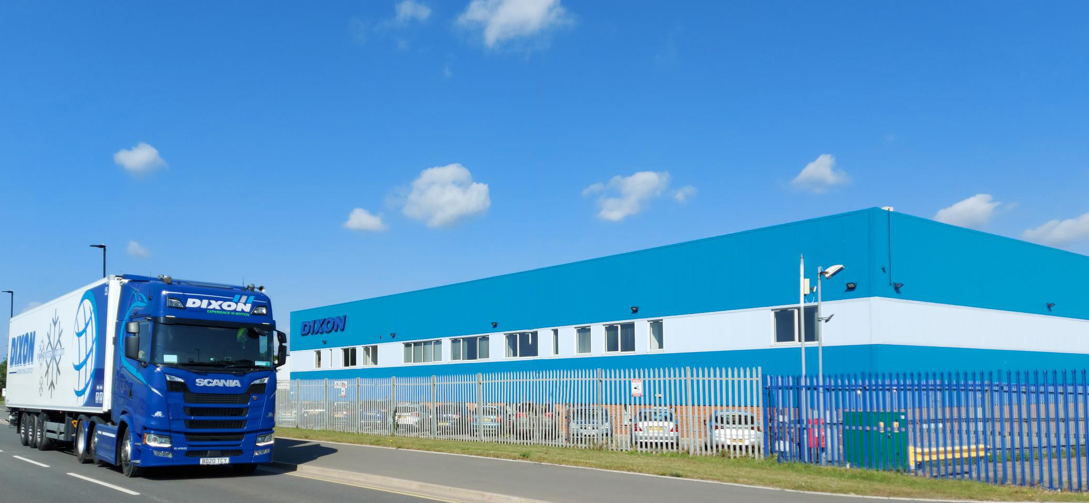
Who we are
SUSTAINABILITY
400 KW Solar Plant​
CNG Trucks ​
Euro VI Diesel Trucks​
Electric Company Cars ​
Plug-ins for trailers ​
Auto-LED lighting ​
Fuel bonus mechanism​
Tyre Pressure Sensors​
Fridge Trailer Solar Panels ​
Rainwater Harvesting

Slide 4
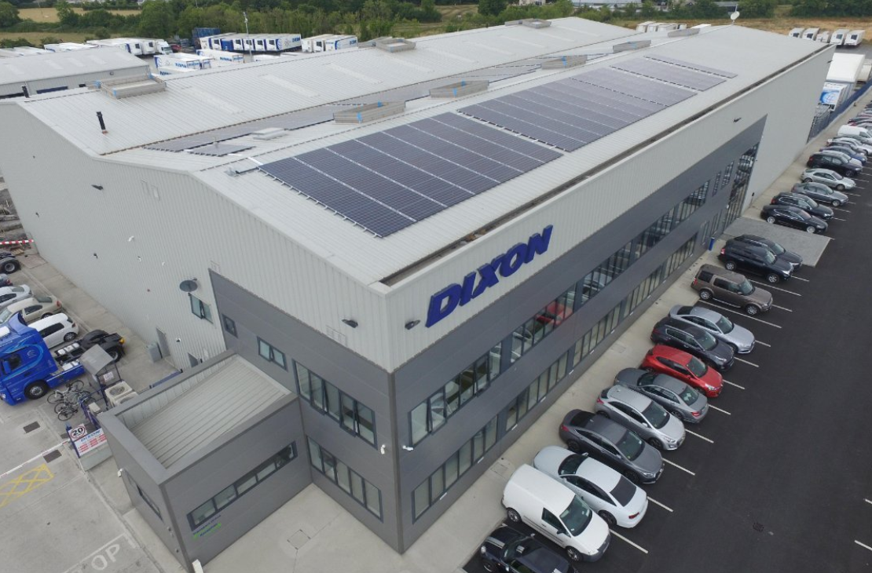
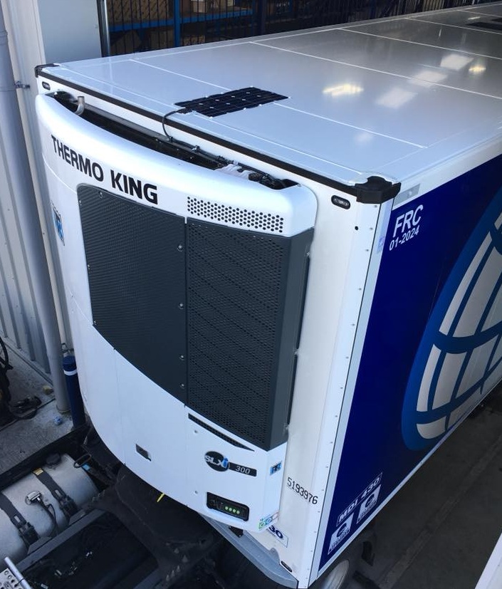
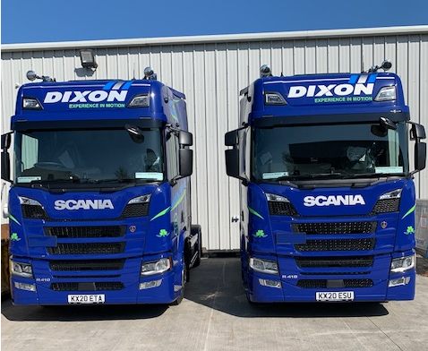
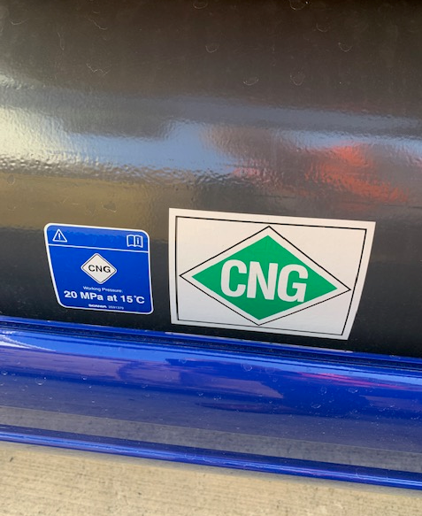
Who we are
Environmental
initiatives
300kw Solar Plant
Electric Company Cars from 2018
Solar Panels on Refrigerated Trailers
Harvesting Rainwater for Truck wash
Recycling and Reusing Water
Investment in Scania CNG Trucks
Driver Fuel Bonus to encourage Eco-Driving
Tyre Pressure Sensors and Monitors

Slide 5
Who we are
Environmental Benefits of cng powered trucks
New Scania CNG (Compressed Natural Gas) trucks
Reducing greenhouse gases
Reducing noise
22%
70%
99%
80%
less CO₂
less nitrogen oxide
less particulate matter
less sulphur dioxide
We use Bio-Gas where possible, which will allows us to run Carbon Neutral

Slide 6
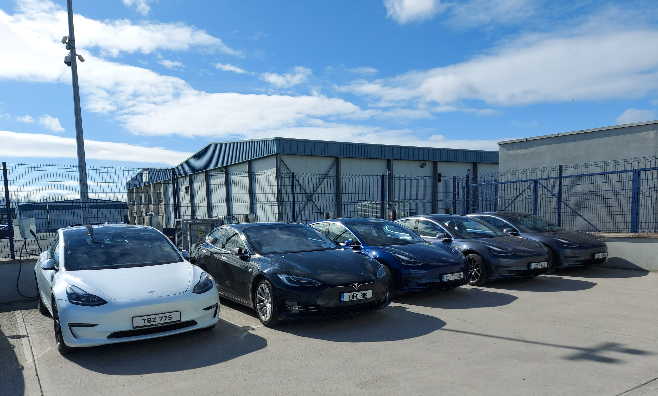
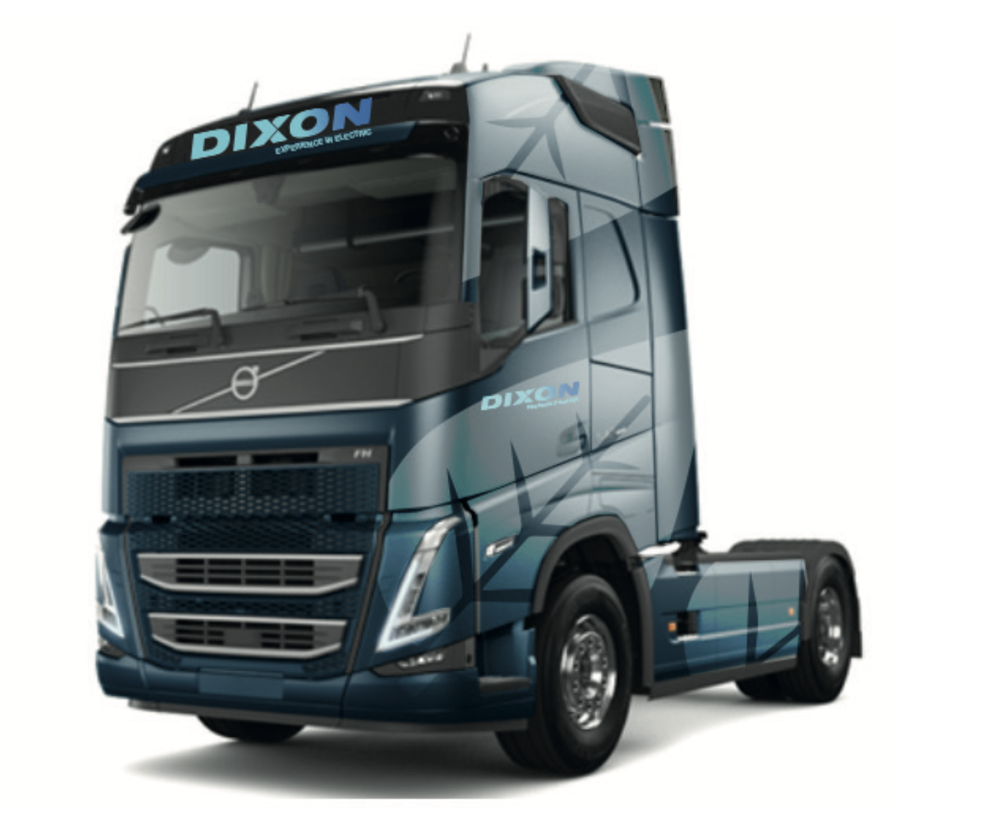
Who we are
INTRODUCTION OF ELECTRIC TRUCKS
For 2023, we are introducing four brand new, fully Electric Volvo trucks to our fleet.
These vehicles will generate zero emissions for the work they are doing and this is the next step in our sustainability journey towards carbon neutrality.

Slide 7
Who we are
THANK YOU FOR LISTENING
ANY QUESTIONS?

