Slide 1

Decarbonisation of UK homes and commercial buildings
May 2023
Liam Mills

Slide 2

What is Decarbonisation and how can we achieve our ambition targets
Reduce co2 and other greenhouse gas emissions that are released into the atmosphere
Transition away from fossil fuels such as gas, coal & oil
Use renewable energy such as Wind Power, Solar Panels and Heat Pumps
Achieve the UKs ambitions on housing stock and commercial buildings
Fabric 1st!

Slide 3

Standards to support the delivery
PAS2035
PAS 2035 is a specification for what is called 'whole-house' or 'whole building' retrofit. This is an approach to the installation of energy efficiency measures (EEMs) which considers the requirement of the entire building, both from a technical standpoint and considering factors like occupancy comfort.
PAS2030
PAS 2030 is a specification for the installation of energy efficiency measures in existing buildings.
PAS2038
PAS 2038 is a set of guidelines for those involved in the retrofit of commercial buildings in England and Wales to follow. It explains the different roles included in the process, as well as the different standards and competencies required.

Slide 4
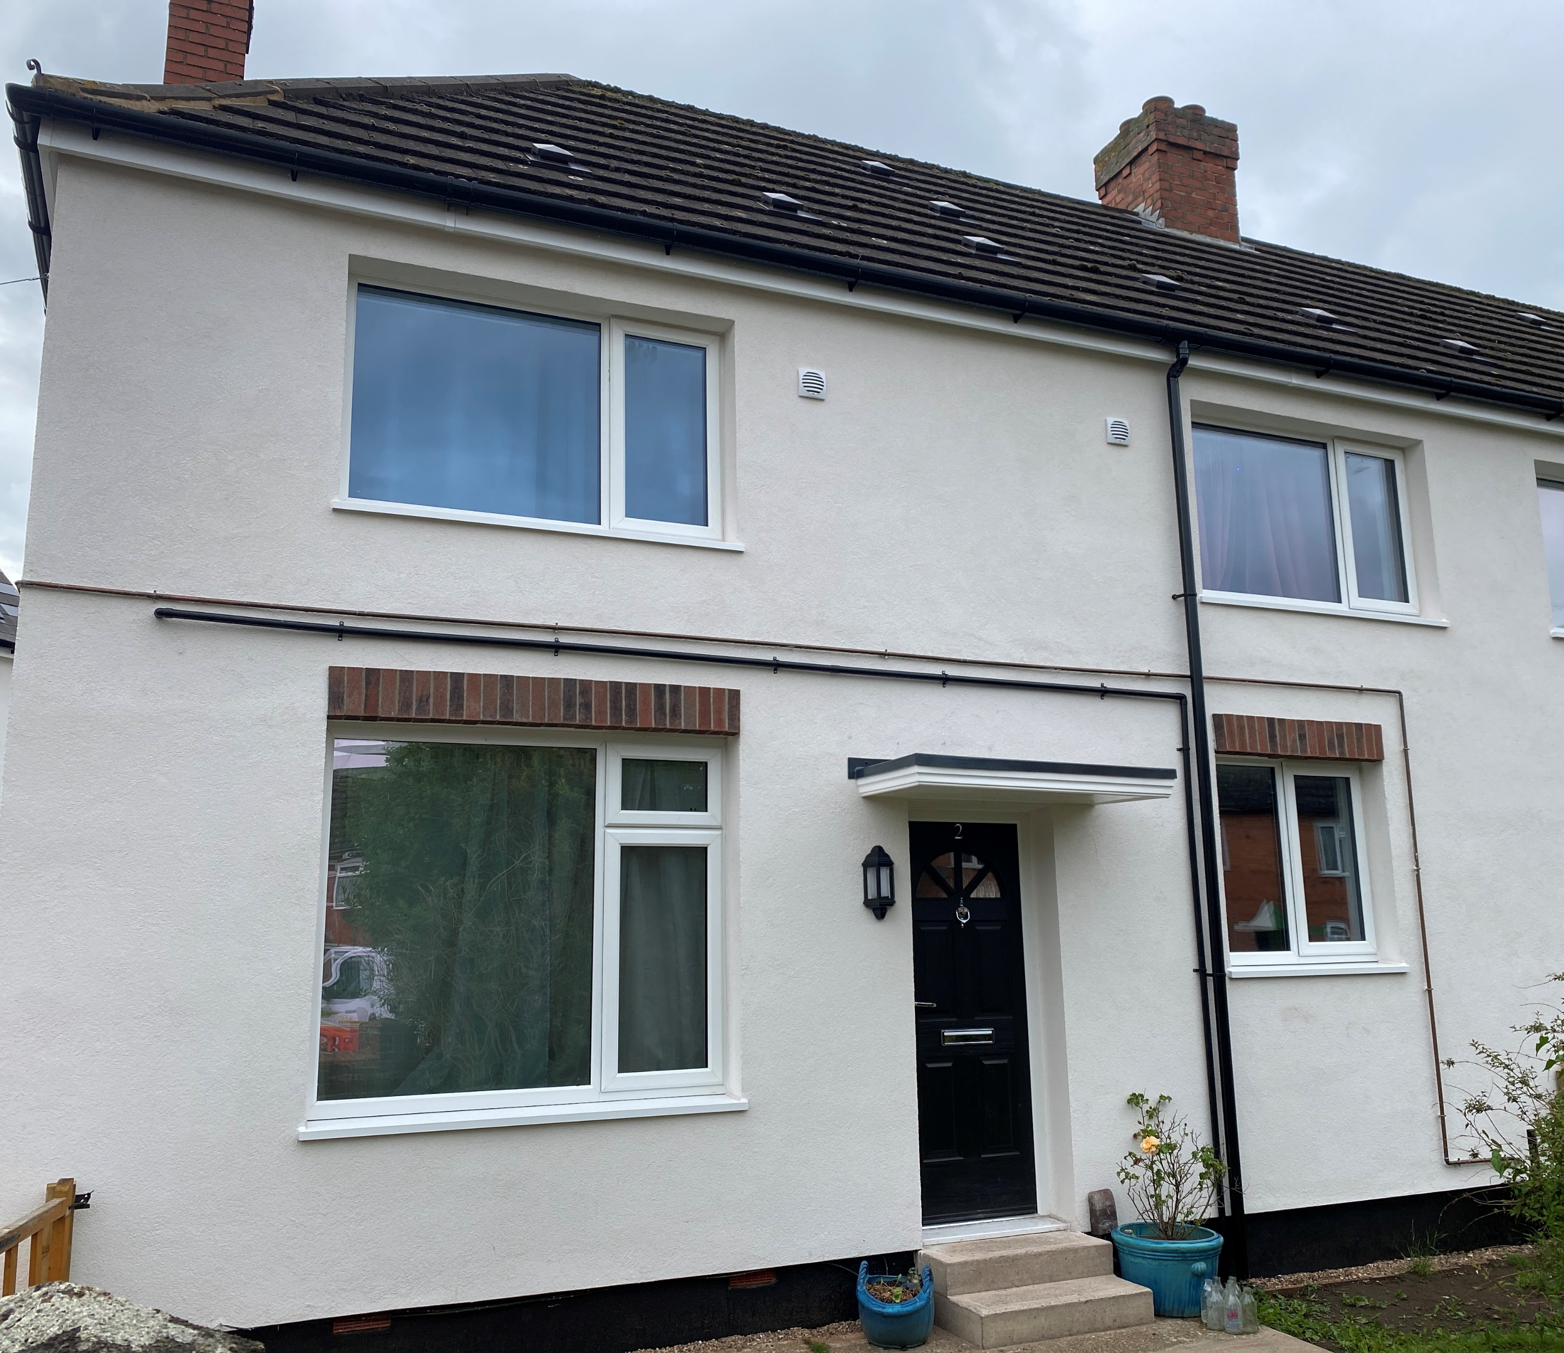
Financial support
Government schemes for social housing – Social Housing Decarbonisation Fund, Energy Company Obligation, Local Authority Delivery and the Home Upgrade Grant
Government incentives for owner occupiers and building owners – Great British Insulation Scheme
Private equity firms – Loans against the energy bill savings?

Slide 5
Minimum Energy Efficiency Standards - MEES
Commercial – Must currently be an ‘E’ rating
A measure, or a package of measures, will fail the 7 year payback test where the expected value of savings on energy bills that the measures are expected to achieve over a period of 7 years, starting with the date the installation is completed, are less than the cost of repaying it.
Domestic – Must currently be an ‘E’ rating and ‘C’ rating by 2030
Never required to spend more than £3500 in energy efficiency improvements
You can count any energy efficiency investment made to your property since 1 October 2017 within the cost cap
if your property can be improved to E for less than the cost cap, that is all you need to spend

Slide 6
What EEC do
We support local authorities in reducing the energy consumer for their tenants within their housing stock
Energy Assessment for domestic properties and commercial buildings
Thermal Performance including testing and design
Help deliver to PAS2035 standard projects when using central government funding
Air Tightness Testing
Retrofit Assessors, Coordinators and Designers

