Slide 1

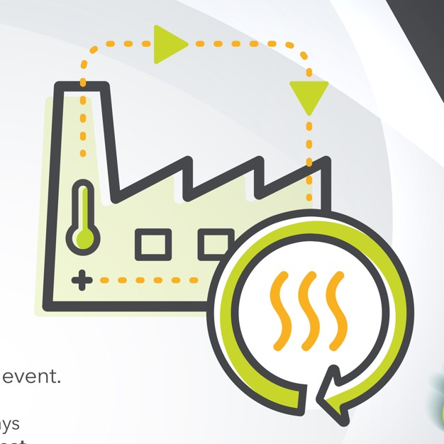



Coventry & Warwickshire
Green Business Programme
WMG’s Net Zero
Innovation Network
WMG, THE UNIVERSITY OF WARWICK
Zoe Mobberley
Marketing Officer

Slide 2

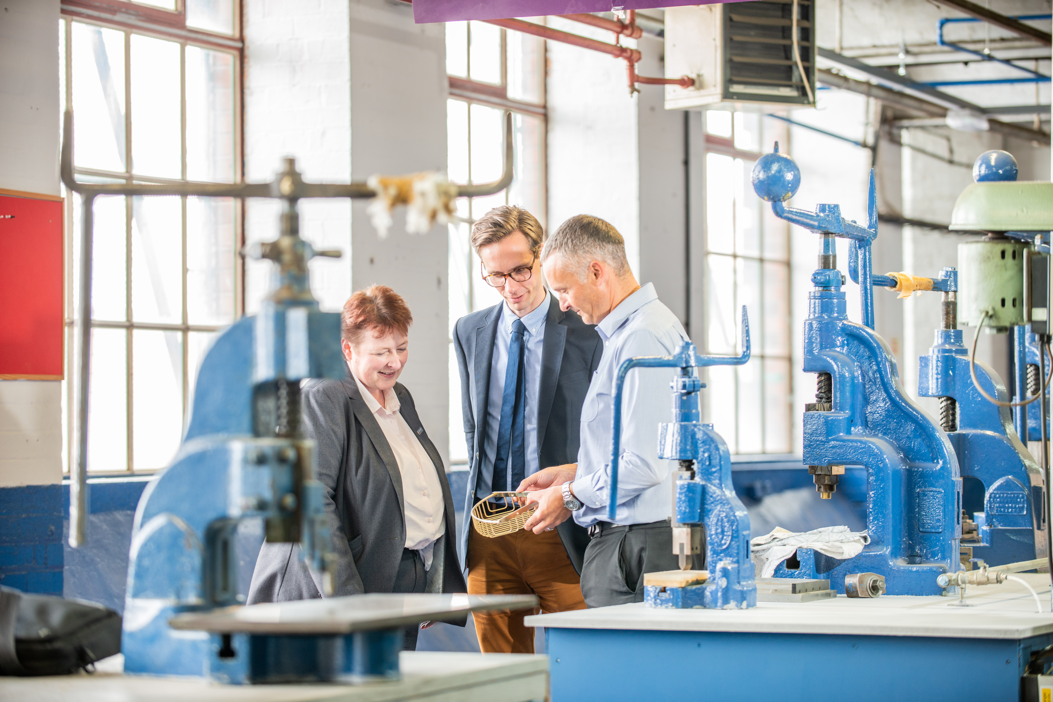

WHO ARE WMG?
Coventry & Warwickshire
Green Business Programme
Established in 1980
University of Warwick department
600+ staff, researchers, engineers, teaching staff
Collaborative R&D with 1,000+ companies
WMG is a founding member of HVM Catapult – set up to help companies de-risk & accelerate innovation for UK plc
Help companies address technology, research and skills challenges

Slide 3
OUR NET ZERO MISSION
Coventry & Warwickshire
Green Business Programme
To support UK manufacturing towards Net Zero through collaboration, process and product management. Sharing best practices that are environmentally, economically and socially sustainable for the duration of our engagement and beyond

Slide 4

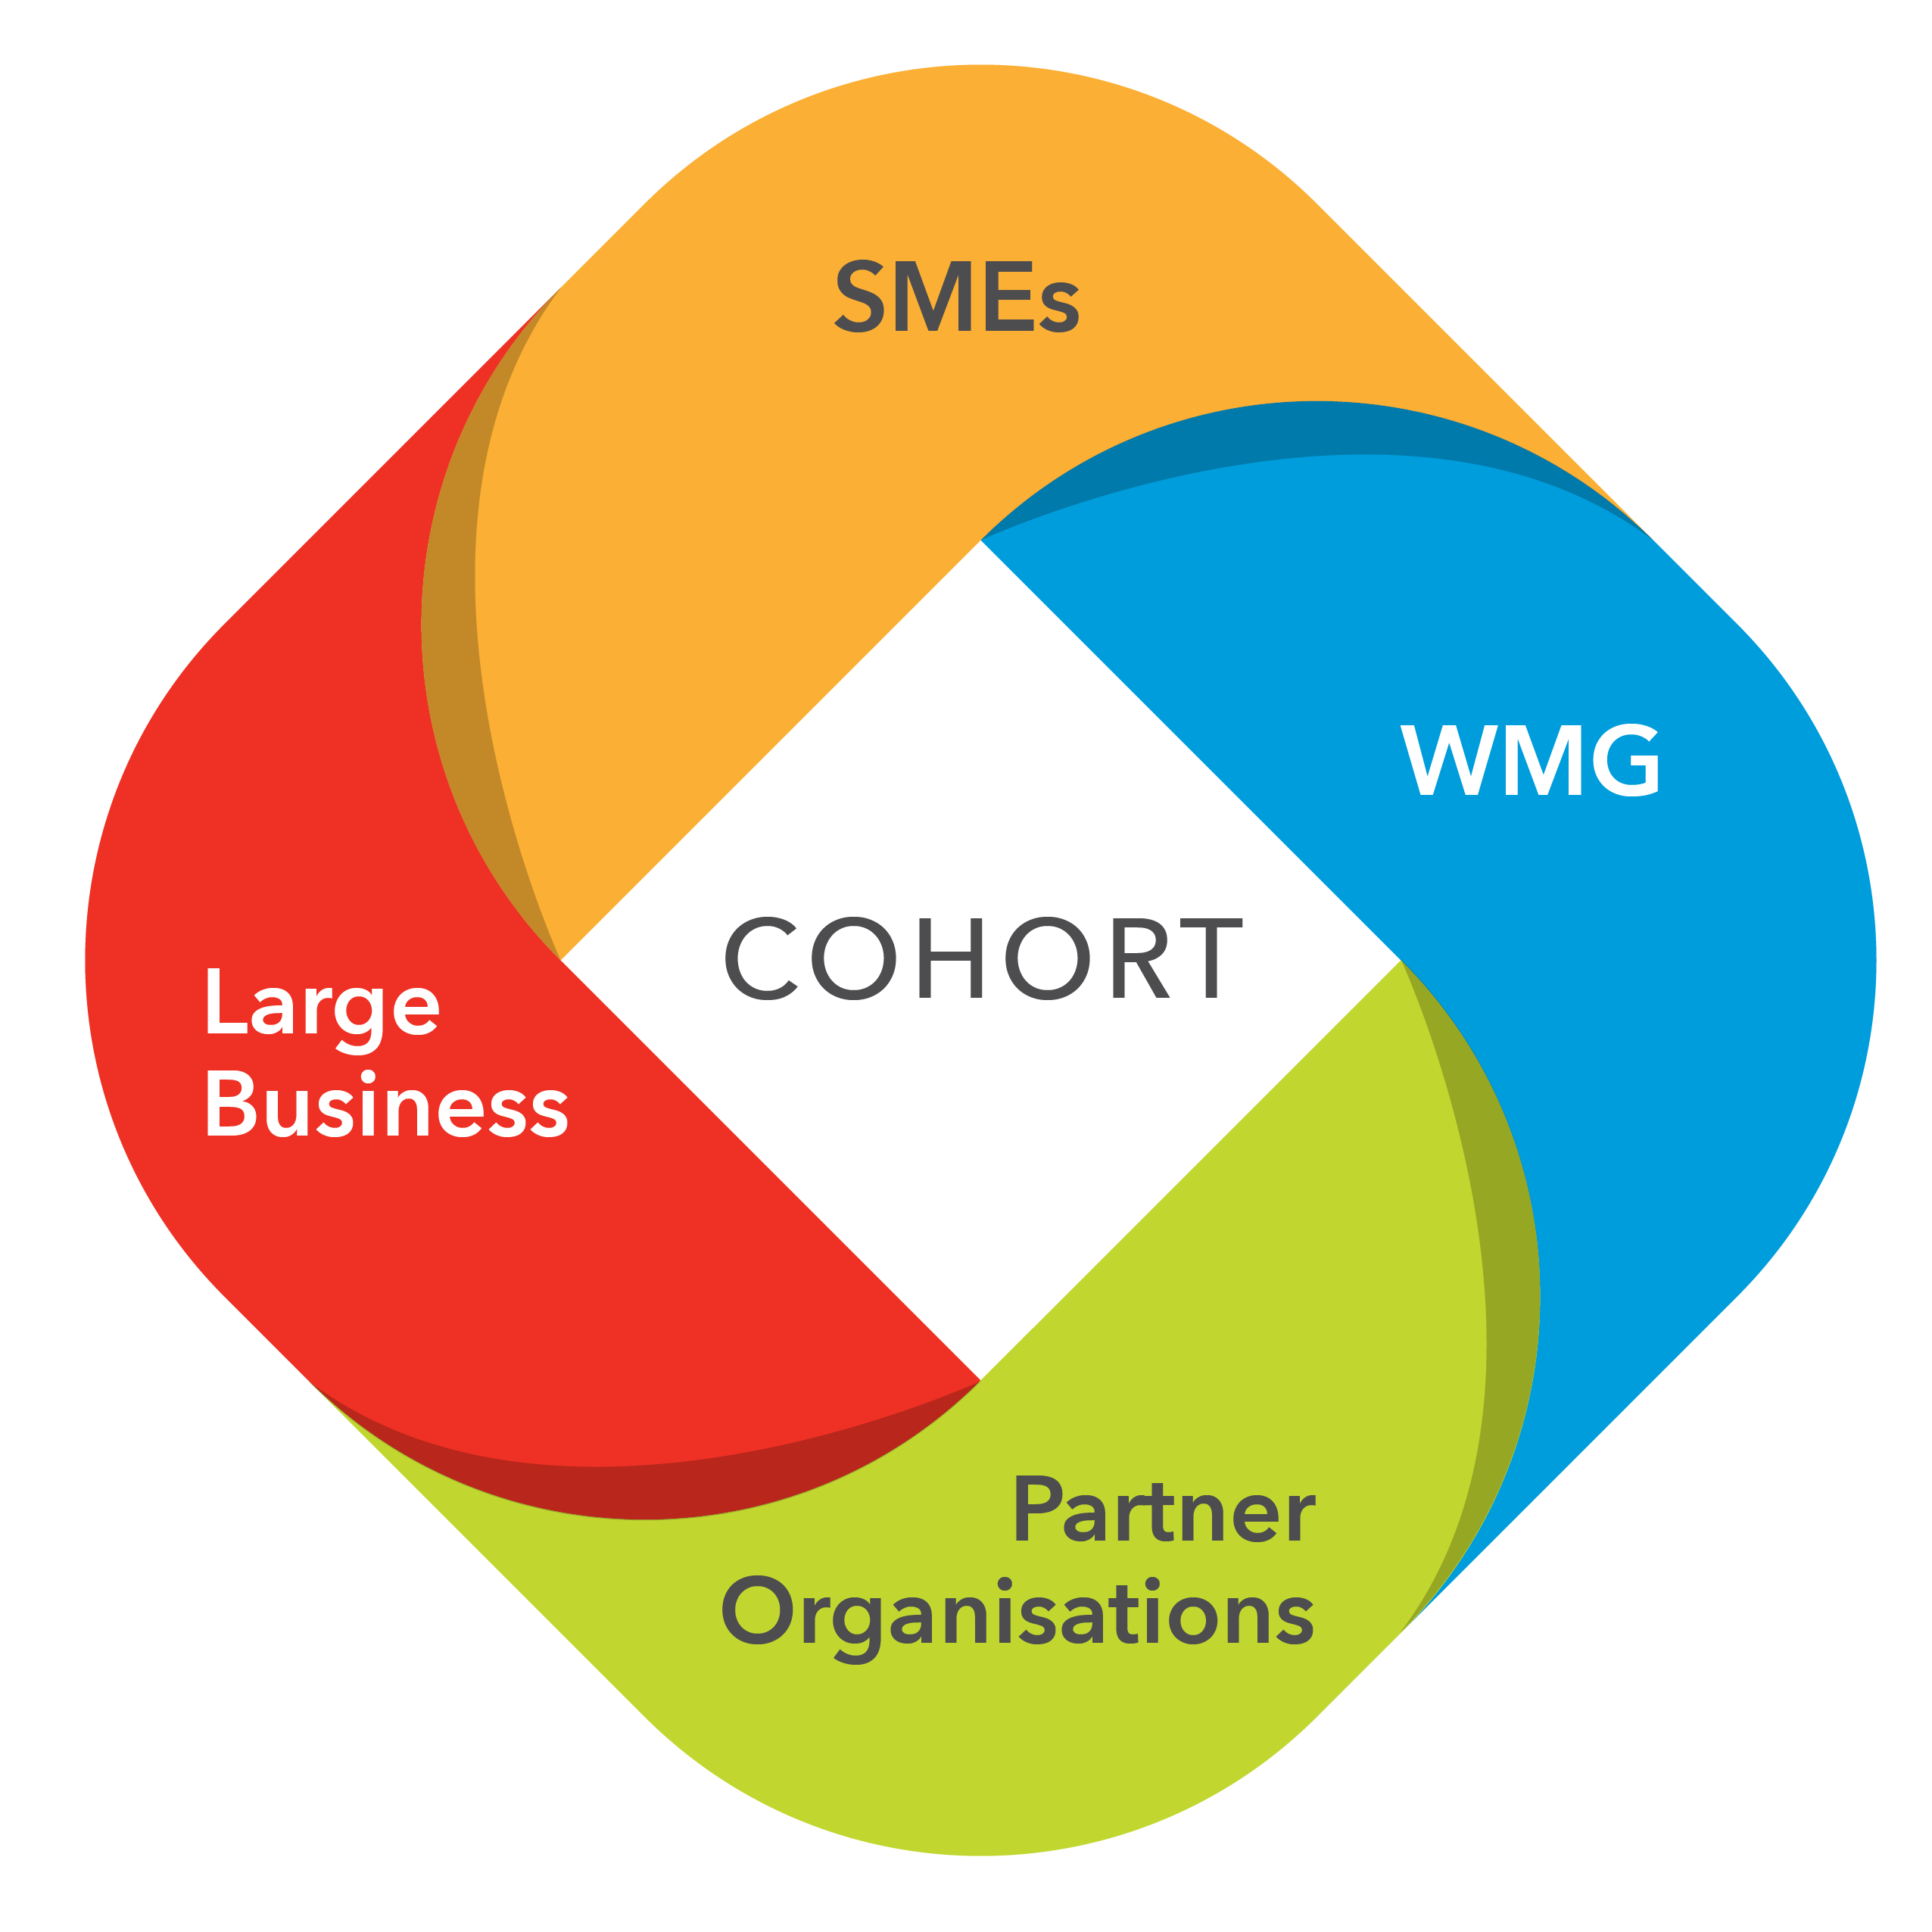






NET ZERO OUTREACH
Coventry & Warwickshire
Green Business Programme
Innovation Projects
Discrete projects focused on sustainable manufacturing
Example projects include:
  Product Carbon Footprint and Life Cycle Assessments
  Waste reduction and Resource Utilisation
  Road mapping to NetZero
  Circular economy and end of life options
  Sustainable materials
COHORTS
Small group of manufacturers
3-6 month programme with multiple engagements
For those ready to introduce sustainable manufacturing practices to their businesses
NZIN EVENTS
Quarterly interactive events
Knowledge transfer
For businesses at every stage of their sustainability journey

Slide 5
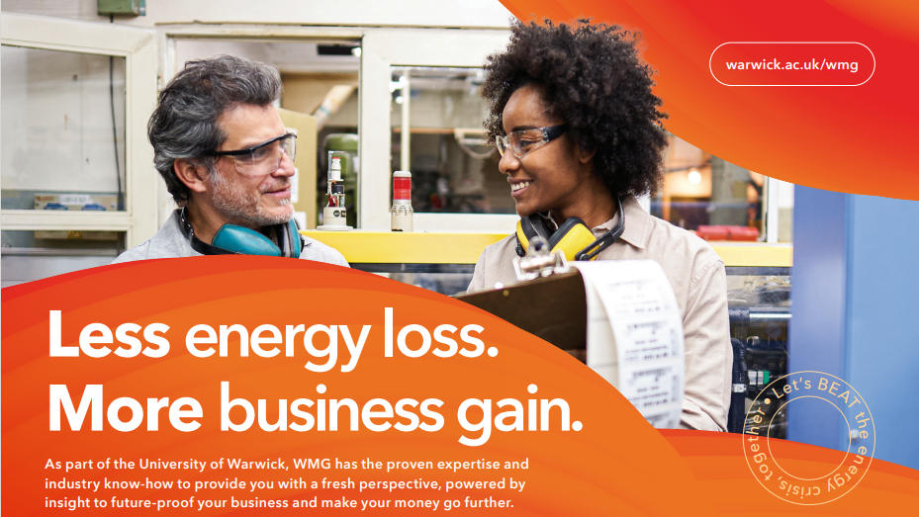
Business Energy Aid Toolkit
Coventry & Warwickshire
Green Business Programme
Are you a UK manufacturer that needs help reducing your consumption and energy bills?
We have created a Business Aid Energy Toolkit (BEAT) to help manufacturing SMEs reduce their energy usage and make significant savings.
The three SME manufacturers who were in the trial achieved energy reductions of up to 90% on individual machines and up to 46% across their production facilities.

Slide 6



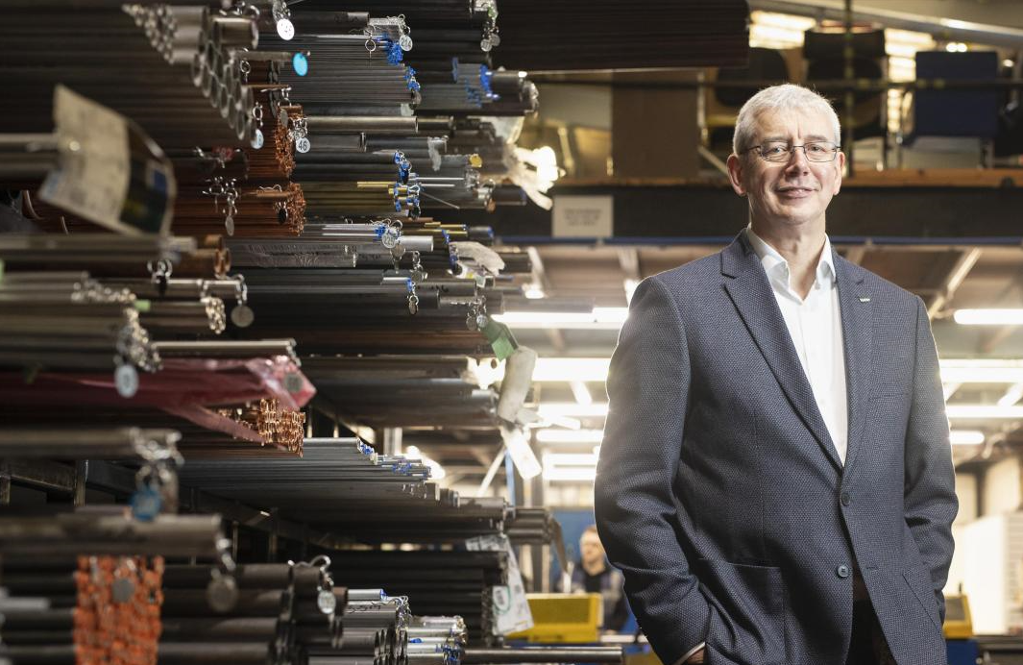
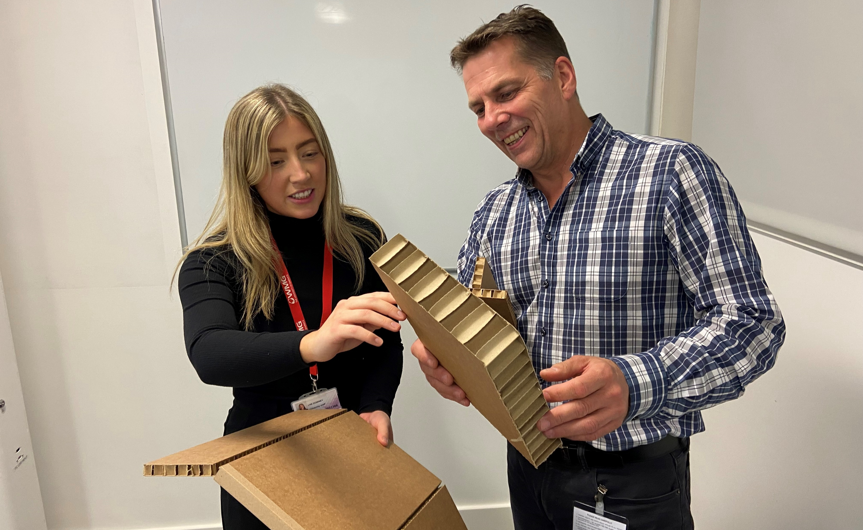
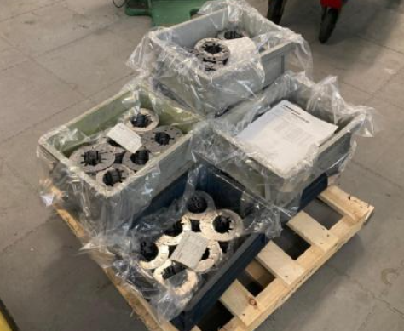
Coventry & Warwickshire
Green Business Programme
NET-ZERO INNOVATION PROJECTS
Brandeur wanted to minimise the environmental impact of their packaging. The calculations revealed that Brandauer’s packaging emissions across the company could be reduced by 61% (equivalent to 9.5 tonnes of CO2) and costs by 15% by using reusable pallets.
Featured in the Times, Lister Tube, Energy Value Stream Map. Short project that saw up to 90% energy savings on individual machines and 46% savings across the production facility
Alternative uses for offcuts project that saw a 60% reduction in total waste and £12,000 per month in additional revenue and two new products to market

Slide 7
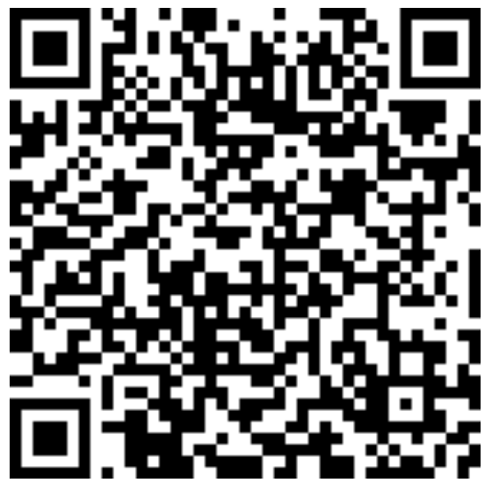




Coventry & Warwickshire
Green Business Programme
How can I find out more?
www.warwick.ac.uk/go/wmgsme
wmgsme@warwick.ac.uk
WMG business
@WMGbusiness

