Slide 1

Coventry Green Business
End of life
Mattress Recycling
and the
Circular Economy
Richard Allsopp Director/Owner

Slide 2
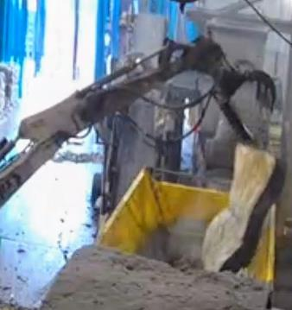
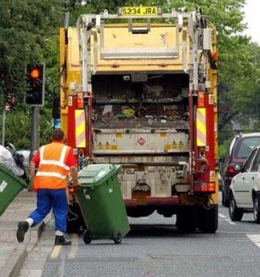
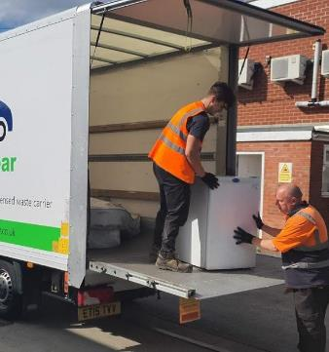
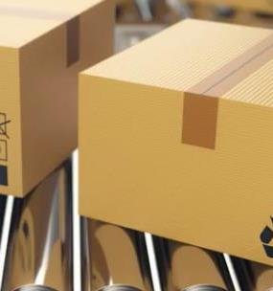
Our Business:
National Services
Services
  Est 2013, Coventry based
  National waste management
  Mattress and bulky waste recycling (2016)
  Legal and Packaging Compliance

Slide 3
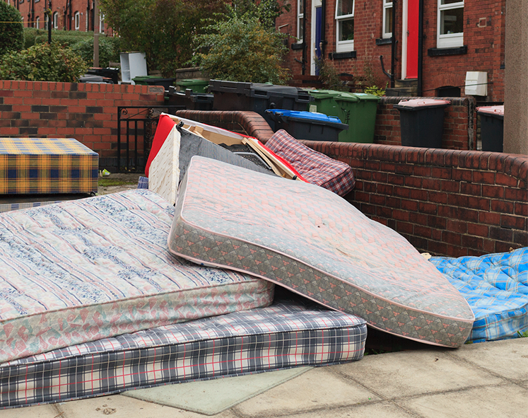
Key Facts:
7 million mattresses sold each year in the UK
3 million+ go to landfill
1.8 million recycled
2 millions reused
Retailers requiring a compliant solution
Similar issues with domestic seating

Slide 4
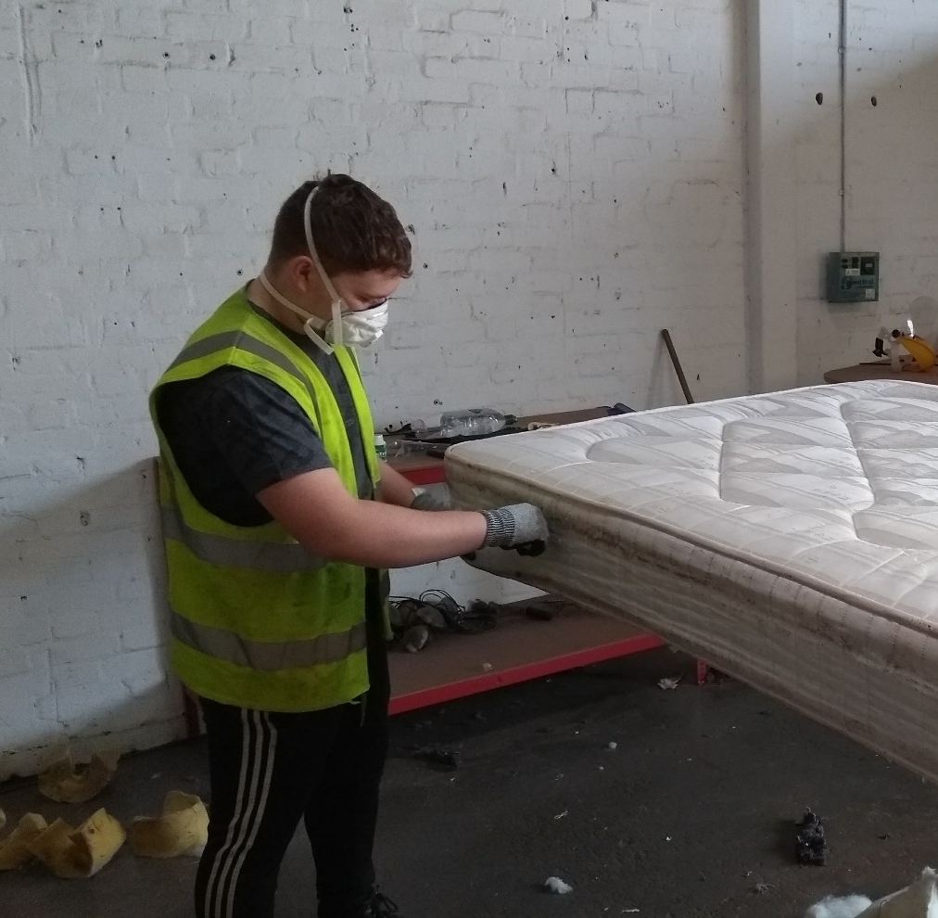
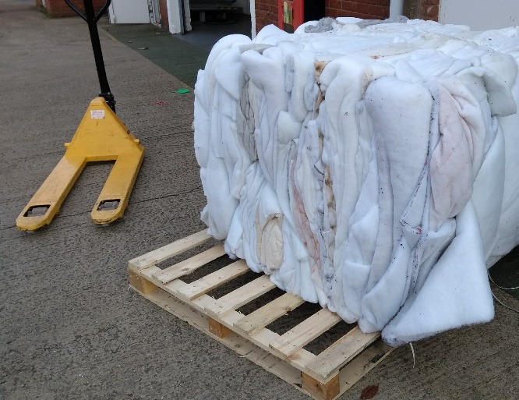
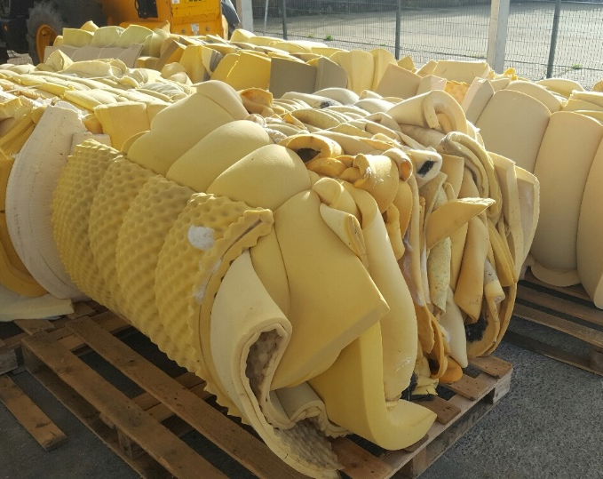
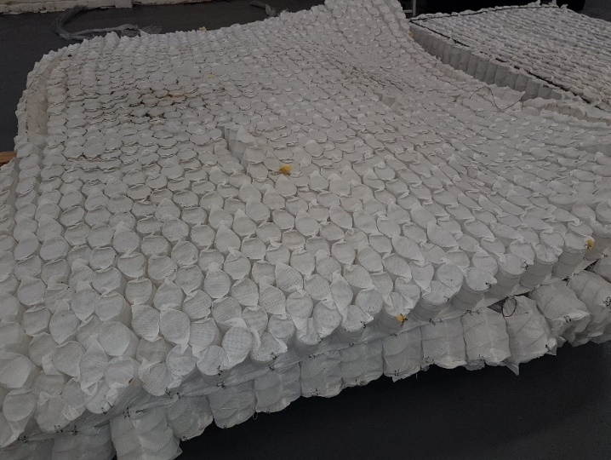
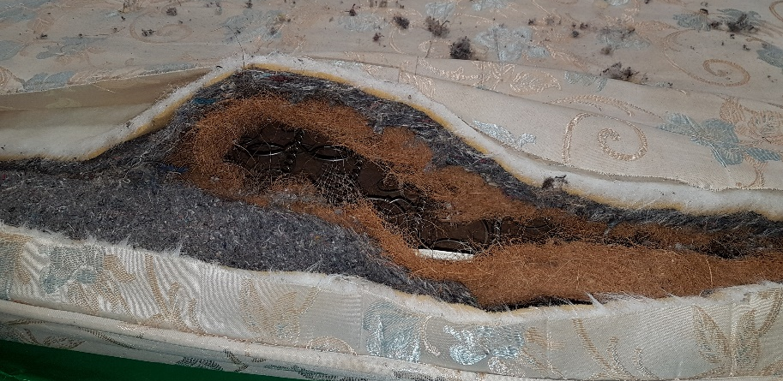
2016 start up:
Early Days of manual processing was tough, but the learning was essential

Slide 5
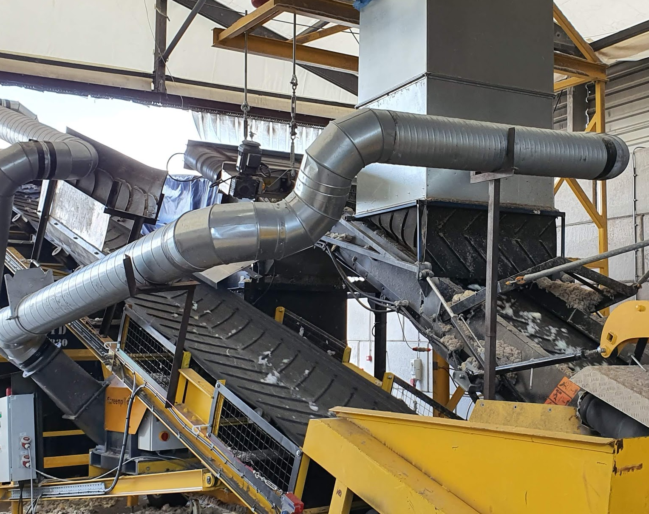
2018: £1.3 Million Investment in an automated facility
Extensive R&D and learning
Fully Permitted facility
Automated processing: 1000+ mattresses per day
£40k grant from Coventry Green Business

Slide 6
