Slide 1
School Food Standards and Catering Tips
for HAF Providers
Hannah Clark
Programme Officer – Food Education Team

Slide 2
Free School Meals
The main qualifying criteria for HAF clubs is eligibility for means tested free school meals
The purpose of free school meals is to provide vulnerable children/young people with a good quality nutritious meal
Some children/young people may only have access to a hot meal at school and may not have access to fresh fruit and vegetables at home
Access to hot nutritious school meals has never been so important, particularly in a post-covid society which is in the cost of living crisis
During holiday periods children/young people may not have access to nutritious food, therefore it is essential that HAF clubs provide the best meals possible
Notes:
See slide
Activity: Baseline knowledge survey

Slide 3
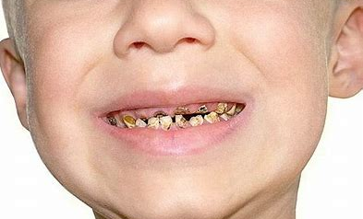

NCMP Data 2020-21
Why compliance matters
Obesity prevalence in Reception up from 9.9% in 19/20 to 14.4% in
20/21
Obesity prevalence in Y6 increased from 21% in 19/20 to 25.5% in
20/21
Dental Decay is the top cause of childhood hospital admission for 5-9 year olds
Every year more than 150 children in Lincolnshire have their teeth removed under general anaesthetic
Eating healthily helps children and young people cope more effectively with stress, manage their emotions and get a good sleep
Overweight and obese children are likely to stay obese into adulthood and more likely to develop non-communicable diseases like type 2 diabetes and cardiovascular diseases at a younger age
It is often difficult for overweight children to participate in physical activities as they tend to be slower than their peers and contend with shortness of breath
The number of children and young people being treated for Type 2 diabetes, has gone up by nearly 50% in five years. The first cases of Type 2 diabetes in children were only diagnosed around 25 years ago.

Slide 4

HAF food provision
It is a DfE requirement that all food and drinks provided during the HAF programme are compliant with the school food standards – this is stated within the HAF T&Cs
School Food Standards expect that the majority of meals are hot and that all menus comply with the standards
Please ensure all information provided is shared with staff running the clubs
https://www.gov.uk/government/publications/school-food-standards-resources-for-schools

Slide 5
Background – School Food Standards
Mandatory School Food Standards set in legislation since 2015 to ensure food in school is nutritious and high quality
Promote good nutritional health, protect nutritionally vulnerable and promote positive eating behaviour
Provide schools, caterers and HAF club providers with framework to build creative and nutritionally balanced menus
Ensure children benefit from the correct balance of energy, vitamins and nutrients across the week
Promote positive food choices and provide wider range of foods
Restrict items high in fat, sugar and salt

Slide 6
HAF food provision
The standards apply to all food served during the HAF programme (until 6.00 p.m) including breakfast, snacks, lunch and tea
Embed healthy eating and nutritional education into your HAF planning and delivery as stated in the DfE guidance
Don’t offer any type of food or sweets as incentives, treats or rewards (e.g. fast food, ice lollies, sweets, chocolate, soft drinks)
Model positive food and drink choices consistently and talk about food and its nutritional benefits

Slide 7

Excess sugar soon adds up…
Added sugar maximum recommended daily allowance:
KS1 child = 5 tsp/20g
KS2 child = 6 tsp/24g
11+ and adults = 7 tsp/28g
Glass of fruit juice (150ml) = 3.75 tsp/15g
Fruit yoghurt = 4.5tsp/18g
30g portion cereal (a typical serving is more like 60g) = 1.3 tsp/5.3g
Fruit flavoured snack e.g. fruit flakes = 2.5 tsp/10g
Jam sandwich = 3.5tsp/14g
Apple juice carton = 5 tsp/20.2g
Chocolate biscuit bar = 2 tsp/8.2g
Total = 22.5 tsp/90.7g
4 times a child’s RDA (just during a typical day!)
As educators we have a moral responsibility to model and help children and young people to make positive food choices

Slide 8
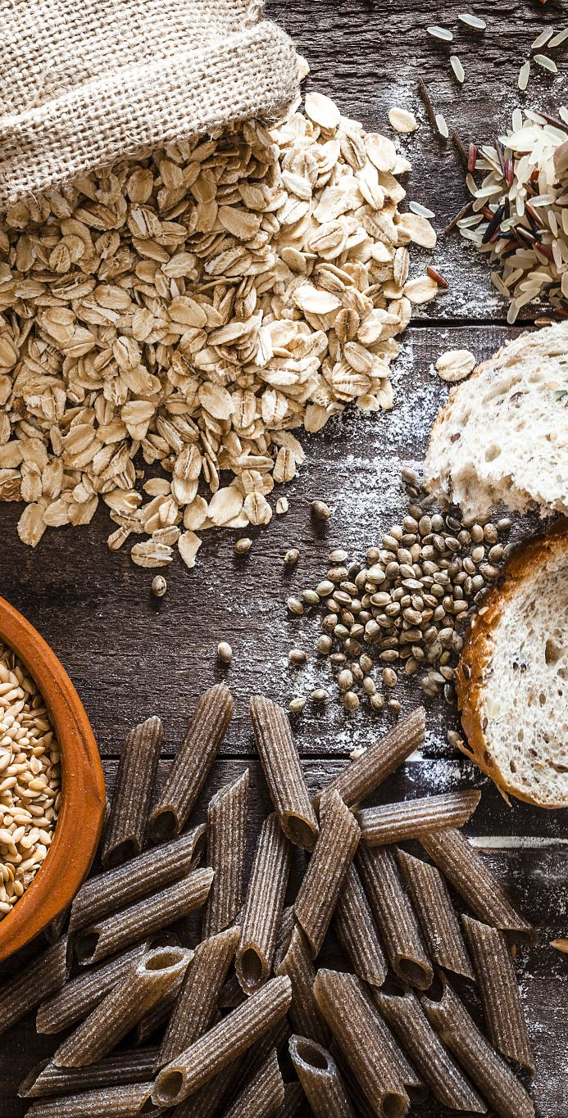
Starchy Foods
One or more portions every day
Three or more types of starchy foods each week
One or more wholegrain varieties each week
Additional bread (1/2 slice) should be available for after the main meal
Important source of energy and B vitamins
Help children feel full and less likely to snack on foods high in fat sugar or salt

Slide 9
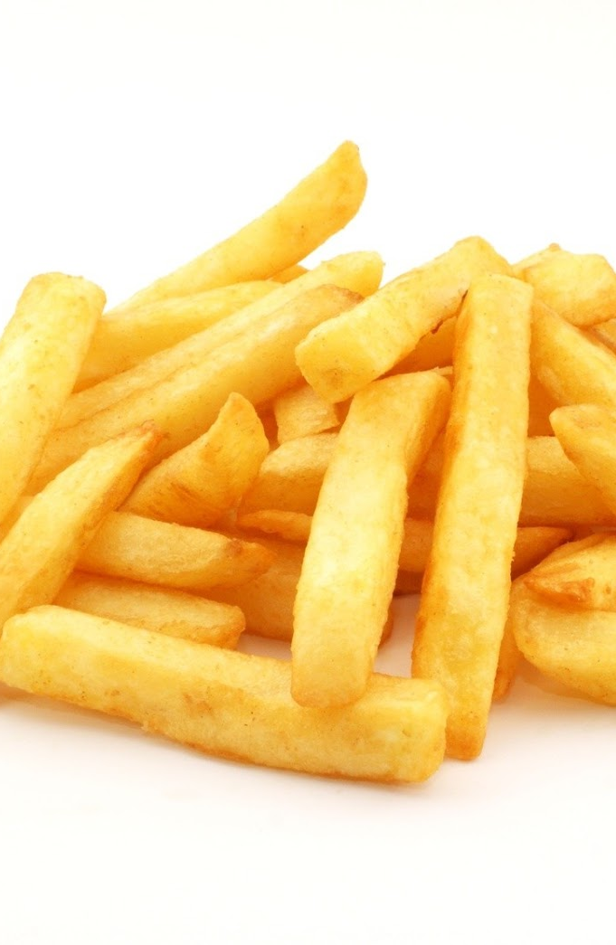
Starchy foods cooked in oil
Only permitted two days per week
Roast or sauteed potatoes
Chips
Wedges
Pre-prepared potato products
Fried rice
Fried bread
Noodles
Hash browns
Garlic bread
Naan bread
Chapattis
Ciabatta
Herb bread
Pancakes
Waffles
Doughnuts
This Photo by Unknown Author is licensed under CC BY-NC-ND

Slide 10
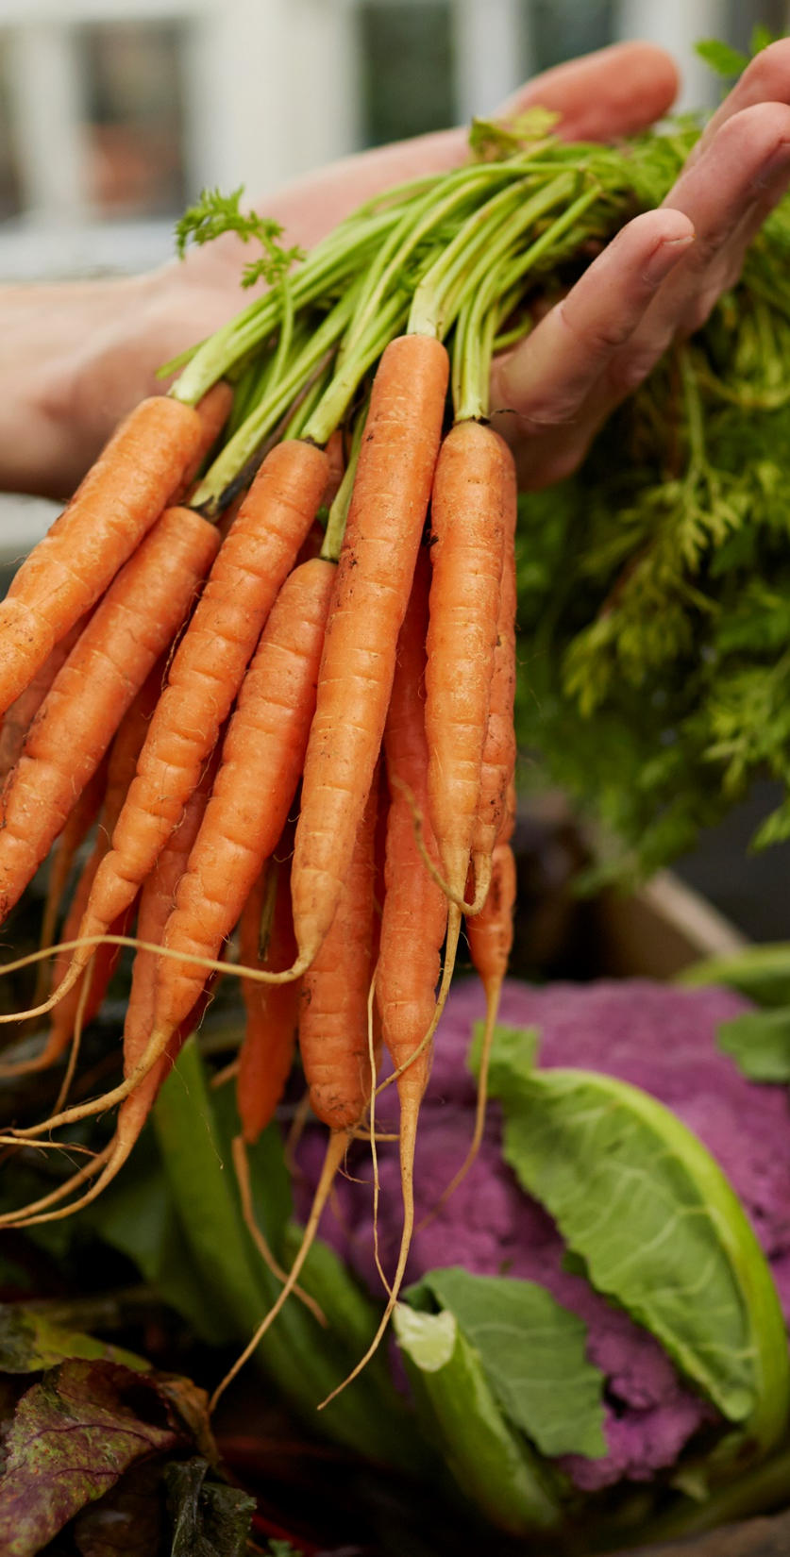
Fruit and Vegetables
One or more portions of fruit and veg/salad every day. Vegetables must be an accompaniment as well as any vegetables in the main dish.
A dessert containing minimum 50% fruit two or more times a week – this means the fruit must weigh the same as the total weight of the other ingredients. Decorative fruit or jam does not count
At least three different fruits and three different vegetables each week
Embeds healthy eating habits for life, reducing risk of heart disease, stroke and some cancers
Fruit and veg good source of essential vitamins and minerals and often good source of fibre

Slide 11
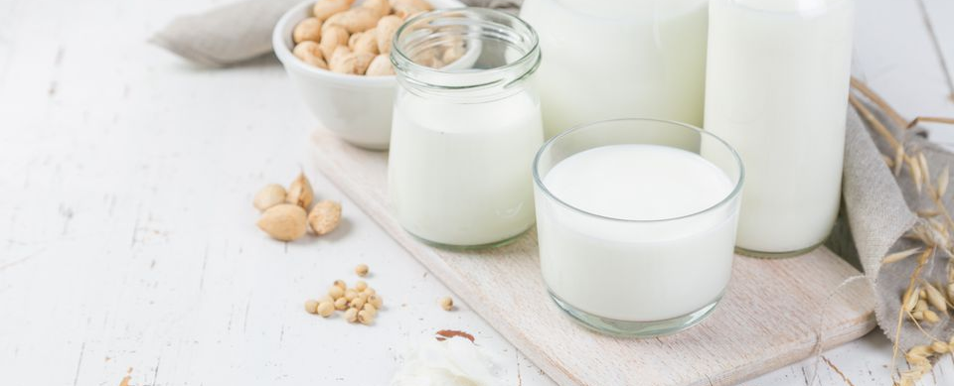
Milk and Dairy
Include a portion of dairy every day – low sugar yoghurt or ice cream, cheese, milk, custard or cream can be used.
A good source of energy, protein, calcium, vitamin A and riboflavin
This Photo by Unknown Author is licensed under CC BY

Slide 12
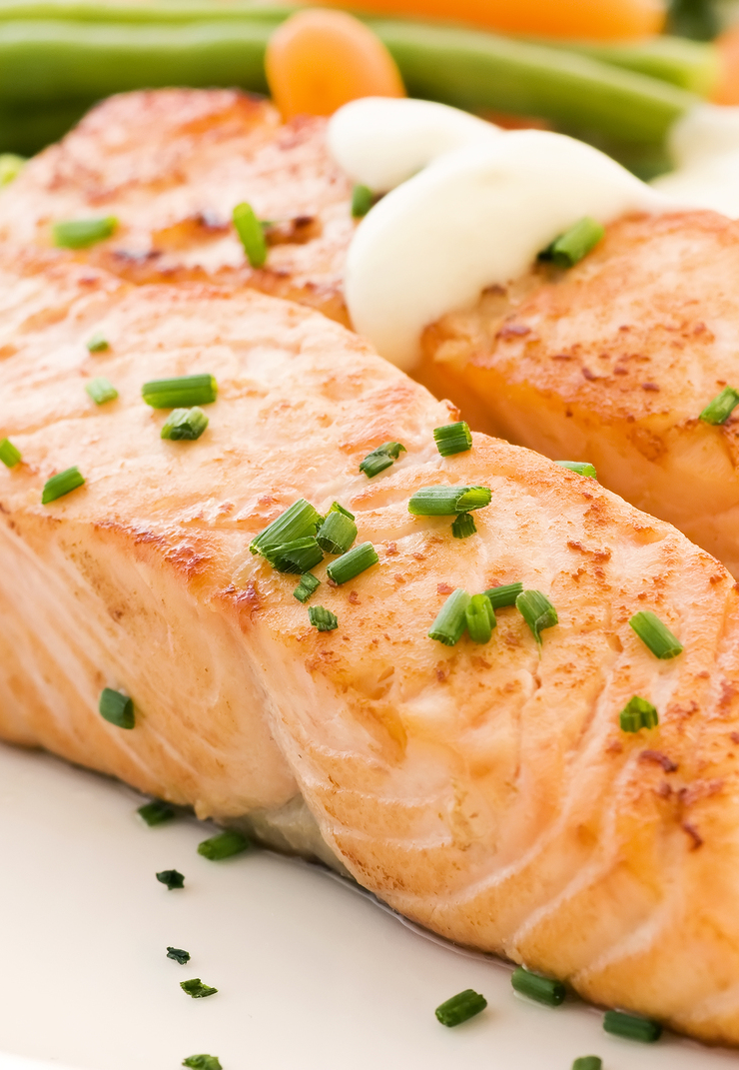
Meat, fish, eggs, beans and other sources of non-dairy protein (cheese not included in this standard)
A portion of food from this group every day
A portion of meat or poultry on three or more days a week
Oily fish once or more every three weeks
For vegetarians, a portion of non-dairy protein three or more days a week
A processed meat or poultry product (manufactured or home made) no more than once a week in primaries or twice a week in secondaries. Includes burgers, meat balls, sausages, goujons, coated chicken, pasties.
Provides protein and essential minerals including zinc and iron
This Photo by Unknown Author is licensed under CC BY-SA

Slide 13
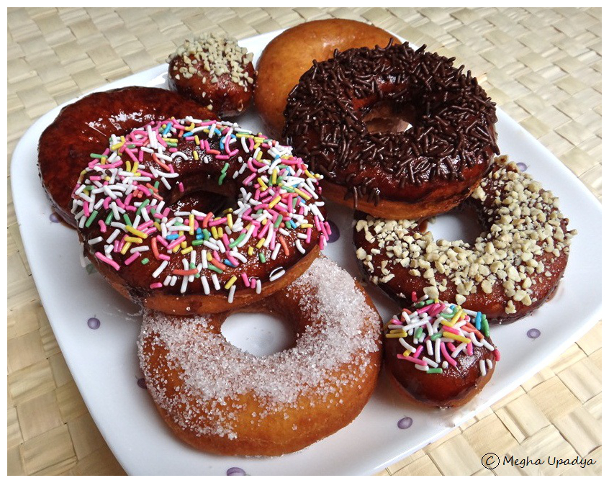
Foods high in fat, sugar and salt
No more than two portions (combined) a week of deep fried, battered or breaded food – usually fish, nuggets, chips, hash browns are the main items found
No more than two portions of pastry each week – includes sausage rolls, pies, croissants, breakfast pastries, quiches and dessert pies
No snacks except vegetables of fruit with no added sugar, salt or fat (nuts and seeds can be provided but most schools are nut-free) – no nachos, crisps, popcorn etc
Crackers many be served at lunch but must be with dairy food or fruit and veg
No confectionery (sweets, marshmallows, cereal bars, sprinkles) or products containing or coated in chocolate
Desserts, cakes and biscuits are allowed ONLY at lunchtime. The Government guidelines for children age 7-10 is a MAX of 24g added sugar a day. Allowing for breakfast & evening eating we recommend sugar be limited to 8g or less per dessert portion per child. In Lincolnshire recipes and product specifications are checked for this.
Salt must not be added
Limit condiments to 10g (this includes ketchup and jam etc) per child
Foods in this group high in energy but provide few other nutrients
Reducing intake can help reduce risk of heart disease
Too much salt can encourage a taste for salty foods which may lead to high blood pressure in later life
This Photo by Unknown Author is licensed under CC BY-NC-ND

Slide 14

Healthier drinks
Offer free fresh drinking water at all times
Recommend that only milk and water are offered
The more water is offered, the more readily children will accept it
Do not provide sugary or sweetened drinks as they offer little nutritional value, contribute to weight gain and tooth decay
Do not provide drinks containing additives, preservatives, flavourings, colourings and sweeteners
This Photo by Unknown Author is licensed under CC BY

Slide 15
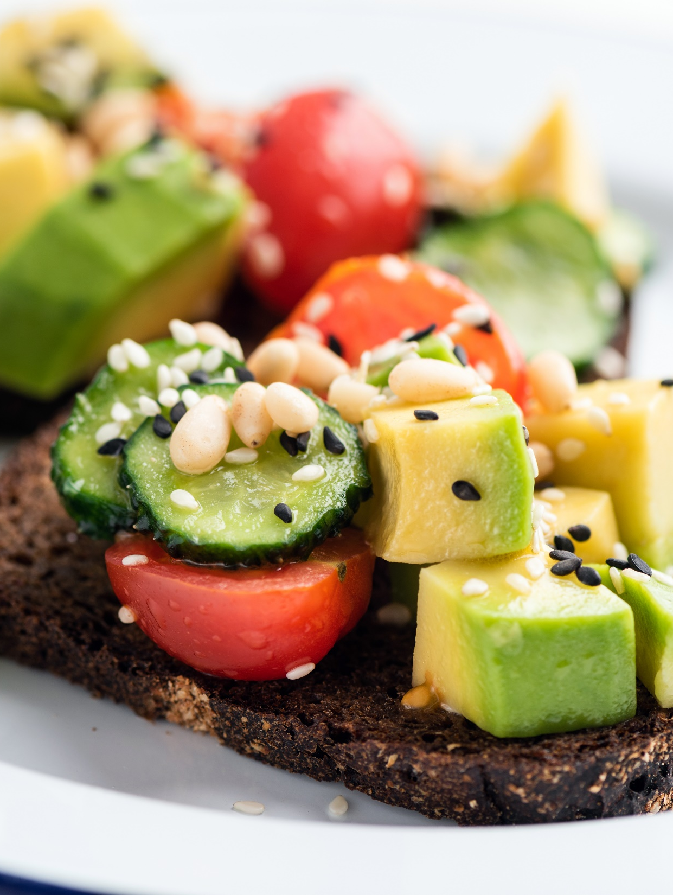
Food other than lunch
Restrictions apply to all other food served up to 6.00pm
Other food must be checked in conjunction with lunch menus as some items are restricted

Slide 16
One off days & trips
School Food Standards guidance states ‘hot food wherever possible’ however we know hot food is not always possible (e.g. trips)
For days when a cold meal is the only option use the following steps:
Pick a starch (wholegrain is best, try to vary from bread if possible – couscous, rice, pasta etc)
Add a protein (cold meats work well as do eggs, bean salads, tuna etc)
Always have a side of veg – salad sticks & baby tomatoes are often used.
Include dairy – cheese sticks or yoghurt are most portable
Take a low sugar dessert – reduced sugar flapjack and a piece of fruit is ideal
Provide water
Make sure you can store it correctly to keep food cold

Slide 17
What to avoid on one off days & trips
As you will want to provide the highest quality and best nutritional profile for these days, we recommend that you stay away from the restricted items
  Manufactured meat products
  Starchy foods cooked with or in oil
  Pastry items
  Deep fried, breaded & battered items
  Instead, where possible, choose whole foods, good quality meat, fresh vegetables/salad, at least one fruit, slow release energy starches.

Slide 18
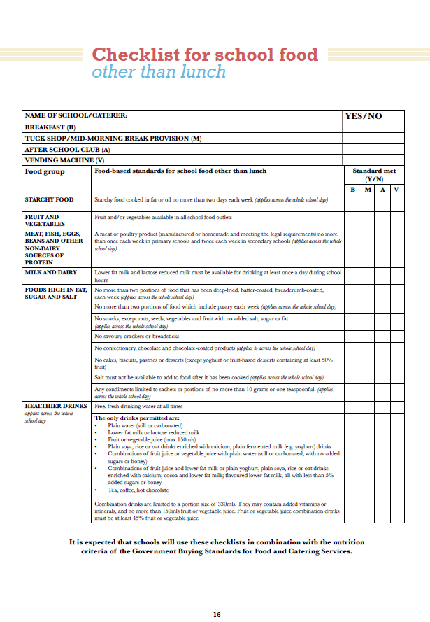
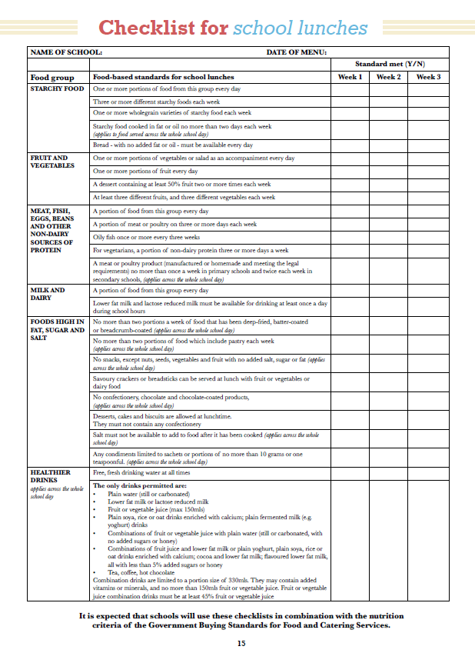

Slide 19
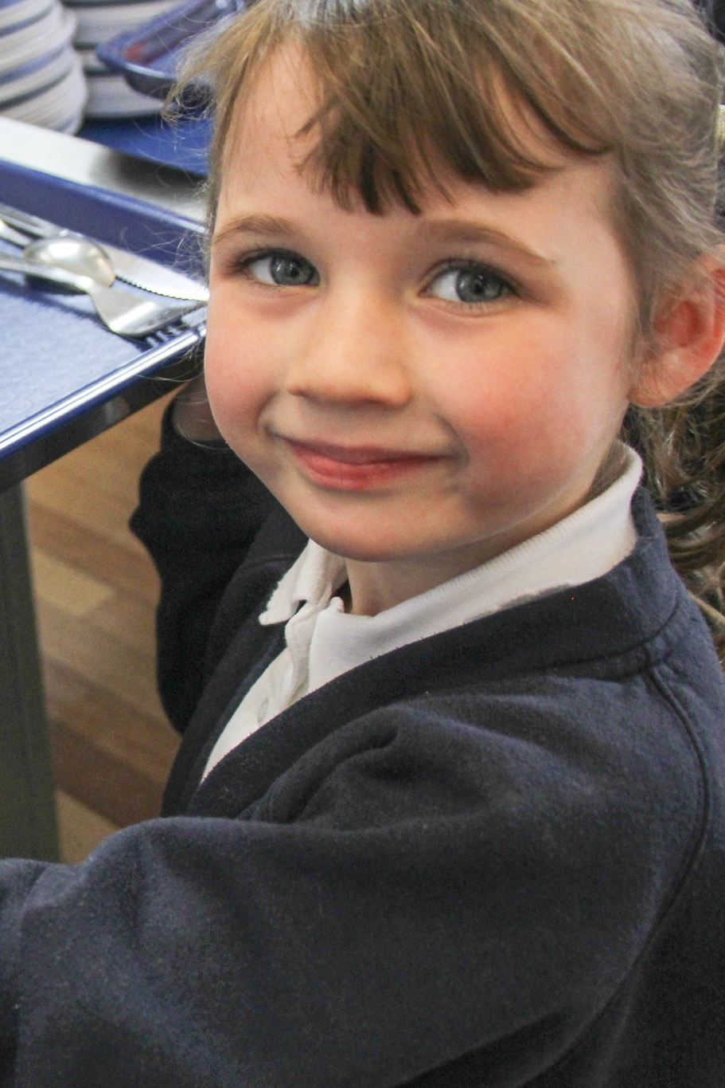
Encouraging children/young people to eat
Fear of trying new foods (neophobia) is a common occurrence
Know what is on the menu and be enthusiastic about it, eat with the children and talk about new foods
All foods should be put on the plate (unless the child has an allergy)
Serve new foods with familiar foods, but don’t hide them in it
Talk about new foods with the children and encourage them to try new foods
Persevere and be patient - it can take up to 15 attempts before a child gets used to the taste of a new food and decides whether they like it or not and their tastes often change
When serving a new food don’t remind the child they have refused it previously
Don’t coax or force a child to eat and if the food is still refused take it away without comment
Praise and reward children for trying new foods

Slide 20
Dining environment
Ensure meals are served in appropriate environment and staff/children/young people sit at tables to eat
Allow children opportunities to be independent
Ensure club staff sit and eat hot meals with children/young people and model social skills, cutlery skills, manners, talk about food, nutrition and positive food choices, encourage to try new foods
Promote happy positive meal times and be mindful that as well as being relaxed and sociable, they are a learning opportunity – not all children/young people have this experience at home

Slide 21
Food Presentation
Ensure servery is clean, tidy and well managed
Ensure staff are wearing aprons or tabards at all times during food service
Model positive food choices and put all food on the plate
Present the food carefully on the plate so that it looks appetising

Slide 22
Food Safety
Ensure all staff handling or serving food have a minimum of Level 2 Food Safety Training
Adhere to strict hygiene protocol and ensure high standard of personal hygiene (hand washing, hair tied up, minimal jewellery, aprons/tabards to avoid cross contamination risk)
Keep serving area clean, tidy, clear of obstructions and wipe up any spillages
Use utensils to serve food!
All staff to model good hygiene to children/young people and brief children on this before participating in cooking sessions

Slide 23
Allergens
An open discussion with Julian Edwards from Allergen Accreditation for all involved in food organising, preparation and delivery of the HAF programme:
Bitesize Session - Natasha's Law and Food Allergens – YouTube
Other links and resources:
Technical guidance, templates and the Food Standards Agency’s (FSA) free online allergen training (Please note this was updated in June 2020, so if you’ve done it before, do it again- it also includes sections on Natasha’s Law.)
https://www.food.gov.uk/business-guidance/allergen-guidance-for-food-businesses
For allergen spec sheets and knowledge on anaphylaxis:
https://www.anaphylaxis.org.uk/.

Slide 24
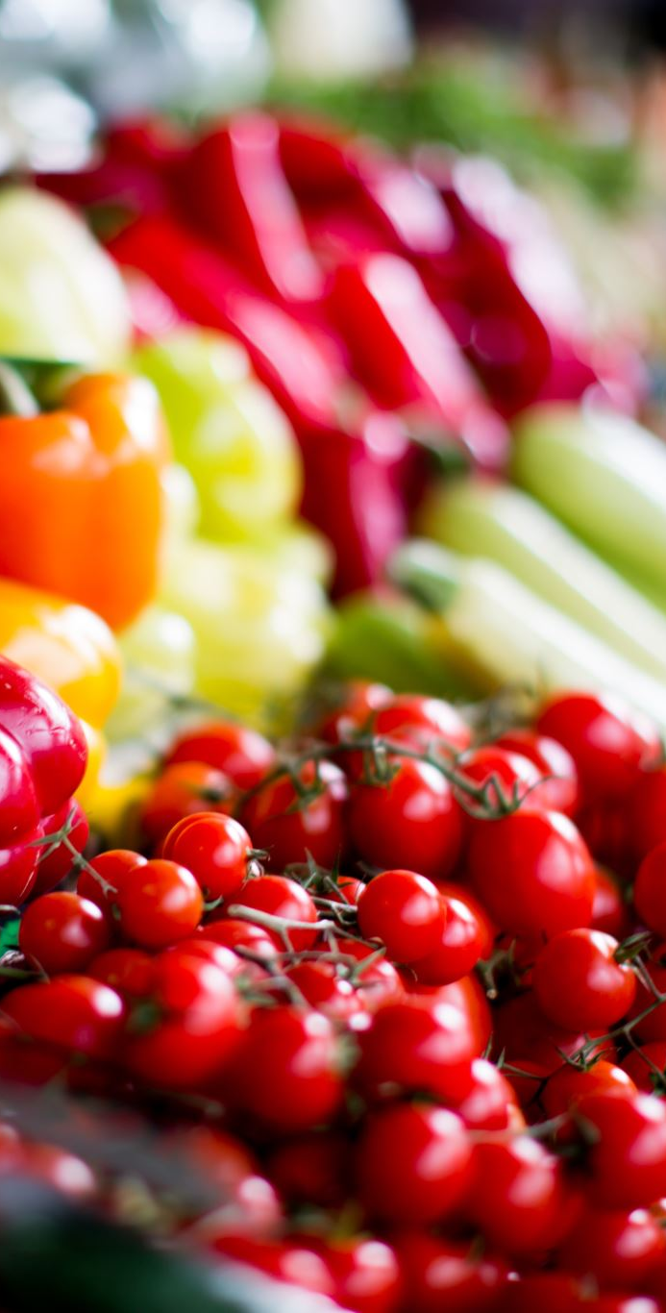
Food Education Team
Our current services include:
Free telephone and e-mail support on all aspects of food education and provision
Staff and governor training (including lunchtime staff)
Catering recruitment support
Marketing support, parents evening etc
Lunchtime and dining reviews
Menu setting support
School Food Standards checks and certification
Support setting up in house catering
Bespoke support
foodeducation@lincolnshire.gov.uk

Slide 25

Any questions?

