Slide 1
Decarbonization Net Zero Energy Management Audits Steve stones, Energy Consultant Pro enviro 15 November 2023
Pro Enviro Limited
Steve Stones Pro Enviro Ltd

Slide 2
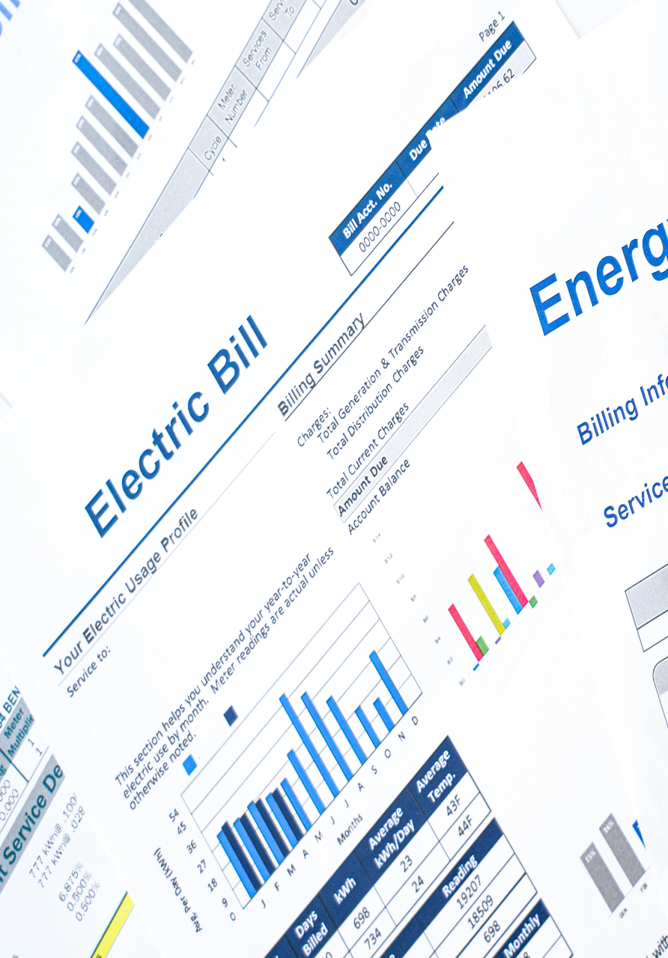
Why Have an Audit
Everyone knows that energy prices have increased and none of us know where they will even out or what the new norm will be.
Reducing consumption reduces operating costs and carbon emissions, both of which are important.
How do we reduce consumption if we do not measure and monitor what we are currently doing.
The Audit provides an opportunity to start the process of understanding what improvements might be possible.

Slide 3
Energy Audit
The objective of the audit is to try and identify cost effective ways that an organisation can make both environmental and economic improvements by reducing energy consumption.

Slide 4
Decarbonisation Barriers
Many organisations believe they do not have the skills or the time available in house to deal with decarbonisation issues.
All organisations can make improvements, the scale of the improvements will depend where the business is starting from.
This project, and the support and grants it offers, can help organisations overcome the barriers and make a start on implementing improvement plans.

Slide 5
Case Study
Ceramics manufacturer
Had two 22kW compressors – 15 years old
Logger installed to map consumption
Approximate consumption 70,000 kWh pa.
Approximate cost £21,000 pa
Variable speed compressor installed
Savings estimated at 43,000 kWh pa
Saving achieved by matching air supply to demand with reduced waste.
Savings valued at £12,900.
Compressor cost £17,000, resulting a payback period of 1.3 years prior to any possible grant application

Slide 6
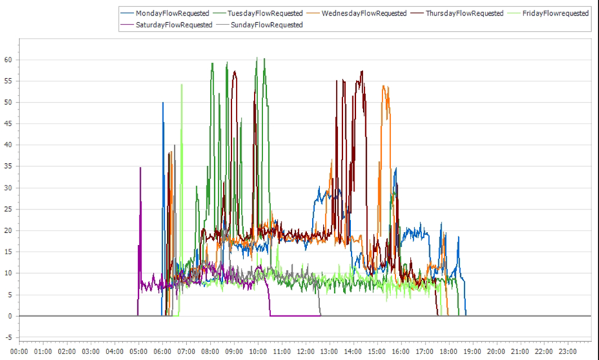
Case Study

Slide 7
Conclusion
It is essential that businesses consistently monitor and measure their energy usage. The more energy data you have, the more detailed your energy profile will be.
Acting now to reduce your energy consumption could lead to significant results both financially and environmentally, helping your company survive the energy price increases that everyone is experiencing.
Improve opportunities for new business due to the ability to demonstrate improvements to your customers as they look to improve the performance of their supply chains.

Slide 8
Questions steve.stones@proenviro.co.uk www.proenviro.co.uk
Pro Enviro Limited
Steve Stones Pro Enviro Ltd

