Slide 1
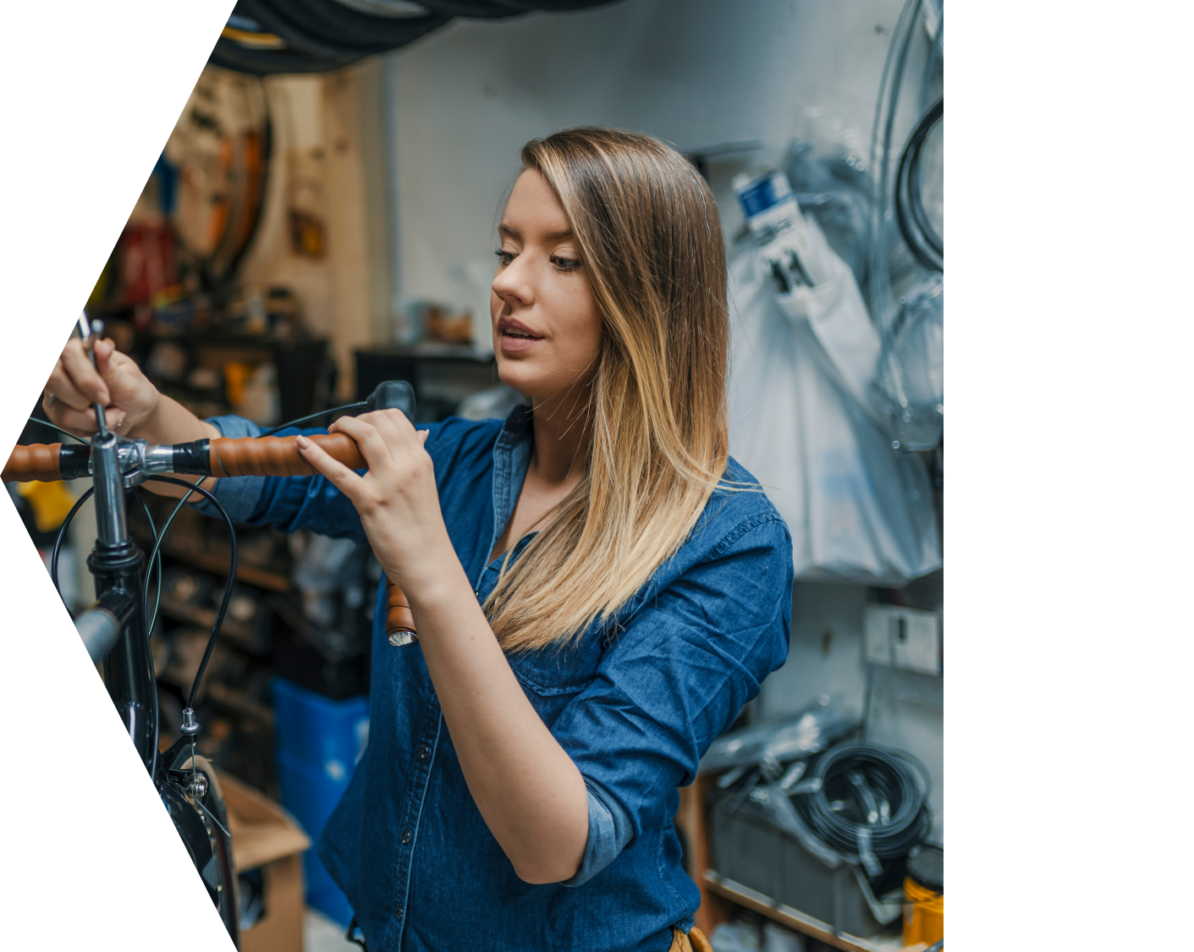



DECARBONISATION
NET ZERO PROGRAMME
Funded by UK Shared Prosperity Fund

Slide 2

On Today's Agenda
Discussion Points
  Introduction
  Objectives of the Programme
  Our Commitment
  The Benefits for Your Business
  Decarbonisation Journey
  Registration Process

Slide 3

DNZ PROGRAMME
West Midlands Combined Authority along with Aston University and our partners are committed to empowering businesses in the West Midlands to reduce environmental footprint and navigate escalating energy costs.
ABOUT US
Aston University has a successful history of supporting SME growth in the West Midlands, thanks to contributions from EBRI, Aston Centre for Growth, and CRÈME.
Introduction
Supporting West Midlands Businesses

Slide 4

OBJECTIVES
What We Aim to Achieve?
  Support decarbonisation efforts in local businesses while improving the natural environment
  Align with the UK government's legally binding climate target to reduce carbon emissions to
  Net Zero by 2050
  Provide immediate support to businesses to enhance their competitiveness and sustainability

Slide 5

Our Commitment
A Sustainable Future
  We are fully committed to delivering Energy Audits for small and medium-sized enterprises (SMEs) by March 2025
  Our commitment includes supporting a wide range of small businesses, from sole traders and micro-businesses to manufacturing companies in the Birmingham, Coventry and Black Country regions *depending on eligibility

Slide 6

BENEFITS
For Your Business
  Cost Savings: Energy-efficient measures can significantly reduce your energy bills
  Carbon Footprint Reduction: Contributing to a cleaner and more sustainable environment
  Grant Opportunities: Access to grants ranging from £1000 to £100,000 to implement energy efficiency recommendations

Slide 7





The Journey Ahead
What to Expect in Your Decarbonisation Journey?
Energy Assessment
Register
Audit Triage
Recommendations
Grant Application
Start by completing the registration form on BGWM’s website or by contacting our team.
After registration, our Business Engagement Managers will reach out to you to complete the audit triage and check your eligibility.
We will then conduct a FREE assessment, examining your energy usage and operations.
Based on the assessment, we'll provide you with recommendations for cost-effective energy saving measures.
Your business has the opportunity to apply for grants of up to £100,000 to implement the energy efficiency recommendations.

Slide 8
BUBS
Birmingham Unit Base Support Ltd cut energy costs by £19,000 and reduced carbon emissions by 25 tonnes annually by switching to LPG-powered dual-fuel generators.
Read More - https://bit.ly/3MtMnqK
DG Russell
DG Russell Commercials Ltd cut costs and reduced their carbon footprint by 6 tonnes per year by replacing lighting with energy-efficient LEDs, saving £1,800 annually - a 60% reduction in electricity consumption.
Read More - https://bit.ly/3tV4pfb
Case Studies
Previous Success Stories

Slide 9

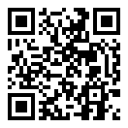
Is Your Business Ready to Make the Change?
EMAIL ADDRESS
decarb@aston.ac.uk
PHONE NUMBER
0121 204 4828
TO REGISTER
bit.ly/DNZ-Audit-Register
Get in Touch Today!

Slide 10
Is Your Business Ready to Make the Change?
EMAIL ADDRESS
decarb@aston.ac.uk
PHONE NUMBER
0121 204 4828
TO REGISTER
bit.ly/DNZ-Audit-Register
Learn more about the programme

