Slide 1
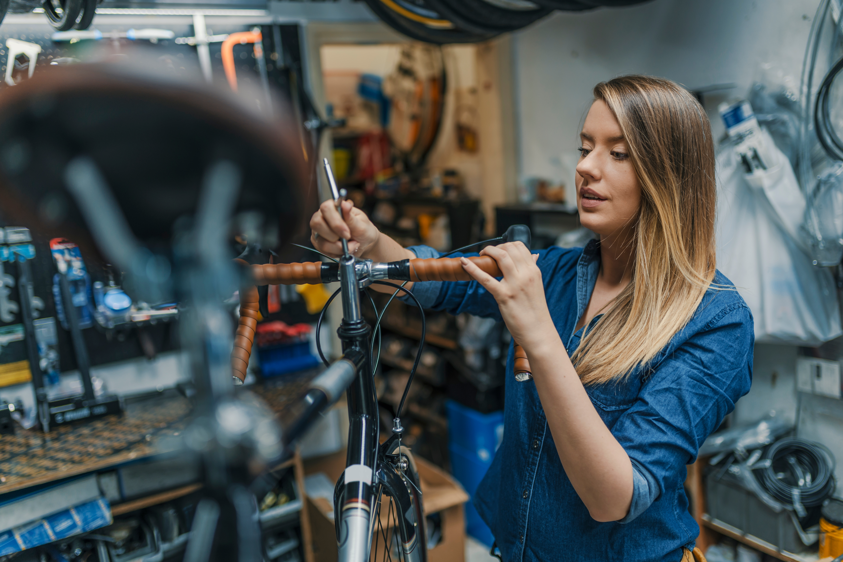
Green Business Network

Slide 2
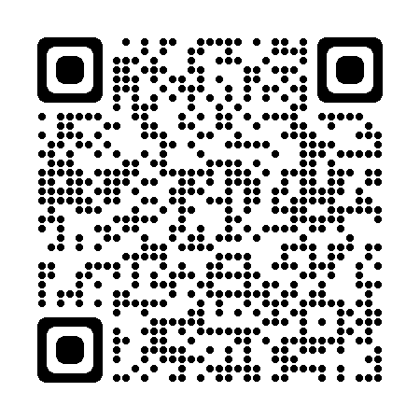

What is it?
The Green Business Network allows businesses to come together, share ideas and promote energy, resource, waste and water efficiency as well as engage on low carbon, environmental and green sustainability initiatives.
Free to join
Over 2,700 members

Slide 3
Why join
Monthly newsletter
Networking and supply chain opportunities
Access to webinars, networking events, podcasts

Slide 4
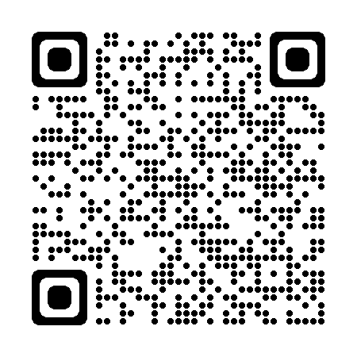
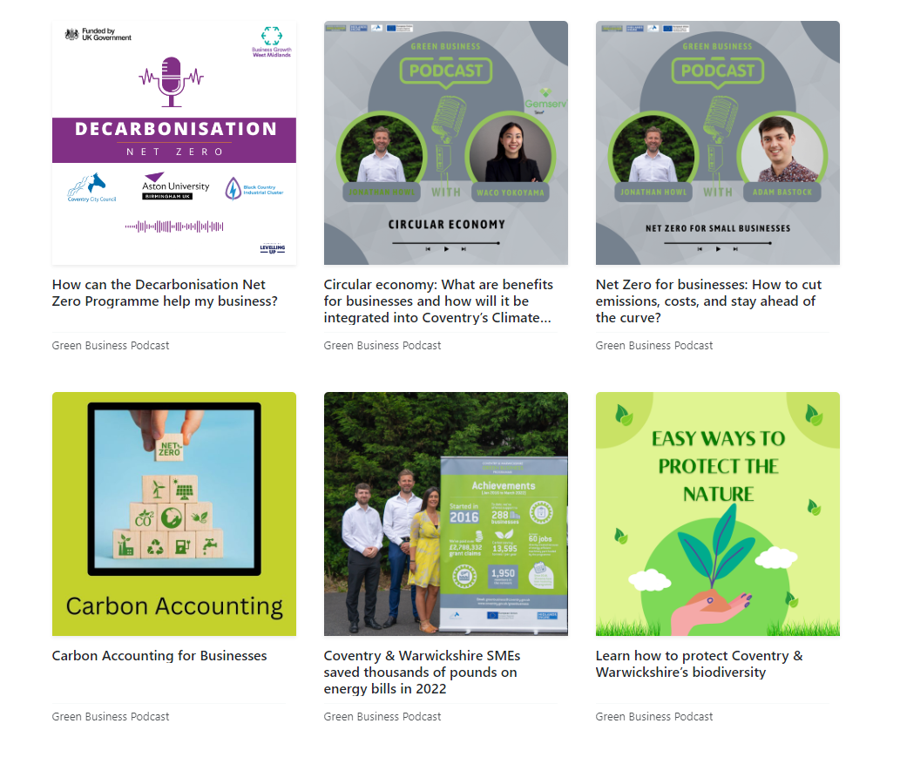
Podcast
New episodes every
month
Over 10 episodes so far discussing solar PV, heat pumps and sustainable business practices
Use the QR code or this link to subscribe

Slide 5
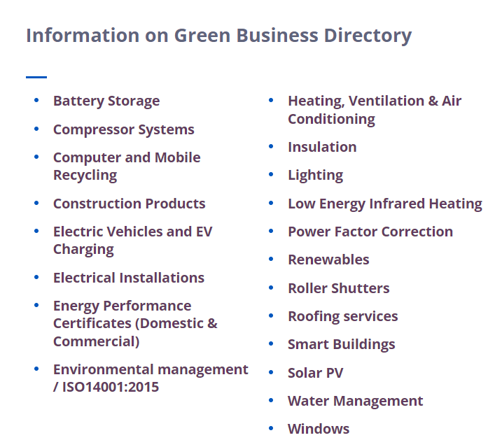
Green Business Directory
Over 100 local suppliers and installer
20 categories including solar PV, roofing services and water management
If you are a local installer or supplier please get in touch and we will add you to the directory

Slide 6

How to get involved
Join our network and face-to-face events
Send your story to the newsletter editor and this could be included in the monthly edition (maria.covlea@coventry.gov.uk)
Follow us on social media and share your opinion about the DNZ programme and Green Business Network

Slide 7
www.businessgrowthwestmidlands.org.uk
Twitter: @decarbprogramme
LinkedIn: Decarbonisation Net Zero Programme

