Slide 1
Notes:
All my notes

Slide 2
Housekeeping
Hello and Welcome!
Please turn your video off
Mute yourself to reduce background noise, but unmute to ask questions
You can also use the chat function to ask questions
This webinar will be recorded
There is a Q & A session at the end of each speaker so please interact
The slides and the recording will be sent out to all the attendees
We will also send out a feedback form, please let us know how we did!

Slide 3
On Today's Agenda
12:30 Start
12:30 - 12:35 Welcome and Housekeeping
12:35 - 12:55 Carbon Accounting for businesses, David Wilshin
12:55- 13:05 Q&A
13:05 - 13:20 Carbon Accounting - Case Studies, Tammy Jacobs
13:20 - 13:25 Q&A
13:25 - 13:30 Grant funding and expert support opportunities
13:30 End

Slide 4
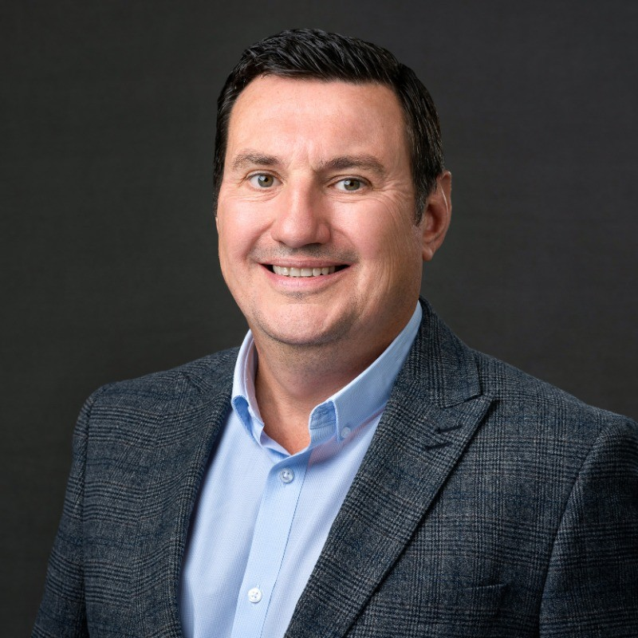
Carbon Accounting for businesses
David Wilshin

Slide 5
Your Partner on your journey to Net Zero
Carbon Accounting
For Businesses
Webinar 28th February 2024
Presented by: David Wilshin

Slide 6
Carbon Management
Sustainability in the whole
Climate Action is one of the 17 UN Sustainable Development Goals (SDGs).

Slide 7
Carbon Management
GHG Emissions
GHG
7 main gases
convert back to
tCO₂e
CO₂
_{(Carbon Dioxide)}
_{GWP x1}
CH₄
_{(Methane)}
_{GWP x28}
N₂O
_{(Nitrous Oxide)}
_{GWP x265}
HFCs
_{(Hydrofluorocarbons)}
_{GWP x150 -11,500}
PFCs
_{Perfluorocarbons)}
_{GWP x6,500 – 9,200}
SF₆
_{(Sulphur}
_{Hexafluoride)}
_{GWP x23,500}
NF₃
_{(Nitrogen}
_{Trifluoride)}
_{GWP x16,100}

Slide 8
Carbon Management
What the terminology is and what it means
Carbon Neutral – short term
Means balancing your reducing GHG emissions by “offsetting” an equivalent amount of carbon for the amount produced.
Net Zero – long term
This is reached when the amount of residual CO₂e emitted is matched by the quantity of CO₂e removed or captured. You cannot achieve net–zero by offsetting.
© AUDITEL 2023
© AUDITEL 2023

Slide 9
Carbon Management
What the terminology is and what it means
Operational Carbon
Means the GHG emissions associated within your business’ operational boundaries and within the organisational control.
Embodied Carbon
Means the carbon associated with the material extraction, transport to manufacturer and manufacturing of a specific items or products.
© AUDITEL 2023
© AUDITEL 2023

Slide 10
Greenhouse Gas Protocol
Carbon Accounting
N₂O
NF3
HFC S
CH₄
CO₂
PFC S
SCOPE 2
INDIREC T
SCOPE 3
INDIREC T
SCOPE 1
DIREC T
SCOPE 3
INDIREC T
S F₆
LEASED ASSETS
ELECTRICITY, STEAM, HEATING & COOLING FOR USE
EMPLOYEE COMMUTING
TRANSPORTATION & DISTRIBUTION
BUSINESS TRAVEL
COMPANY FACILITIES
PROCESSING OF SOLD PRODUCTS
PURCHASED GOODS & SERVICES
CAPITAL GOODS
FUEL & ENERGY RELATED
TRANSPORTATION & DISTRIBUTION
WASTE FROM OPERATIONS
COMPANY VEHICLES
USE OF SOLD PRODUCTS
END-OF-LIFE TREATMENT OF SOLD PRODUCTS
LEASED ASSETS
FRANCHISES
INVESTMENTS
UPSTREAM ACTIVITIES
REPORTING COMPANY
DOWNSTREAM ACTIVITIES

Slide 11
SCOPE 1
SCOPE 2
Importance
of Scope 3
SCOPE 3
© AUDITEL 2023

Slide 12
Carbon Management
Opportunities & Challenges
Market Forces
Challenges
Consumer demand
Lack of expertise & good data
Legal reporting
Too big a challenge
Your competition
Confusion
Tender returns – PPN 06/21
Fear of Greenwashing
Increasing costs
Perceived cost
Notes:
So why should organisations, feel that carbon management is an important subject matter? Well, there’s a lot of market forces at work out there, and we hear people talk about these all the time. Firstly, we increasingly see consumer demand is putting pressure on organisations to be able to demonstrate their carbon credentials. Increasingly, we have a savvy audience buying products and services from us, and we need to meet those consumer demands.
There’s increasing levels of legislative requirements, legal reporting, government requirements, industry requirements, to meet certain greenhouse gas emission standards or carbon reporting standards, and we can’t ignore those. Those are there today and they’re increasing by the year. These again are driving the consumer demand as the organisations which have legislative requirements have measured their footprint and are managing their carbon. They initially started with their scope 1 and 2 but as they now move to looking at their scope 3 they want to work with suppliers who are also managing their carbon emissions.
PPN 06/21 was a new procurement policy notice published in 2021 where any tender that is bid for central government, greater than five million in value, that bid submission has to be supported with a carbon reduction plan, and other carbon or environmental-based credentials. And this again is driving pressure for organisations to demonstrate their carbon credentials and their position in regard to the environment.
And importantly as all of this occurs, ripples are being created within the supply chain, causing other businesses to now need to meet those standards. So even if you don’t directly supply a government contract of five million, if you are supplying a business that supplies or is bidding for the government contract, when they put together their carbon reduction plan to meet the tender requirements, one of the steps they’re going to do is look at their Scope 3 emissions and tap you up as a supplier to ask for what your credentials are. So increasingly, you’re going to see this ripple effect occurring through the market and through the supply chain, causing organisations all around the world to need to pull up their socks and consider carbon credentials in more detail. Those suppliers who are managing their carbon are winning more work as a result.
And it isn’t just work they are winning. As I know from my time at Bakers, the younger generation really cares about these areas. Our graduate recruitment team were asked by applicants what we were doing in terms of our carbon reduction. And we are increasingly seeing young talent want to work with those organisations who are managing their carbon emissions.
And the final market force that’s at work, is increasing cost. A large part of Carbon management, is about carbon removal or reduction, using less energy in your organisation. Using less energy will save you money, because there’s an increased cost to energy; it’s a fossil fuel, it’s limited in its provision and we’re seeing a lot of volatility in that market. So there’s a strong pressure for companies to remove the amount of energy they use, which ties in brilliantly with carbon management.
But on the other side of the equation, what we’ve also seen in many of the organisations we’ve spoken with is that whilst these market pressures, these forces, are at work and we see them and feel them, on the other side of the equation, there are challenges. Things that are stopping organisations from actually doing something in this area. A lot of the time, we see companies where they lack real internal expertise or awareness on how to measure where they are today. They lack the ability to get to good data and order that data in such a way to turn it into something meaningful. It leads to a lot of head-scratching a lot of confusion as to what to do, and that confusion can lead to paralysis or inaction.
Many clients we speak to, admit that they just feel the challenge is too big. It’s just too big an elephant to eat all in one go – how am I possibly going to deal with this? Many of them feel that, in fact, they’re such a small contributor in the scheme of things, what could little old me possibly do, what difference could I possibly make? But the reality is, the challenge is big if you look at it in the whole, but if we break it down to bite-sized chunks, to a stepped process, over a period of time, it does become an achievable objective, something we can rise to as a challenge. And very importantly, if we all take a step to deal with some of the challenge, even if the amount of our own footprint is small, by taking account of our own footprint, doing something about it, it will mean we create ripples in the supply chain. We ask our supplier questions. And as we do that, we will influence the wider world and the wider market. So, no matter how big or small the organisation, by all of us doing something, it can make a bigger difference elsewhere through the ripples we create.
We see that there’s a lot of confusion. What does good look like? What terminology should be used? This confusion leads to a lot of fear that they may be caught or accused of what’s become termed as greenwashing. Making environment statements or propositions which aren’t really making the meaningful difference that they should be making. And that leads again to paralysis for a lot of companies where they’re not moving for fear of doing something wrong.
And the final challenge that gets in the way of people dealing with carbon management is a perception of cost, particularly after the last couple of years that we’ve all been through. Businesses, in many cases, still just getting back on their feet, reorganising, re-growing, dealing with the new world. There’s a perception that this is just another cost that I just can’t be dealing with right now. However as I said at the beginning we work with clients using our carbon, cost and procurement expertise so that being carbon neutral could potentially be a cost-neutral exercise. So even that challenge is probably less relevant today than it used to be.

Slide 13
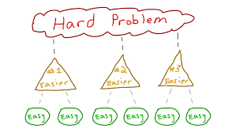
Notes:
OK, so after that your brain may be feeling like……………….
Hopefully you are not feeling like this……………….
Having set out the scope and requirements the Next part of the webinar will break down the activities and give you some ideas how to approach your PPN 06/21 carbon reduction plans

Slide 14
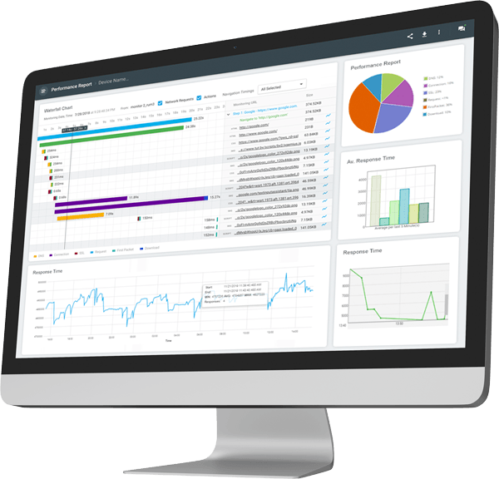
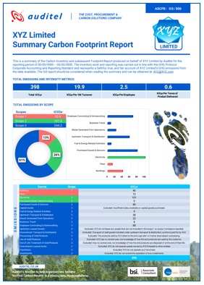
Carbon Management Process
The new normal
Step 1
Measure
Step 2
Set Targets
Step 4
Verify
Step 3
Reduce
Notes:
We are now going to move on to the process for Carbon Management and go into a little bit of detail on some of the stages, particularly measurement.
And measurement is one of the most important steps, as you can not reduce what you can’t measure. So that is always the starting point, measuring your carbon emissions, the carbon footprint of your organisation. So:
Step One is to define and measure where you are today.
Step Two, to come up with implementable plans to reduce your carbon within that period.
Step Three, If you want to reach carbon neutrality offset what’s left by way of emissions.
Step Four, have that documented and validated, to provide comfort in your claims. And some clients go further and get verification from a recognised body to gain certification e.g. PAS 2060.
So what’s involved in each of those steps?

Slide 15
Carbon Management Process
Roadmap to Net Zero
tCO₂e →
Net Zero
Year 1
Year 2
Year 3
Year 4
Year 5
1. Baseline
1. Measure
1. Measure
1. Measure
1. Measure
2. Set Targets
2. Set Targets
2. Set Targets
2. Set Targets
2. Set Targets
3. Reduce
3. Reduce
3. Reduce
3. Reduce
3. Reduce
4. Verify
4. Verify
4. Verify
4. Verify
4. Verify
Starter
Emerging
Mature
Market Leader
Market Leader

Slide 16
Carbon Management
Grades of Carbon Reporting
Level 9
Validated Highest Quality
09
Level 8, plus | 3rd party validation
Level 8
Highest Quality
08
Level 7 plus | All scope 3, including
Life cycle emissions products | Life cycle emissions on products
Validated High Quality
Level 7
07
Level 6, plus | 3rd party validation
High Quality
Level 6
06
Standard
14068
Level 5
05
Okay
Level 4
04
Map all emission sources
Define & document boundaries
Recognised calculation method
Scope 1 & 2 emissions
Material scope 3
Internal Verification
Poor Quality
Poor Grade
Level 3
03
Low Grade
Level 2
02
No value
Level 1
01
Notes:
There are, broadly speaking, 9 grades of carbon reporting that you can find in the marketplace through our research. Right at the bottom at Level 1, almost the no-value carbon reporting, is when someone just takes their energy usage data and they plug it into some unverified portal online, either free or low cost. They plug in a bunch of energy usage data and they get a ton of CO2 equivalent numbers back in return. That is not a carbon footprint report. It’s just a number based upon energy data, and it’s not even a verified number because you don’t know what calculation method or factors are being used in the background to give that number. It’s pretty much pointless and worthless.
You then work up the different grades. Level 4 carbon footprint report, for example is where they have looked at various emission sources. They have achieved a level of definition documentation around the boundaries of what it is that that footprint report is covering. They may be using recognised calculation methods. But in many cases, it’s still only goes to Scope 1 and Scope 2 emissions. Most of them I’ve seen make a promise of looking at Scope 3 at some point down the road, but they’re not really getting into it just yet or doing it just yet. And that’s a very common level of reporting you see.
Level 6 or upwards, is where the carbon footprint report does map in some detail all of the emission sources, considering everything that is material to the organisation. Now, you can exclude Scope 3 emissions which are not material to the overall footprint, and broadly speaking, without getting into the finer minutiae or detail, that would be anything less than 1%, any single level of emissions less than 1%. You can exclude up to 5% of your emissions in Scope 3 for that reason. However Level 6 or above provides detail, definition and documentation as to those boundaries, that narrative as to what it is we’re actually measuring within the organisation. It absolutely has to look at Scope 1 and 2 emissions, but it should then also go further to look at all material scope 3 emissions. We work to a minimum of level 6 so that our clients, even if they are not looking to achieve PAS 2060 certification, have a high quality of carbon footprint.

Slide 17
Carbon Management
Typical Programme of Work
Carbon
Footprint
Report
Workshop
Data
Analysis
Report
Review
Face to Face
Carbon Workshop
1
Data collection plan boundary setting
4
Data
analysis
5
Production of Carbon Footprint Report
6
Verifier Opinion Statement
7
Promotion
of progress
Case Study
Statement
Case Study
2
3
8
Statement
Start of Carbon Journey
Document
Carbon Management Statement
Production of
a “Completed Footprint”
case study and social media promotion
Net Zero Pledge and/or another framework
11
Carbon Reduction
Report
Workshop
Report
Development of Science-based targets
9
Carbon Reduction Workshop
10
Carbon Reduction Plan (PPN 06/21 compliant)
12
Notes:
A face-to-face Carbon Workshop to understand your current situation, challenges, opportunities, and aspirations.
Production of a “start of journey” case study and social media posts to announce your partnership with Auditel and your commitment to Net Zero.
Production of a Carbon Management Statement for Wilsons Tree Surgery that outlines your vision, mission, values, and objectives for carbon management.
Data collection plan & draft boundary setting documentation to define the scope and boundaries of your GHG inventory across Scopes 1, 2, and 3.
Data analysis to collect and analyse your data, apply appropriate emission factors and estimation methods, and calculate your GHG emissions.
Production of the Carbon Footprint Report that shows your environmental impact and performance over time, using the internationally recognised Greenhouse Gas Protocol Standards and the ISO 14064 Standards.
Verifier Opinion Statement (VOS) of the Carbon Footprint Report that certifies your carbon claims and gives them credibility and resilience against third-party scrutiny.
Production of a “Completed Footprint” case study and social media posts to share your verified carbon footprint results and celebrate your achievements.
Development of Science-based targets (SBT) to reach Net Zero ambitions that are aligned with your business strategy and stakeholder expectations, using the latest science and best practices.
Face-to-face Carbon Reduction Workshop to identify and evaluate the most effective and cost-efficient reduction measures for your organisation, such as energy efficiency, renewable energy, fleet optimisation, waste management, logistics reviews, carbon offsetting, and supply chain optimisation.
Updated Sustainability Statement that reflects your updated vision, mission, values, objectives, targets, and actions for sustainability.
Carbon Reduction Plan (PPN 06/21 compliant) for bid submissions that outlines your roadmap to achieve your GHG reduction targets and showcases your carbon reduction strategy.

Slide 18
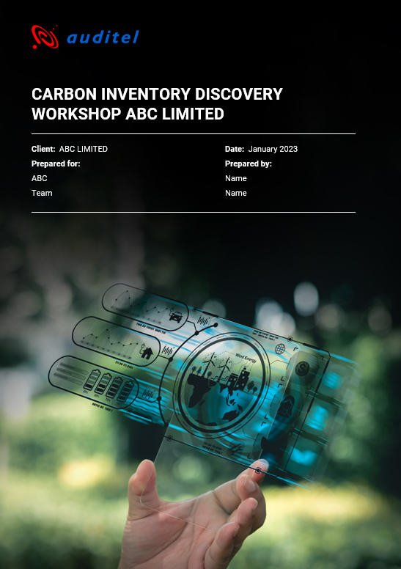
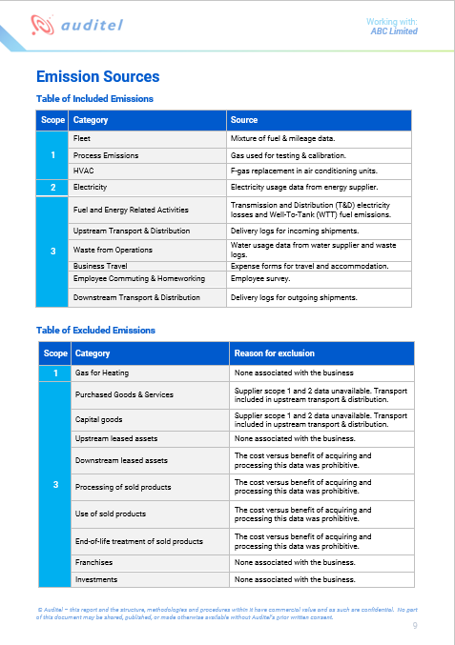
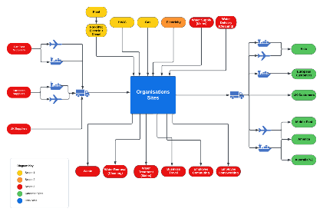
4. Emissions & Data Mapping
A Foundation for Your Carbon Footprint

Slide 19
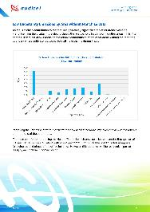
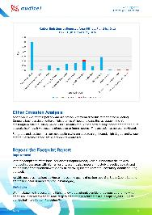
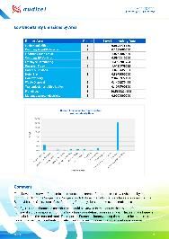
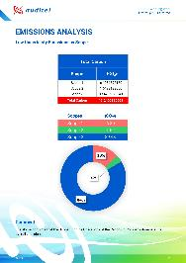
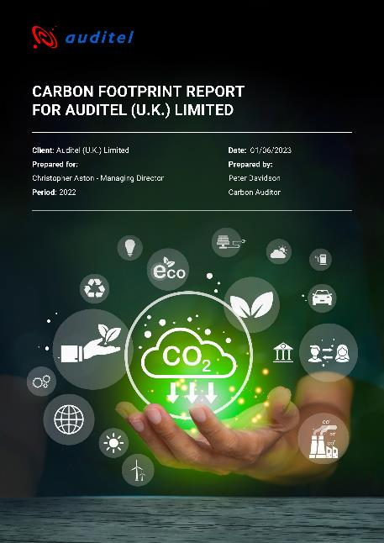
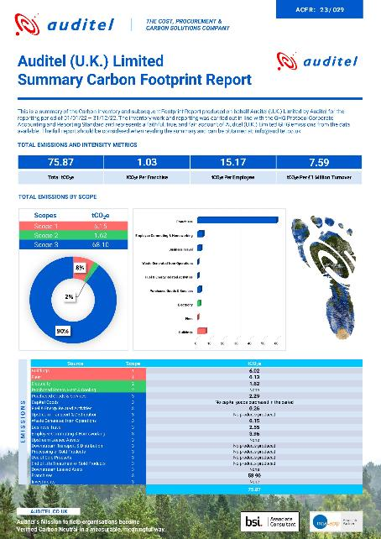
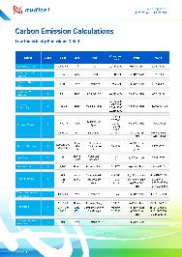
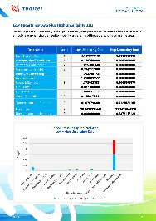
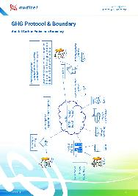
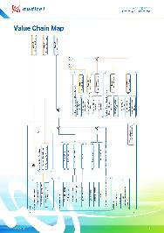
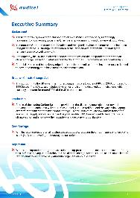
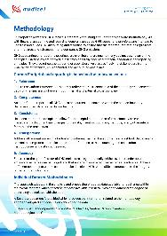
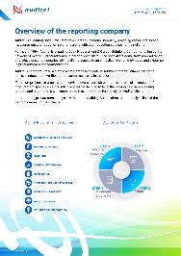
6. Carbon Footprint Report
A Snapshot of Your Environmental Impact

Slide 20
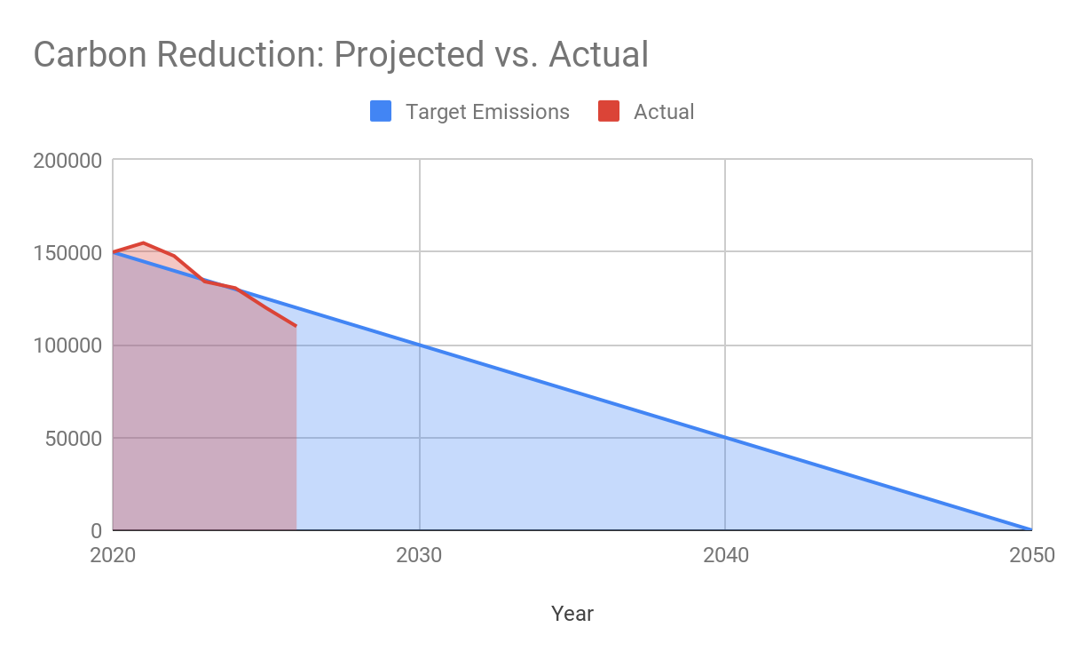
Science Based Targets
Reporting Net Zero progress

Slide 21
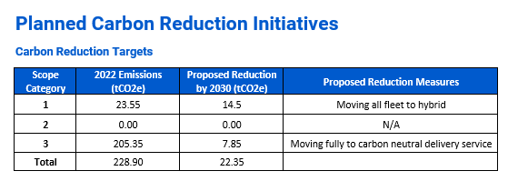
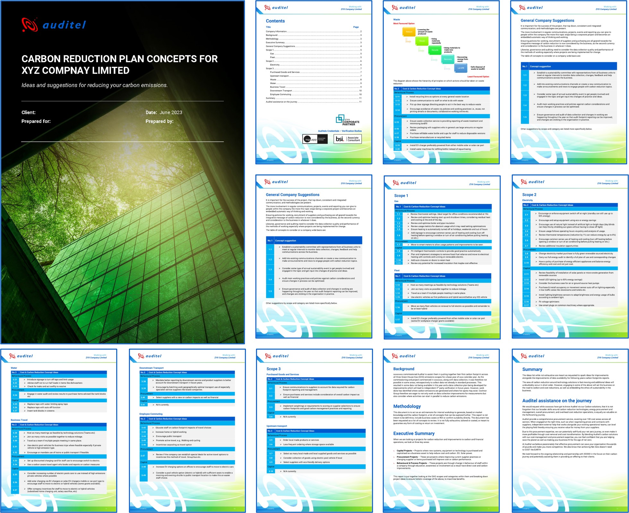
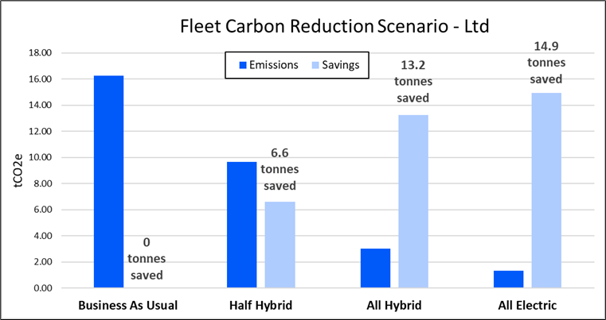
12. Carbon Reduction Plan
A Roadmap to Your Net Zero Ambition

Slide 22
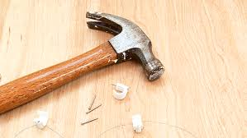
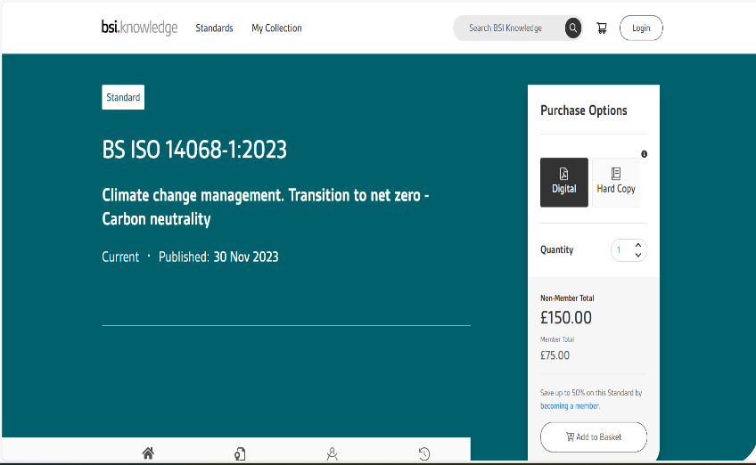
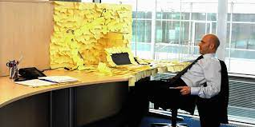
Notes:
3 – ONE WORD OF WARNING THOUGH, HAVE A SERIOUS THINK ABOUT WHETHER YOU HAVE THE INTERNAL RESOURCE OT WORK THROUGH THE SPECIFICATION
PIC 4 - YOU DON’T WANT IT TO BE THE LAST DIY JOB YOU DO!

Slide 23
2000
Who are Auditel?
History
2017
Full scope Procurement
1994
Expanded to 80 consultants, delivering full scope procurement on over 100 cost areas
Carbon Solutions
Formal launch of Carbon Solution team
Company Founded
Helping SME’s buy and manage energy supplies
2013
Energy Savings team
Launched specialist ESOS lead assessor team. Started delivering client energy reduction projects
2024
80 qualified Carbon Auditors
Now with over 100 consultants UK wide, 80 of whom are formally qualified in Carbon Solutions work
Our Mission…
To help organisations manage Carbon in a measurable, meaningful and potentially self-funding way.
Notes:
Explain how we are different from a carbon consultancy and how we can genuine help make the journey in a cost-effective way
Work with clients to continually bring cost savings and value

Slide 24
Your Partner on your journey to Net Zero
Thank you
Presented by: David Wilshin
Email: david.wilshin@auditel.co.uk
Mobile: 07415 922729
© AUDITEL 2023

Slide 25
Carbon Accounting for businesses
Tammy Jacobs

Slide 26
Pro Enviro
Pro Enviro is a specialist energy engineering and process optimisation consultancy with over 30 years of experience working with manufacturing and other business clients.

Slide 27
Tamaryn Jacobs Project Manager
Project manager at Pro Enviro, a specialist energy, process optimisation and carbon emissions reduction consultancy, has been involved in delivering innovative solutions to decarbonise the energy-intensive sectors of the UK economy throughout the last 30 years.
Being part of the Pro Enviro team, I have developed robust skills and a proven track record of success. I have been instrumental in developing successful energy and carbon emissions reduction projects and developing the carbon accounting framework for each of the companies we work with. Putting my hardworking, can-do attitude to work to help businesses record, quantify and qualify their carbon emissions because if you don’t know what you emit, you cannot reduce your emissions.
I have sat on the IDRIK - The Industrial Decarbonisation Research and Innovation Centre - round table discussions about standardising Scope 3 emissions.
Created sustainable decarbonisation plans for a multitude of organisations that we work with.
Submitted 12 applications to the Science Based Targets initiative. 9 companies that have successfully achieved SBTi accreditation and 3 that are awaiting the review process.

Slide 28
Pro Enviro Case Study
Datagraphic Ltd.
Successful Implementation of Net-Zero Carbon Strategy and Sustainable Solution Projects

Slide 29
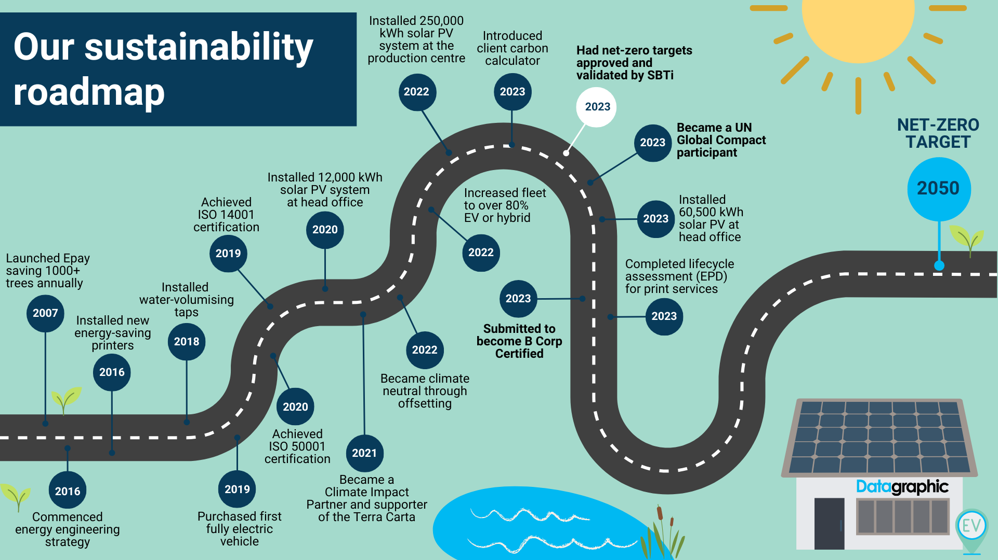
Client Summary
Datagraphic are a printed and digital media document processor with over three decades of experience helping public and private sector organisations automate and digitally transform manual and repetitive document processing.
Using automation technology, secure IT platforms and efficient high-speed printing and mailing equipment to annually present millions of people with outbound communications – online and in print – generated from the data within their clients’ systems. They turn physical inbound paper files into digital information assets their clients’ teams can access from anywhere to deliver services and make decisions faster.

Slide 30
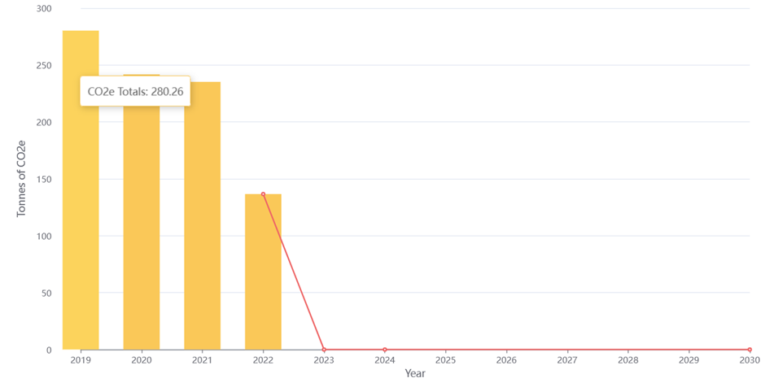
The Old System
In 2019, Pro Enviro helped Datagraphic implement a ‘greener’ way of operating. This has been achieved through the implementation of a range of different improvement activities. We started the journey of carbon footprinting by tracking Datagraphic’s Scope 1 and 2 emissions using CFAR – a Carbon Footprinting, Accounting and Reporting system developed by Pro Enviro. This has helped us record, track and monitor Datagraphic’s clients’ Scope 1 and 2 emissions.
The numerous low carbon and process optimisation strategies implemented by Pro Enviro have reduced the amount of carbon offsetting Datagraphic does through Climate Care by making real-world changes to their operation. We have started the lengthy process of collecting their Scope 3 emission data, which is presently ongoing.
Totals CO₂e in tonnes per year

Slide 31
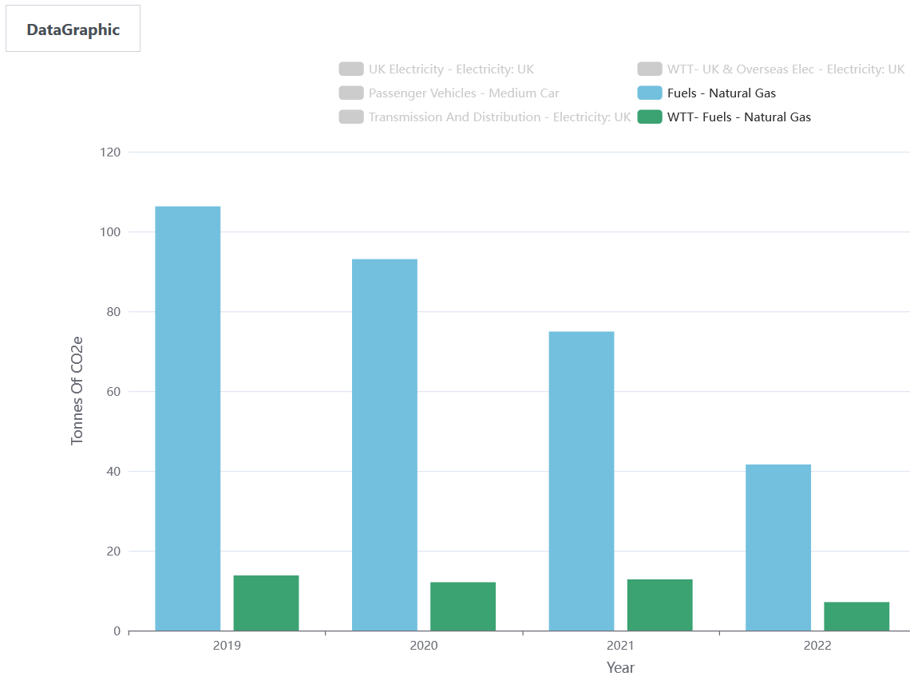
Delivering Net Zero Renewable Energy Projects – Reduction in Gas usage:
Reduction in Gas Usage
Through process optimisation and consultancy projects, we have made various improvements to the operation within Datagraphic, one of them being how they use natural gas throughout their facilities.
We assisted in the successful application for EGS (Economic Growth Solutions) grant funding to facilitate the implementation of Net Zero Strategies. These were achieved through a series of temperature and heating monitoring exercises where we have significantly reduced the amount of gas used onsite.
This reduction of 64.8tCO2e represents a 60.1% improvement compared to the 2019.

Slide 32
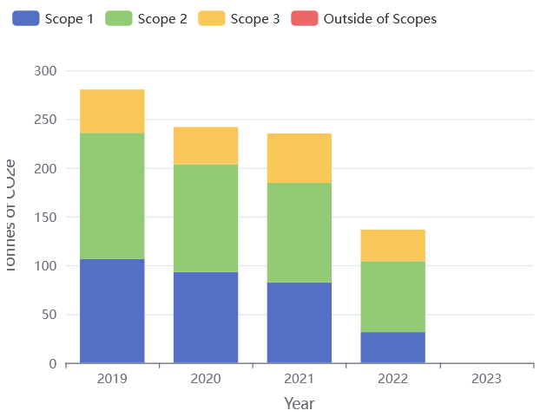
Delivering Net Zero
CO2e emission per unit of production at Scopes 1, 2 and partial Scope 3
As a result of the significant investment in process optimisation and installation of renewable technologies, the company has significantly reduced CO2e emissions per unit of production compared to 2019.
The impact of the current solar installation at Datagraphic’s headquarters in Rugby and the planned additional installation of solar at their Chesterfield site will allow them to generate more electricity than they currently use, putting Datagraphic in a carbon deficit, thereby enabling them to make the claims that they are carbon neutral at scope 1 and 2 of their operation.

Slide 33
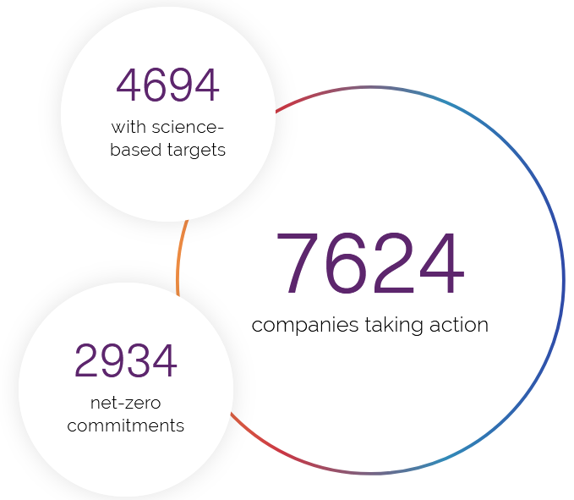
SBTi Accreditation and Verification
Datagraphic is now working on the next phase of its sustainability plans by reaching out to its suppliers and partners to report on its carbon emissions. Capturing this information will enable us to understand their emissions throughout the value chain. This will help the organisation reach its net zero target, including Scope 3 emissions by 2035.
We assisted with the application process by collecting, collating and analysing the company’s performance data and verifying the submitted documents. Datagraphic received its SBTi accreditation at the end of April 2023, and their net zero targets have been verified and accepted as Science Based. Peter Wells, head of Sustainability and Commercial Manager, said, “We couldn’t have done it without the help of Pro Enviro”.

Slide 34
Pro Enviro Case Study
Elite Plastic Ltd.
Achieving Net Zero and Sustainable Manufacturing

Slide 35
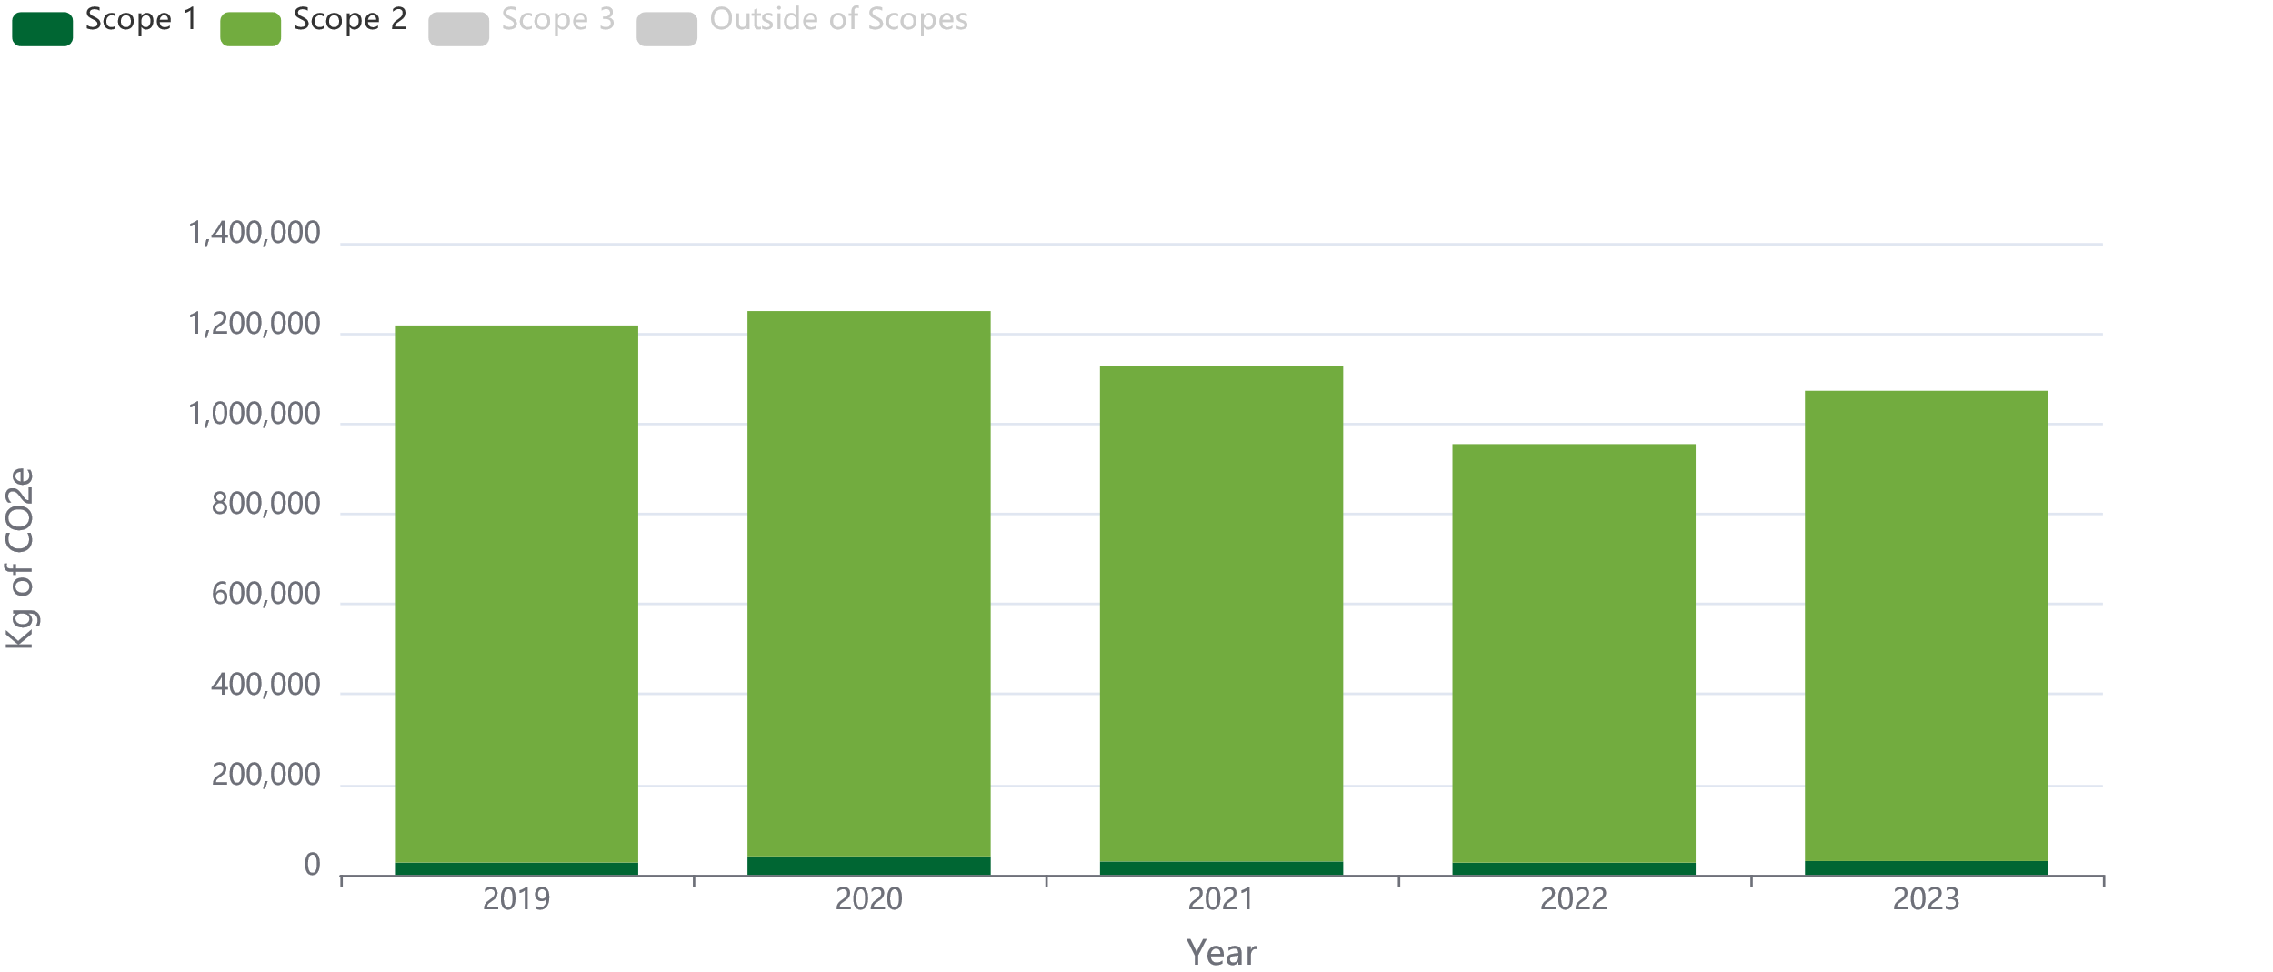
The Old System
Elite Plastics, a leading plastic manufacturing company, recognized the urgency of reducing carbon emissions and their environmental impact several years ago. To address this challenge, they partnered with us at Pro Enviro to embark on a long-term low-carbon process optimisation strategy, focusing on technology and behavioural changes. This case study examines Elite Plastics' journey towards reducing emissions, its energy monitoring and management initiatives, and the significant CO2e savings it has achieved.

Slide 36
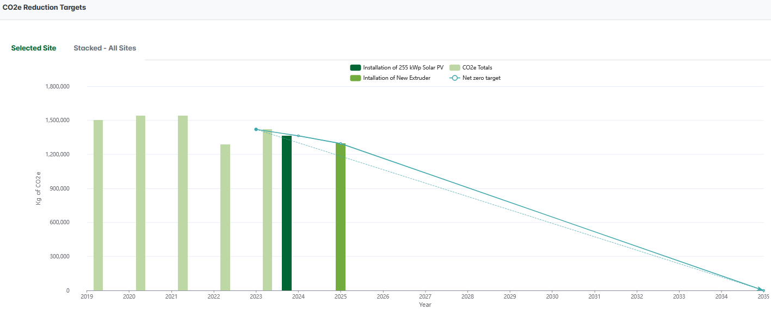
Delivering Net Zero Projects
Thanks to these concerted efforts and initiatives, Elite Plastics has achieved an impressive cumulative CO2e savings estimated to exceed 500 tonnes.
These accomplishments highlight the company's proactive approach to sustainability, responsible energy management, and commitment to reducing its environmental impact.

Slide 37
SBTi Accreditation and Verification
Elite Plastic is now working on the next phase of its sustainability plans by reaching out to its suppliers and partners to report on its carbon emissions. Capturing this information will enable us to understand their emissions throughout the value chain. This will help the organisation reach its net zero target, including Scope 3 emissions by 2035.
We assisted with the application process by collecting, collating and analysing the company’s performance data and verifying the submitted documents. Elite Plastic has submitted its SBTi application this month, and we expect to have their net zero targets verified and accepted as Science Based by May 2024.

Slide 38
Pro Enviro Case Study
Servosteel Ltd.
Achieving Net Zero and Sustainable Manufacturing

Slide 39
Client Summary
Servosteel is the UK's largest independent steel roll processor and provides a well-established and innovative processing service to the steel community. The company has an annual capacity of over 500,000 tonnes, processed and managed from a single 200,000-square-foot facility based in the Black Country.
Current processing facilities include 3 Slitting lines, 2 Decoiling lines, a Coil Pickling line, a Blanking Line, and a Coil Recovery Line. These facilities enable the company to provide the services of a “complete one-stop steel shop". In recent years, the company has made significant investments in the provision of laser cutting services and now operates one CO₂ laser cutting machine and one fibre laser cutter.
The company has an annual energy consumption of ~1.8m kWh of electricity and ~3.6m kWh of gas for steam generation. Total energy costs are ~£280,000 per annum.
The company operates continuous processes 24 hours per day, five days per week.
Servosteel has recently experienced significant increases in energy costs and pressure on the maximum demand (MD) level as the company grows. The business involves several different processes that can all run independently, and the company knew that they needed to improve control of the patterns of energy usage to ensure that MD levels were within the level of Authorised Supply Capacity (ASC).
Any avoidable energy consumption: maybe an item of plant left on longer than is required, such as local and site-wide compressors required analysis. There is also a need to ensure that equipment is running when required, for example, the extraction system on the Pickling Line.
It is important that any energy improvement projects or processes be accurately monitored over extended periods to ensure that the impact of the investment or improvement can be evaluated effectively.

Slide 40
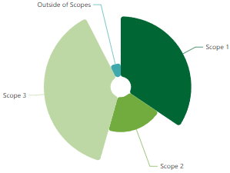
Current GHG footprint
The energy audit results for Scope 1 and 2 emissions have been used to generate our baseline emissions footprint for 2019. Using the Carbon Footprinting Accounting and Reporting (CFAR) tool from Pro Enviro, we have calculated our emissions from our baseline year of 2019 for Scope 1 & 2:
This includes emissions from:
UK electricity, Electricity generated, Natural Gas, Diesel (avg biofuel blend), LPG, Mileage from petrol average car.
Emission Type |  | tCO2e
Scope 1 and 2 | 2019 | 1279.21
 | 2020 | 954.38
 | 2021 | 1187.25
 | 2022 | 1070.27
 | 2023 | 956.85
% Reduction Since 2019 |  | 25%

Slide 41
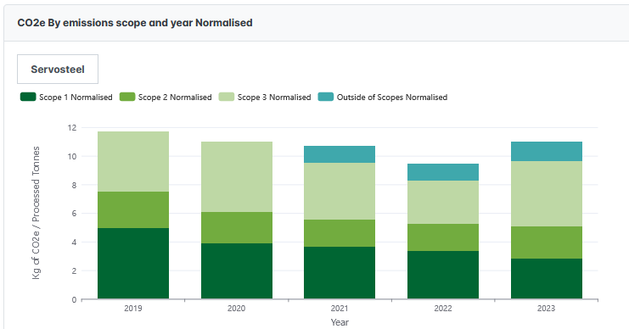
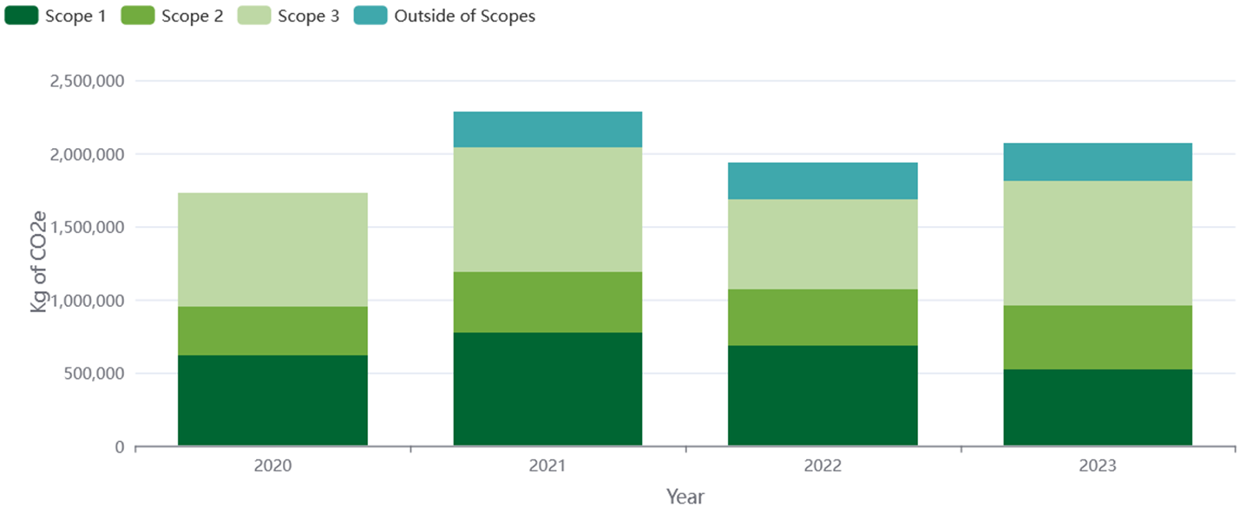
Data Collected
Scope 1 and 2 data has been collected for the following emission sources: Fuels - Gaseous fuels - Natural gas, UK electricity - Electricity generated - Electricity: UK, Fuels - Liquid fuels - Diesel (average biofuel blend), UK electricity for EVs - Cars (by market segment) – Sports, UK electricity for EVs - Cars (by size) - Large car and Fuels - Gaseous fuels - LPG. Scope 3 is a lengthy process, and we have already collected an extensive list of our Scope 3 data. This includes the collection of the following data: WTT- fuels - WTT- liquid fuels - Diesel (average biofuel blend), WTT- fuels - WTT- gaseous fuels - Natural gas, WTT- pass vehs & travel- land - WTT- cars (by size) - Average car, Business travel- land - Cars (by size) - Average car, WTT- UK & overseas elec - WTT- UK electricity (T&D) - Electricity: UK, Transmission and distribution - T&D- UK electricity - Electricity: UK, Material use - Construction - Mineral oil - Primary material production, Material use - Construction - Wood - Primary material production, Water supply - Water supply - Water supply, UK electricity T&D for EVs - Cars (by market segment) – Sports, Waste disposal - Metal - Metal: scrap metal - Closed-loop, Waste disposal - Refuse - Commercial and industrial waste – Landfill, Material use - Construction - Metals - Primary material production, Homeworking - Office Equipment, Water treatment - Water treatment - Water treatment, Homeworking - Homeworking (office equipment + heating), WTT- fuels - WTT- gaseous fuels – LPG, Freighting goods - HGV (all diesel) - Articulated (>33t), Hotel stay - Hotel stay – Germany, Business travel- air - Flights - Short-haul, to/from UK, Waste disposal - Refuse - Commercial and industrial waste - Open-loop,
Emission Reduction Plan
We have enlisted the assistance of Pro Enviro, specialist energy, process optimisation and carbon emissions reduction consultants who have been involved in delivering innovative solutions to decarbonise the energy-intensive sectors of the UK economy throughout the last 30 years.
We are committed to the development of a comprehensive net-zero carbon strategy that is uniquely tailored to our production and needs, which we will be implementing over the next eight years to align ourselves with the Paris Agreement of limiting global warming to below 1.5°C. developing a comprehensive net-zero carbon strategy

Slide 42
Emissions Target
Based on the data collected and the SBT set, we are implementing several zero carbon and carbon reduction projects in line with our target of 100% zero emissions by 2035 in all Scope 1 and 2 emissions.

Slide 43
SBTi Accreditation and Verification
Servosteel Ltd. is now working on the next phase of its sustainability plans by reaching out to its suppliers and partners to report on its carbon emissions. Capturing this information will enable us to understand their emissions throughout the value chain. This will help the organisation reach its net zero target, including Scope 3 emissions by 2035.
We assisted with the application process by collecting, collating and analysing the company’s performance data and verifying the submitted documents. Servosteel Ltd. has submitted its SBTi application this month, and we expect to have their net zero targets verified and accepted as Science Based by May 2024.

Slide 44
Decarbonisation Net Zero Programme
Jonathan Howl

Slide 45
DNZ PROGRAMME
The Decarbonisation Net Zero Programme aims to provide information and expert advice and support to businesses enabling them to make significant decarbonization and money-saving changes to their business. This Programme is part of the wider West Midlands Business Support activity funded through the UK Shared Prosperity Fund (UKSPF).
Grant funding for energy efficiency varies by region, however, for businesses in WMCA and Warwickshire, we can offer grants between £1K to £100K based on up to 50% intervention. Unfortunately, Warwickshire does not offer support for renewable energy under this programme.
Introduction
Notes:
Grant support - up to 50%, grants between £1k - £100k.

Slide 46
OBJECTIVES
What We Aim to Achieve?
Support decarbonisation efforts in local businesses while improving the natural environment
Align with the UK government's legally binding climate target to reduce carbon emissions to
Net Zero by 2050
Provide immediate support to businesses to enhance their competitiveness and sustainability

Slide 47
The Journey Ahead
What to Expect in Your Decarbonisation Journey?
Energy Assessment
Register
Audit Triage
Recommendations
Grant Application
Start by completing the registration form on BGWM’s website or by contacting our team.
After registration, our Business Engagement Managers will reach out to you to complete the audit triage and check your eligibility.
We will then conduct a FREE assessment, examining your energy usage and operations.
Based on the assessment, we'll provide you with recommendations for cost-effective energy saving measures.
Your business has the opportunity to apply for grants of up to £100,000 to implement the energy efficiency recommendations*.
Notes:
V important – QUOTES needed - you will need to get 3 quotes. This ensures best value you can use your preferred supplier). Important to state you have to apply for the grant BEFORE starting any work, and the grant is paid out following install and claim

Slide 48
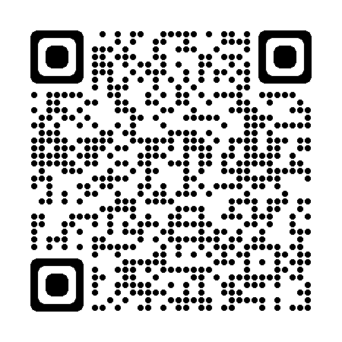
Other resources
Green Business Network
The Green Business Network allows businesses to come together, share ideas and promote energy, resource, waste and water efficiency as well as engage on low carbon, environmental and green sustainability initiatives.
Free to join
2900 members
Networking opportunities
Free newsletter
Be the first one to find out more about events and grant support opportunities
Join now
Use this QR code to join

Slide 49
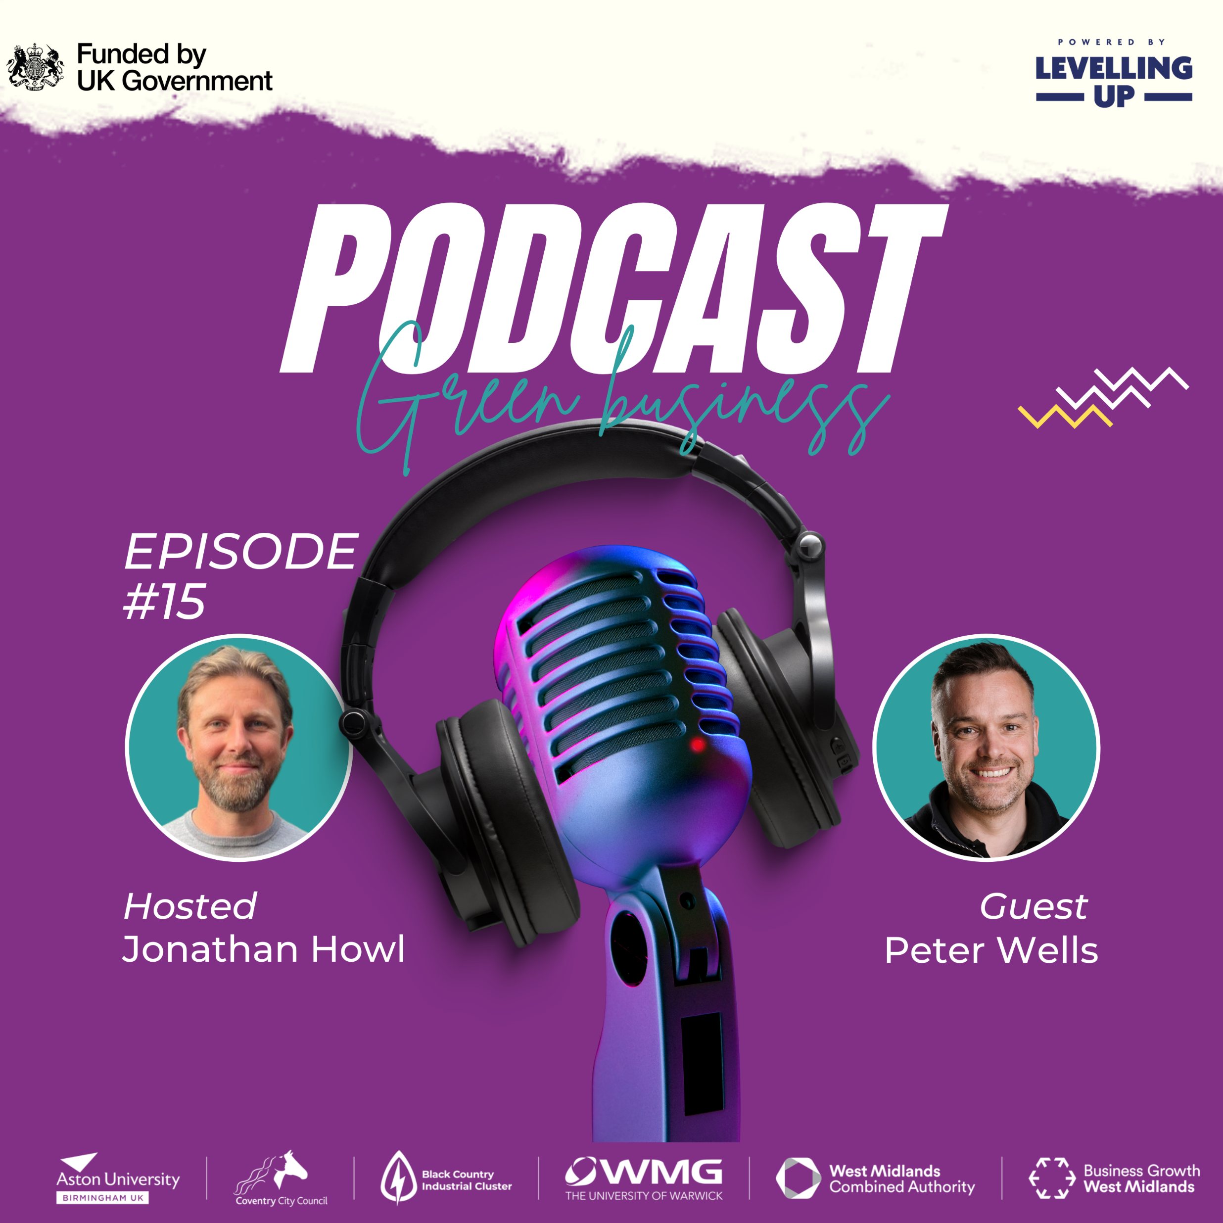
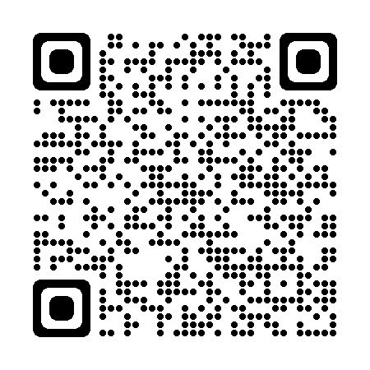
Other resources
Green Business Podcast
Listen to our monthly podcast to learn more about energy, resource, waste and water efficiency as well as engage in low carbon, environmental and green sustainability initiatives.
New episodes every month
Over 10 episodes so far discussing solar PV, heat pumps and sustainable business practices
Use the QR code or this link to subscribe

Slide 50
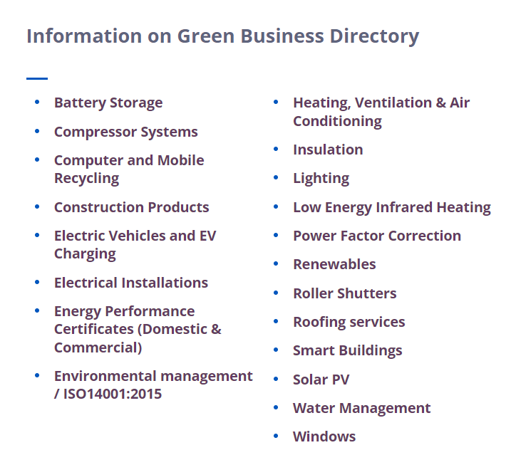
Other resources
Green Business Directory
Find a list of local suppliers and installers who can help you improve your business .
Over 100 companies
20 categories including solar PV, roofing services and water management
If you are a local installer or supplier please get in touch and we will add you to the directory
Notes:
As a local council we have to stay impartial………

Slide 51
Upcoming events
Our upcoming engagements with businesses will take place at various local exhibitions, where we've secured a stand:
Midlands Business Expo: February 29th, CBS Arena, Coventry
Coventry Business Expo: March 13th, Village Hotel, Coventry
FSB Event: March 18th, Coombe Abbey Hotel (Fully booked)
Venturefest: March 21st, Eastside Rooms, Birmingham
Next webinar:
Decarbonisation Net Zero grants success stories March 13th

Slide 52
Is Your Business Ready to Make the Change?
EMAIL ADDRESS
decarb@aston.ac.uk
PHONE NUMBER
0121 204 4828
TO REGISTER
West Midlands: bit.ly/DNZ-Audit-Register
Warwickshire: https://bit.ly/3skX34q
PLEASE NOTE: Due to different funding streams, we are currently offering grants towards renewable energy for West Midlands businesses only.
Learn more about the programme

Slide 53
www.businessgrowthwestmidlands.org.uk
Twitter: @decarbprogramme
LinkedIn: Decarbonisation Net Zero Programme

