Slide 1

Coventry SEND: Core Training
Session 2: Understanding Behaviour

Slide 2

This session will cover the following topics:
Understanding behaviour and some of the reasons behind it
Behaviour as communication
Preventative/proactive approaches
Intervening positively
Building relationships/emotional support
Top tips for teaching staff
Use of positive language
Case study

Slide 3
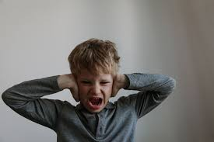

Some behaviours from children and young people that staff within school settings may face on a daily basis
Refusal to follow instructions or complete tasks.
Rudeness/answering back.
Physical assaults.
Self injurious behaviour – head banging, cutting.
Becoming withdrawn.
Bullying.
Absconding.
Hiding under tables.
Notes:
Every day adults face behaviours from children and young people within their settings.
There are many different types of behaviours but these are just some of the more common:
Refusal to follow instructions or complete tasks.
Rudeness/answering back.
Physical assaults.
Self injurious behaviour – head banging, cutting.
Becoming withdrawn.
Bullying.
Absconding.
Hiding under tables.

Slide 4

What are the reasons behind some of these behaviours?
Discuss on your tables.

Slide 5
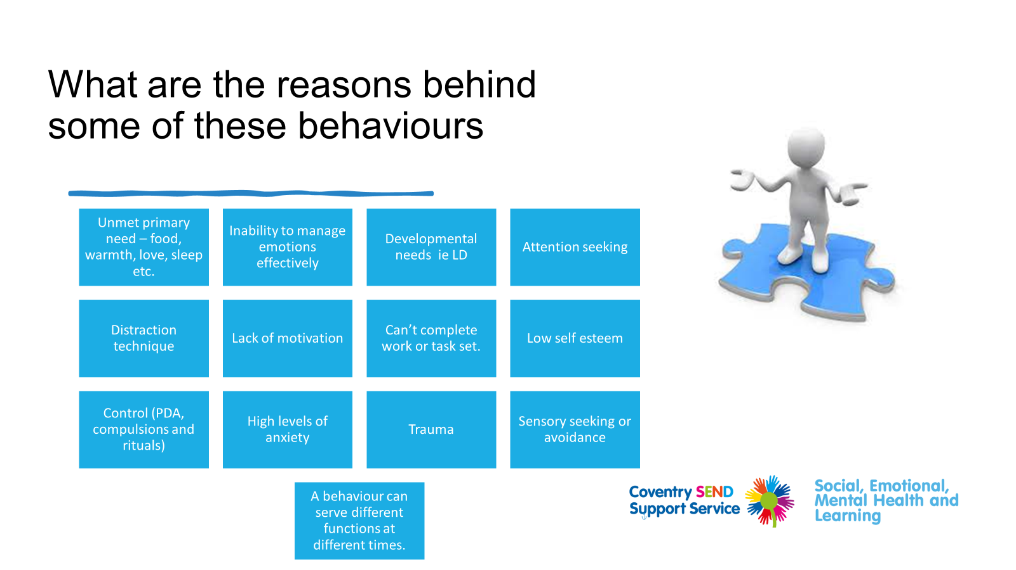
Notes:
There are many potential reasons for the behaviours that are seen within school settings, they can include:
Unmet primary need – food, warmth, love, sleep etc.
Inability to manage emotions effectively
Developmental needs ie LD
Attention seeking
Distraction technique
Lack of motivation
Can’t complete work or task set.
Low self esteem
Control (PDA, compulsions and rituals)
High levels of anxiety
Trauma
Sensory seeking or avoidance
It is important to note that a behaviour can serve different functions at different times. Do not assume because a child came in one day displaying challenging behaviour because they had missed their breakfast that this will be the same cause of an outburst the next day.

Slide 6
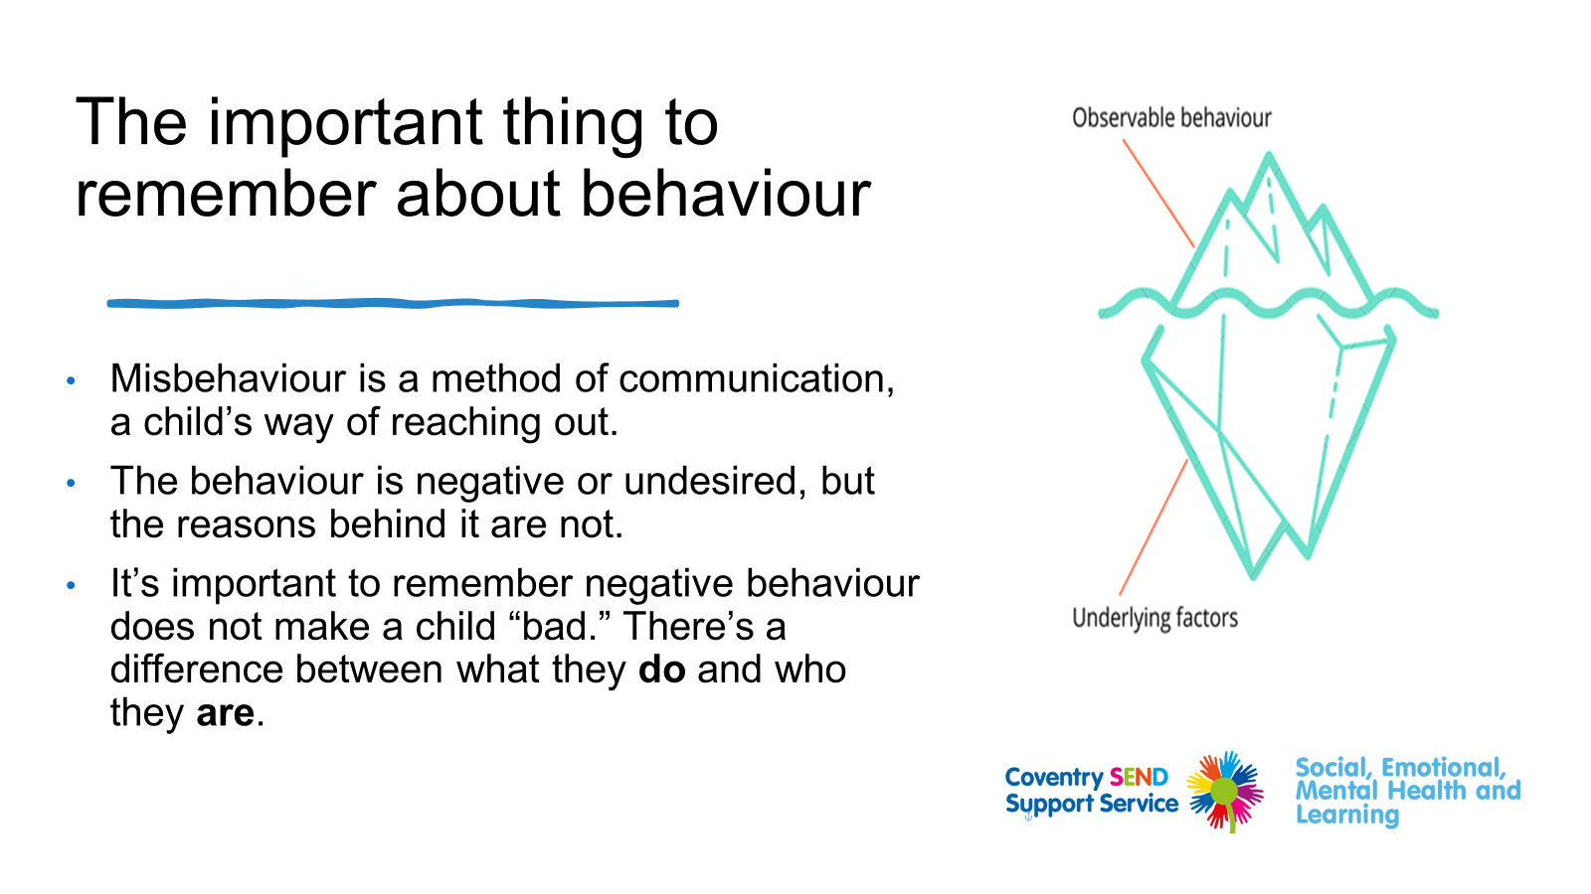
Notes:
The important thing to remember about behaviour
•Whatever you think is an underlying reason for challenging behaviour it is important to remember that it is a method of communication a child’s way of reaching out. Just like a baby cries when they are hungry, wet or tired this is the same for the young people we work with.
As adults we have had a lot of practice in decoding own feelings and have the skills for many different ways of managing and expressing those feelings.
Unlike adults, young children have limited communication skills because they have not had the time to perfect these skills. So, instead of saying they are lonely or bored, objects are thrown or words are said.
Please remember that:
•The behaviour is negative or undesired, but the reasons behind it are not.
•It’s important to remember negative behaviour does not make a child “bad.” There’s a difference between what they do and who they are.

Slide 7
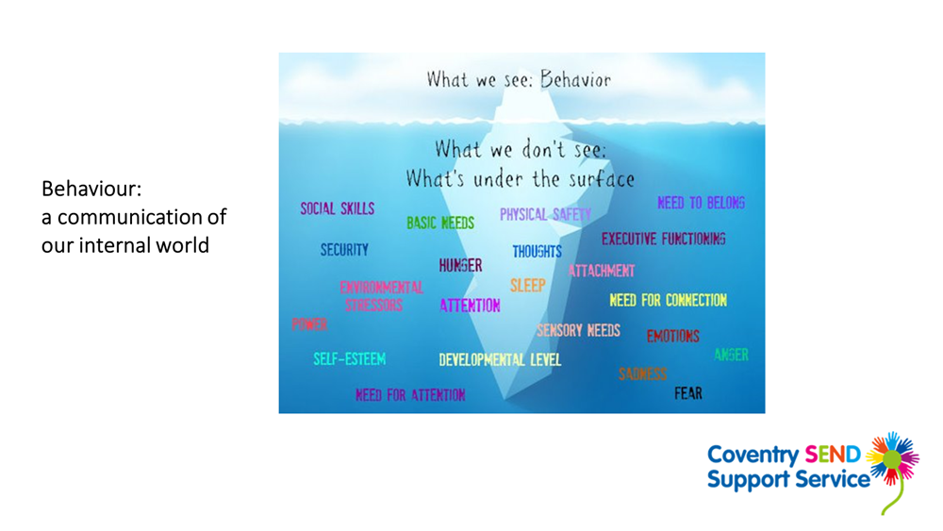

Notes:
If you were in the staff room and a colleague walked in and threw their papers across the room, what would you do?​
Would your first reaction be to say, ‘what are you doing throwing that, we don’t throw things in school!’​
Or would it be​
What’s the matter?​
There is always a reason for a behaviour, sometimes it is more obvious than others

Slide 8

Behaviour is communication!
Exploring the Function of Behaviour
Getting Curious…
Curiosity, without judgment:​
Is how we help children become aware of their inner life, reflect upon the reasons for their behaviour;​
Is wondering about the meaning behind the behaviour for the child;​
Let the child know that the adults understand; and​
Involves a quiet, accepting tone that conveys a simple desire to understand the child​.
“I’m a little confused, usually you love going to PE, but today you don’t want to go. I’m wondering what’s different about today?”
Notes:
Behaviour is often a way of children to communicate with us. Getting curious is key! Understanding the behaviour is important to understand what the child is trying to tell us and why. Behaviour is a communication of the child’s internal world. When children are not able to communicate with us verbally, they can do it through their behaviours. Trying to understand the underlying causes of behaviours is crucial: “I’m a little confused, usually you love going to PE, but today you don’t want to go. I’m wondering what’s different about today?”

Slide 9
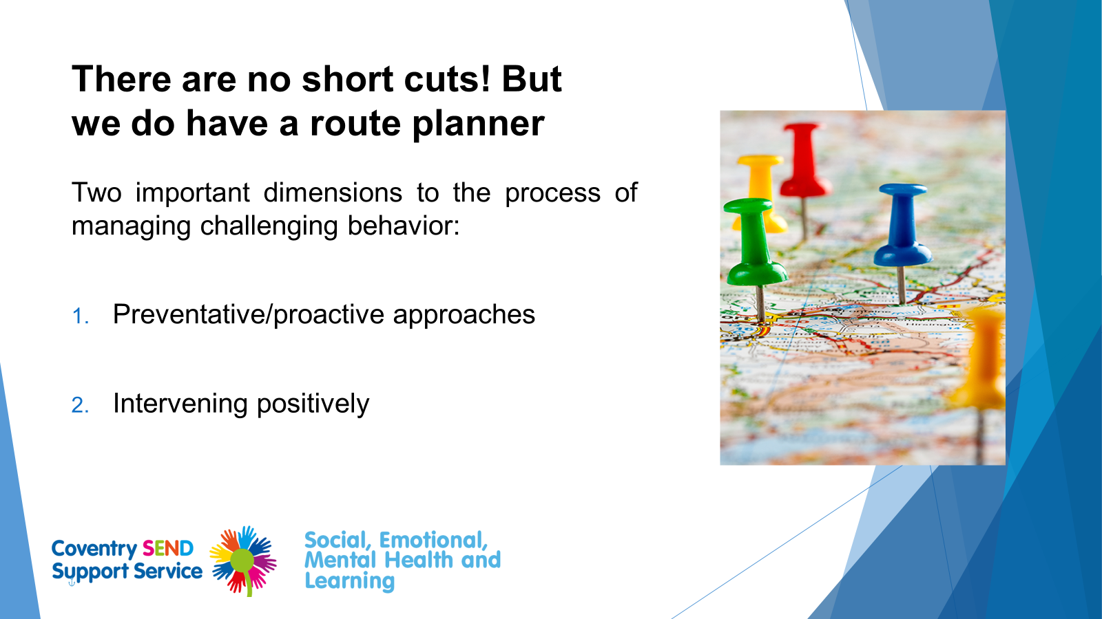
Notes:
There are no short cuts to managing behaviour:
Two important dimensions to the process of managing behaviour:
1.Preventative approaches
●
2.Intervening positively.

Slide 10
Preventative strategies
We are going to look at some preventative strategies for you to put in place that may stop behaviour from occurring.

Slide 11

Relationships and Emotional Support
Developing and maintaining good relationships and providing continuous emotional support for children and young people is absolutely key when looking at managing behaviour.
It is the most effective preventative approach to managing behaviour within the school setting.
Notes:
Firstly let us look at relationships and emotional support:
Building and maintaining relationships is foundational to all behaviour management, no matter what your role is within the setting.
It is the most effective preventative approach to managing behaviour within the school setting.
Children will be more likely to comply and do what is expected of them if you have a good relationship with them.

Slide 12
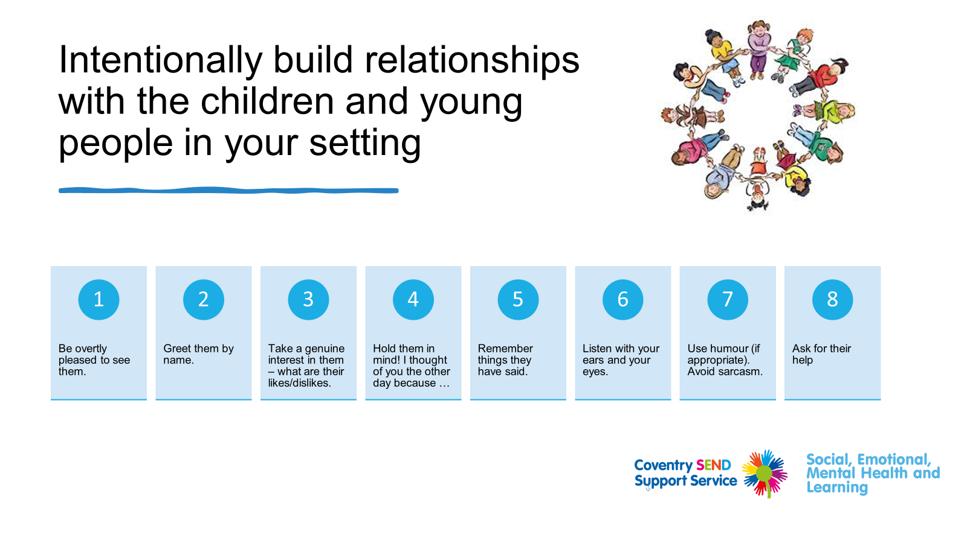

Slide 13
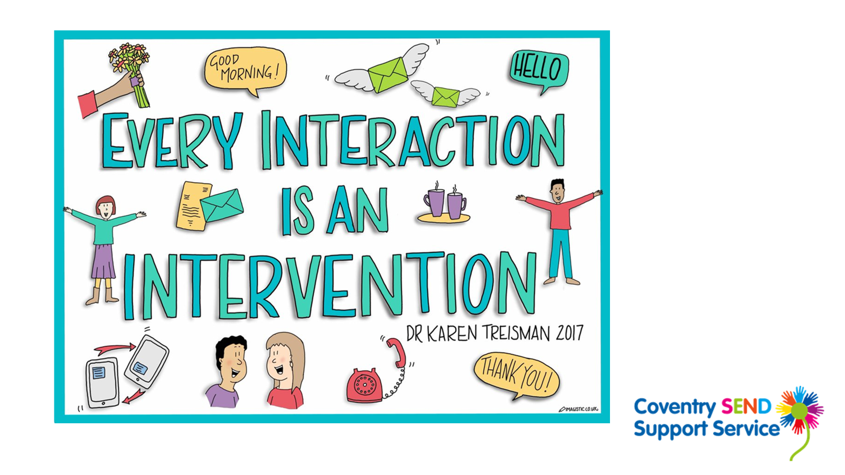
Notes:
As members of the school staff you are in the extremely privileged position of being able to build relationships with young people. The more we can provide each other these moment of simple, human connection – even a brief nod or a moment of eye contact – the more we’ll be able to support children to communicate their needs.
Siting a child nearby, having a quick check in the morning, letting them know that they are being held in mind “I thought about you yesterday when I saw XXX on the television”.

Slide 14
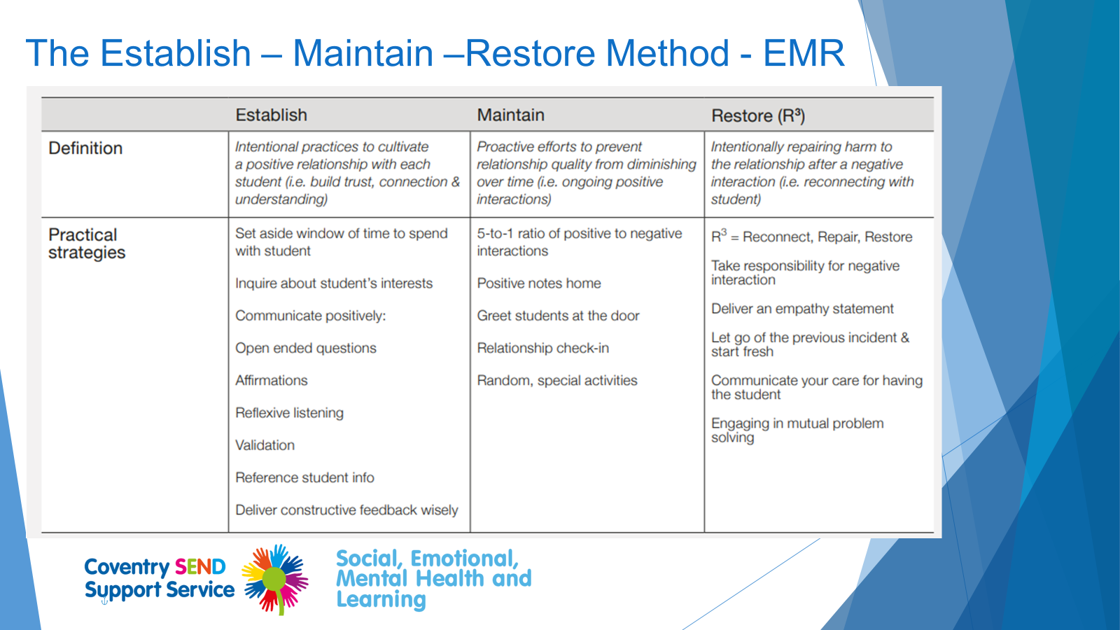
Notes:
A good way to build positive relationships with pupils is the EMR method, from EEF which has promising results from a small study. Summarised below, it involves focusing intentionally on the pupils who it is most difficult to connect with, who may be most in need of a consistent, positive relationship. It is recommended that this technique should take no longer than 30 minutes per week and can be completed during periods the adult already spends with pupils, representing an efficient use of time. It is not only important to establish the relationship, but maintain and restore it.

Slide 15

Emotional support
Children need to feel:
Safe
Welcomed
Valued
Supported
Motivated
If they are missing any of these, it is then reflected within their behaviour.
Notes:
Emotional support is key to behaviour.
You know as adults in a workplace we want to feel safe, welcomed, valued supported and motivated, this is the same for children and young people within schools. If they do not feel one of these then it is going to be reflected within their behaviour.
Do not under estimate the importance of emotional support with your children. By providing emotional support, you will build solid relationships with the children and young people you work with. If they feel that they can trust you, that you will support them/forgive them no matter what they will in turn be more likely to be relaxed, happy, behave in a positive manner.
Emotional support is key to improving Mental Health.
Even if they have a ‘blip’ the fact that you have spent the time building good relationships with them it will be far easier to turn their behaviour round than if you do not.
It is important that you think about how you can make children and young people feel these things while they are in your care.
I always think if that is my loved one what would I want others to do for them.

Slide 16

Rules and routines: Predictable environment
Consistency is key!
Clear rules, structures, routines and sanctions.
Display class rules visually and refer back to them positively throughout.
Consistency at all times by all members of staff.
Focus on primary behaviour only.

Slide 17

Supporting learning
Scaffold learning.
Break tasks down into small and manageable chunks.
Use word mats.
Allow processing time.
Use technology.
Provide variety and engagement.
Most importantly:
Know your pupils well,
Where are they at?
Where do they need to be?
What are their barriers to learning?

Slide 18
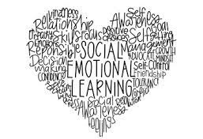
Social Emotional Needs
Find a hook into lessons if you have a disengaged learner.
At least 5 positive interactions for pupil per lessons.
Agree an inconspicuous prompt that can be used to signal class teacher if pupil needs help.
Class teachers to recognise and reinforce what pupils are very good at and use this within the classroom as a tool to help build their confidence.

Slide 19

Other useful tips
Allow movement breaks.
Use non-verbal prompts.
Consider your language.
Allow concentration aids to those who require it.
Cue pupils in by their name.

Slide 20
Other useful tips continued…
Consider your body language.
Do not shout.
Change of face.
Dynamic risk assessment.

Slide 21

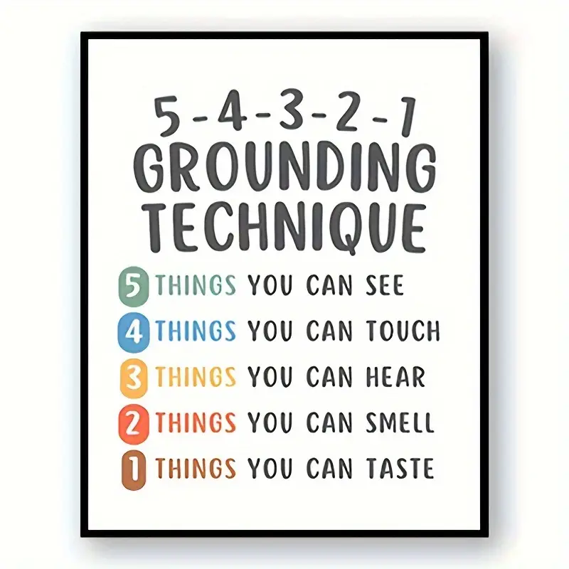
Help with regulation
Grounding technique – 5 senses.
What colours can you see in the room?
Square breathing.
Go to their safe space.
Resistance bands.
Support network in schools.

Slide 22

The importance of positive language

Slide 23

The importance of positive language!
Negative Phrasing
Don’t throw the pen​
Stop running​
Some of us are not paying attention
Don’t tear the book.
Don’t bite
Stop shouting
Positive Phrasing
Put the pen down on the table.
Walk thank you.
I need to see everyone’s eyes are on me.
Books are for reading not tearing.
Biting hurts! We can bite food, not…
Use softer voices.
The use of thank you rather than please!
Notes:
Positive language is so important when a child or young person is becoming dysregulated.
Do not use negative phrasing such as Don’t run, stop shouting etc.
Think about how you can say things in a more positive way.
Walk please thank you.
Indoor voices thank you.
Always use thank you at the end rather than please as it is then an assumption what you are asking them to do will be done.

Slide 24
DO’s
DON’Ts
Stay calm Help in the heat of the moment by naming the emotion. E.g. “I can see you are really angry right now”, “You look furious” Validate their emotion – I think you feel…, that’s ok/understandable and I want to try to help you Listen without judgement – do you really understand how your child feels and why? Even if you don’t agree! Give simple choices to help redirect the behaviour. | Don’t expect them to hear / respond to you immediately. Don’t order them to feel differently. Try not to retaliate or escalate the situation. Don’t force a child to apologise when they don’t feel sorry (approach after cooling off and later support them to understand the impact of their behaviour). Avoid labelling e.g. ‘bad’ or ‘good’ or ‘naughty’

Slide 25


Case Study

Slide 26
Case Study: Joe
Joe was raised at a planning meeting because he was not achieving his expected level of attainment and he often became disruptive in lessons.
Joe comes from a large family with several older and younger siblings. He experienced emotional abuse and neglect in his developmental history, which included physical injury when adults were unable to control their anger.
Information was gathered about Joe’s learning, his experience of school, including what a good/not so good lesson looks like and his ideal school.
Joe scored at least within the average range on the cognitive assessment and demonstrated effective learning behaviours during assessment activities.
He reported that teachers often shout in lessons, and he gets told off a lot.

Slide 27


What are your thoughts around Joe’s behaviour and what he may be communicating in the school setting?
Getting curious…!

Slide 28
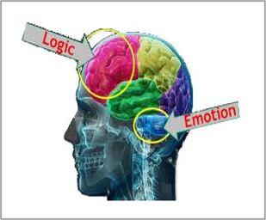
It is likely that teachers shouting and getting angry with Joe trigger a trauma response due to the early trauma and neglect that he experienced.
He may associate adults being angry with him being hurt physically and emotionally. It is likely that Joe is experiencing hypervigilance when adults around him seem angry.
When someone is experiencing threat, fear and/or heightened anxiety, energy is drawn away from the thinking brain to the emotional brain; the stress response to a real or perceived threat effectively hijacks the brain to keep the individual safe.
Joe’s disruptive behaviour can be framed as a communication of his early trauma and the fight/flight response that is triggered.
It is likely that his lack of progress is due to his hypervigilance: pupils who are hyper-vigilant are therefore likely to use more of their brain capacity being aware of and attending to perceived threat in their environment, which draws cognitive functioning away from learning.

Slide 29
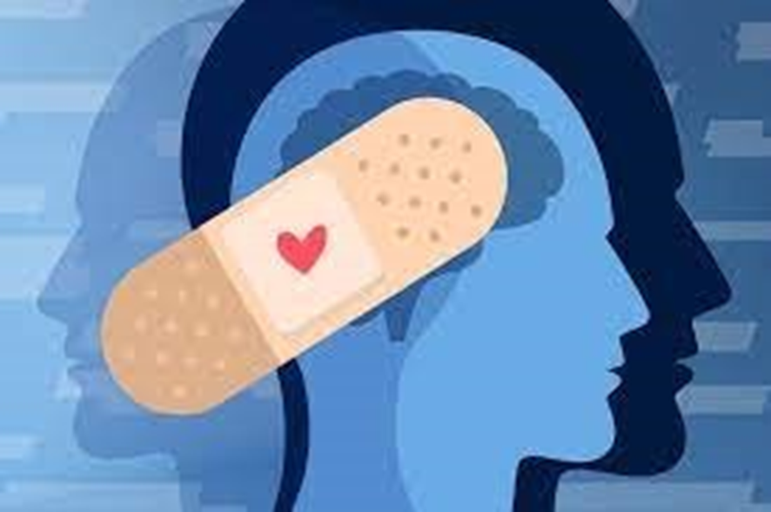
A focus on behaviour is a focus on the symptom of the difficulty rather than the underlying cause of the presenting behaviours.
Notes:
We need to consider systemic as well as within child causes of presenting behaviours
Contact the EP team if you are interested in setting up an Iceberg Project.

