Slide 1

Coventry SEND: Core Training
Session 3: Creating an Inclusive classroom, improving outcomes for all.

Slide 2


Session 3 Aims and Objectives
To provide an overview of Ordinarily Available Provision across Coventry schools.
To highlight the impact of quality first teaching with reference to the “The Five a Day” principle.
To provide a range of “Helpful Hints” to support all staff to create and foster an inclusive classroom
To highlight current education research and provide links to useful resources and websites.

Slide 3

"Although there are individual differences between all our young people, some basic approaches will help everyone, including staff. Primarily we are trying to create a feeling of safety, a holding environment, a secure base from which to learn. This feeling of safety is just as vital in secondary schools as it is in primary schools, special schools, alternative and Early Years provisions.
(Teacher handbook:SEND, NASEN P.45, 2022)
Notes:
Link to vital role we play in children’s educational journey

Slide 4
What is Ordinarily Available Provision?
The term ‘Ordinarily Available Provision’ relates to the range of activities, experiences and strategies offered as quality first teaching for all children with SEND grounded in the SEN Code of Practice.
Ordinarily Available provision is a framework that will help all pupils to thrive and learn. It is also embedded in the teaching standards, which provide the minimum expectations of high-quality teaching across all schools.
The SEND Code, explain that schools are expected to:
Provide high quality provision for children with SEND from their delegated budgets
Provide high quality teaching
(paras 6:96 – 6:99 )
Ordinarily Available Provision 2023-2024, City of York Council

Slide 5
What is Ordinarily Available Provision?
Schools should offer Universal Provision to all pupils. It should be built around a strong whole school behaviour management policy and inclusive ethos. Examples of universal support include:
A positive classroom climate, focusing on praise and encouragement.
Routines that promote emotional wellbeing, and successful transition.
A classroom environment and layout that account of SEMH needs of learners.
Active, engaging and meaningful resources & supports for learning available.
Access to named quiet areas of school and playground.
Planned/ targeted support from Teacher or Teaching assistant in the classroom.
Action plans to meet need with regular monitoring of progress.
Staff who have knowledge and skills of meeting the needs of learning – through training/ CPD.
Trained staff to support pupils at unstructured times of day, such as break & lunch time.
A well planned a structured PSHE curriculum, that is stimulating and effectively delivered

Slide 6
Why is Ordinarily Available Provision Important?
Ordinarily Available Provision will improve outcomes for all children, with or without an Education Health and Care Plan (EHCP). Children with an EHCP will also benefit from this type of provision in addition to the provision written in their plan.
In Coventry, Ordinarily Available Provision is catergorised into 5 areas:
General Provision
Provision to support language and communication needs
Provision to support cognition and learning needs
Provision to support social and emotional needs
Provision to support physical and sensory needs.
.
https://www.coventry.gov.uk/downloads/file/28989/school-age-ordinarily-available-provision

Slide 7
What does Ordinarily Available Provision look like in Coventry?
Here are some examples of the support Coventry Local Authority expects to be available in schools for students without an EHC Plan – General Provision
Wave 1
Wave 2
Wave 2
All adults have high expectations and seek to promote independence and self care skills where possible
Students individual progress Is monitored through a pupil passport, individual education plan or SEND support plan.
Student’s individual progress is monitored through a SEND Support Plan (or there will be plans to progress to one).
Support is co-ordinated by the class teacher
Support is co-ordinated by the schools SENDCo working together with class teacher(s)
There is regular communication between the home, school and external professionals to discuss progress and support. This happens at least three times per year.

Slide 8
Impact: what does the evidence tell us?
It is vital that all teachers understand each pupil’s individual characteristics and needs and how these connect to the classroom environment and the content of what they are teaching. This is an important principle in the consistent delivering of ordinarily available provision as it means teachers recognise the specific barriers to learning that an individual child faces and are then equipped to identify what adaptations can be made to allow them to flourish.
Recent evidence from EEF (Education Endowment Foundation, 2021) highlights that what has the biggest impact for pupils with SEND is…..
Special Educational Needs in Mainstream Schools. Guidance Report. Education Endownment Foundation, 2021)
Quality Teaching

Slide 9
What is Quality Teaching?
The EEF guidance report states that for pupils with SEND in mainstream schools it is vital that they receive high-quality teaching. Consideration must be given to the classroom environment and management. As teachers, the report highlights that it is important to recognise that;
“such high-quality teaching – adjusting, adapting and assessing in the classroom – is of course crucial for the progress of all pupils”.
The EEF guidance report also highlights that high quality teaching for pupils with SEND is grounded in strategies that will either “already be in the repertoire of every mainstream teacher or can be relatively easily added to it”. It is not about reinventing the wheel or increasing workload.
Special Educational Needs in Mainstream Schools. Guidance Report. Education Endownment Foundation,
2021)
Notes:
Adaptive teaching strategies sit firmly at the heart of this: adapting planning prior to the lesson and adjusting practice during the lesson.

Slide 10
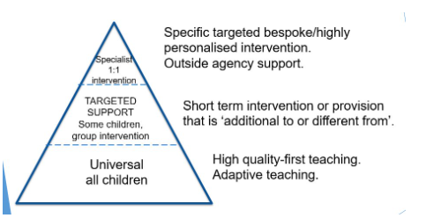
Quality First Teaching
The Code of Practice says that every teacher is a teacher of SEND. High quality teaching is effective for all children and young people. Through delivering quality first teaching settings are implementing the graduated response.
High quality teaching is crucial to the progress of pupils with SEND and teachers are vital orchestrators of ​‘assess, plan, do, review’ – the graduated response process detailed within the SEND Code of Practice. This is the first step in identifying barriers and developing strategies to support all pupil, including those with SEND.
Special Educational Needs in Mainstream Schools. Guidance Report. Education Endownment Foundation, 2021)
Notes:
Link to previous session (graduated response)

Slide 11
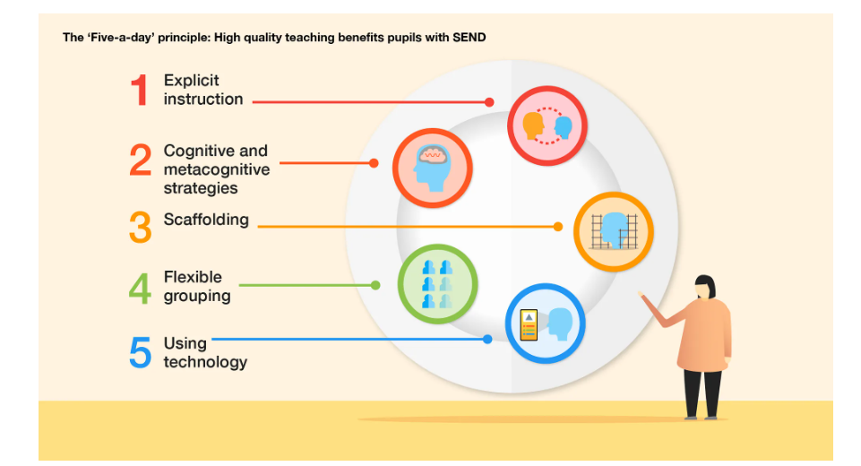
The “Five-A-Day” principle
Use of the Education Endowment Foundation (EEF) ‘five-a-day’ principle supports teachers to develop quality first teaching which improves provision and outcomes for pupils with SEND. Research suggests that there are approaches which teachers can employ to support learning and improve outcomes for all pupils, including those with Special Educational Needs.
Best of all, this ​‘Five-a-day’ is already part of most teachers’ practice (or can be relatively easily added), meaning that small tweaks could make a significant positive difference for the pupils we teach.
Notes:
Emphasise the importance making “small tweaks” and not adding to teachers workload but that with these tweaks teachers will make a huge impact

Slide 12


Slide 13

Time for a movement break – 2 mins
Notes:
Reflection point - How long do we expect children to sit still, sustain focus? Why are movement breaks important?
Many children seek movement throughout the day, as do adults, in an attempt to get them to the optimal level in order to carry out a certain task or engage adaptively within their environment.
The aim of the movement breaks are to help create the level of alertness which enables a child to focus and concentrate.
Some examples (that may already do)
Hands on chair push hands to lift bottom off chair.
Chair sit (Do 10)—have child sit down and stand up repeatedly from their chair
Themed workouts for the class to carry out.
Hand out exercise books, equipment and collect from peers
Classroom helper

Slide 14
Explicit instruction
What is it?
Explicit instruction refers to a range of teacher-led approaches focused on teacher demonstration followed by guided practice and independent practice.
What can it look like in practice?
The EEF’s SEND in Mainstream guidance report shares the following teaching habits as important tenets of explicit instruction:
• teaching skills and concepts in small steps;
• using examples and non-examples;
• using clear and unambiguous language;
• anticipating and planning for common misconceptions; and
• highlighting essential content and removing distracting information.
Special Educational Needs in Mainstream Schools. Guidance Report. Education Endownment Foundation, 2021)
Notes:
Explicit teaching, sometimes called explicit instructions, is a teacher-directed method of teaching.
Explicit teaching is usually used to introduce a new skill, idea or concept.
EXAMPLE
Teacher has a goal or learning objective that states what they want the child/ren to achieve using clearly-set success criteria.
Teacher breaks down the task into small, manageable steps and helps the children to achieve by demonstrating guided modelling and by giving consistent feedback.
Some children may need visuals to help them get a clear understanding of what they are expected to learn and achieve.
Teacher plans what materials will be needed, what will be said including all instructions, what modelling will be done and then they give the child/ren time to practise, helping and guiding them when needed
With explicit instruction, there are clear overlaps with ‘adaptive teaching’, particularly the references to checking understanding and asking questions frequently. By building in opportunities for feedback throughout a lesson, teachers are better able to adapt their teaching as they go, to ensure greater pupil understanding

Slide 15

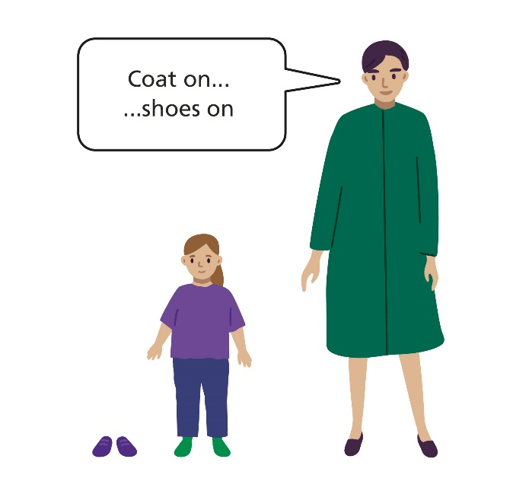

Helpful Hints - Explicit Teaching
Notes:
‘Understanding’ is sometimes referred to as ‘receptive language’ or ‘comprehension’. It is our ability to listen to what someone else is saying, recognise the words, and respond to this.
Children with difficulties understanding instructions can present in many different ways.
Some may miss out critical steps in a task, be last to carry out an instruction, or appear not to be listening. Many children will compensate and mask their lack of understanding by copying their peers or making guesses from the situation they are in.
1. Short, precise instructions – example such as "Get your coat" or '"Shut the door". Keeping instructions short and simple will help children understand.
2. Keep language to a minimum - Slow down your rate of speech, giving the child lots of time to think about what you have said. • Remember to use simple language, reduce your sentences to 1-2 words at a time, the child is more likely to be successful if the instruction is short. Instead of ‘Bobby go get the banana’, say ‘get banana’
3. Cue in with name – students may miss that instruction is for them

Slide 16
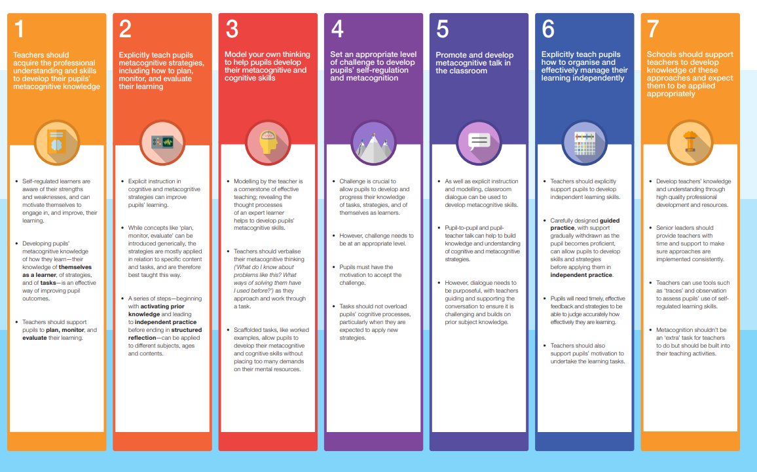
Cognitive and metacognitive strategies
What is it?
Cognition is the mental process involved in knowing, understanding, and learning. Cognitive strategies are skills like memorisation techniques or subject-specific strategies like methods to solve problems in maths. Cognitive strategies are fundamental to learning and are the ‘bread and butter’ of effective teaching.
Metacognition refers to the ways in which pupils monitor and purposefully direct their thinking and learning. Metacognitive strategies are strategies we use to monitor or control our cognition, such as checking whether our approach to solving a mathematics problem worked or considering which cognitive strategy is the best fit for a task.
What might this look like in practice?
Special Educational Needs in Mainstream Schools. Guidance Report. Education Endownment Foundation, 2021)
Notes:
Cognition makes sense of the world. Metacognition makes sense of cognition itself.
The term ‘cognitive strategies’ refers to the techniques teachers use that explicitly support pupils to learn and retain information. As adult learners, we often find our own cognitive strategies without needing to be taught them. Whether it’s remembering a phone number, learning an instrument or studying for an NPQ, many of us will have found our own ‘cognitive strategies’ to help us to learn successfully.
Some of our pupils, and many of those with SEND in particular, may lack the skills to select appropriate strategies independently.
Two types of cognitive strategy recommended in the EEF’s evidence review are:
Mnemonic interventions and Graphic organisers – link to helpful hints on next slide
Metacognition – thinking about thinking
Refers to a learner’s understanding of their own abilities and their attitudes towards learning (myself as a learner); what strategies are available to them that they know to be effective (my knowledge of strategies); and their knowledge about specific kinds of tasks (my knowledge of this task).

Slide 17
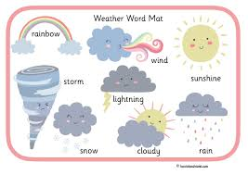

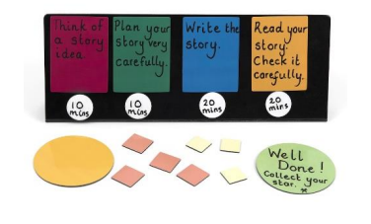
Helpful Hints - Cognition
Notes:
Organising information visually can support pupils’ understanding of content, making abstract learning more concrete and reducing reliance solely on the verbal.
Other examples might be a Frayer model, a Venn diagram, a knowledge organiser, a T‑chart of pros and cons, a mindmap or a timeline
Word MaT – they provide visual support for spelling and writing, helping children learn new words and improve their vocabularly in a fun and engaging way. By using word mats, children can easily reference practise spelling words correctly, leading to improved writing skills overall.
Processing time - Offer additional thinking time to formulate responses and act upon instructions
Visual - Offer a visual task timeline as part of a task slicing approach:

Slide 18

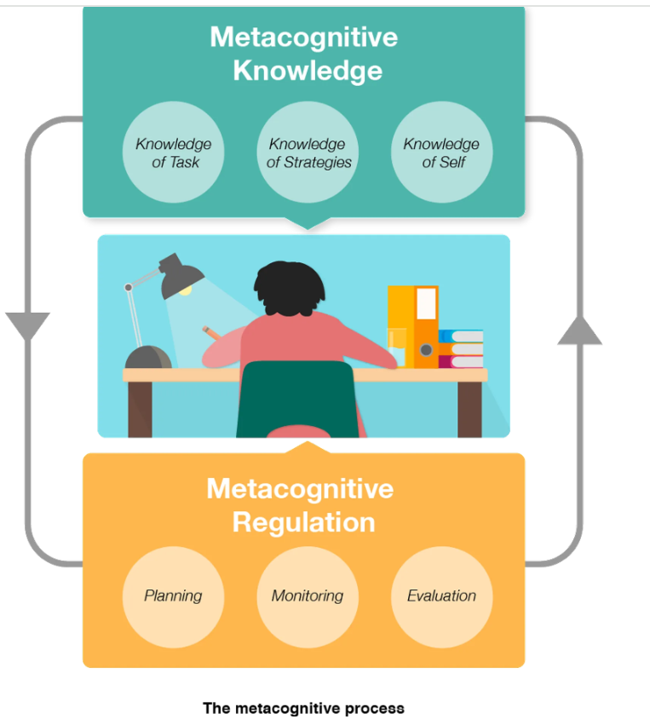
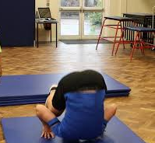
Helpful Hints - Metacognition
Special Educational Needs in Mainstream Schools. Guidance Report. Education Endownment Foundation, 2021)
Notes:
1. Self-regulated learners are aware of their strengths and weaknesses, and can motivate themselves to engage in, and improve, their learning.
developing self-regulated learning and metacognition, this means we need to make sure that we don’t give too much information at the same time (when delivering explicit instruction), and do not expect the learner to take on too much challenge when doing guided practice and independent work.
Teachers can model their thinking as they approach a task to reveal the reflections of an effective learner.
2. Teachers can outline their thinking about their knowledge; for example, while teaching young pupils how to perform a forward roll safely in PE, a teacher might talk through her actions as she demonstrates: ‘I don’t want to hurt my neck and want to do this neatly. So first, to protect my neck, I need to tuck my chin to chest like this. Then when I start to roll, I remember not to roll onto my head. Instead, look how I’m going to roll onto my back and shoulders. This also means my back is round, so I can smoothly roll like this. Now, who can remember what I did first to protect my neck?’
3 Common teaching strategies to better organise and structure classroom talk and dialogue include ‘Socratic talk’, ‘talk partners’, and ‘debating’ (each strategy having its own clear parameters and rules for responsible dialogue).

Slide 19
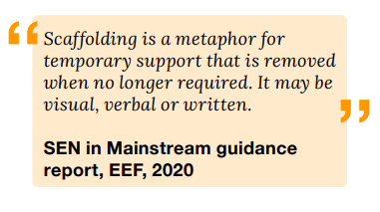
Scaffolding
What is it?
Scaffolding is one of the five evidence-based approaches—a ‘Five a-day’—
that the EEF’s guidance report, Special Educational Needs in Mainstream Schools, recommends to support pupils with SEND to make good academic progress. Consider how you can
provide scaffolds in a way that reduces stigma, promotes independence and reduces over time.
What might this look like in practice?
Making information relevant and interesting to the learner, where it enhances the learning experience, can be a useful strategy – it is important that additional detail does not distract from the key content of the lesson. Furthermore, use of memory strategies reduce the amount of information to be held in the learner’s mind at any one time (cognitive load) allowing them to process information without losing it. In school, these may be concrete resources e.g., number lines, word banks, reminders of rules.
Special Educational Needs in Mainstream Schools. Guidance Report. Education Endownment Foundation, 2021)
Notes:
Talk about analogy of scaffolding on a house – removing it when no longer needed.
The point of scaffolding – whether on a house or in a classroom – is that it provides the support required, which is then removed when no longer needed. For teachers, how and when we remove our classroom scaffolds is a vital part of effective practice for pupils.
The EEF defines scaffolding as ‘a metaphor for temporary support that is removed when it is no longer required’, providing ‘enough support so that pupils can successfully complete tasks that they could not yet do independently

Slide 20
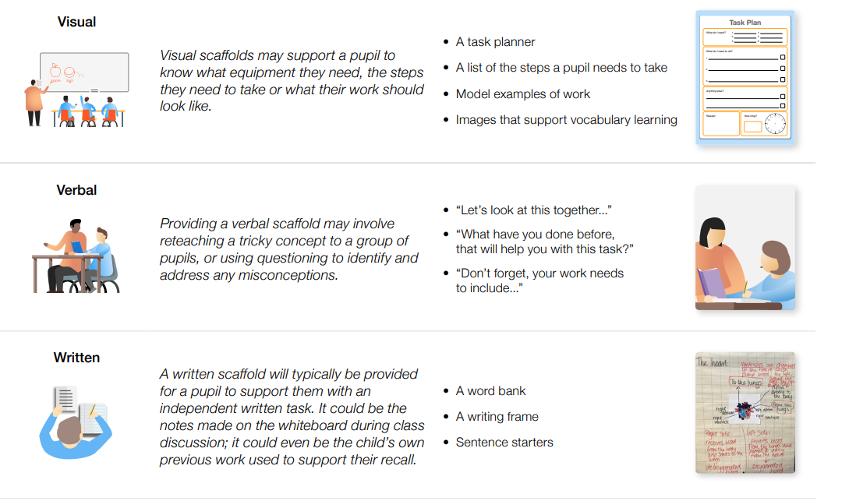
Helpful Hints - Scaffolding
Special Educational Needs in Mainstream Schools. Guidance Report. Education Endownment Foundation, 2021)
Notes:
Rather than requiring teachers to be creating different worksheets for pupils with different needs, scaffolding can be a term used to describe:
1. A verbal scaffold, such as a teacher correcting a misconception at a pupil’s desk - Providing a verbal scaffold may involve reteaching a tricky concept to a group of pupils, or using questioning to identify and address any misconceptions.
2. - A visual scaffold, such as a task planner - Visual scaffolds may support a pupil to know what equipment they need, the steps they need to take or what their work should look like.
3. A written scaffold, such as a writing frame- A written scaffold will typically be provided for a pupil to support them with an independent written task. It could be the notes made on the whiteboard during class discussion; it could even be the child’s own previous work used to support their recall.

Slide 21
Flexible grouping
What is it?
Flexible grouping is driven by data. You can use data you already have about students to group and regroup them to meet their evolving needs. The data doesn’t have to be fancy. It can be as simple as observing students’ work during a lesson. In doing so, you may see that some students could benefit from more practice in a small group before moving on.
What might this look like in practice?
Allocating groups flexibly, based on the individual needs that pupils currently share with other pupils.
Grouping pupils together where they all need additional instruction to carry out a skill, remember a fact or understand a concept.
Special Educational Needs in Mainstream Schools. Guidance Report. Education Endownment Foundation, 2021)
Notes:
The SEND Code of Practice makes clear that teachers are responsible and accountable for the progress and development of the learners in their class, including where learners access support from teaching assistants and specialist staff.

Slide 22
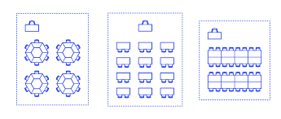
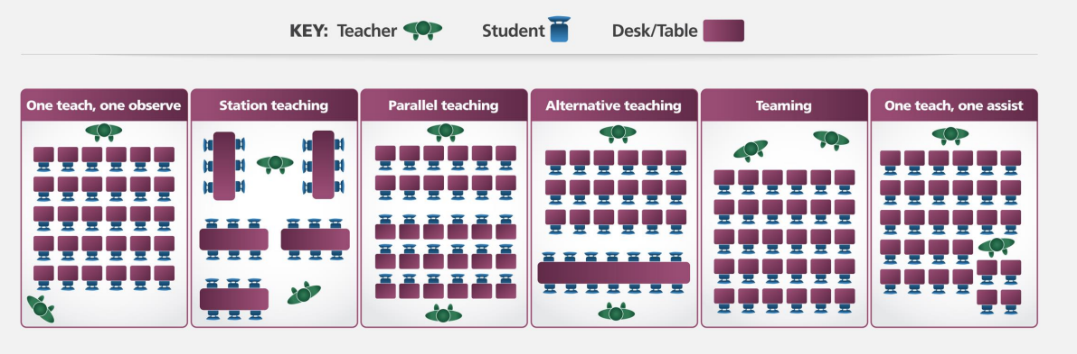
Helpful Hints
Flexible Grouping
When planning TA support in lessons, teachers can consider implementing co-teaching approaches:
Classroom Layout
(Teacher Handbook:SEND. Embedding Inclusive Practice. NASEN, 2022)
Notes:
Allocate pupils to groups flexibly based on the individual needs that they currently share with other pupils
Play to strengths – example good reader/writer
Consider the lesson you are delivering and how you group
Study buddy – comfortable and supportive peer
Talk through each approach....
One teaches, one observes: One adult leads the lesson and the other gathers data on the learners.
Station teaching: Learners are arranged in groups of six – two stations include facilitated instruction, with remaining stations focused on independent, partner or small group work. The two stations of learners receiving facilitated instruction are planned as part of a lesson sequence; these stations should be planned to meet the needs of individual learners in a lesson and should change throughout a series of lessons.
Parallel teaching: In this approach, all learners have double the opportunities to participate in class discussions, as the teacher and TA split the class into two groups. This approach can be used for part of a lesson; it is important that both groups have equal time with the teacher.
Alternative teaching: Sometimes, it can be beneficial for one adult to work with most of the class, while the other focusses attention on a small group. This approach can enable pre-teaching of new vocabulary to take place, provide time for misconceptions to be clarified with a small group of learners or for further support to learners who need extra time to understand previous teaching.
Teaming: The teacher and TA share leadership in the classroom; both are equally engaged in the instructional activities.
One teaches, one assists: The teacher leads the lesson while the TA supports individual learners quietly. The teacher provides guidance to the TA on which learners to support and the levels of scaffolding needed.
There is no ‘one-size-fits-all approach’ to TA deployment, and different strategies may work better in different subjects, or with different groups of learners. Emphsise that teachers should continually reflect on deployment of TAs in lessons, and the impact the TA support has regarding the learning of all learners, including those with SEND.
This reflection should include both feedback from the TA and the voice of the learner(s) a TA is supporting.
2. The classroom environment can have a huge impact on the senses and nervous system, and therefore on learning and progress
2. The layout of the room needs careful thought: how learners are grouped, accessibility to resources and parts of the room (such as coat and bag hangers), and visibility of whiteboard and displays. It may be appropriate to set up areas according to learner needs – for example, a quiet corner, a help station, or an individual working area.
Consider displays
Be mindful of visual clutter – a place for everything and everything in its place

Slide 23
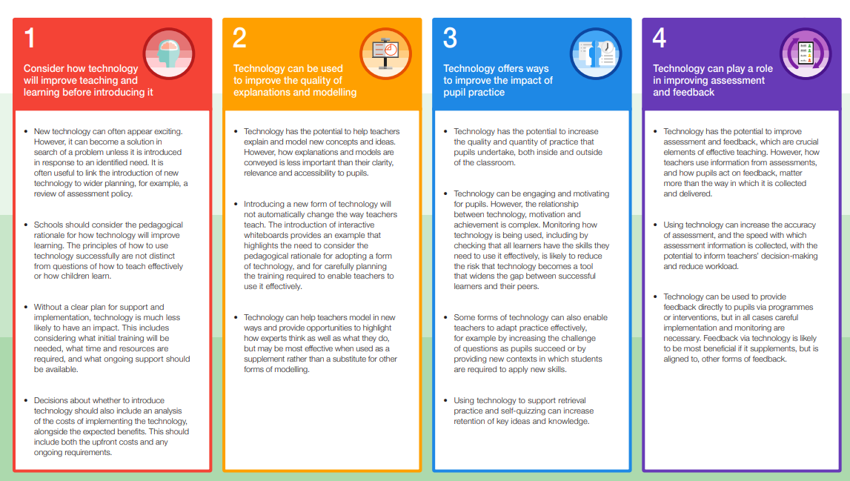
Using technology to support pupils with SEND
What is it?
Technology can be used by a teacher to model worked examples; it can be used by a student to help them to learn, to practice and to record their learning. For instance, you might use a class visualiser to share students’ work or to jointly rework an incorrect model.
What might it look like in practice?
https://educationendowmentfoundation.org.uk/education-evidence/guidance-reports/send
Notes:
Talk through each of the 4 areas from the digital technology summary of recommendations

Slide 24
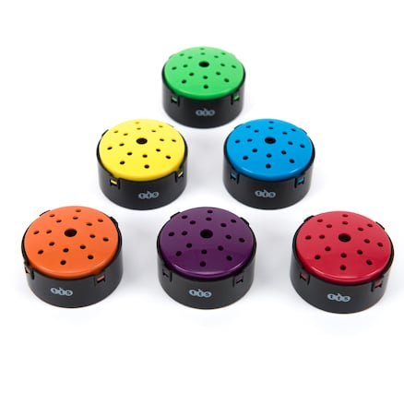
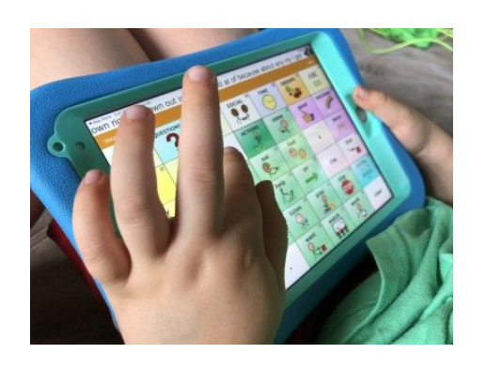

Helpful Hints
Using technology
https://d2tic4wvo1iusb.cloudfront.net/production/eef-guidance-reports/send/EEF_Special_Educational_Needs_in_Mainstream_Schools_Guidance_Report.pdf?v=1718616295
Notes:
The evidence review for this guidance report found evidence that, for pupils with SEND, technology can be a useful tool for supporting teaching.
1 Successful approaches could include using:
• instructional apps—apps that provide instruction, modelling, or practice opportunities for a wide range of skills;
• non-instructional apps—apps that provide tools to aid learning, such as note-taking apps; talking tins, recording devices
• speech-generating apps to augment the communication skills of pupils with communication difficulties
The use of technology can also support students sensory needs – using music to support students to filter out overwhelming background noise

Slide 25
Additional Helpful Hints
​Provide a predictable routine – whole class and individual timetables
Limit environmental distractions - excessive noise, distracting visual stimuli, clutter, etc. (For some students listening to “white noise” or soft background music can help concentration and focus.)
Acoustics – Sound waves bounce off hard surfaces, causing reverberation which makes listening more difficult. Soft furnishings such as carpet, rugs, curtains/blinds, cushions and display boards can help.
Regular movement breaks - include meaningful physical activities, songs, movement, sensory activities, jobs, heavy work, proprioceptive and vestibular activities
Allow access to a ‘focus tool’, but ensure rules around the use of them is understood, so as not to be used as a distractor.
Reinforce – Use visual materials and real objects to reinforce new vocabulary
Reduce fluorescent or distracting lighting
An area dedicated to emotional wellbeing is equally valuable in early years, primary and secondary settings.

Slide 26

Reflective Practice – 5 mins
What do I currently do well for every pupil?
What small tweaks do I need to make to my classroom practice to improve Ordinarily Available Provision?

Slide 27
Reference list and websites
https://democracy.york.gov.uk/documents/s172751/Annex%20B%20SEND%20Ordinarily%20Available%20Provision%20PRINT.pdf
Teacher Handbook:SEND. Embedding Inclusive Practice. NASEN (2022)
Department for Education and Department of Health (2014 (updated 2015)) The Special Educational Needs and Disability Code of Practice: 0-25 years, London: DfE and DoH
https://educationendowmentfoundation.org.uk/news/eef-blog-five-a-day-to-improve-send-outcomes
(https://d2tic4wvo1iusb.cloudfront.net/production/eef-guidance-reports/send/5-a-Day_Reflection_Tool_2023.pdf?v=1715691009
Special Educational Needs in Mainstream Schools. Guidance Report. Education Endownment Foundation, 2021)
https://www.coventry.gov.uk/downloads/download/5427/ordinarily_available_provision_-_early_years_school_age_and_post_16

