Slide 1
Welcome!
Net Zero Webinar Week
Day 2: Energy Audits: Assessing and Improving Your Business’s Energy Use

Slide 2
Energy Audits: Assessing and improving your business’s energy use
Notes:
Best time to do a webinar on energy efficiency is when its minus 5 and everyones got their heating on full!

Slide 3
Housekeeping
Hello and Welcome!
Please turn your video off
Mute yourself to reduce background noise, but unmute to ask questions
You can also use the chat function to ask questions
This webinar will be recorded
There is a Q & A session at the end so please interact
The slides and the recording will be sent out to all the attendees
We will also send out a feedback form, please let us know how we did!

Slide 4
On Today's Agenda
Discussion Points
About me: Jonathan Howl
Energy Audit: Objectives and actions
Energy efficiency measures and examples - real world examples
Energy report summary and cost/carbon savings
Decarbonisation Net Zero Programme: Grants and support available
Q & A

Slide 5
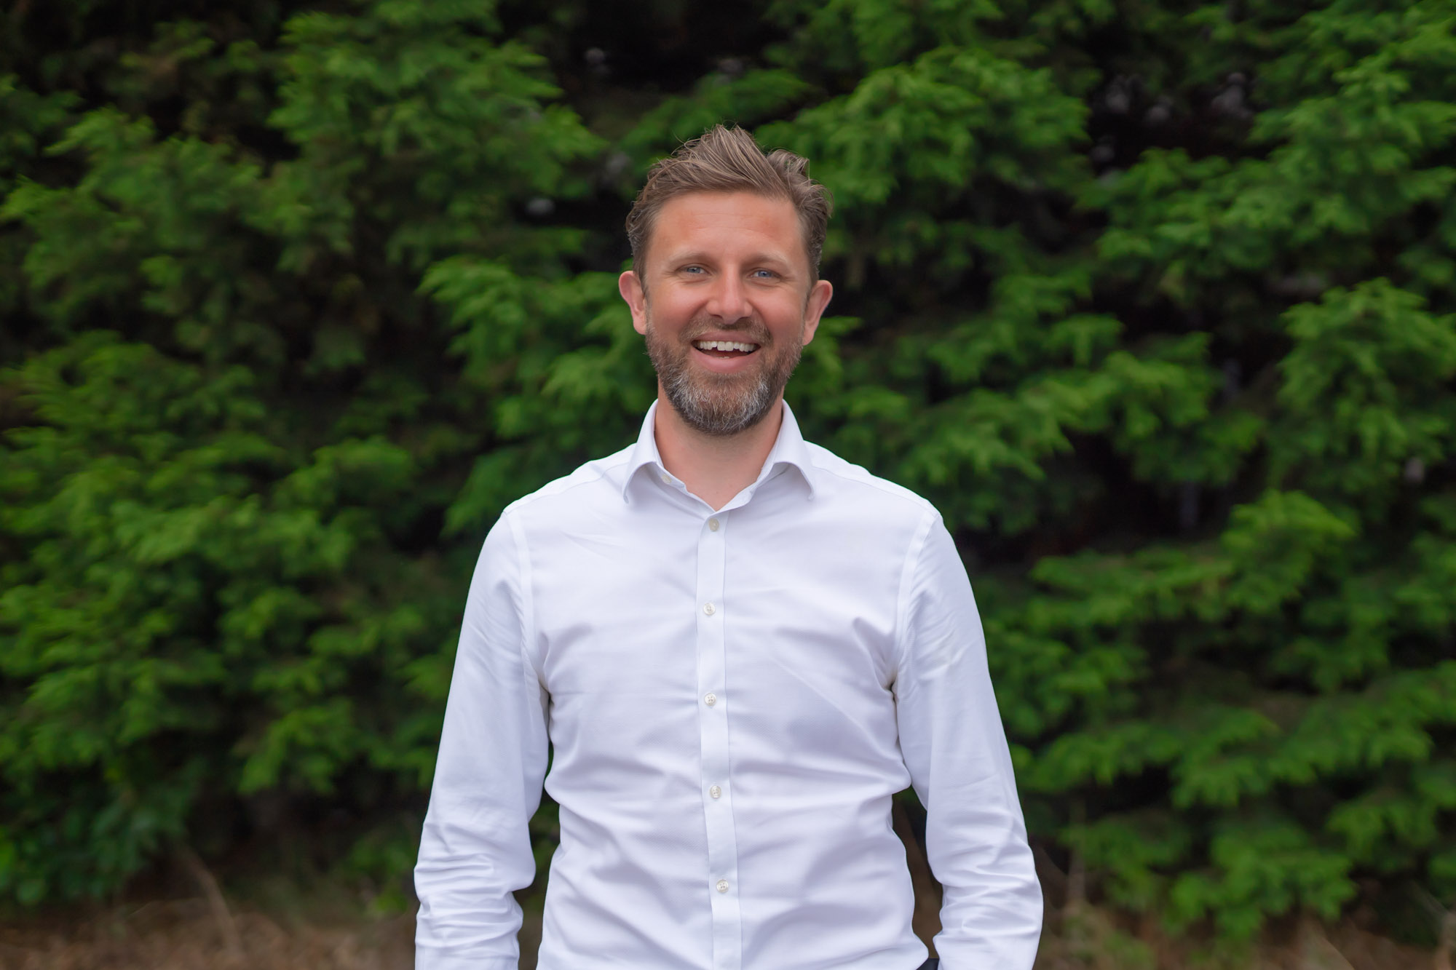
About me
Jonathan Howl
Energy Efficiency Advisor, CCC
Holds a BSc in Geography
MSc in Sustainability and Environmental Management
Practitioner IEMA member
22-year career in the telecoms and IT industries
Started working for Coventry City Council in 2021, since then I have helped over 300 businesses reduce their carbon footprint and energy expenditure

Slide 6
Energy Audit
First step: A discussion
Our energy audits are carried out using ISO50002 methodologies.
This will show you a ‘standard’ audit methodology - for larger consumers of over 750,000kWh/per annum our programme can also provide a ‘high intensive’ audit
Will help identify areas where improvements can be made
Give you the tools to carry out basis self-assessment
Need to be an SME and meet other eligibility requirements
This energy audit can’t help you with:
Your EPC rating & certification
ESOS/ISO14001 certification
Notes:
ESOS – energy savings opportunity scheme. Over 250 employees, t/o more than £44 million. Carbon Trust methodologies. Guidance – flag thing to you. You an then engage with respective experts in e heating
Hopefully this session will give business owners ideas in regards to their own buildings

Slide 7
Energy Audit
First step: A discussion
The first step of an energy audit is a conversation with the business representative. This conversation will focus on:
Business goals
Current baseline energy consumption
The support required
Priorities
Overall sustainability plan
Other benefits of reducing carbon
Notes:
Baseline - if you can’t measure it, you can’t manage it. So need bills prior ideally. Also gives us the energy rate, which has a massive bearing on the ongoing savings and payback periods.
My favourite part of my job is meeting different business owners, learning how they operate and then seeing where we can help Ownership of the building (has a bearing on measures with longer payback). Where the business sees their capital best allocated.

Slide 8
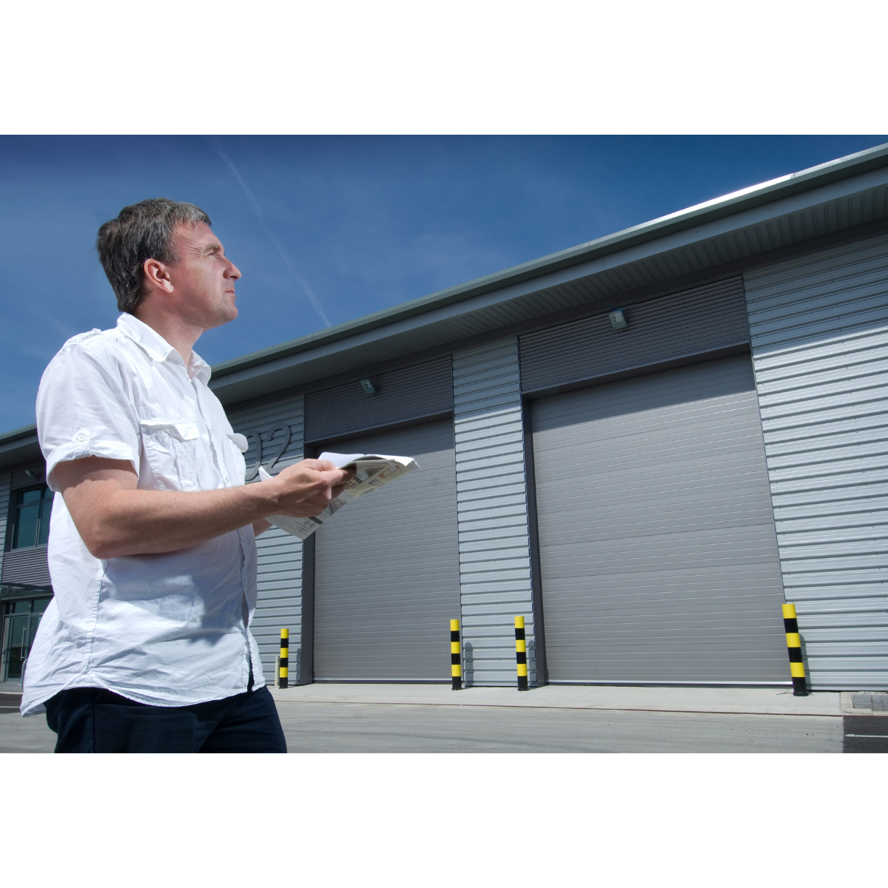
Energy Audit
Second step: A walk around your business premises
During this step your Business Energy Advisor will try to identify:
Where energy is being wasted
How energy can be saved
How the energy produced can become greener
Savings are benchmarked against annual energy consumption
Notes:
Walk around site. Not rocket science, take notes and pictures. Energy consumption v important

Slide 9
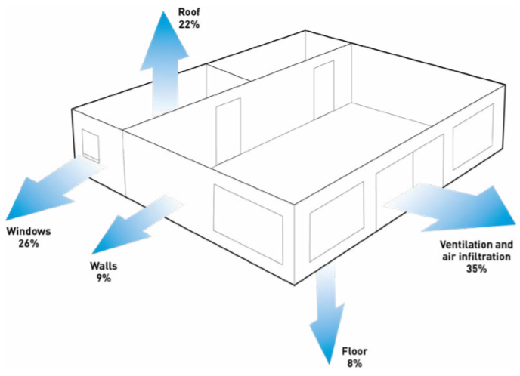
Energy efficiency
Windows and doors
Replace inefficient single-glazed windows and doors
New double-glazing should have U-value of 1.6 or below
Carbon Trust states efficiency gains of 26%
Notes:
Walk you through things I typically identify and what the potential efficiency gains are

Slide 10
Example:
Measure | Indicative project cost (£) | Indicative annual savings (£) | Payback period excl. funding | Carbon saving (tCO2e)
Double glazed windows | £3000.00 | £845.53 | 3.5 years | 3.31
Notes:
Important to state that throughout, an indicative cost will be used. You MAY already have a quote in, we can easily use this. But it is

Slide 11
Energy efficiency
Insulation
Insulating walls and roof space in order to reduce heat loss
Carbon Trust states efficiency gains of 9% for walls and 22% for roof insulation

Slide 12
Example:
Measure | Indicative project cost (£) | Indicative annual savings (£) | Payback period excl. funding | Carbon saving (tCO2e)
Roof insulation | £3000.00 | £2051.33 | 1.5 years | 6.31
Notes:
Important to state that throughout, an indicative cost will be used. You MAY already have a quote in, we can easily use this. But it is

Slide 13
Energy efficiency
Roller shutters
Replacing manual closing and uninsulated shutter doors
New doors should be rapid closure and insulated to minimise heat loss
Typically used in manufacturing areas where heat expenditure may be high
Carbon Trust states efficiency gains between 9% and 18%
Notes:
Efficiency savings vary depending on installation. Ones I’ve helped with can also improve security

Slide 14
Example:
Measure | Indicative project cost (£) | Indicative annual savings (£) | Payback period excl. funding | Carbon saving (tCO2e)
Rapid closure & insulated shutter doors | £30,000 | £9625.00 | 3 years | 18.70
Notes:
Important to state that throughout, an indicative cost will be used. You MAY already have a quote in, we can easily use this. But it is

Slide 15
Energy efficiency
Lighting
Replacing traditional fluorescent and halogen lighting
Efficiency gains vary (Carbon Trust calculator), but payback periods are generally around 3 years
Most common energy efficiency improvement measure
Other benefits: better light quality
Fluorescent bulbs are expensive, need replacing regularly and are being phased out by new legislation
Notes:
Very bespoke depending on site, usage etc. still use Carbon Trust methodology. Old style bulbs are expensive and will soon be phased out.

Slide 16
Example:
Measure | Indicative project cost (£) | Indicative annual savings (£) | Payback period excl. funding | Carbon saving (tCO2e)
LED lighting | £17,045.00 | £4463.00 | 3.5 years | 4.09
Notes:
Important to state that throughout, an indicative cost will be used. You MAY already have a quote in, we can easily use this. But it is

Slide 17
Energy efficiency
Air compressor
Variable speed compressors are significantly more efficient than traditional models, providing approximately 40% ongoing savings
Air line leakages are also a significant source of energy waste in older compressed air systems
Notes:
Most compressor companies will give a detailed efficiency analysis as part of the proposal

Slide 18
Example:
Measure | Indicative project cost (£) | Indicative annual savings (£) | Payback period excl. funding | Carbon saving (tCO2e)
Variable speed compressor | £49,500 | £20,500 | 2.5 years | 23.3
Notes:
Important to state that throughout, an indicative cost will be used. You MAY already have a quote in, we can easily use this. But it is

Slide 19
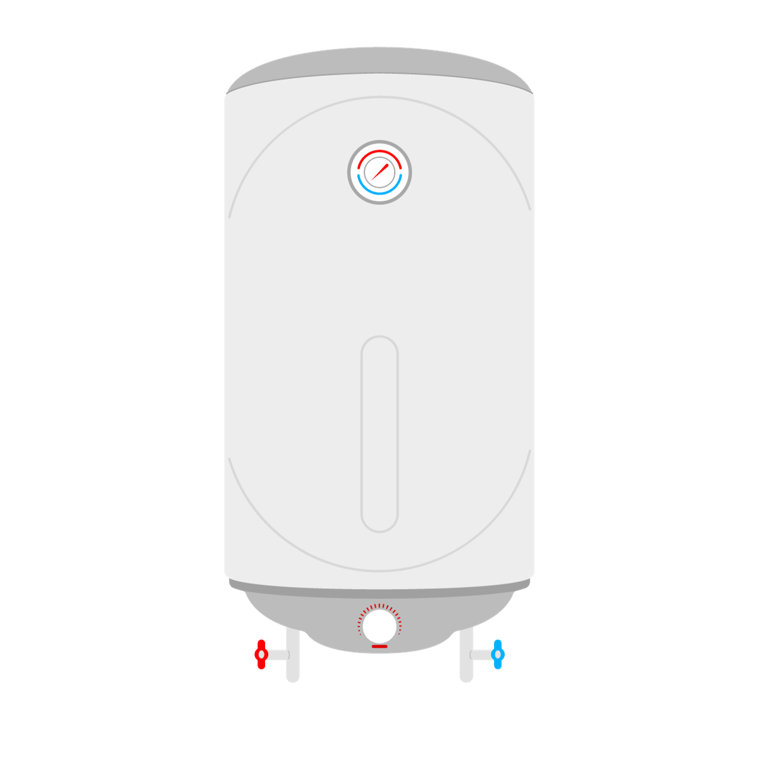
Energy efficiency
Heating
Heating is usually the most significant energy cost in a workplace, accounting for up to 40% of energy use in a non-domestic building.
Often the improvement measure with the most different options as is very bespoke for each site and business sector
Notes:
Very bespoke per site and per sector. I will give guidance on support I’ve given. We have done whole sessions on this in the past

Slide 20
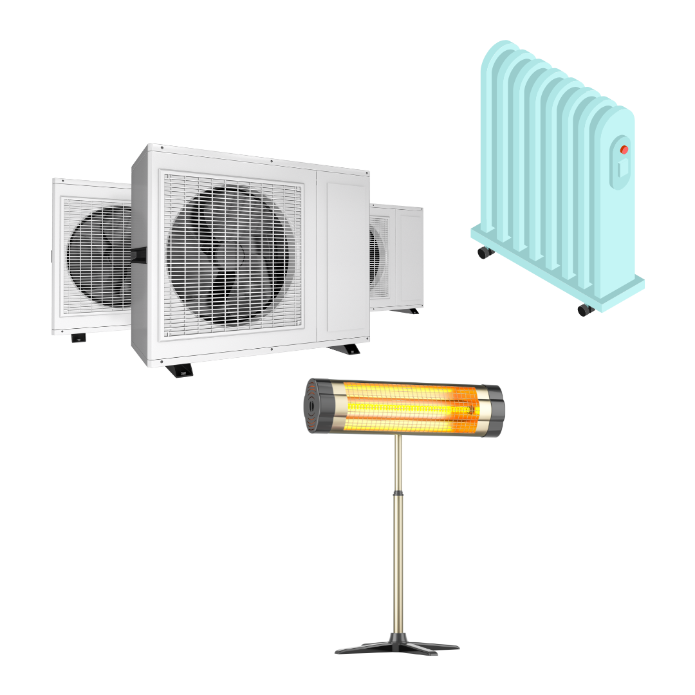
Energy efficiency
By replacing old, inefficient gas boilers with new model savings of up to 30% can be achieved. New models need SAP seasonal efficiency rating of c90%
Electric radiators or IR heaters can ‘heat the man, not the space’
Destratifcation fans can reduce heat consumption by 20% in industrial units where space heaters are used
Heat pumps and HVAC are significantly more efficient, especially if used with solar PV
Notes:
Simple - upgrade gas boiler BUT still fossil fuel. Can swap out boiler for IR/elec rads and hot water points. Can use heat pumps or A/C. For manufacturing sectors they often have large space heaters - yet to see a suitable ‘renewable’ alternative for this (when we do I will do a specific session on it) but destrat fans work well – make what’s in place work more efficiently

Slide 21
Example:
Measure | Indicative project cost (£) | Indicative annual savings (£) | Payback period excl. funding | Carbon saving (tCO2e)
High efficiency boiler | £15,545.00 | £1958.93 | 8 years | 10.87
Notes:
Important to state that throughout, an indicative cost will be used. You MAY already have a quote in, we can easily use this. But it is

Slide 22
Green energy
Solar Pv
Typically, each solar panel generates around 200 - 350W of energy in strong sunlight.
Solar panels generate free and green electricity during the daytime that can be used on-site.
Can also be used in conjunction with battery storage for those businesses with high night-time usage.
Can underpin other low-carbon measures, such as ASHP and EV charging
Notes:
We are all very pro-solar. I have seen paybacks of between 9 months to 3-4 years for a standard installation. The main funding we have cannot be used to support a solar install however I would always discuss it during the audit and provide payback details and guidance. Grant or no grant, it is worth considering, especially if you own the building. Also allows you to promote yourself as a ‘green’ business and makes eg elec heating more viable

Slide 23
Example:
Measure | Indicative project cost (£) | Indicative annual savings (£) | Payback period excl. funding | Carbon saving (tCO2e)
51kWp solar PV array | £49,500.00 | £11,462.25 | 4.3 years | 10.31
Notes:
Important to state that throughout, an indicative cost will be used. You MAY already have a quote in, we can easily use this. But it is

Slide 24
Energy efficiency
Machinery
Replace machinery with more efficient model, both in terms of energy consumption and productivity
Examples include CNC machines, lathes and dust/fume extraction
Improve manufacturing processes
High intensity audit can look at this area in more detail for qualifying companies
Notes:
Eg CNC machines – produce more in quicker time and have a lower consumption. Metalwork Processes – centrifuge - cut down on oil passing through the washer reduced washer operation time AND allowed the oil to be re-used

Slide 25
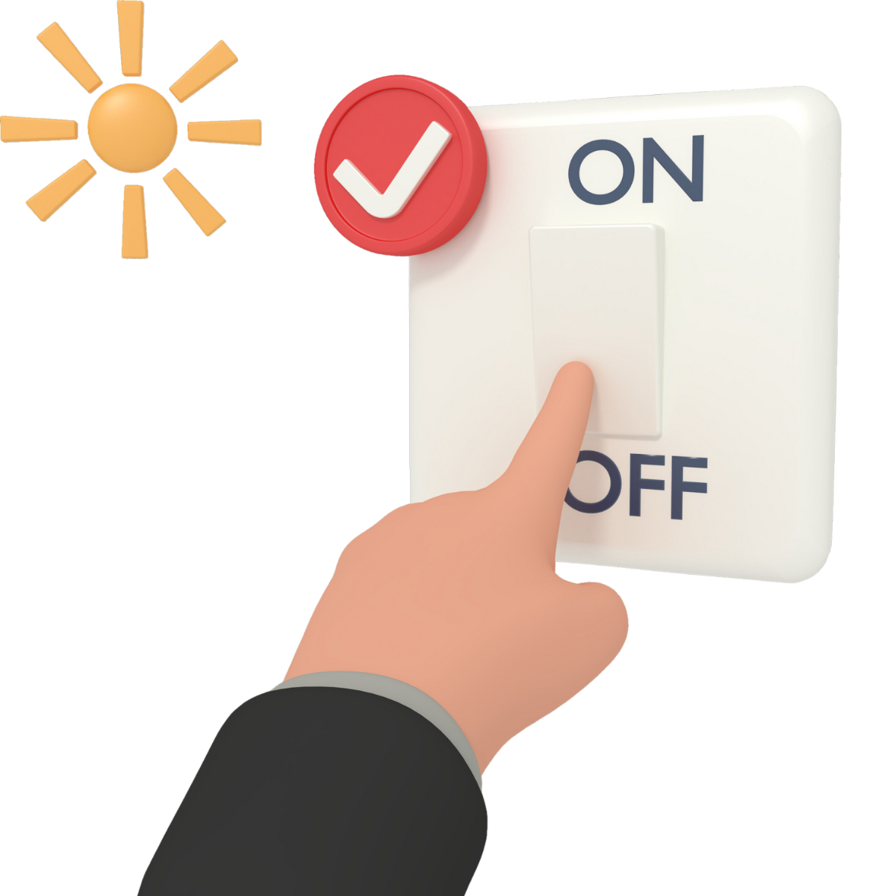
Energy Management
Behavioural Changes
The Carbon Trust estimate that companies can save up to 10% on energy costs by no cost measures. Good housekeeping measures which include:
Ensure all lights are switched off when not in use
Ensure all PCs and monitors are switched off when
not in use (at the plug).
Ensure external doors are closed when not in use – This is to prevent heat escaping through the open doors
Electricity is metered half hourly and data should be available from the electricity supplier.
Assign a staff member as ‘energy champion’, tasked with setting rules and increasing staff engagement

Slide 26
Energy Report
Measure | Indictive project cost (£) | Indicative annual savings (£) | Payback excl. funding | Carbon saving (tCO2e)
DG windows | £3,000 | £845 | 3.5 years | 3.31
Roof insulation | £3,000 | £2,051 | 1.5 years | 6.31
Roller shutters | £30,000 | £9,625 | 3 years | 18.70
LED lighting | £17,045 | £4463.00 | 3.5 years | 4.09
Boiler | £15,545 | £1,958 | 8 years | 10.87
Air compressor | £49,500 | £20,500 | 2.5 years | 23.3
51kWp solar | £49,500 | £11,462.25 | 4.3 years | 10.31
Energy management | £FOC | £10,000 | Immediate | 10.0
TOTALS | £167,590 | £60,904.25 | 2.75 years | 86.89
Allows business to prioritise measures based on cost savings and business need
Shows estimated capital costs and paybacks. Business will then need to obtain their own quotes for the work
Further detail on each recommendation is given
Business can then engage with chosen suppliers for confirmed costs and expert advice
Notes:
Again – reiterate that this is for guidance only - suppliers will give confirmed capital price, offer more specialised advice - EG in regards to heating once a supplier has been to site a totally different installation has been suggested - this is fine and can still be supported. Cannot stress this enough - Our time is free, the audit is free and the grant is a grant - but you will need to engage with expert, reputable suppliers

Slide 27
OBJECTIVES
What We Aim to Achieve?
Support decarbonisation efforts in local businesses while improving the natural environment
Provide immediate support to businesses to enhance their competitiveness and sustainability, including free guidance and access to 50% grants of between £1000 - £100k
Align with the UK government's legally binding climate target to reduce carbon emissions to
Net Zero by 2050

Slide 28
The Journey Ahead
What to Expect in Your Decarbonisation Journey?
Energy Assessment
Register
Audit Triage
Recommendations
Grant Application
Start by completing the registration form on BGWM’s website or by contacting our team.
After registration, our Business Engagement Managers will reach out to you to complete the audit triage and check your eligibility.
We will then conduct a FREE assessment, examining your energy usage and operations.
Based on the assessment, we'll provide you with recommendations for cost-effective energy saving measures.
Your business has the opportunity to apply for grants of up to £100,000 to implement the energy efficiency recommendations.
Notes:
V important – QUOTES needed - you will need to get 3 quotes. This ensures best value you can use your preferred supplier). Important to state you have to apply for the grant BEFORE starting any work, and the grant is paid out following install and claim

Slide 29
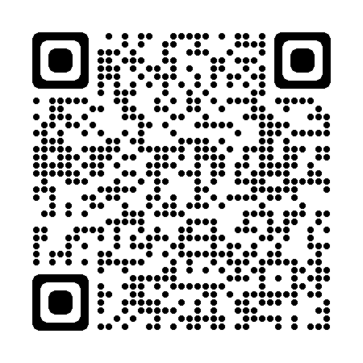
Other resources
Green Business Network
The Green Business Network allows businesses to come together, share ideas and promote energy, resource, waste and water efficiency as well as engage on low carbon, environmental and green sustainability initiatives.
Free to join
3300 members
Networking opportunities
Free newsletter
Be the first one to find out more about events and grant support opportunities
Join now
Use this QR code to join

Slide 30
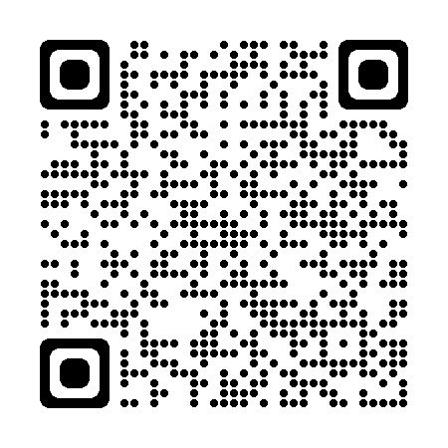
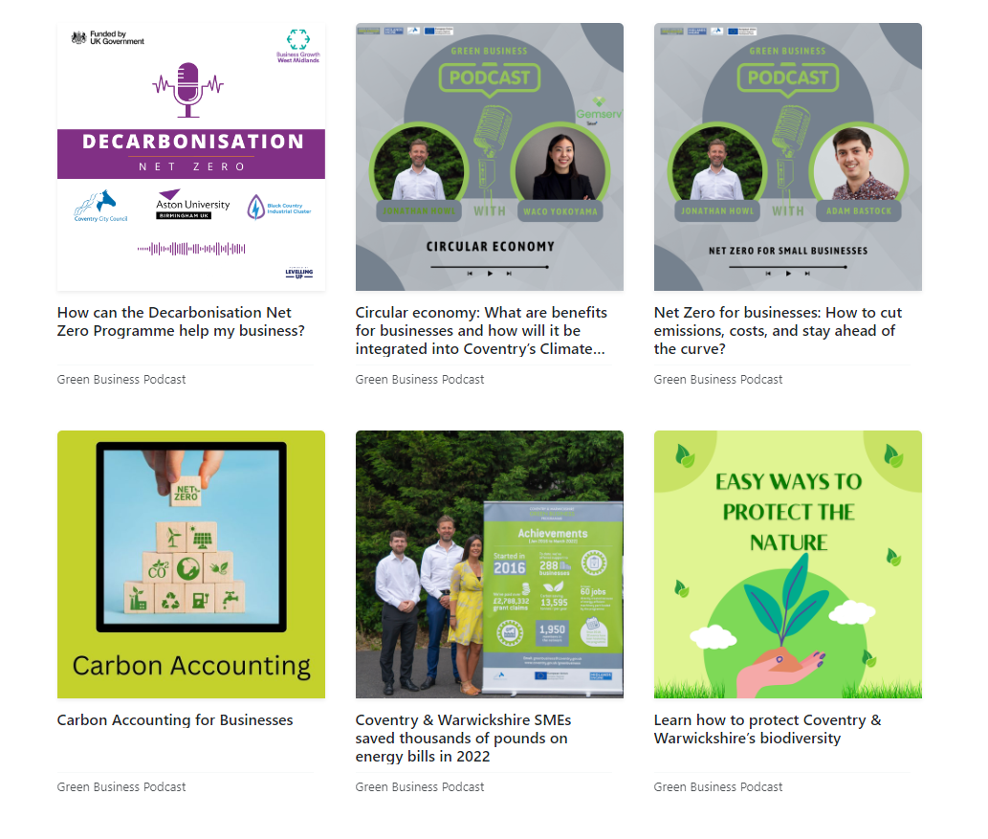
Other resources
Green Business Podcast
Listen to our monthly podcast to learn more about energy, resource, waste and water efficiency as well as engage in low carbon, environmental and green sustainability initiatives.
New episodes every month
Over 20 episodes so far discussing solar PV, heat pumps and sustainable business practices
Use the QR code or this link to subscribe

Slide 31
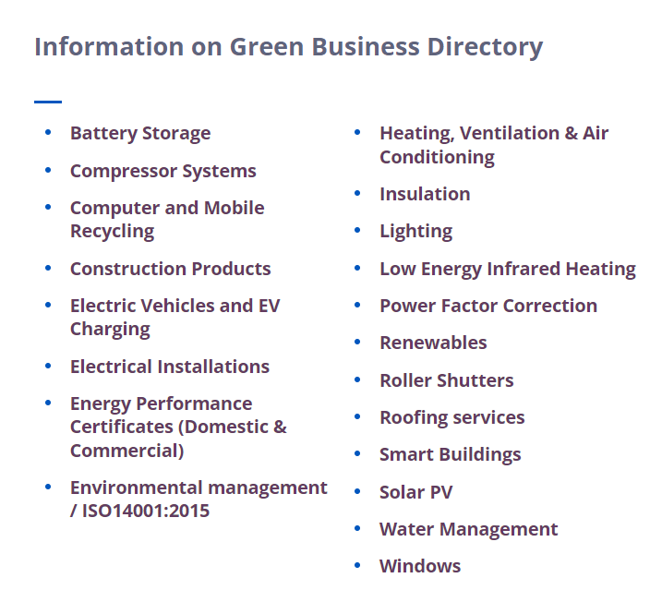
Other resources
Green Business Directory
Find a list of local suppliers and installers who can help you improve your business .
Over 100 companies
20 categories including solar PV, roofing services and water management
If you are a local installer or supplier please get in touch and we will add you to the directory
Notes:
As a local council we have to stay impartial………

Slide 32
Is Your Business Ready to Make the Change?
EMAIL ADDRESS
decarb@aston.ac.uk
PHONE NUMBER
0121 204 4828
TO REGISTER
West Midlands: bit.ly/DNZ-Audit-Register
Warwickshire: https://bit.ly/3skX34q
Learn more about the programme

Slide 33
Q & A

Slide 34
Thank you all for joining!
The presentations and a recording for this webinar will be sent out to you shortly.
Notes:
NEXT EVENTS - Tomorrow’s webinar gives case study examples – so will go through the actual projects referred to in these slides in more detail. 10th October – MTC event

Slide 36
www.businessgrowthwestmidlands.org.uk
Twitter: @decarbprogramme
LinkedIn: Decarbonisation Net Zero Programme

