Slide 1


Welcome!
Net Zero Webinar Week
Day 4: Carbon Accounting Explained

Slide 2





Your Partner on your journey to Net Zero
An Introduction to Carbon Accounting
Presented by: David Wilshin
Date: 26th September 2024
© AUDITEL 2023

Slide 3
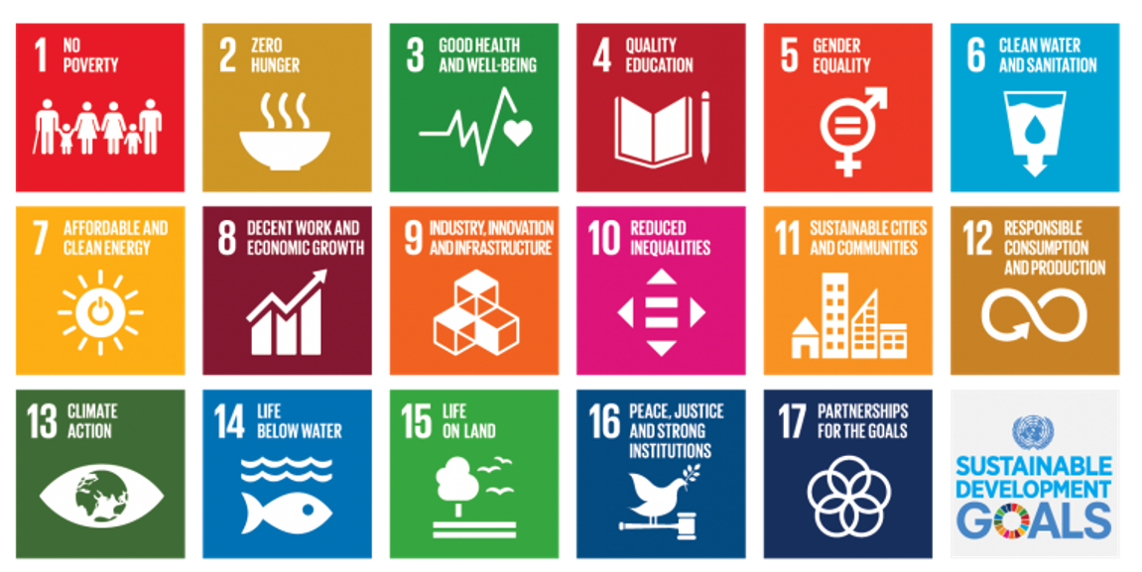
Carbon Management
Sustainability in the whole
Climate Action is one of the 17 UN Sustainable Development Goals (SDGs).

Slide 4


Carbon Management
What the terminology is and what it means
Carbon Neutral – short term
Means balancing your reducing GHG emissions by “offsetting” an equivalent amount of carbon for the amount produced.
Net Zero – long term
This is reached when the amount of residual CO₂e emitted is matched by the quantity of CO₂e removed or captured. You cannot achieve net–zero by offsetting.
© AUDITEL 2023
© AUDITEL 2023

Slide 5

Carbon Management
What the terminology is and what it means
Organisational Carbon
Means the GHG emissions associated within the operational boundaries of the subject and within the organisational control.
Embodied Carbon
Means the carbon associated with the material extraction, transport to manufacturer and manufacturing of a specific items or products.
© AUDITEL 2023
© AUDITEL 2023

Slide 6
Carbon Management
Net Zero Ambition
Net Zero – long term
Generally accepted definition means 90%
reduction in GHG emissions.
GHG Emissions
CO₂ Removals
Current State: Net amount of GHG emissions is>55 GT CO₂e year
Goal: Net amount of GHG emissions is zero GT CO₂e year
To limit global warming to 1.5’C, we must reach net-zero carbon emissions no later than 2050
Anthropogenic GHG emissions
Anthropogenic carbon removals

Slide 7
Carbon Management
GHG Emissions
GHG
7 main gases
convert back to
tCO₂e
CO₂
_{(Carbon Dioxide)}
_{GWP x1}
CH₄
_{(Methane)}
_{GWP x28}
N₂O
_{(Nitrous Oxide)}
_{GWP x265}
HFCs
_{(Hydrofluorocarbons)}
_{GWP x150 -11,500}
PFCs
_{Perfluorocarbons)}
_{GWP x6,500 – 9,200}
SF₆
_{(Sulphur}
_{Hexafluoride)}
_{GWP x23,500}
NF₃
_{(Nitrogen}
_{Trifluoride)}
_{GWP x16,100}

Slide 8











Carbon Management
Opportunities & Challenges
Market Forces
Challenges
Consumer demand
Lack of expertise & good data
Legal reporting
Too big a challenge
Your competition
Confusion
Tender returns – PPN 06/21
Fear of Greenwashing
Increasing costs
Perceived cost
Notes:
So why should organisations, feel that carbon management is an important subject matter? Well, there’s a lot of market forces at work out there, and we hear people talk about these all the time. Firstly, we increasingly see consumer demand is putting pressure on organisations to be able to demonstrate their carbon credentials. Increasingly, we have a savvy audience buying products and services from us, and we need to meet those consumer demands.
There’s increasing levels of legislative requirements, legal reporting, government requirements, industry requirements, to meet certain greenhouse gas emission standards or carbon reporting standards, and we can’t ignore those. Those are there today and they’re increasing by the year. These again are driving the consumer demand as the organisations which have legislative requirements have measured their footprint and are managing their carbon. They initially started with their scope 1 and 2 but as they now move to looking at their scope 3 they want to work with suppliers who are also managing their carbon emissions.
PPN 06/21 was a new procurement policy notice published in 2021 where any tender that is bid for central government, greater than five million in value, that bid submission has to be supported with a carbon reduction plan, and other carbon or environmental-based credentials. And this again is driving pressure for organisations to demonstrate their carbon credentials and their position in regard to the environment.
And importantly as all of this occurs, ripples are being created within the supply chain, causing other businesses to now need to meet those standards. So even if you don’t directly supply a government contract of five million, if you are supplying a business that supplies or is bidding for the government contract, when they put together their carbon reduction plan to meet the tender requirements, one of the steps they’re going to do is look at their Scope 3 emissions and tap you up as a supplier to ask for what your credentials are. So increasingly, you’re going to see this ripple effect occurring through the market and through the supply chain, causing organisations all around the world to need to pull up their socks and consider carbon credentials in more detail. Those suppliers who are managing their carbon are winning more work as a result.
And it isn’t just work they are winning. As I know from my time at Bakers, the younger generation really cares about these areas. Our graduate recruitment team were asked by applicants what we were doing in terms of our carbon reduction. And we are increasingly seeing young talent want to work with those organisations who are managing their carbon emissions.
And the final market force that’s at work, is increasing cost. A large part of Carbon management, is about carbon removal or reduction, using less energy in your organisation. Using less energy will save you money, because there’s an increased cost to energy; it’s a fossil fuel, it’s limited in its provision and we’re seeing a lot of volatility in that market. So there’s a strong pressure for companies to remove the amount of energy they use, which ties in brilliantly with carbon management.
But on the other side of the equation, what we’ve also seen in many of the organisations we’ve spoken with is that whilst these market pressures, these forces, are at work and we see them and feel them, on the other side of the equation, there are challenges. Things that are stopping organisations from actually doing something in this area. A lot of the time, we see companies where they lack real internal expertise or awareness on how to measure where they are today. They lack the ability to get to good data and order that data in such a way to turn it into something meaningful. It leads to a lot of head-scratching a lot of confusion as to what to do, and that confusion can lead to paralysis or inaction.
Many clients we speak to, admit that they just feel the challenge is too big. It’s just too big an elephant to eat all in one go – how am I possibly going to deal with this? Many of them feel that, in fact, they’re such a small contributor in the scheme of things, what could little old me possibly do, what difference could I possibly make? But the reality is, the challenge is big if you look at it in the whole, but if we break it down to bite-sized chunks, to a stepped process, over a period of time, it does become an achievable objective, something we can rise to as a challenge. And very importantly, if we all take a step to deal with some of the challenge, even if the amount of our own footprint is small, by taking account of our own footprint, doing something about it, it will mean we create ripples in the supply chain. We ask our supplier questions. And as we do that, we will influence the wider world and the wider market. So, no matter how big or small the organisation, by all of us doing something, it can make a bigger difference elsewhere through the ripples we create.
We see that there’s a lot of confusion. What does good look like? What terminology should be used? This confusion leads to a lot of fear that they may be caught or accused of what’s become termed as greenwashing. Making environment statements or propositions which aren’t really making the meaningful difference that they should be making. And that leads again to paralysis for a lot of companies where they’re not moving for fear of doing something wrong.
And the final challenge that gets in the way of people dealing with carbon management is a perception of cost, particularly after the last couple of years that we’ve all been through. Businesses, in many cases, still just getting back on their feet, reorganising, re-growing, dealing with the new world. There’s a perception that this is just another cost that I just can’t be dealing with right now. However as I said at the beginning we work with clients using our carbon, cost and procurement expertise so that being carbon neutral could potentially be a cost-neutral exercise. So even that challenge is probably less relevant today than it used to be.

Slide 9


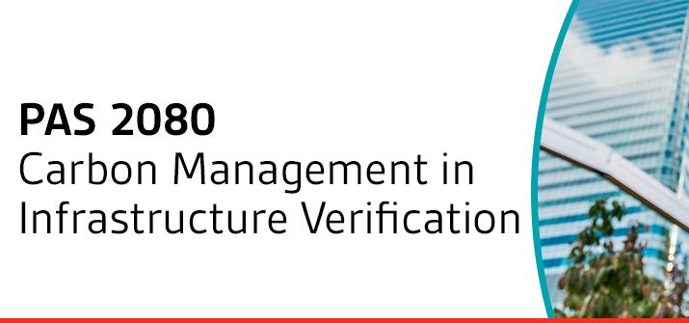


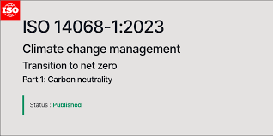

Carbon Management
Standards & Disclosure Frameworks
Verification of Science Based Reduction targets
B Corp
Carbon Management in Infrastructure
Carbon Disclosure Project
Carbon Neutral
Ecovadis
Notes:
There are, broadly speaking, 9 grades of carbon reporting that you can find in the marketplace through our research. Right at the bottom at Level 1, almost the no-value carbon reporting, is when someone just takes their energy usage data and they plug it into some unverified portal online, either free or low cost. They plug in a bunch of energy usage data and they get a ton of CO2 equivalent numbers back in return. That is not a carbon footprint report. It’s just a number based upon energy data, and it’s not even a verified number because you don’t know what calculation method or factors are being used in the background to give that number. It’s pretty much pointless and worthless.
You then work up the different grades. Level 4 carbon footprint report, for example is where they have looked at various emission sources. They have achieved a level of definition documentation around the boundaries of what it is that that footprint report is covering. They may be using recognised calculation methods. But in many cases, it’s still only goes to Scope 1 and Scope 2 emissions. Most of them I’ve seen make a promise of looking at Scope 3 at some point down the road, but they’re not really getting into it just yet or doing it just yet. And that’s a very common level of reporting you see.
Level 6 or upwards, is where the carbon footprint report does map in some detail all of the emission sources, considering everything that is material to the organisation. Now, you can exclude Scope 3 emissions which are not material to the overall footprint, and broadly speaking, without getting into the finer minutiae or detail, that would be anything less than 1%, any single level of emissions less than 1%. You can exclude up to 5% of your emissions in Scope 3 for that reason. However Level 6 or above provides detail, definition and documentation as to those boundaries, that narrative as to what it is we’re actually measuring within the organisation. It absolutely has to look at Scope 1 and 2 emissions, but it should then also go further to look at all material scope 3 emissions. We work to a minimum of level 6 so that our clients, even if they are not looking to achieve PAS 2060 certification, have a high quality of carbon footprint.

Slide 10




Carbon Management Process
The New Normal
Verify
STEP: 01
Measure
STEP: 02
Set Targets
Assure
Validate
STEP: 03
Reduce

Slide 11













Carbon Management
Scopes 1,2,3
NF3
N₂O
HFC S
CH₄
CO₂
PFC S
SCOPE 2
INDIREC T
SCOPE 3
INDIREC T
SCOPE 1
DIREC T
SCOPE 3
INDIREC T
S F₆
LEASED ASSETS
ELECTRICITY, STEAM, HEATING & COOLING FOR USE
EMPLOYEE COMMUTING
TRANSPORTATION & DISTRIBUTION
BUSINESS TRAVEL
COMPANY FACILITIES
PROCESSING OF SOLD PRODUCTS
PURCHASED GOODS & SERVICES
CAPITAL GOODS
FUEL & ENERGY RELATED
TRANSPORTATION & DISTRIBUTION
WASTE FROM OPERATIONS
COMPANY VEHICLES
USE OF SOLD PRODUCTS
END-OF-LIFE TREATMENT OF SOLD PRODUCTS
LEASED ASSETS
FRANCHISES
INVESTMENTS
UPSTREAM ACTIVITIES
REPORTING COMPANY
DOWNSTREAM ACTIVITIES

Slide 12

SCOPE 1
SCOPE 2
Importance
of Scope 3
SCOPE 3
© AUDITEL 2023

Slide 13





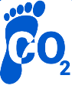
Evolution of Carbon Management
Carbon Maturity Model
Accounting
Externally verified full carbon accounts
Reductions
Product or Service design changes to lower carbon
Whole life carbon in products, both used and sold
Purchase decisions driven by reductions
Operational foot printing with enhanced emission factors
Procurement
Wider operational
changes e.g., Fleet, estate &/or distribution changes
Integrated cost, service & carbon management
Procurement sustainability screening
Operational foot printing normalizing - improved data
Scope 1 & 2 reductions e.g., Energy Audits
Mandatory supplier requirements
Operational Footprint – Data Gaps
Quick wins e.g., Renewable Energy
Key Supplier engagement
Simple supplier survey
Apply environment consideration to every business case
Leadership
Appoint board level sustainable representative
Carbon
Maturity
Model
Board level discussions on carbon
Openly sharing and mentoring others in industry to do the same
Creation of environmental team
1
2
3
4
5
Beginner
Emerging
Established
Mature
Market Leader

Slide 14
Carbon Management
Kicking Off Your Carbon Programme
What Does Year 1 Look Like?

Slide 15

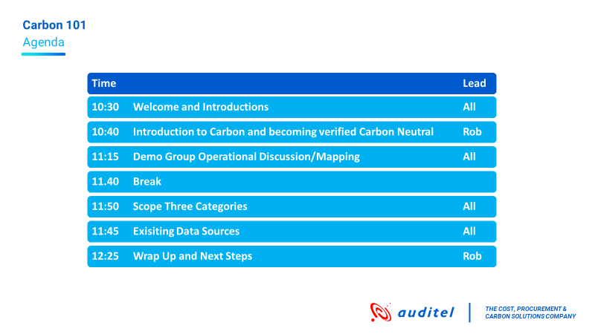
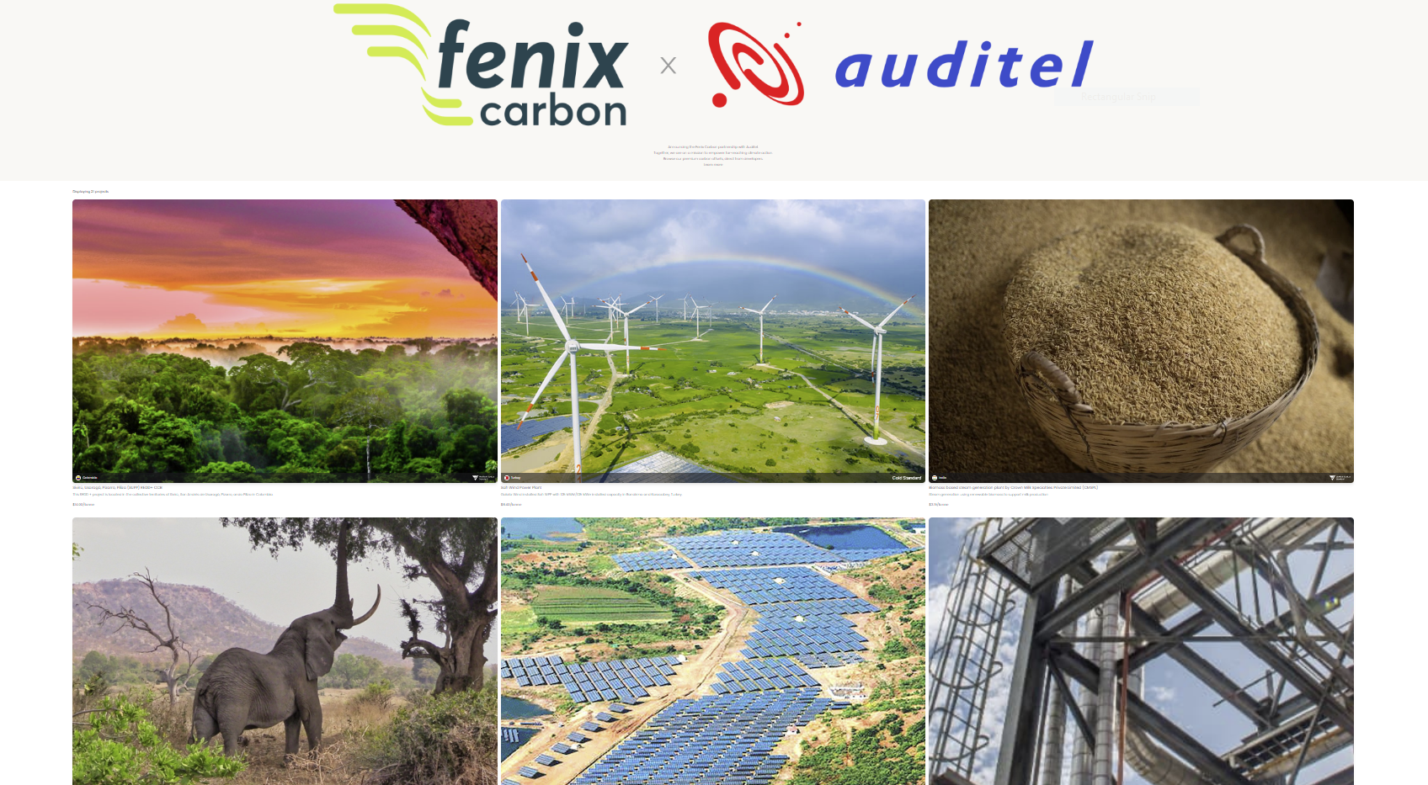

Carbon Workshop
A Kickstart to Your Carbon Journey
Leadership team
for change
Education & planning

Slide 16
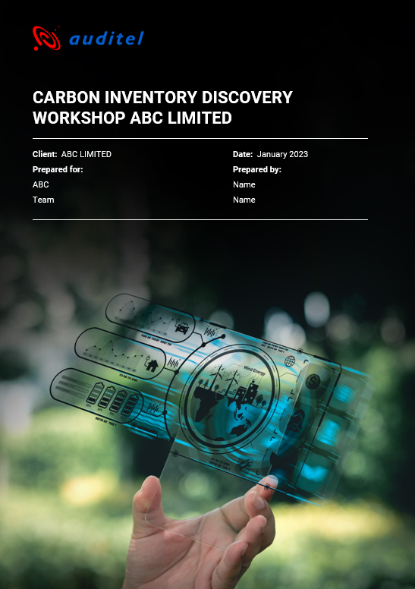
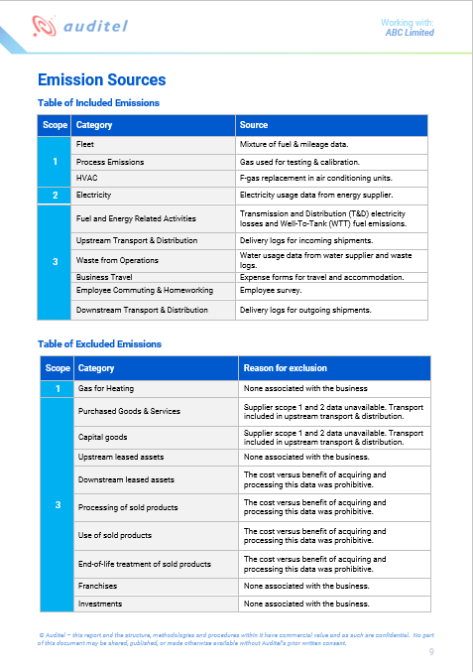
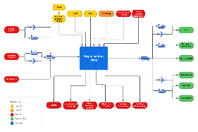
Emissions & Data Mapping
A Foundation for Your Carbon Footprint

Slide 17
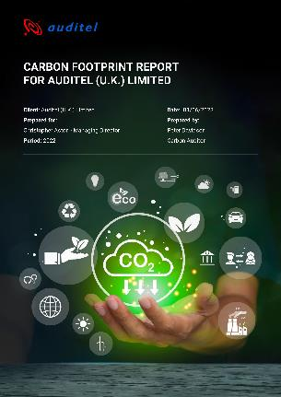












Findings Report
Turning data into Insight

Slide 18
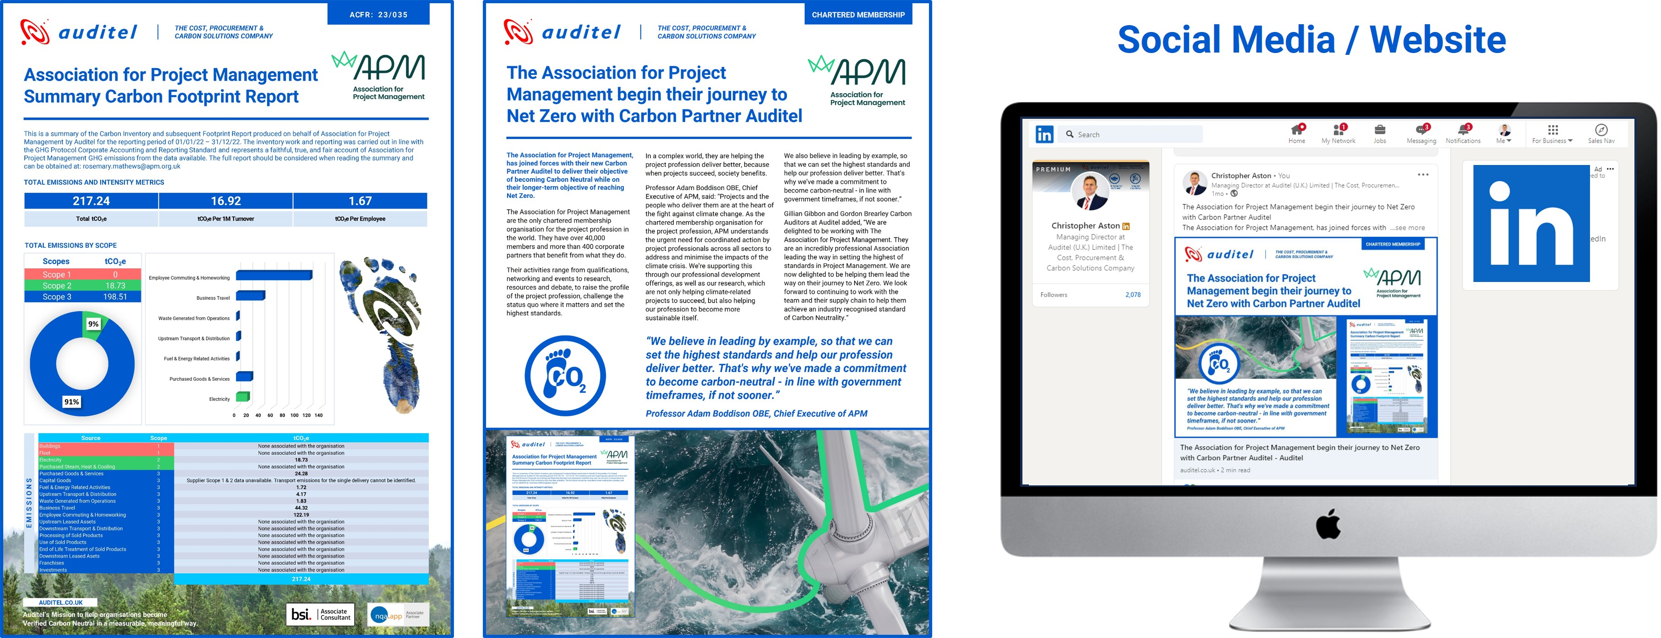
Completed Footprint Publicity
Celebrating & Sharing Your Results

Slide 19
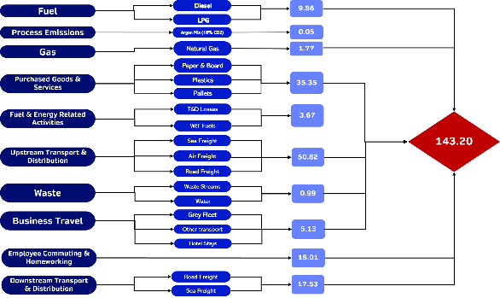

Carbon Reduction Workshop
A Strategy for Your Carbon Reduction Goals

Slide 20
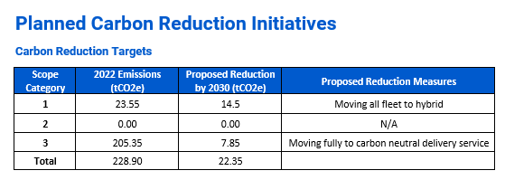
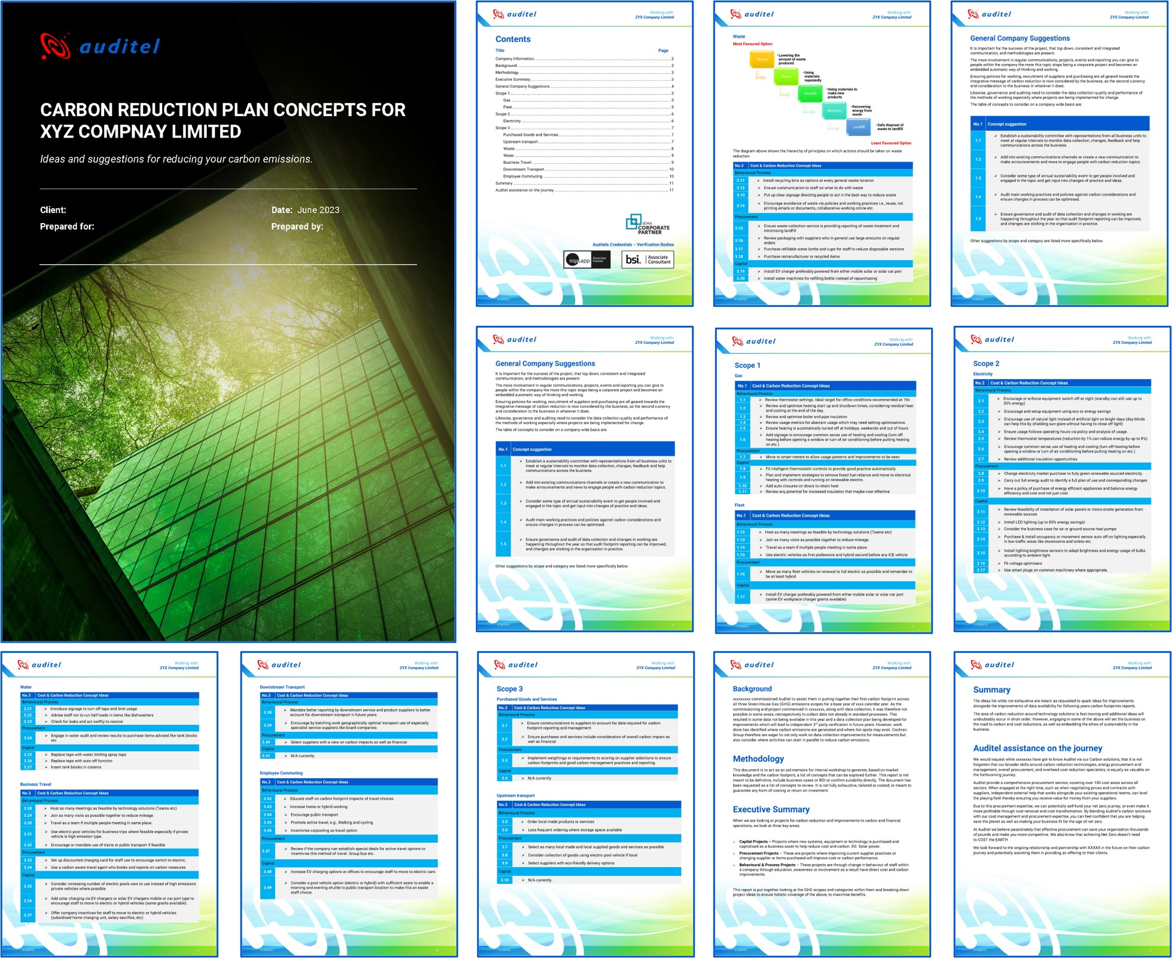
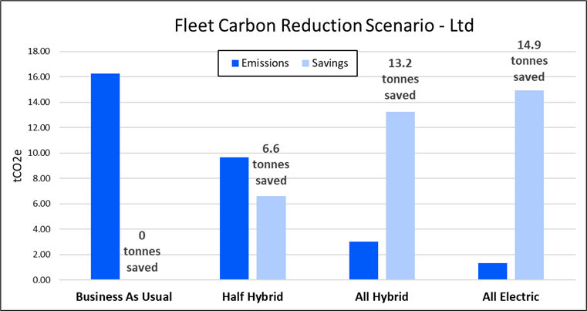
Carbon Reduction Plan
A Roadmap to Your Net Zero Ambition

Slide 21
Scienced Based Target Setting
Aligning to Save the Planet
Current State: Net amount of GHG emissions is>55 GT CO₂e year
Goal: Net amount of GHG emissions is zero GT CO₂e year
Anthropogenic GHG emissions
Anthropogenic carbon removals

Slide 22
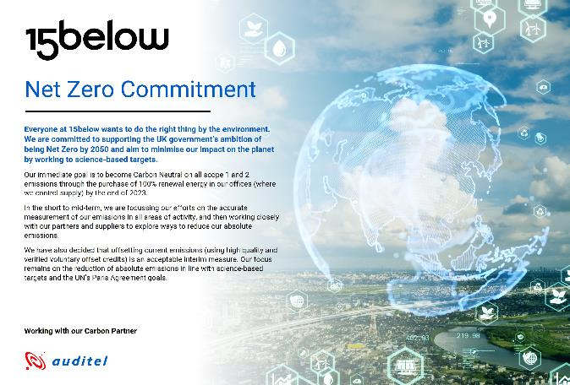
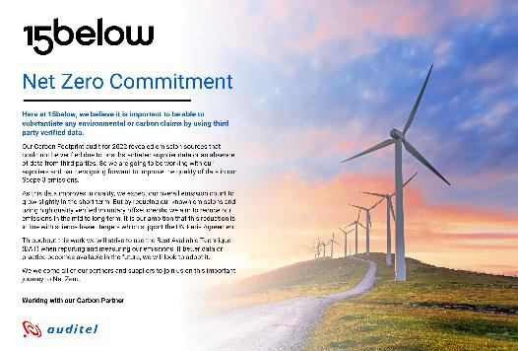
Carbon Management Statement
A Declaration of Your Carbon Commitment

Slide 23











Evolution of Carbon Management
An example of the journey over years
Establish Sustainability Committee
Upskill on measuring emissions
Publish
intention & environmental statement
Measure carbon footprint using existing data
Carbon Reduction Planning workshop
Publish targets and update Net Zero Statement
Conduct energy usage review
Implement easy to implement/high impact emission reductions
Deliver carbon literacy training to staff & stakeholders to influence behavioural change
Implement strategies to reduce energy use
Embed data collection process for enhanced data quality
1) BEGINNER
2) EMERGING
Mandate Supplier Net Zero commitments
Consider vehicle fleet decarbonisation
Encourage home worker efficiency for emission reductions
Implement new travel policy to reduce long-haul aviation travel
Set and implement targets to reduce waste
Carbon Reduction Planning workshop & net zero targets updating
Modify estates strategy in-line with net zero target
Update Net Zero statement
Gain verified status on carbon footprint reporting
Re measure year 2 carbon footprint showing reductions and improved data quality
3) ESTABLISHED
Appoint board level sustainable representative
Develop climate adaptation/climate risk mgmt. approach
Incorporate sustainability into governance arrangements
Implement renewable energy on a part of/all of the estate
Expand travel policy to reduce emissions from commuting
Work with local community/council/businesses to improve local biodiversity
Negotiate with tier 1 suppliers for sustainable options
Embed climate responsibility into staff development
Apply environment consideration to every business case
Continue to measure, reduce and announce your emission achievements in a verified way
4) MATURE
5) MARKET LEADING
Accounting
Reduction
Procurement
Leadership

Slide 24
Your Partner on your journey to Net Zero
Thank you
Presented by: David Wilshin
© AUDITEL 2023

Slide 25
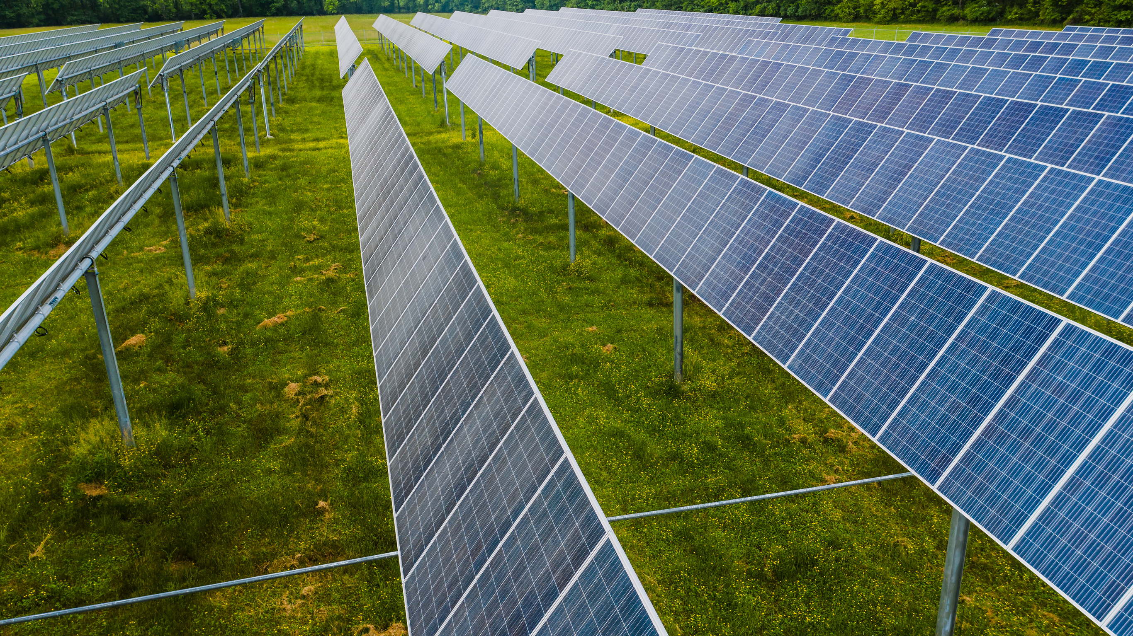
DNZ Programme
A Sustainable Future
  The programme is committed to delivering Energy Audits for small and medium-sized enterprises (SMEs) by March 2025
  Capital grants of between £1,000 to £100,000, to fund up to 50% of the cost of installing energy efficiency measures
  The programme offers support to a wide range of small businesses, from sole traders and micro-businesses to manufacturing companies in the Birmingham, Solihull, Coventry, Black Country and Warwickshire regions *depending on eligibility
Notes:
Note – Coventry have secured a small amount of funding for solar projects, however Warwickshire does not I am afraid. However we can still advise and help you with solar as with or without a grant solar is worth it for many businesses.

Slide 26

Other resources
Green Business Network
The Green Business Network allows businesses to come together, share ideas and promote energy, resource, waste and water efficiency as well as engage on low carbon, environmental and green sustainability initiatives.
Free to join
Over 3,300 members
Networking opportunities
Free newsletter
Be the first one to find out more about events and grant support opportunities
Join now
Use this QR code to join

Slide 27

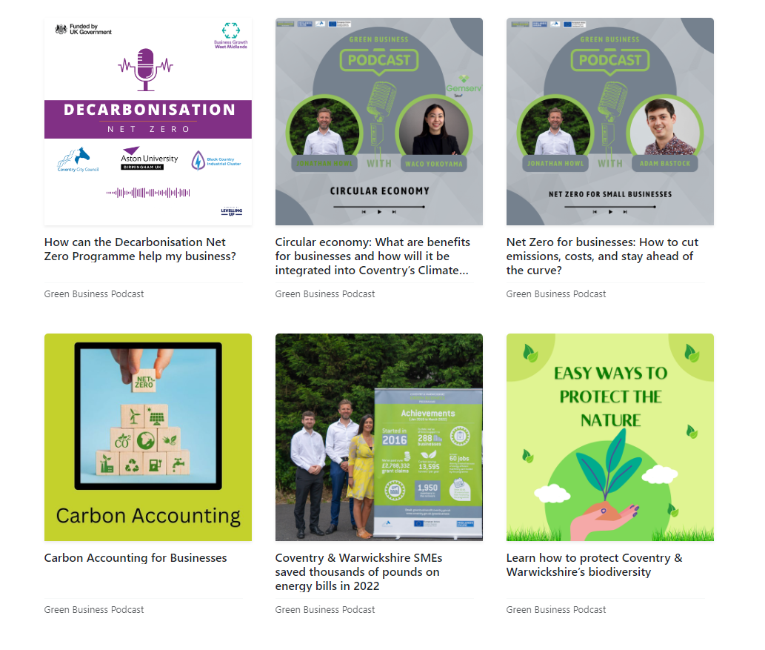
Other resources
Green Business Podcast
Listen to our monthly podcast to learn more about energy, resource, waste and water efficiency as well as engage in low carbon, environmental and green sustainability initiatives.
New episodes every month
Over 20 episodes so far discussing solar PV, heat pumps and sustainable business practices
Use the QR code or this link to subscribe
Notes:
Please listen to our monthly podcasts where we share knowledge and speak to industry experts within solar, heatpumps, carbon accounting as well as share case studies of business on their net zero journey. Scan the QR code and have a listen.

Slide 28
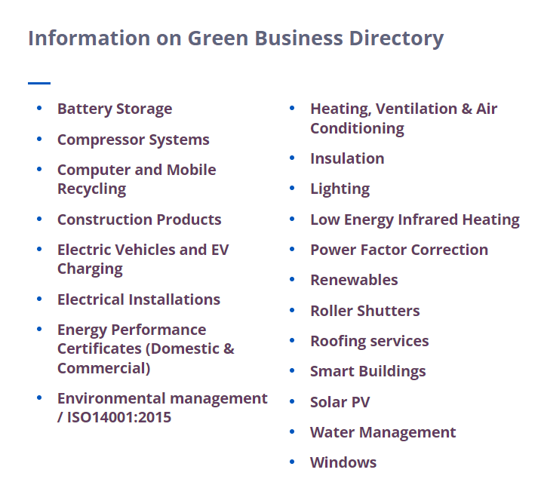
Other resources
Green Business Directory
Find a list of local suppliers and installers who can help you improve your business .
Over 100 companies
20 categories including solar PV, roofing services and water management
If you are a local installer or supplier please get in touch and we will add you to the directory
Notes:
As a local council we have to stay impartial………

Slide 29

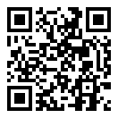
Apply for a free energy audit
EMAIL ADDRESS
decarb@aston.ac.uk
PHONE NUMBER
0121 204 4828
TO REGISTER
West Midlands: bit.ly/DNZ-Audit-Register
Warwickshire: https://bit.ly/3skX34q
PLEASE NOTE: Due to different funding streams, we are currently offering grants towards renewable energy for West Midlands businesses only.
Learn more about the programme

