Slide 1


Coventry SEND Transition Toolkit

Slide 2

Project Background
The work for this toolkit was initiated when in discussions with Heads , SENCos and Specialist Teams concerns were raised about the large number of children with SEND who struggle with the transition from Year 6 to Year 7.
National data shows that there is a significant rise in the number of children excluded from Year 6 to Year 7 and in 2022/23 more than half of the pupils excluded from school were children with SEND.
More specifically in Coventry in 2022-23, there were 44 exclusions of children on SEND support in Y6 (27 children) and 250 exclusions in Year 7 (101 children).
In 2023-24, there were 39 exclusions of children on SEND support in Y6 (23 children) and in Year 7, this rose to 303 exclusions (98 children).
It is worth identifying that the Y6 cohort in 2022/23 then became the Y7 cohort in 2023/24- the cohort where 27 children were excluded in Y6 in 2022-23 were then the same year group where 98 children were excluded in Y7 the following year.
It is therefore vital that we work together and invest our time to get it right for children identified as requiring SEND Support so that they quickly settle into their Secondary Schools and are set for success.
Whilst this project is not statutory, it would be preferred if all schools in the city adopt the processes outlined to ensure greater consistency and equity for all.

Slide 3
The aims of this guidance is to:
Create a more consistent and robust approach to Y6/7 transition for all children with SEND, so that all children have a positive experience regardless of which schools they attend
Provide greater continuity between phases for children with SEND who do not have an EHCP but who required significant support in Primary and would struggle to cope without the same level of provision in Secondary
Provide continuity for children with SEND without a diagnosis who are on the pathway or in the process of information gathering at the time of transition so there is minimal delay in gaining additional support
Support the creation of an effective working relationship between Primary and Secondary SENCOs to aid better knowledge and understanding of the provision offered across the different phases
Ensure that there is clarity and awareness between phases of the emerging challenges of future cohorts
Ensure that targets set in Primary IEP plan reviews are realistic for Secondary Schools to support
Work together across the phases to support parents to increase their understanding and manage expectations
Whilst this toolkit focuses on children with SEND, many of the procedures and activities suggested will benefit all children during the Y6/7 transition process.

Slide 4
In the Spring Term 2024, a team of Coventry SENDCos from both the Primary and Secondary phases met to discuss their concerns around transition from Year 6 to Year 7 for children with SEND. The following differences between the 2 phases and related concerns were identified:
New and more teachers to build relationships with and to communicate how to meet needs with- for pupil and parents/ carers | New peers- tolerance and understanding of needs from others | New buildings and environments- size and layout of playground and buildings, new classrooms, finding their way around a bigger site
Transition between lessons- busy and noisy corridors, finding classrooms, distractions during lesson transition times | Knowing and trusting new adults who can help- time required to build positive relationships | Different and unfamiliar personalities of teachers and their expectations in and around the classroom
New friendships to develop- making good choices about positive, healthy peer networks | Different demands on self- organisation, remembering everything, independence and personal skills | Different levels and type of support offered in different phases
Parents understanding and expectation of Secondary provision and the differences in support available between phases | Different academic challenges, styles of teaching and curriculum- poor academic progression and disengagement common after transition | Identification of and familiarity with new safe spaces- developing awareness of places to avoid where they might experience sensory overload
The aim is that this toolkit will provide schools with a timeline of events and ideas for a range of activities that can be carried out to aid the transition process, removing these obstacles and successfully preparing children with SEND to better manage the changes from Y6 to Y7.

Slide 5
Recommended timeline of transition activities for children with SEND
1.National Offer Day- 3rd March 2025 School places are allocated and initial Y7 lists sent to all schools |  |  | 3. Mid-March 2025 onwards- Dates for meetings between SENDCos to be arranged for children with SEND on their allocation lists. (For all non-SEND children these conversations will happen from Mid-May onwards as per usual) |  |  | 5. April/ May 2025- SENDCos and other relevant Secondary School staff to observe and visit child in their primary school setting. Opportunity created for child to ask questions and share worries accompanied by trusted adult in their primary school |  |  | 7. May/June 2025 Child to meet identified key adult from the Secondary School to start to build relationship prior to transition day- |  |  | 9. July 2025 Transition Day/s for all pupils- where possible, the identified key adult finds time to check in with the child to ensure they are managing the day successfully
Year 6 Year 7
 | 2. By 10th March 2025 A list of prospective Y7 children with SEND, their primary need and associated SEND specialist teams support will be shared with Secondary Schools SEND SLA requests must then be submitted by 14th March |  |  | 4. Mid-March 2025 onwards- In these meetings, SENDCOs to agree a date and method for the handover of all relevant SEND documentation- permission can be sought for early transfer of paperwork from parents allowing Secondary SENDCos more time to become familiar with information about each child |  |  | 6. May/ June 2025- Additional opportunities for transition visits/ taster sessions arranged for children as Individuals or in small groups. Parents invited to an informal meeting/ tour Option that a trusted adult from primary school attends too. |  |  | 8. June 2025- i. Pupil passport completed by Primary School and handed over to Secondary ii. 'Moving to My New School' booklets completed by Secondary Schools and shared; children supported to read with Primary School staff |  |  | 10. July/ August 2025 Summer school/ holiday activities/ transition project/ communication in holidays Transition support to continue from Primary SENDCOs if required during Autumn Term as children get to know new site, people, routines and expectations.

Slide 6
Timeline 1-4: Receipt of Allocation Lists and Sharing of Initial Information
School places allocated on the National Offer Day 3rd March 2025. Initial Y7 lists are sent to all schools including basic information about ALL children such as previous school, date of birth, address and parents/ carers details).
By 10th March 2025, an Excel document will be shared with Secondary schools outlining more detailed information about incoming Y7 children with SEND. Shared information will include:
category of SEND
LA SEND Specialist Services accessed (If schools use private services, this information will need to be passed on in SENDco discussions).
Sharing this information earlier will allow Secondary School SENDCos to request SEND SLA hours with better knowledge of what they will actually need. The closing date for SEND SLAs will be 14th March 2025.
From mid-March 2025 onwards, dates for meetings between SENDCos should be arranged for children with SEND on their allocation lists. (The needs of children with an EHCP should be addressed in Summer reviews that Secondary Schools should be invited to attend).
On 28th March 2025, an Excel form will be sent to Primary Schools by the Data Team. This is to be completed for ALL children- there will be an opportunity to tick a box if a discussion is required about a child e.g. safeguarding, family or friendship concerns.... Even though discussions about children with SEND may already be underway, it is important to tick this box for SEND children as well.
Secondary Schools will then receive the information about all children on 2nd May 2025.
Secondary Schools can start to liaise with Primary Schools to start the transition meetings and information sharing about all non-SEND children as per the usual process. Meetings should not take place until after Year 6 SATs (16th May) although contact to arrange the meetings could occur before then.

Slide 7
Timeline 3 and 4: Information Sharing Activities
Once the SEND lists and information has been shared (by 10th March) , Secondary SENDCos can start to arrange a meeting with the Primary School SENDco from mid-March onwards.
This conversation would be done earlier than the usual Y6-7 transition conversations for all non-SEND children.
The documents outlined below should be shared between schools- earlier is better and before the end of the Summer Term.
SENDCos need to organise which documents will be passed on, what format they will take and a date when this will be organised. So that there is a consistent system across all Coventry Schools, the Local Authority are arranging for schools to the use Datalocker for the secure transfer of documents between schools. Information about how this will be organised within schools will be shared. Schools must ensure accurate and safe transfer to abide by GDPR.
Parents' permission can be sought for early documentation transfer between schools- a template letter has been created which can be used if required (see attached documents). If there is an appeal process underway, it is advised that school do not transfer information for the children involved until a school place has been secured .
Most recent Individual Plan/ My Support Plan/ EHCP- up to date targets
Behaviour and safeguarding records
External reports and outcomes of needs assessments
Within these documents and/or in the professional's discussion, the following information should be shared:
Name
DOB
Summary of Needs inc. Diagnosis
SEND journey summary so far i.e. are they awaiting diagnosis? Statutory assessment?
Medical conditions
Summary of academic achievements- data
External Agency link specialists and assessments completed
Travel arrangements
Successful interventions and daily support provided
Information about parental involvement and expectations
Strengths and talents
Likes and dislikes
Triggers and warning signs
Successful de-escalation strategies
Advice on friendships and interactions with peers

Slide 8
Timeline 5, 6, 7 and 9: Transition Visits and Information Sharing Activities:
Steps 5, 6, 7 and 9 of the suggested timeline are covered in the following 6 pages.
An extensive range of ideas for activities and visits are listed for staff, children and parents which may support your planning for transition and offer different approaches for you to consider.
Many of these are already established in our Secondary Schools and have proven to be beneficial for the pupils, parents and staff.
Schools are not expected to organise all activities listed, but the aim is that several of them are carried out, chosen according to individual children and their characters and SEND needs.
Where possible and appropriate, Secondary School Staff may find it beneficial to ask Primary School staff to accompany the children with SEND on additional visits. They would use their knowledge and experience of each child to help identify what they might find challenging or supportive in their new school setting.
There is also a transition checklist from page 14 to 16 which you may choose to use. This will provide an opportunity to record transition activities undertaken for each child. This may provide useful evidence if further support is required for the child.

Slide 9
Transition Visits and Information Sharing Activities:
Recommendations for Schools prior to the start in Year 7
Secondary School staff to have the opportunity to observe children with SEND in their primary classroom/ school setting watching them as they learn alongside their Teacher/ Teaching Assistant; allows a better understanding of support provided in Year 6 to plan for September but also to help manage expectations in discussions with parents/ carers
Primary School SENDCOs visit Secondary Schools to observe different approaches and expectations to inform discussions with parents/ carers about support that can be offered in Secondary Schools eg. Via a coffee morning or tour for group of SENDCos of feeder schools?
Primary School Teacher/ Teaching Assistant/ Pastoral Team member to attend an early additional visit at the Secondary School with the child to help gain an understanding of the transition preparation needed in the Summer Term to be carried out by Primary school and parents/ carers
Additional small group sessions for Y6 children with SEND to meet other Y6 children or 'singles day' for children moving on their own before transition day for all pupils- arranged within Learning Mentor/ Pastoral team network?
Additional subject specific activity/taster sessions at the Secondary School e.g. sports events, craft activities, computing workshops, drama, science experiences
Ensure child is clear on the format of the Transition Day when all pupils visit the school and pre-arrange with them the strategies they can use if they struggle to cope including who they can go to and where they will be- more than 1 transition day for all pupils is ideal where possible
Ensure all teachers are aware of the individual needs of each child, reasonable adjustments agreed for each child with SEND, communicating how and when these can be used - pupil passports to be shared with all relevant staff and understanding of needs established
Provide detailed information about the first day at the Secondary School (and week 1 timetable if available) for primary staff/ Parents/ Carers to talk through with child
Secondary School to take photographs of key staff and areas of the site to create a 'Social Story' that Primary staff can share with pupils for use in Primary school and then over the summer holidays at home- may be individual or a generic version on the website depending on child's needs
Secondary colleagues invited to end of Year 6 events if appropriate
Communicate with child during the summer holidays e.g.in the form of postcards/ letters/ emails (including from trusted adult) to help prepare- school to set up a dedicated transition email address

Slide 10
Transition Visits and Information Sharing Activities:
Recommendations to support Pupils
Meet Secondary school staff in their Primary school setting with SENDCo/ Class teacher- chance to discuss worries and ask questions- pre-empt support required and identify risk points | Make sure pupil is aware of school expectations and understands the support and opportunities available to them e.g. incentives/ rules and regulations | Invitations to summer school activities (if relevant) Or Ensure understanding of any summer transition projects requested by Secondary School
Invitation to attend the Secondary school with parents/ carers e.g. coffee morning | Meet assigned 'trusted/ key person' from Secondary School- invest time to start building a relationship | Preparation for transition work with pastoral teams at Primary Schools- increased independence, self organisation, timetables, site maps, social stories, coping strategies, meeting new people
Invitation to additional transition visits- ensure pupil has a chance to see the dedicated 'safe', calm spaces that meet sensory needs and allow 'time out' breaks when needed | Share links to transition information pages on school website Secondary School to create a 'Social Story' for the child to keep and refer to | Pupil passport created by child and Primary School staff to be passed on to Secondary School SENDCO and shared with new teachers

Slide 11
Transition Visits and Information Sharing Activities:
Recommendations to support Parents
Invitation to a joint meeting at Primary School in Summer Term to discuss new individual support plan targets and discuss concerns, expectations, reasonable adjustments and what support will look like at Secondary School | Primary Schools to support Secondary schools in their communication and relationship building with parents/ carers who are difficult to engage | Ensure that parents understand the school procedures and skills required e.g. uniform, attendance, punctuality, homework, organisation, independence...
Identify a link person for parents to liaise with and share contact details | Agree with parents/ carers the means of communication for the Autumn Term to share progress and discuss challenges and potential solutions early | Invitation to attend the Secondary school with child before the transition day to answer further questions e.g. coffee morning (Primary SENDCO to attend?)
Ensure parents have access to a timeline of transition events and key dates so they know what to expect and when things are happening | Highlight parents to the relevant sections of the school website for additional transition information | Outline how parents can support their child and the school

Slide 12
Transition Section of School Website
It is important that children and parents can access information about the school and transition on the school website. The following 3 pages outline suggested content which would be beneficial for all children moving into Year 7:
Open Day/s dates | Sample weekly timetables | Names, roles and contact details of key personnel for Year 7 and SEND including photographs
Transition Day/s dates | Outline of a typical day including timing | Link to SEND Information Report
Links to transition timeline/ key dates and upcoming events | Copies of transition letters and communication | SEND terminology- a glossary
School site map | Link to video tour / photographs of the school | Video tour/ photographs of the relevant SEND/ Inclusion areas
Summer School/ holiday activities/summer transition project information (if relevant) | How to arrange a visit | Links to the school's social media
Links to charities and organisations that support children with SEND | Link to SEND Policy | FAQ section

Slide 13
Sample FAQs to consider for your website which will benefit all children...
What time does school start and finish? | What will I need to bring to school every day?
What do I wear at school? | What happens at lunch time and where do we eat?
How long does each lesson last? | Do I need to bring money to buy lunch?
How do I know what lessons I have? | Will I have a locker?
Who do I tell if I feel unwell? | How do I know what the homework is?
What happens if I am late for school? | What should I do if I do not understand my homework?
What happens if I get lost? | Are there sets for different subjects?
What happens if I am late for a lesson? | Can I ride my bike to school?
Who can I contact if I am upset or worried and need help? | Will I get rewards for doing well with my learning and/or behaviour?
What happens during break times? | Am I allowed to bring a mobile phone?
Is the whole school on the playground at breaktime? | How will I make friends if I don't know anyone else?
Where can I go if I need a quiet space at break times? | Am I allowed to go to the toilet during lesson times?
Are the teachers strict? | Will we go on any trips or have visitors?
Are there any clubs I can join and how do I join them? | Do you have house teams?
What are the school rules? | When will I know what class I am in?
Can I choose where to sit in the classrooms? | Can I bring a drink to school to drink in lessons?

Slide 14
More sample questions to consider for your website which may specifically benefit children with SEND...
I am anxious about asking or answering questions in class...what should I do if I do not understand the work? Will the teacher know not to ask me a question? | I have fine motor difficulties and find writing with a pen difficult. Would I be able to use a computer for some of the longer pieces of work? | I often need to keep my coat on because I have sensory needs. Will it be ok for me to do this? I will take it off when I am able to.
I find it hard to cope with others too close to me and work better at the end of a row. Can I sit on my own and near to the front of the class? | I do not cope in noisy or busy places... Is there somewhere calm and quiet that I can go to at break and lunch times? | It helps me to have a task board for each lesson but I would rather others do not see this. Could this be quietly shared with me at the start of every lesson?
I sometimes rock or fidget in my chair without realising it. Would I be able to take a movement break so that I do not get into trouble or distract others? | I am frightened in busy, small spaces...will I be able to leave the classroom 2 minutes early to avoid crowded corridors? | I like to know what is happening every day and find managing changes to the timetable difficult. Will there be a way of warning me if changes are planned?
If I get anxious, will I be able to take time out of the classroom to calm down? Will the teacher understand and where should I go? | I find organising myself difficult which I get embarrassed about... Will I be able to borrow a pen discreetly if I haven't got one? | I take time to process what is being said to me. Will the teachers know that I need to time to think before asking me things again?
Questions created from information gathered in research carried out in 'Improving the quality of transition from Year 6 to Year 7 for pupils with SEND'
by the Southampton Inclusion Partnership and Outreach Service

Slide 15
Suggested Checklist for Transfer of information between Schools page 1
Pupil's Name: Primary School: Primary SENCo: School Contact details:
Information | Notes | Date
Summary of Needs including Diagnosis (where appropriate) and related communication/ letters
SEND journey summary so far i.e. are they awaiting diagnosis? Statutory assessment?
Medical conditions
Summary of academic achievements- data
Names of external Agency link specialists and assessments completed (including copies of assessments)
Successful interventions and daily support provided
Information about home background, parental involvement and expectations (include sibling information if relevant)
Strengths and talents
Likes and dislikes
Triggers and warning signs
Successful de-escalation strategies
Advice on friendships and interactions with peers
Most recent Individual Plan/ My Support Plan/ EHCP- up to date targets shared (plus historical information)

Slide 16
Suggested Checklist for Transfer of information between Schools page 2
Information | Notes | Date
Behaviour Records
Safeguarding Records
Pupil passport
Name and contact details of link teacher/ SENDCO/ Headteacher from Primary School for ongoing communication
Secondary School to pass on example timetables, homework expectations, uniform, map of site etc.
Suggested Checklist for Transition Activities for Pupils
Meet Secondary school staff in their Primary school setting with SENDCo/ Class teacher- chance to discuss worries and ask questions
Invitation to attend the Secondary school with parents/ carers e.g. coffee morning
Invitation to additional transition visits- ensure pupil has a chance to visit dedicated 'safe', calm spaces that meet sensory needs and allow 'time out' breaks when needed
Make sure pupil is aware of school expectations and understands the support and opportunities available to them e.g. incentives/ rules and regulations
Meet assigned 'trusted person' from Secondary School- invest time to start building a relationship
Share links to transition information pages on school website
Invitations to summer school activities or ensure understanding of any summer transition projects requested by Secondary School If relevant)

Slide 17
Suggested Checklist for Transition Activities for Pupils contd... page 3
Information | Notes | Date
Preparation for transition with pastoral teams at Primary Schools- increased independence, self- organisation, timetables, site maps, social stories, coping strategies, meeting new people
Pupil passport created by child and Primary School staff to be passed on to Secondary School SENDCO and shared with new teachers
Invitations to summer school activities or ensure understanding of any summer transition projects requested by Secondary School If relevant)
Suggested Checklist for Transition Activities for Parents
Invitation to a meeting at Primary School in Summer Term to discuss new individual plan targets and discuss concerns, expectations and what support will look like.
Identify a link person for parents to liaise with and share contact details.
Invitation to attend the Secondary school with child before the transition day to answer further questions and meet other parents/ carers/ pupils e.g. coffee morning (Primary SENDCO to attend?)
Agreement on means of communication in Autumn Term to share progress and discuss challenges and potential solutions early.
Primary Schools to support Secondary schools in their communication and relationship building with parents who are difficult to engage

Slide 18
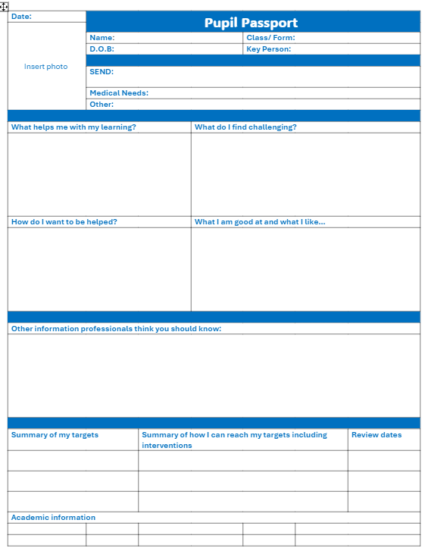
Timeline 8: i. Using a Pupil Passport
It is important that SENDCos pass on all relevant SEND information about each child to other relevant staff in their school
All relevant teachers and support staff must be familiar with the reasonable adjustments required for each child/ young person with SEND in their class/es and aware of the support they need to aid success
A pupil passport provides a one-page overview of the needs of a child with SEND for all teachers and support staff that come into contact with them.
It will help teachers and support staff understand the needs, behaviours and reasonable adjustments required for each child with SEND that they work with.
Some schools use a pupil passport as their IEP.
Learners should be involved in developing their passport
It is recommended that the child and a known, trusted adult from the Primary School work together to discuss the information to be included in the pupil voice section
Parent and Teacher views are also vital and should be included in the 'other information professionals think you should know' section
The Pupil Passport should be reviewed with the child/ Young Person during the second half of the Autumn Term to identify if any adaptations are required
It should then be reviewed regularly- at least twice in each academic year.
New passports created as a result of a review should be shared with all relevant staff promptly. Passports should be issued to new staff and form part of the transition process between year groups.
This template and a completed example are available as a Word document on the SENDCO section of the SEND website.

Slide 19
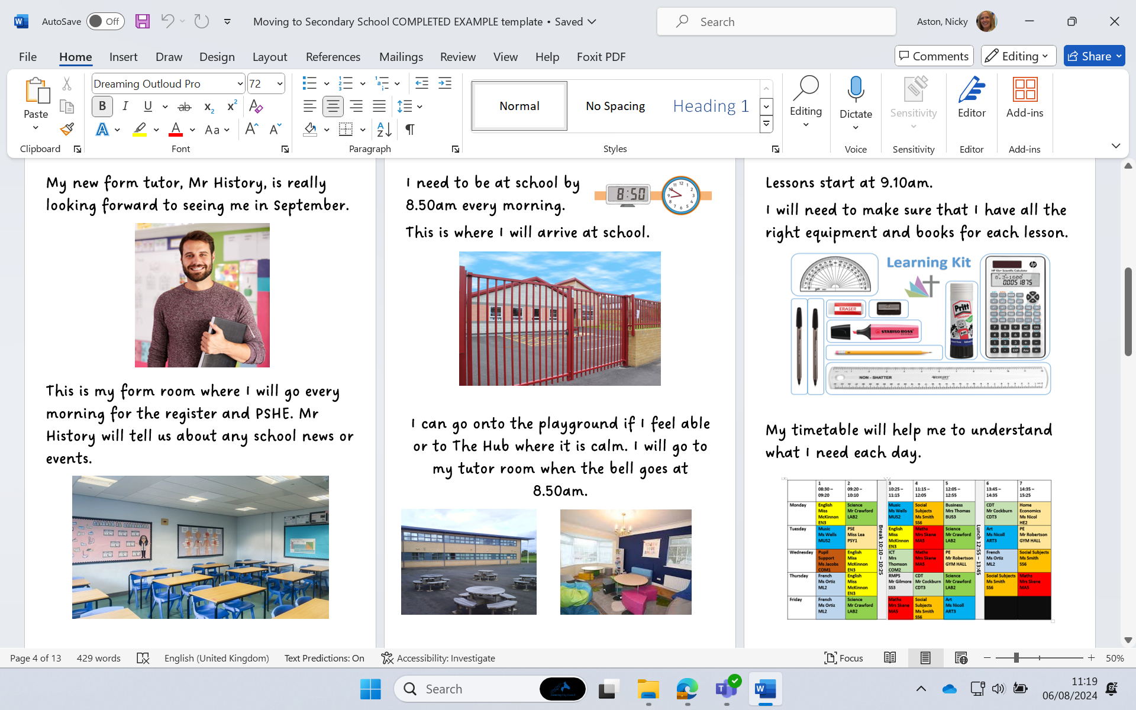

Timeline 8 ii. Creating a Social Story about Moving to Secondary School
A sample Social Story booklet and blank template has been created. This can be adapted by Secondary Schools for children with SEND who might need something to regularly look through at home during the summer holidays to help them to prepare for their move to their new school. A generic one could be uploaded onto the school website, but individual children may still require something with information specific to them, such as the name and photograph of their key adult.

Slide 20
Timeline 10: Suggestions for continued transitional support once the Autumn Term is underway...
Transition to continue into the Autumn Tern- open communication with Primary Schools for questions, extra support and advice if needed once child has started
Arrange regular and consistent pupil check ins with a trusted person during Autumn Term, investing valued time for relationship building, even when things appear to be going well
Secondary school to hold an event in October for Year 7 child to catch up with Primary Teacher/ SENCo to discuss how they have settled and share work completed
Communicate regularly with parents to share successes and progress, discuss challenges and consider potential solutions together
Review and adapt pupil passport in collaboration with the pupil and staff who work with them- share amendments with all relevant staff
Ensure that staff are adequately supported and skilled to effectively manage individual children with SEND in their classes and organise training where required

Slide 21

Some examples of School Websites/ Resources which support transition
President Kennedy School - The Bridge (Year 7) (pks.coventry.sch.uk) and related 'Transition Pack': download.asp (pks.coventry.sch.uk)
PowerPoint Presentation (finhampark.co.uk)- Transition Activity pack
Inclusion/SEND – Caludon Castle School- Year 7 SEND FAQs
Transition Booklet: download.asp (bishopullathorne.co.uk)
Transition Booklet: download.asp (stokepark.coventry.sch.uk)
Moving on Up: Transitioning from Year 6 to Year 7 Activity Booklet (twinkl.co.uk)
Starting secondary school - BBC Parents' Toolkit - BBC Bitesize :Advice for pupils and parents to support the start to secondary school​
Supporting school transitions | Resources | YoungMinds- advice for staff and activities for pupils​
Moving up! The transition to secondary school | Anna Freud 4 Minute video for pupils and downloadable teacher toolkit with ideas for transition activities​
Social stories and comic strip conversations (autism.org.uk)​
Social Story Sampler - Carol Gray - Social Stories (carolgraysocialstories.com)​
MOVING INTO YEAR 7: Transition | Teaching Resources (tes.com) Free resource- need to log in
SecondarySchool_TransitionBooklet_Compass.pdf (compass-uk.org)

Slide 22
The following publications have been used to support the creation of this document:
EEF Blog: Supporting pupils through transitions – a trio of… | EEF (educationendowmentfoundation.org.uk)
Transition_tool.pdf (d2tic4wvo1iusb.cloudfront.net): EEF Transition Toolkit
Southampton Transition Project.pdf (nasen.org.uk)
The STEPs project (School Transitions across Education for Pupils with SEND): led by York St John and Lancaster Universities in collaboration with the City of York Council
Supporting learners with autism during transition.pdf (nasen.org.uk)
Report on the Autism Transitions research project (yorksj.ac.uk)

Slide 23

Thanks to the following Coventry colleagues for sharing their time and experience through the different stages of the creation of this project:
Jo Green –Virtual School
Lucy Bishop- Parkgate Primary
Lucy Pater- Stoke Primary
Louise Graham- Caludon Castle School
Steph Lovick- Ernesford Grange Community Academy
Estelle Collett-Cox- Henley Green Primary
Anthea Swales- Seva School
Charlotte Bosworth- Seva School
Sarah Plimmer- Coundon Primary
Alicia McKeown- West Coventry Academy
Transition Working Group
Alex Blackburn- Sidney Stringer Academy​
Nazbeen Akhtar- Sidney Stringer Academy​
Jackie Salter- Bishop Ullathorne​
Alex Ford- Lion Alliance/ Finham Park MAT​
Jo Jacobs- Gosford Park Primary​
Mani Samra- Stoke Park School​
Fiona Oliver- Cardinal Wiseman ​
Rebecca Diaz- Finham Park MAT​
Shani Denne- Holbrook Primary​
Sonya Moran- Moathouse Primary​
Sian Harris- Castle Phoenix Trust
Coventry LA Data Team

