Slide 1

Early Help Presentation
Notes:
House keeping
Toilets
Fire
Respect voices

Slide 2



Today’s Presenters
Nikki Town
Early Help Assessment
Coordinator (EHAC)
Steve Turner
Early Help Module
Coordinator
Fiona Smith
Early Help Assessment
Coordinator (EHAC)
Notes:
steve
There are 10 EHACS in Coventry who are based city wide
EHAC supports the schools in Coventry including the ELC’s (extended learning centre’s) and the Special Schools.
EHAC will meet with you regularly where you can discuss children you have identify met 2 to 3 Supporting Families Criteria
EHAC will support you to access EHM and model how to record on the system
Your EHAC can accompany you on home visits where there is an assessment/plan, or you are in the process of completing one
Your EHAC can support you in Team Around the Family Meetings
Your EHAC will provide oversight on your assessments and plans as well as your evidence to make a supporting families claim
To give help and advice when needed and to signpost to other agencies
Kerrie

Slide 3
Today’s Agenda & Aims
This is a presentation to explain:
What is Early Help?
How it works in Coventry
Right Help Right Time
How to identify families that may need Early Help support
The Early Help Module (EHM) recording system
Resources Available
We hope that at the end of this presentation you have:
A clear understanding of Coventry’s Early Help offer
How to help a family in need

Slide 4
What is Early Help?
How does it work in Coventry
Early Help, also known as early intervention, is the support given to a child, young person, and their family when a problem first emerges. Help may be required at any stage in a child’s life from pre-birth to adulthood and applies to any problem or need that the family cannot deal with or meet on their own.
Early Help in Coventry is not a service provided by one agency but is an approach that services adopt with many stakeholders working together to produce an early help offer.
The Early Help Offer (system) is the network of services, processes and interactions that aim to help children, young people
and families at the earliest opportunity.

Slide 5
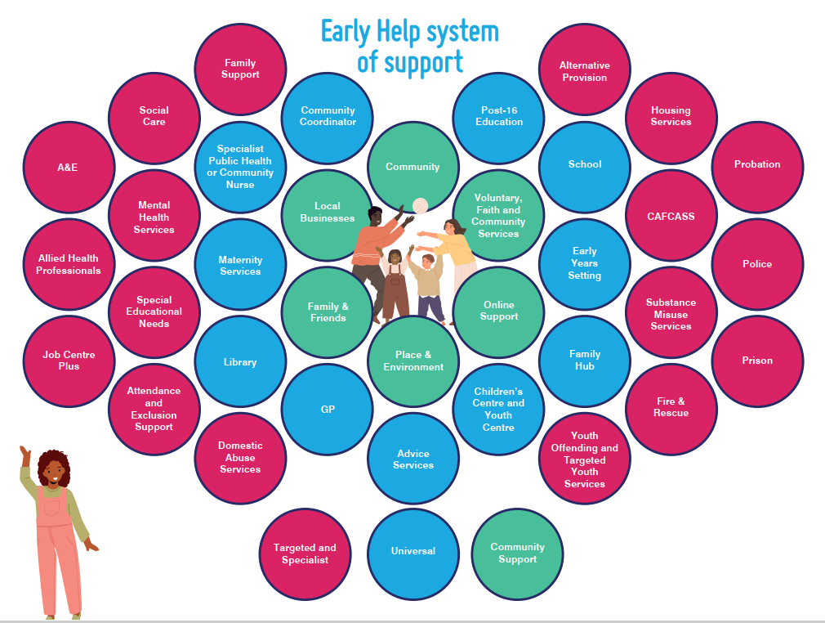
Notes:
jupinder
You can see from this honeycomb affect the early help system of support
The Early Help System is not a single service. It is a network of services, processes and interactions that aim to help children, young people and families at the earliest opportunity.
A strong Early Help System is made up of many different types of practitioners and services who operate as one.
You will note that the schools are a vital part of the Early Help Strategy.
Little bit of an explanation of how we are moving away from “I am referring to early help” we are finding it is a barrier because people assume that this is a children’s services intervention.
Early Help is about encouraging people at all different times of life, when they ask for help they are asking for a help from a wide range of services who are working together.

Slide 6
I am Early Help
I am Early Help V4.mp4
Notes:
Play video

Slide 7
Right Help Right Time
Right Help Right Time is for practitioners in all agencies working with children, young people and their families in Coventry. This guidance will assist professionals to identify the support that a child, young person or family might need and how best this support can be provided.
Professionals from all agencies working with children and young people have a shared responsibility to keep them safe and provide an effective, efficient and co-ordinated service to support their health and wellbeing.
Promoting children’s welfare is most effective when they receive help early and at a level according to their needs. The aim is to provide early interventions for children, young people and families that require support in order to prevent them moving towards higher levels of need, and to reduce the levels of need once these have been identified

Slide 8
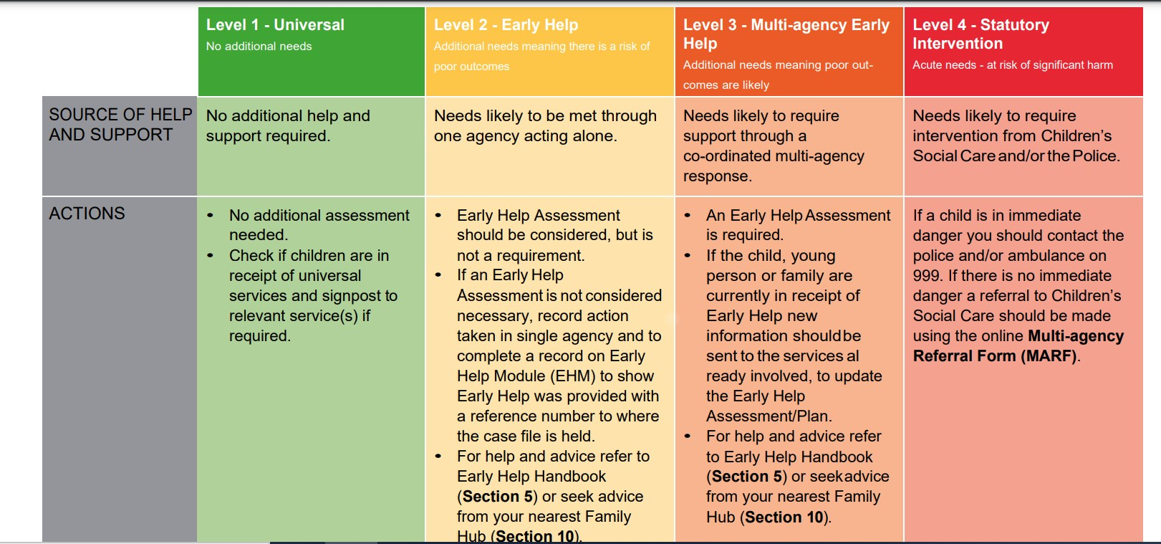
https://www.coventry.gov.uk/coventry-local-safeguarding-children-board/right-help-right-time

Slide 9


https://www.coventry.gov.uk/family-hubs/family-hubs-families-carers
Notes:
The Family Hub Offer : the universal front door to families, offering a “one stop shop” of family support services for all families. This is a partnership offer provided from across a wide range of sources of help that connect together to provide high quality joined up support. The offer includes services delivered from a Hub building, delivered in communities and through a virtual offer. It is based on three principles of Access, Connections and Relationships.
Supporting Families : an approach to work with whole families who have multiple needs through co-ordinated intensive family support. This support is identified through an early help assessment and delivered through an early help plan, led by a Lead practitioner and enabled by the work of the team around the family, working with them to help bring about sustainable changes and improve the children’s lives.

Slide 10
How to identify children & families that need help
Early Help is about identifying children & families at the earliest onset of their difficulties and then providing the right help at the right time by the right people.
We are always looking out for children & families that may need some form of help and a key role you can play as a member of the early help partnership is becoming an identifier.
Notes:
Kerrie
Professionals from all agencies working with children and young people have shared responsibility to keep them safe and provide effective, efficient and co-ordinated service to support their health and wellbeing.
The aim is to provide early interventions for children, young people and families that require support in order to prevent them moving towards higher levels of need, and to reduce the levels of need once these have been identified.
Partners have ‘pledged’ how they will deliver services to children, young people and their families in line with the Early Help Strategy, in partnership with one another.
This is New early help strategy is now out for 2023-2025 (a copy of the strategy is in your packs)

Slide 11
The first thing to consider is where you may
have the opportunity to identify families
At the school gates
In the library
In the community
School fetes
Clinics
On the ward
In the family home
During an appointment
GP Surgeries
Notes:
Kerrie
Professionals from all agencies working with children and young people have shared responsibility to keep them safe and provide effective, efficient and co-ordinated service to support their health and wellbeing.
The aim is to provide early interventions for children, young people and families that require support in order to prevent them moving towards higher levels of need, and to reduce the levels of need once these have been identified.
Partners have ‘pledged’ how they will deliver services to children, young people and their families in line with the Early Help Strategy, in partnership with one another.
This is New early help strategy is now out for 2023-2025 (a copy of the strategy is in your packs)

Slide 12
What can I see | What can I hear | Feelings you may have
The person is visually distressed
The interaction between adults and children
Arguing or shouting
Telephone conversation
A feeling of anxiety
Being worried
Feeling helpless / what can I do to help?
Notes:
Changes in behaviour
An increase in lateness
A decrease in attendance
Missed appointments
Behaviour that is out of the ordinary
Visible signs of distress

Slide 13
What can you do once a family
has been identified
Have a conversation with them to establish what life is currently like.
The conversation can be guided around 10 Life Circumstances.

Slide 14
The 10 Life Circumstances
Education related concerns
Child development related concerns
Health needs related to adults or children
Concerns related to the Misuse of drugs and alcohol
Concerns related to Parenting / relationship breakdown in the household
Concerns related to Children at risk or experiencing harm in the household
Concerns related to Crime or offending behaviour
Concerns related to Domestic abuse
Concerns related to Secure and suitable housing
Concerns related to Family finances to worklessness

Slide 15
The below link will take you to the Supporting Families webpage, where you will find the 10 Life Circumstances.
Each Life Circumstances has a link to a ‘Toolkit’ page.
The Toolkit pages list resources and agencies that can support a child and family with that specific headline:
https://www.coventry.gov.uk/common-assessment-framework-caf/supporting-families-programme

Slide 16
Early Help Module (EHM)
The Early Help Module (EHM) is the recording system used by Coventry Children’s Services and its Early Help Partners to record all Early Help Support that takes place across Coventry.
Having a shared system is recognised as being the most effective way to share information securely and avoids agencies recording in isolation.
EHM has been adopted by Coventry Children Services to:
Encourage communication between agencies in a systematic way.
Support multiagency working.
To provide children and families with a single assessment of need and one family plan.
EHM training
Steven.turner@coventry.gov.uk
Notes:
Steve
EHM is something we are hoping all professionals will eventually have access to.
It always informed to be shared effectively.
For example, if any MARFS are made the MASH workers can check EHM for any work that has been completed by Early Help if they cannot get hold of the practitioner and this can be used to form their outcome.
Steve

Slide 17
Resources Available

Slide 18
Portal link
https://www.coventryfamilies.co.uk/
Early help home https://www.coventry.gov.uk/earlyhelp
Early Help Free Phone Number: 0800 8870545
Notes:
Steve
Show websites

Slide 19
Short video of a parent who was supported by a Primary School and their EHAC
Southfields Family Brittany.mp4

Slide 20
Thank You

