Slide 1

Early Help Presentation

Slide 2

Today’s Presenter
Steve Turner
Early Help Module
Coordinator

Slide 3
What is Early Help?
How does it work in Coventry
Early Help, also known as early intervention, is the support given to a child, young person, and their family when a problem first emerges. Help may be required at any stage in a child’s life from pre-birth to adulthood and applies to any problem or need that the family cannot deal with or meet on their own.
Early Help in Coventry is not a service provided by one agency but is an approach that services adopt with many stakeholders working together to produce an early help offer.
The Early Help Offer (system) is the network of services, processes and interactions that aim to help children, young people
and families at the earliest opportunity.

Slide 4
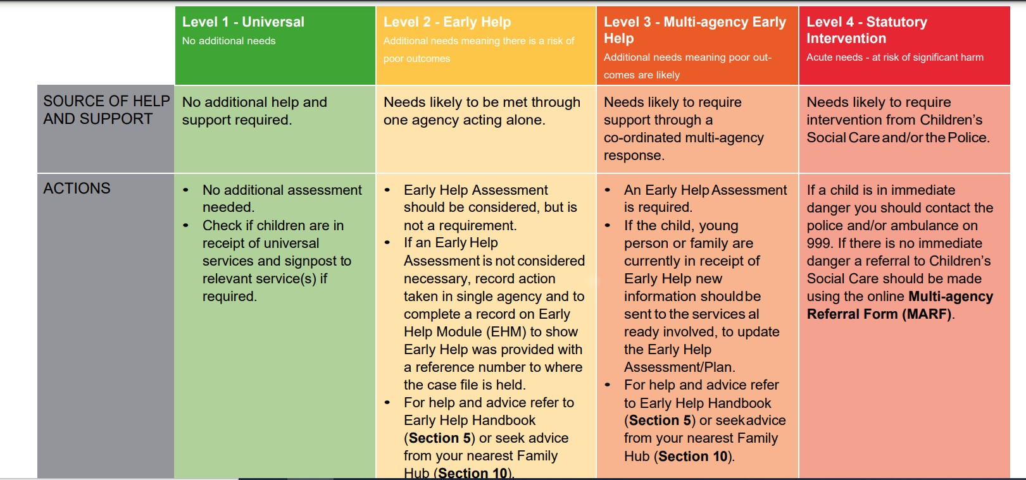
https://www.coventry.gov.uk/coventry-local-safeguarding-children-board/right-help-right-time

Slide 5

The Route To Advice
ROUTE 1
ROUTE 2
Check EHM to find out if the child is or has ever received any support
Use the free phone number or email address to ask for advice
Professional
The professional has identified a family that need early help support
If they are receiving support, you can contact the allocated professional
Contact your allocated EHAC for advice
Telephone: 0800 8870545
Email: earlyhelp@coventry.gov.uk

Slide 6
The Early Help Module (EHM)
EHM is the shared recorded system available to all professionals within Coventry’s Early Help Partnership.
Its primary function is to:
Encourage communication between agencies in a systematic way.​
Support multiagency working. ​
To provide children and families with a single assessment of need and
one family plan.

Slide 7
The Early Help Module (EHM)
To gain access to EHM you are required to attend a training session.
There are several options for training:
A 2-hour generic session, delivered via Microsoft Teams, typically aimed at brand new users and professionals who are looking to gain an understanding of Coventry's Early Help offer and how EHM fits into this process.
A bespoke session delivered to agency teams, tailoring the session to the agency specific requirements. This can be delivered via Teams or in Person at the agencies setting.

Slide 8
The Early Help Module (EHM)
The sessions are free to access and once a professional has attended a session a login for the system can be created.
To discuss your training requirements or for a list of the generic training dates or if you have any questions relating to EHM, please send an email to:
steven.turner@coventry.gov.uk

Slide 9
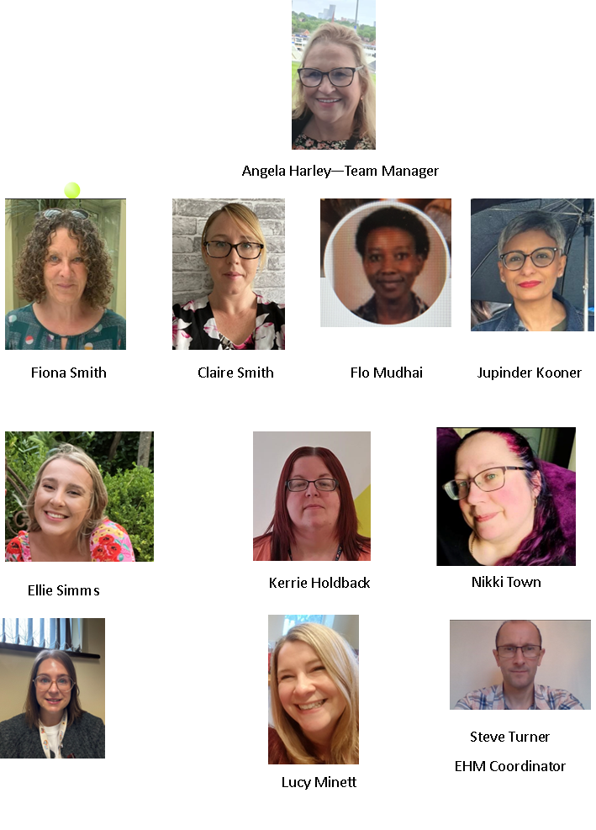
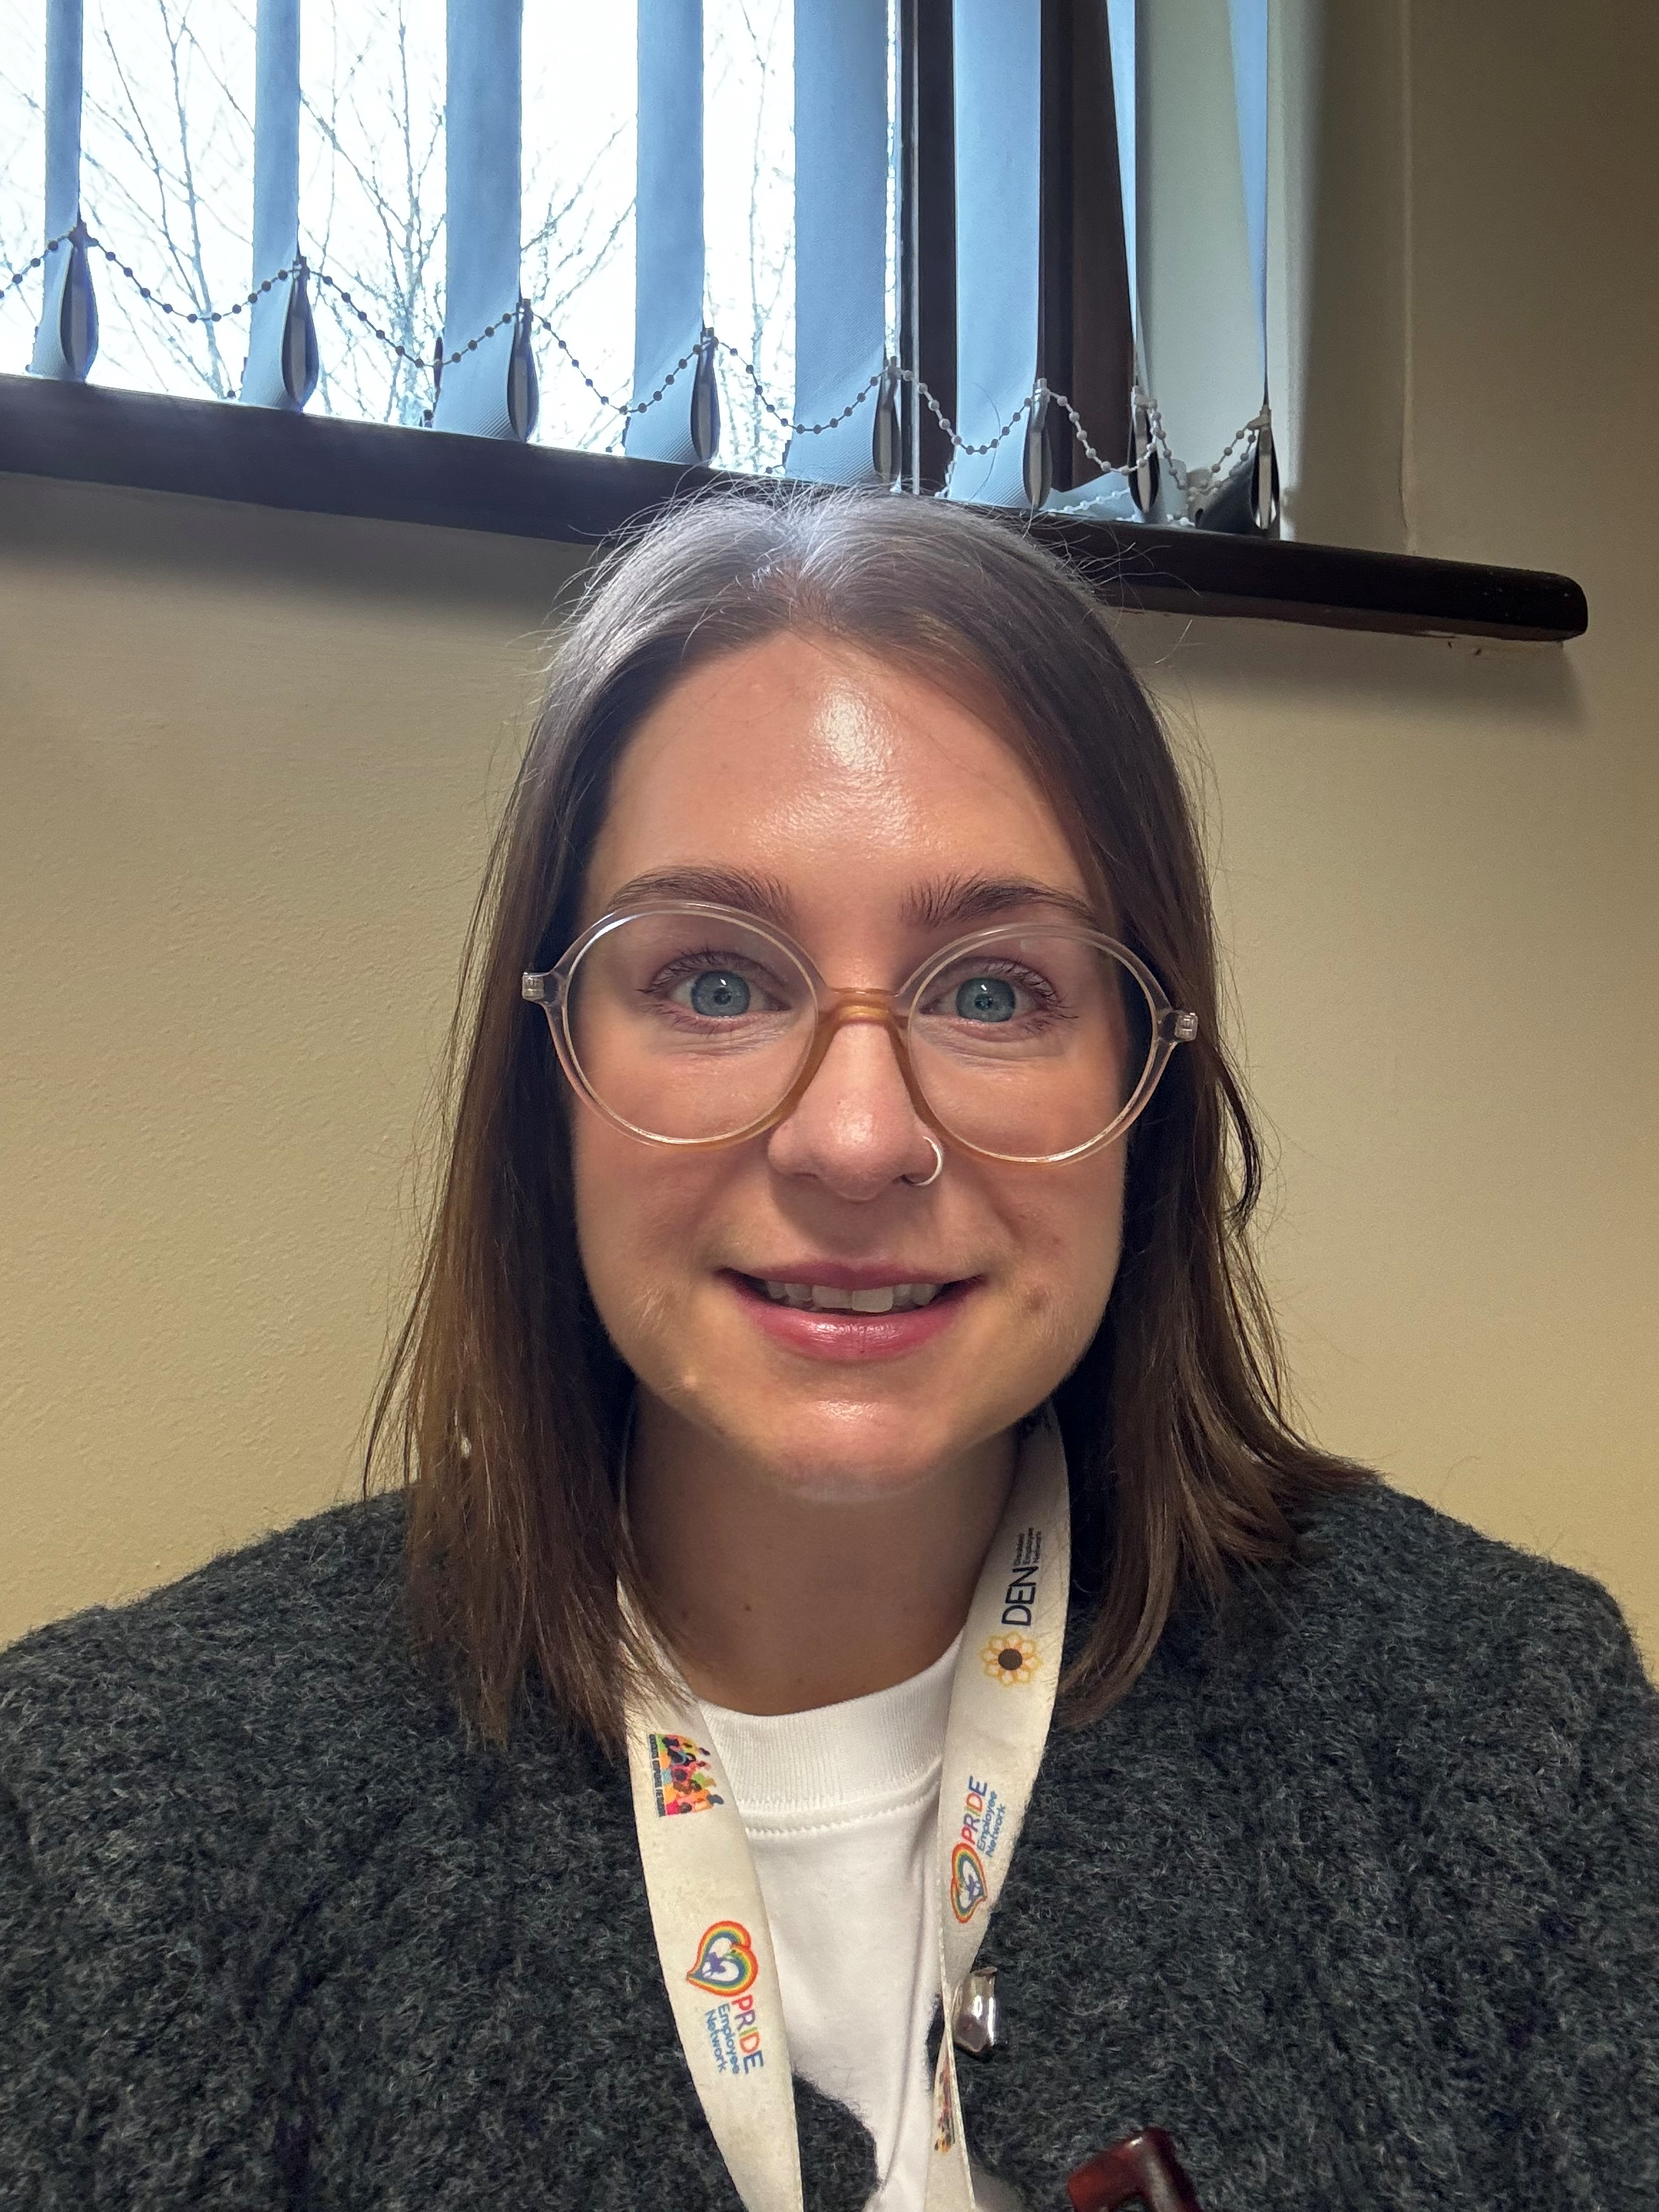

The Early Help
Assessment Coordinators
(EHACs)
Catherine.Goulding-Huckle@coventry.gov.uk

Slide 10
The Role Of The EHACs
There are 9 EHACs and 1 EHM Coordinator in Coventry, the team are based within Coventry’s Childrens Services Early Help
They are responsible for the support, development and promotion of Coventry’s Early Help offer.
They work closely with all partner agencies to:
Offer Advice & Guidance
Practical support
Support with recording on the Early Help Module (EHM)

Slide 11
The Role Of The EHACs
They work with all partner agencies within Coventry’s Early Help offer, this includes:
All Primary and Secondary schools
Extended Learning Centre’s
Special Schools
Private schools
Private Nursery settings
Health Agencies including, GP Surgeries, Midwifery, Health Visitors & School Nurses
Change Grow Lives
Coventry Haven
Panaghar

Slide 12
Advice & Guidance
EHACs will visit their allocated schools every half term for a meeting to discuss any children & families that may require an offer of early help support.
They will meet with all their allocated agencies to discuss any children and families that may need some level of additional support.
EHACs have an extensive knowledge of many different agencies in Coventry and can signpost to these agencies if a family is in need.

Slide 13
Practical Support
Practical support can come in many ways, for example:
An EHAC can accompany you on home visits where there is an assessment/plan, or you are in the process of completing one.
An EHAC will meet with parents / carers to discuss early help support that is available.
They can attend team meetings to share good practice.
The EHAC team deliver workshops.
They can start assessments and plans for children & families on behalf professionals.
An EHAC can support you in Team Around the Family Meetings.

Slide 14
The Early Help Front Door
A team of Children’s Services staff lead by 2 EHAC’s
The function of the front door is to act a single point of entry for all work coming into the early help offer.
A member of the team will ‘pick up’ and or start a contact record for a child or children.
The contact record is created on EHM.
The front door's function is to process all Request for Help’s that come into the system.

Slide 15
To contact an EHAC or EHM Coordinator please use the phone number or email address below:
Telephone: 0800 8870545
Email: earlyhelp@coventry.gov.uk

