Slide 1
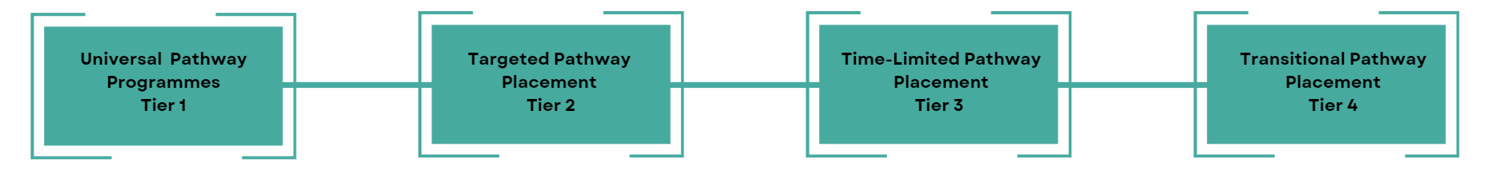
Coventry Alternative Provision Education Partnership Aim:
To equip children and young people with the vital skills, qualifications, knowledge and experiences which assist them to flourish through education and in their transition to adulthood.
Multi Agency Approach to provision:
A graduated model to support each young person to remain in Mainstream Education wherever appropriate, through universal, targeted and specialist provisions that are suitable for the assessed need of the individual and which provide the right support, in the right place at the right time. This will be achieved through;
Universal support as part of a broad and balanced curriculum.
Targeted support placements.
Time-limited support placements in an alternative provision setting.
Transitional support return to mainstream or suitable Post-16 destination
The model is underpinned and supported by a
bespoke Behaviour and Belonging Training Pathway
as part of the Coventry SEND Workforce Strategy.

Slide 2
Belonging in Coventry…..
“Belonging’ is that sense of being somewhere where you can be confident that you will fit in and feel safe in your identity. As schools are one of the few shared social institutions which can create a sense of belonging or exclusion, it’s vital that they are places of welcome and belonging.
A school is just a building. What happens in any school is down to the people in and around it: the children, their families, the staff - and the leaders.
How leaders think, decide, act and reflect, and draw on their knowledge to create a roadmap of possibilities is critical to the well-being of children and adults”
Kathryn Riley, Professor of Urban Education, UCL Institute of Education (IOE)
We know that culture eats strategy for breakfast so the CAP Graduated Model has to be underpinned and supported by a culture of belonging

Slide 3

Belonging / Behaviour Training Pathway
When The Adults Change (WTAC)
Proven track record with evidence of working successfully with Secondary Schools
Year-long commitment from schools as guided and supported towards system change
The programme will include:
A training day for Behaviour Leads, Sencos, CAP coordinators and one other staff member from each school
Personalised meeting with school leaders
Direct contact with members of the WTAC team throughout the programme
A highly practical bespoke implementation plan
A tailored training plan based on bite-sized chunks of CPD
The ability to measure culture and gauge practice
Opportunities to review and revisit each step
Full data reporting and progress reviews
Access to our Behaviour Change Course
Access to our Behaviour for Leaders Course
Access to our Parent Coach Course
Invitations to attend virtual INSETs and virtual training with Charlotte and the WTAC team
Access to a video library that allows you to engage in training at any time
A full year's support
Creation of an Implementation Plan- clear, easy to follow pathway based on school context and conversation outcomes.
Ongoing review.
Full access to online training platforms, virtual inset, twilight live online sessions, resource library, recorded sessions and ‘phone-a- friend’ on call support.
Relational review- online tool completed by schools
90-minute telephone conversation with Leaders

Slide 4
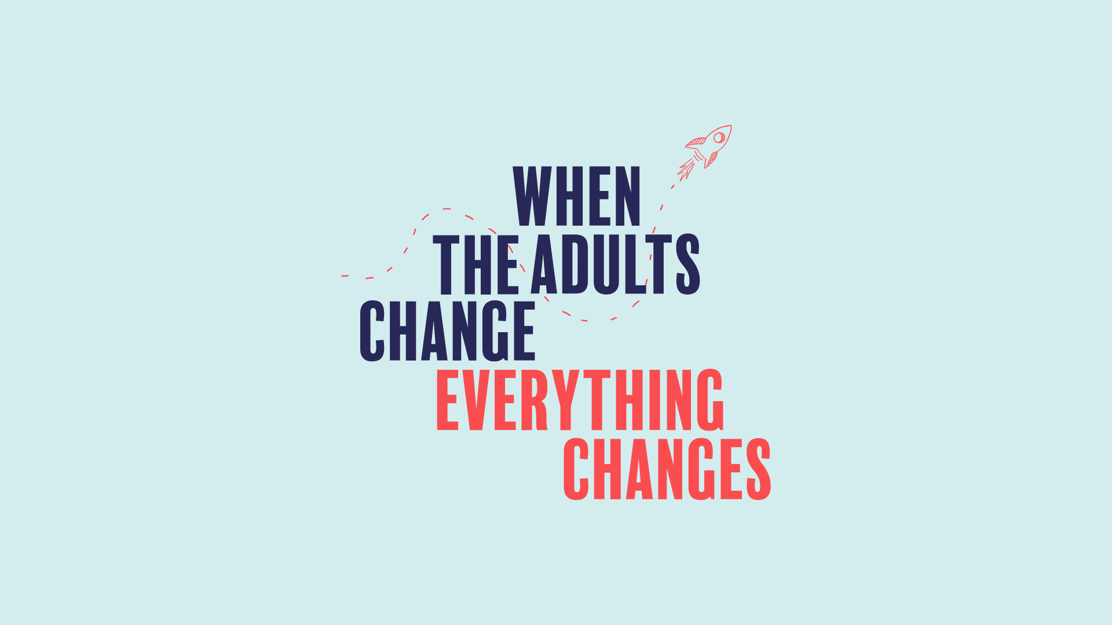

Slide 5
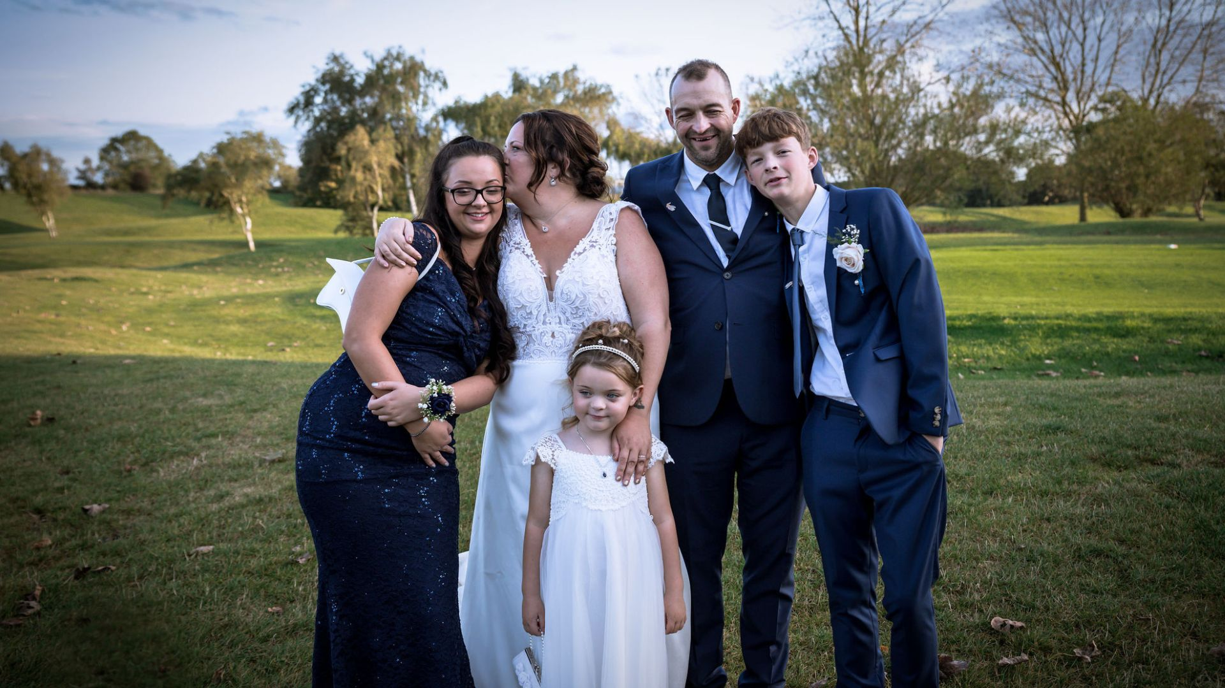

Slide 6


Slide 7
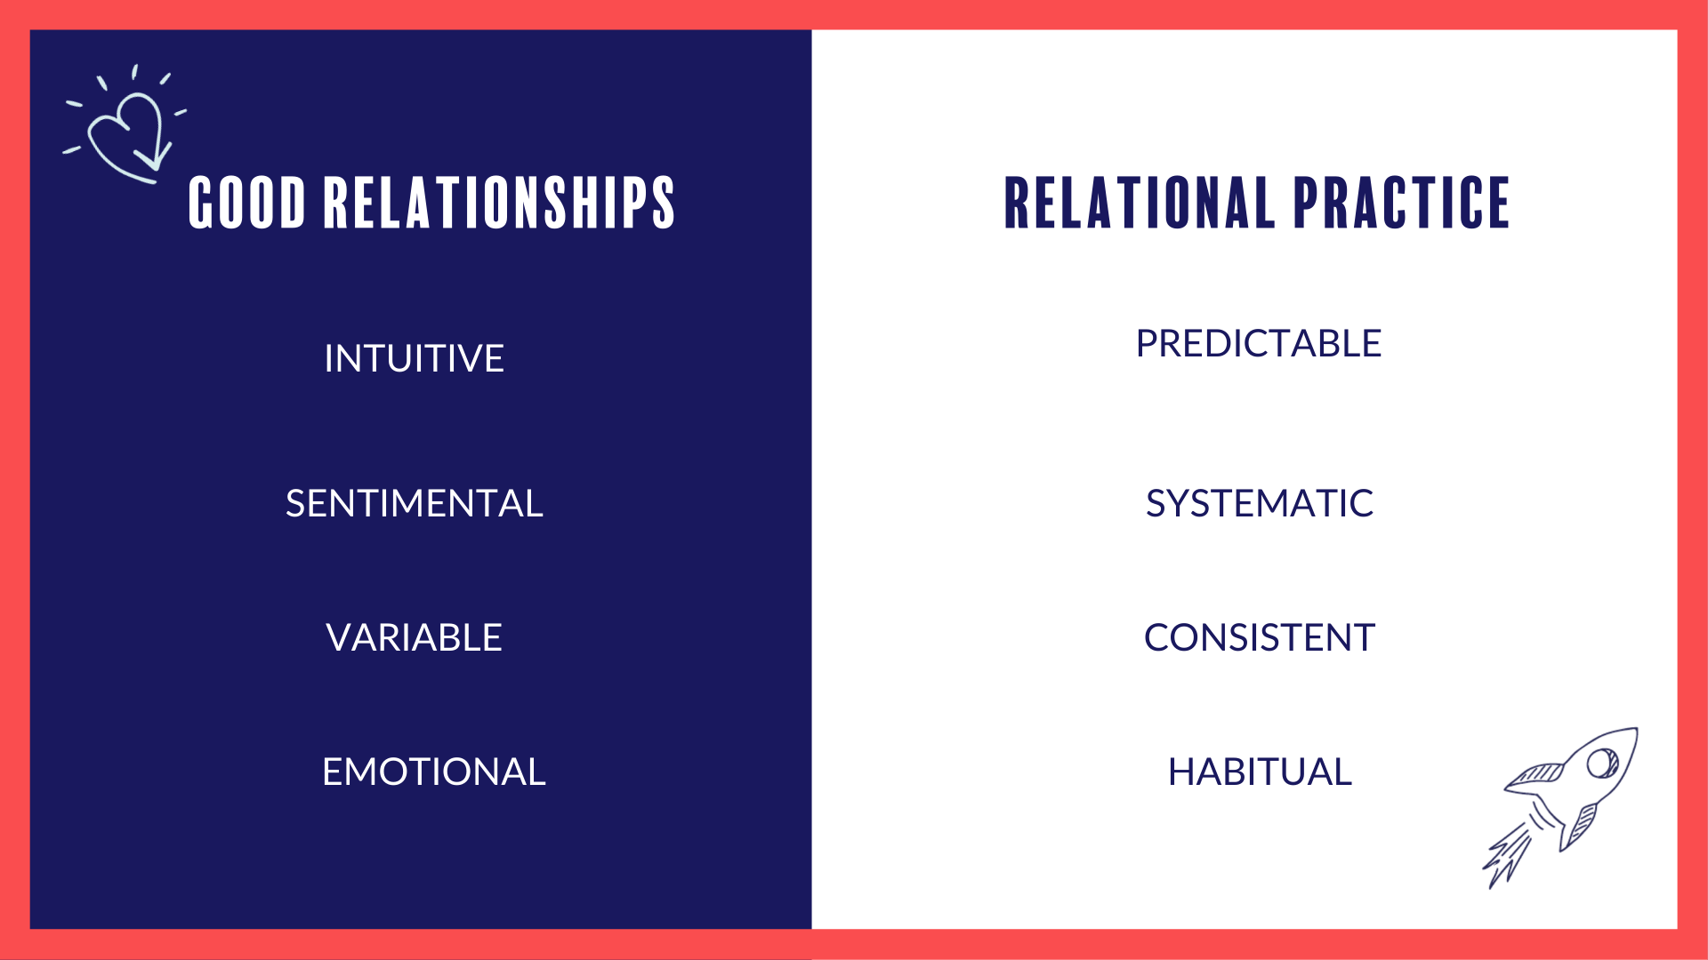

Slide 8
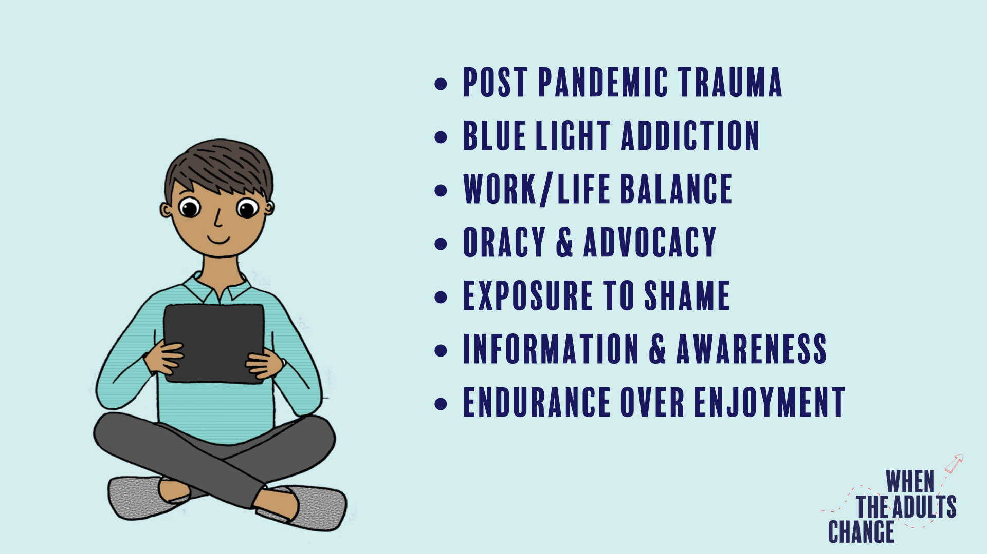

Slide 9
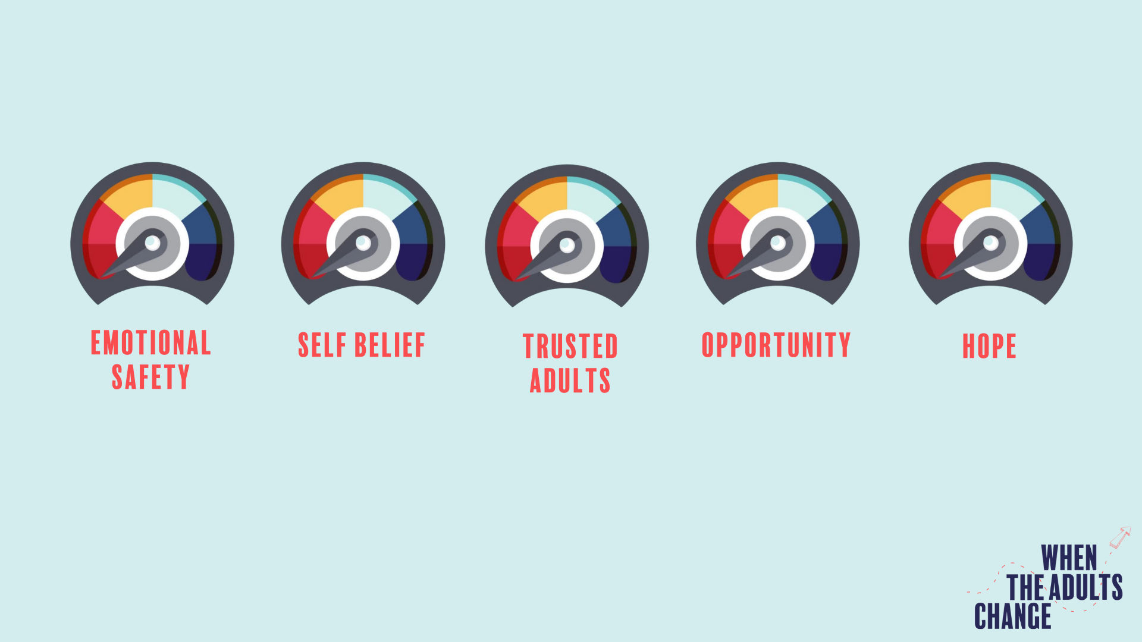

Slide 10


Slide 11


Slide 12


Slide 13


Slide 14


Slide 15


Slide 16


Slide 18
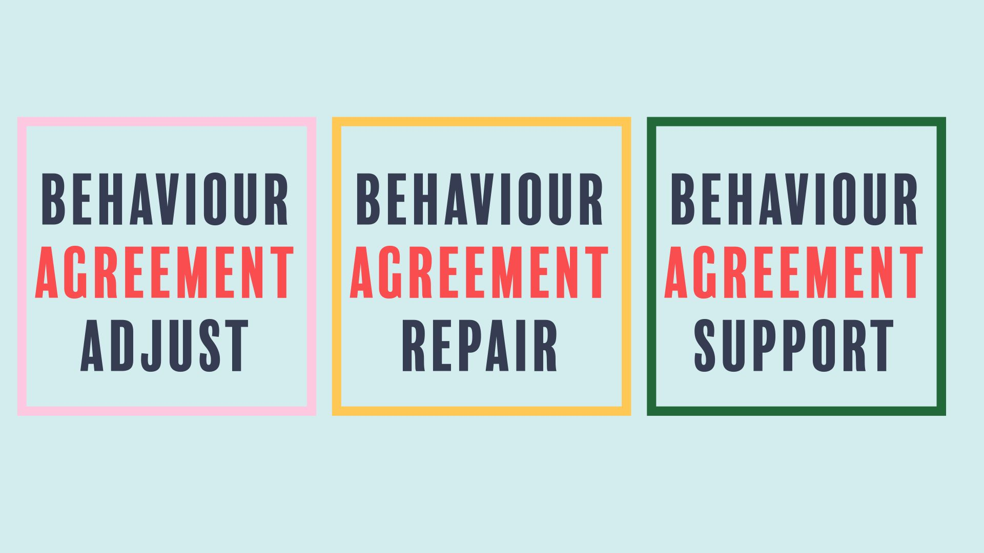

Slide 19


Slide 20
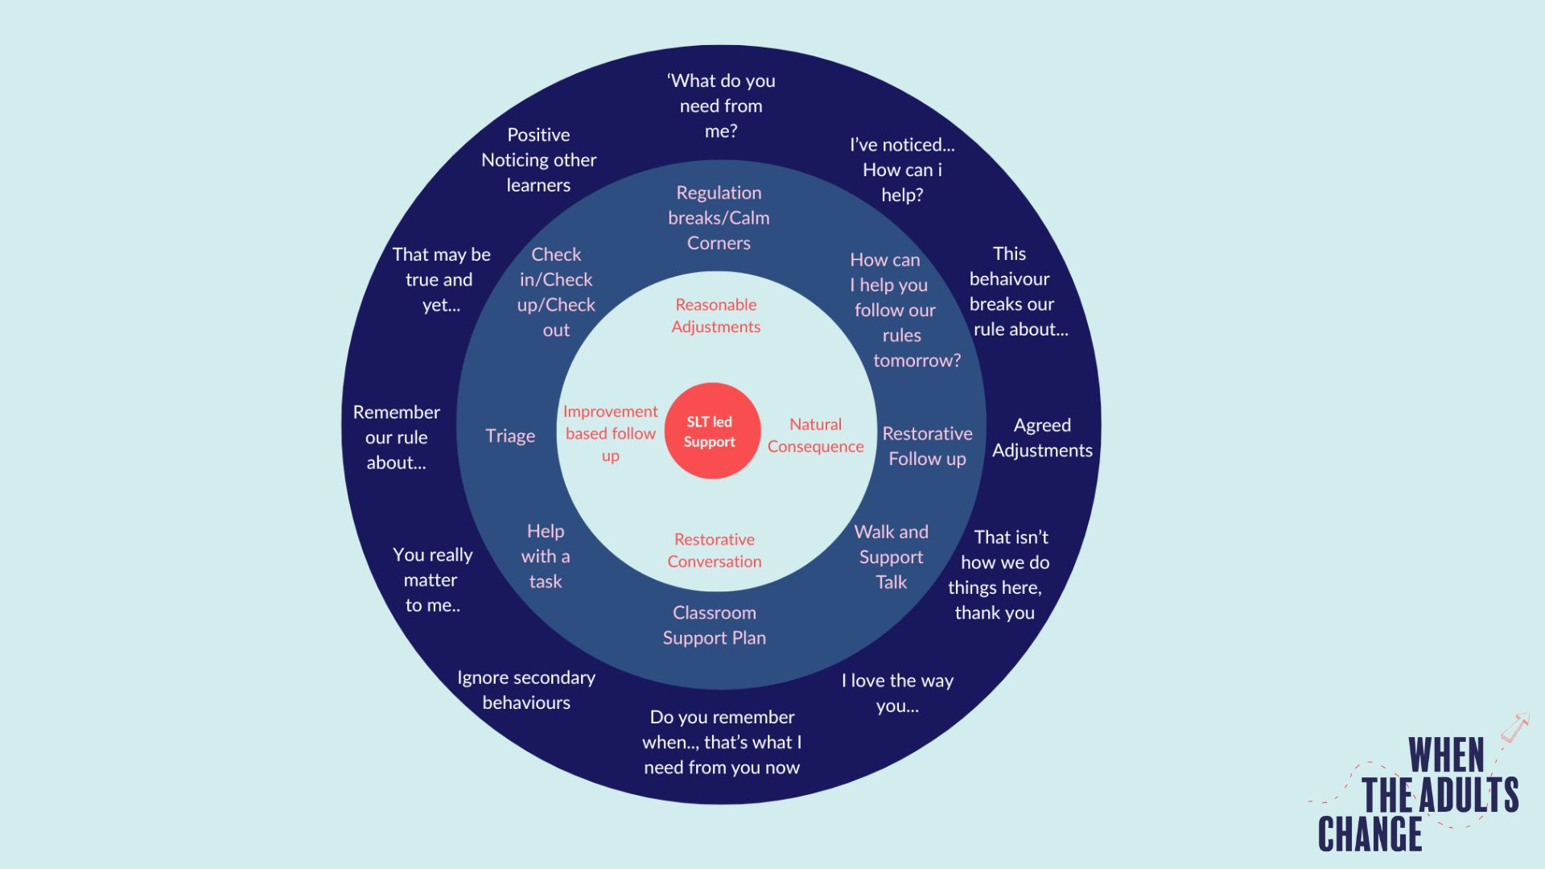

Slide 21


Slide 22


Slide 23


