Slide 1

Multilingual Me!
Today, we will think about what it means to be multilingual.

Slide 2
Objectives
We can see that we are all, in some way, multilingual.
We can learn about the languages our classmates speak or understand.
We can realise that we know more about languages than we think.

Slide 3
Let's Go!
How many languages do you know?
With a partner list any languages you know and one word from that language. (Don't worry about the spelling). Who knows more than five?
Here's three to start you off...
1. German Hallo
2. English Hi
3. Hindi Namaste नमस्ते

Slide 4
Tell us!
1 to 5 challenge.
Share with the class which languages you speak, hear or understand.
If you speak another language, would you demonstrate counting up to five to your class?

Slide 5

Lingua (it means 'tongue' in Latin)
Monolingual means you speak ____ language.
Bi-lingual means you speak ____ languages.
Multilingual means you speak _____ languages.
Do you think you are monolingual, bilingual or multilingual?
What other words can you think of with these prefixes?
"mono"
"bi"
"multi"

Slide 6
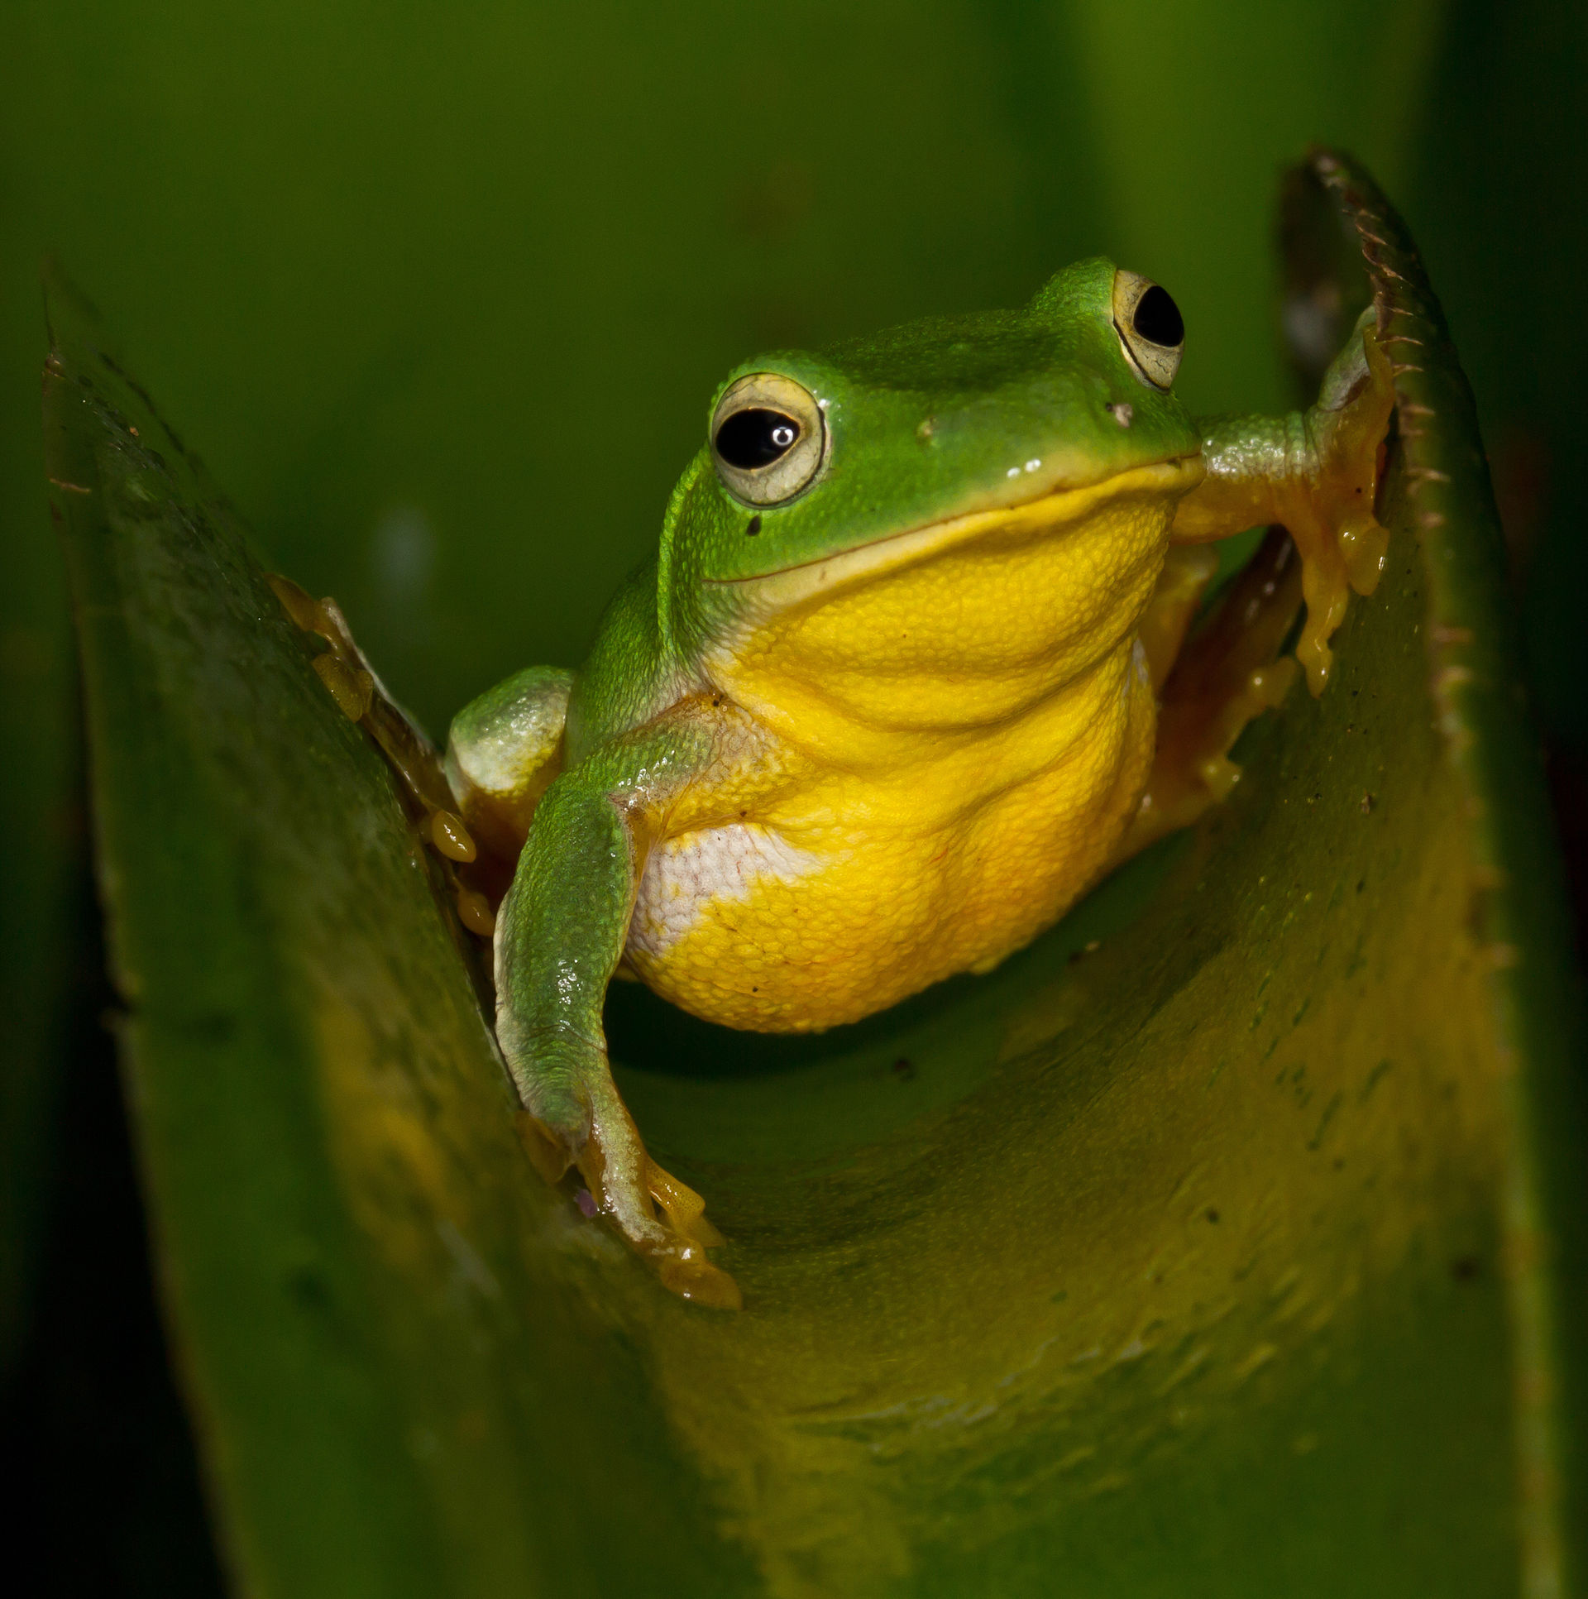
OK, get ready....
The next slides will ask you about how you communicate.
Crouch down behind your chair then jump up, like a frog, if the statements apply to you.
Be ready to give the class examples and explain why you jumped up.

Slide 7
Stand up if......
You hear your friends speaking other languages.

Slide 8
Stand up if......
You communicate with your hands, face and body.

Slide 9
Stand up if......
You speak or hear another language at home.

Slide 10
Stand up if......
You can think of a famous person who speaks another language.

Slide 11
Stand up if......
You have watched a film or heard a song or poem in another language.

Slide 12
Stand up if......
You use different words with your friends than with your family.

Slide 13
Stand up if......
You think you speak with an accent or in a dialect.

Slide 14
Stand up if......
You are learning another language.

Slide 15
Stand up if......
You have ever written or worked out a code.

Slide 16

How often did you stand up?
Being multilingual doesn't necessarily mean reaching a fluent level in a foreign language.
We all communicate in ways other than speaking English - we just don't realise it.
Discuss your answers from the previous slides. Why did you jump up?

Slide 17

Multilingual Me
Your task is to create a poster all about you and the languages you speak or hear and how you communicate in general.
You could join your ideas together to make a Multilingual Us poster.

Slide 18

My Example
My name is Abigail. I speak English at home.
My Mum comes from Belgium. She speaks Flemish, which is a bit like Dutch.
I don't speak Flemish, but I understand some words.
I listen to music in Spanish.
I have watched a French film called Petit Nicolas.
I speak English with a Kent accent.
I sometimes buy food from a Chinese supermarket. I like looking at the Chinese writing.
I went to Greece and heard the language and saw it written on signs.
My best friend, Is-Haaq, speaks Arabic.
I am learning French.

Slide 19
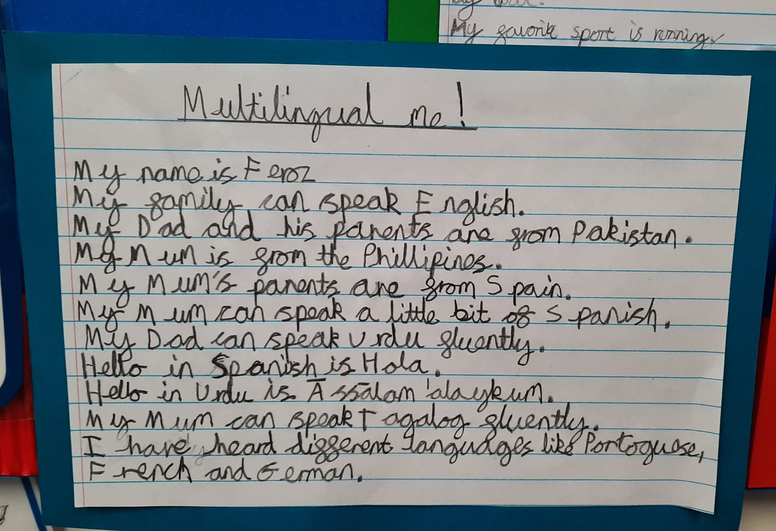
Feroz' example

Slide 20
Try this if you need help getting started...
My name is _________. I speak ___________ at home.
My Mum comes from ____________ and my Dad comes from ________.
She speaks ___________. He speaks _______________.
I don't speak __________, but I understand some words.
I listen to music in _________.
I have family/friends living in ________________.
I speak English with a _______ accent.
I went to __________ and heard the language and saw it written on signs.
My friend speaks _______________.
I am learning _____________ in school.
My favourite food is _________and it comes from _____.

Slide 21
WoLLoW would like to know...
Do you feel multilingual?
If you could speak one other language, which language would that be?
Why?
(I'd learn British Sign Language)

