Slide 1

A Celebration of Languages
Today let's celebrate the different languages that we speak, understand and learn.

Slide 2
Objectives
We can see that not all languages use the same writing system as English.
We can see that our lives are full of things from all over the world.
We can show how we appreciate and celebrate the different languages we speak in our community.

Slide 3
Let's Go!
Can you remember...
3 gestures from other countries
3 signs in British Sign Language
3 ways you could indicate you find a meal tasty

Slide 4
How many languages do you recognise?
Bonjour
مرحبا
Guten Tag
สวัสดี
cześć
Hola
Ciao
你好
German
Chinese
Polish
Spanish
French
Arabic
Italian
Thai

Slide 5

What was your score out of 10?
What do these words mean?
Bonjour
مرحبا
Guten Tag
สวัสดี
cześć
Hola
Ciao
你好
French
Arabic
German
Thai
Polish
Spanish
Italian
Chinese

Slide 6
Can you finish the sentences...
My car is made in __________
My spaghetti comes from _________
My mobile phone comes from _________
My naan was made in ____________
My cheese comes from _____________
My olives come from __________
My sushi comes from __________
Deutschland
Italia
中国
इंडिया
La France
Ελλάδα
日本

Slide 7
Do you
remember which languages we
speak in our class?

Slide 8
Tell us more....
Can you teach us how to say "hello" in your other language?
What similarities and differences do you notice between the languages we have heard?
What sounds do you hear?
What do you like about these languages?

Slide 9
Tell us more....
How is your language written?
Does it use the same alphabet as English?
Is it written left to right?
Is it written top to bottom?

Slide 10
Tell us more....
Do you know a song or a poem in your other language?​
Which countries speak your language?​
Have you been there? What is it like?

Slide 11

The following slides are choices...how will you celebrate your classroom of languages?

Slide 12

1) Create a Class Poem
Your task is to write a poem about the languages spoken in your class.
You can use words from other languages.
It could be entirely in other languages.
It doesn't have to rhyme.
My example is on the next slide...

Slide 13
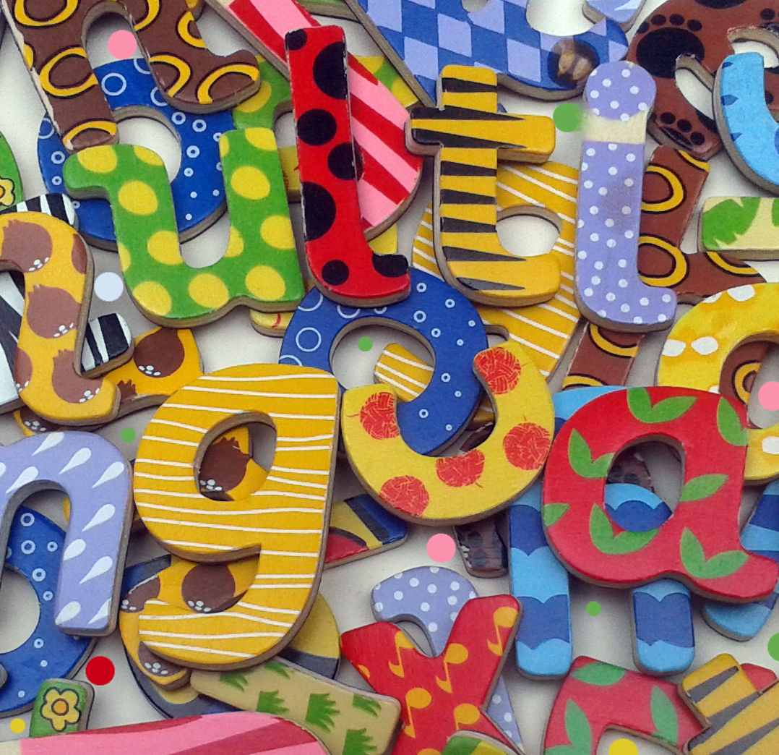
My Multilingual Class
Deutsch, English, Français and Polskie
We are a multilingual class
Harry likes la música de España
Thai food is our favourite lunch
Poppy reads menus in other languages
Ahmed's Dad works in Barcelona
عربى and Ελληνικά
We learn languages together in der Schule!

Slide 14

2) Make a Video
Hola! Hallo! Bounjourno! Namaste! As-salamu Alaikum!
Film people in your school, or class, saying a greeting in a language, other than English, that they speak.
Edit the clips to create a film celebrating all the languages spoken in your school community.

Slide 15
3. Make a class language mobile
Think about the items in your house or in your classroom.
Where do you see writing in different languages?
Where do the things in our lives come from?
Where is your car made?
Where is your school jumper made?
Where does pasta come from?
If you have a mobile phone, where is that made?
Where are your bananas grown?

Slide 16
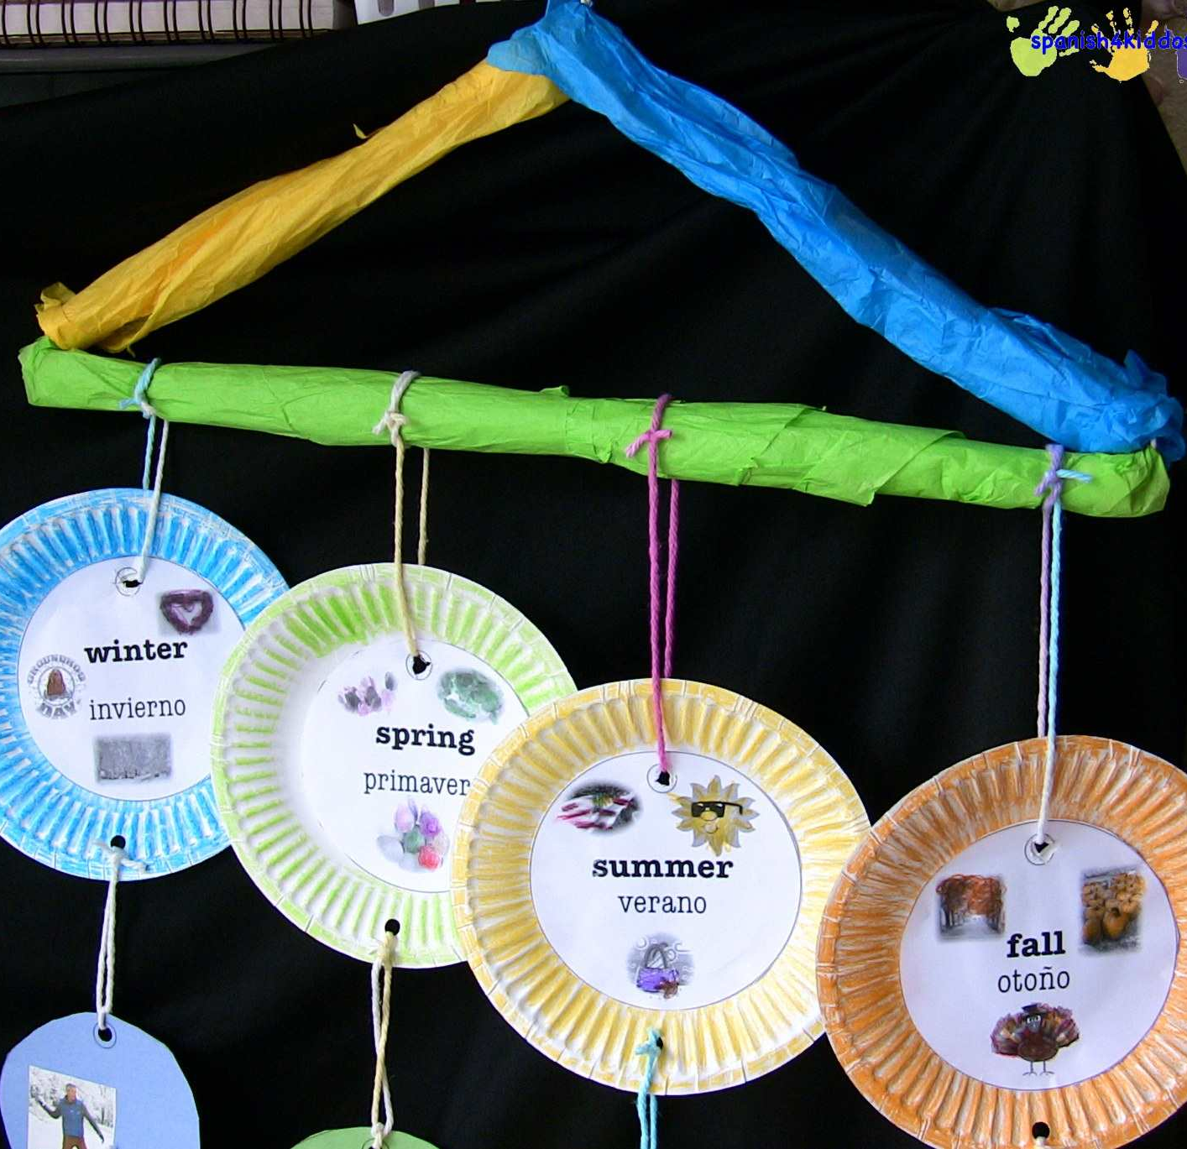
My example
Find pictures of things you have in your life that come from other countries or that show other languages.
Copy out the words in the language (e.g., spaghetti from Italy).
Attach your pictures and words to a coat hanger and create a hanging mobile.

Slide 17
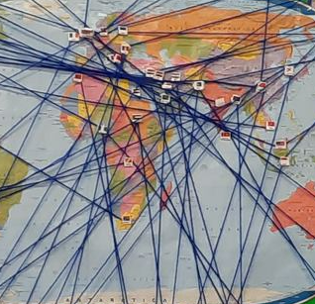
4. Make a Mural
Take a photo of pupils in your class or school.
Link their photo to their country of heritage on the world map.

Slide 18
5. Prepare a class assembly
Show
Show others in you school how proud you are of your multi-lingual class.
Create
Create an assembly all about the languages you speak and hear.
Show
Show others the words you know and the songs and poems you recognise. Show others the maps, flags, traditional clothes or food of the countries whose languages you speak.

Slide 19

6. Teach a mini lesson
Have you enjoyed teaching others to count from 1 – 5 or to say "hello" in your other language?
You could take this further and teach a language lesson.
Can you teach how to ask someone's name and how to respond. Or can you teach how to ask how old someone is?

Slide 20

7. Act it out
Create a drama sketch about how we communicate:
with one shared language
with those who speak languages we don't understand
with other forms of communication that don't require words

Slide 21
WoLLoW would like to know...
What three things you have learnt about language and communication in this unit?
Tell these to your partner.
At home tell them to your parents or carers.

