Slide 1

Journey

Slide 2
Objectives:
Think about the journeys we have made in our lives.
To learn about journeys people make when they move countries.
To consider different types of journeys.

Slide 3
Let's go...
Across all cultures and all time periods, humans have been on journeys.
Tell you partner three things about a journey you have been on.
1
2
3

Slide 4
Let's investigate...
On the next slide, you will see the word journey in lots of languages.
1. Can you add any words to the map?
2. What do you notice about the way the words are written?
3. Can you see any patterns?
4. Are there any similarities between the languages?
5. Why do the same words appear in different parts of the world?

Slide 5
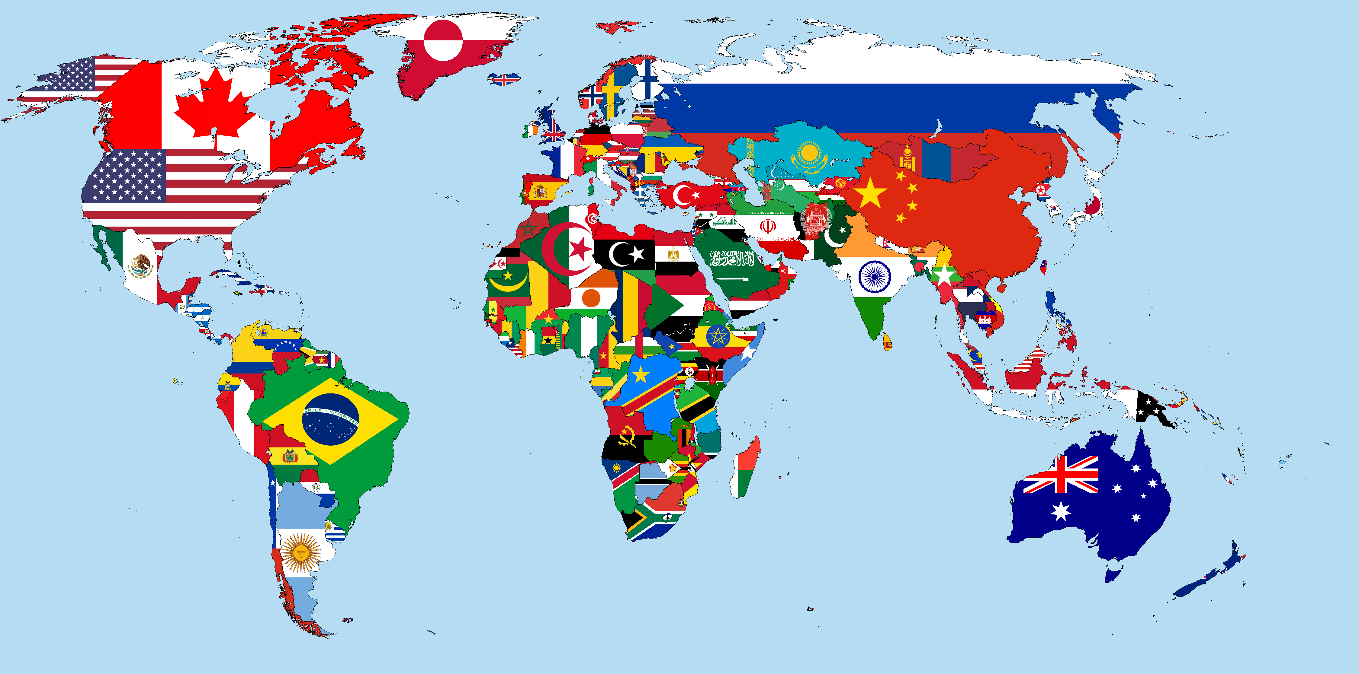
resa
ferð
путешествие [puteshestviye]
Reise
подорож [podorozh]
journey
viaje
viaggio
سفر
旅行 [lǚxíng]
seyahat
旅 dabi
حلة [rihla]
যাত্রা [yātrā]
رحلة [rihla]
viaje
यात्रा [yaatra]
irin ajo
hành trình
njem
ගමන [gamana]
puriy
safari
paglalakbay
jornada
viaje
rwendo
journey
uhambo
reis
haerenga

Slide 6
Where does the word "journey" come from?
It comes from the old French word for "day", journee. It could mean a day's travel or a day's work. The modern French word for "day" if jour.
What does the word “journey” mean to you?

Slide 7
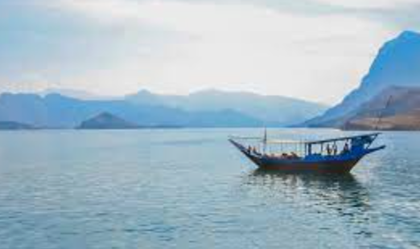
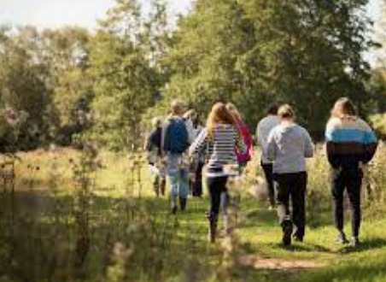
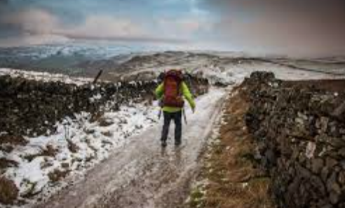
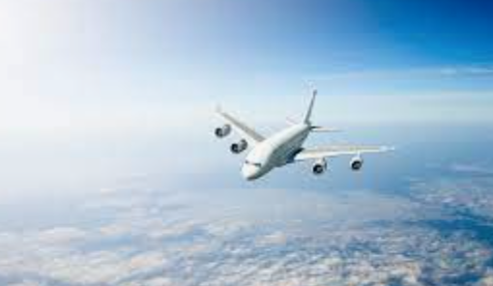
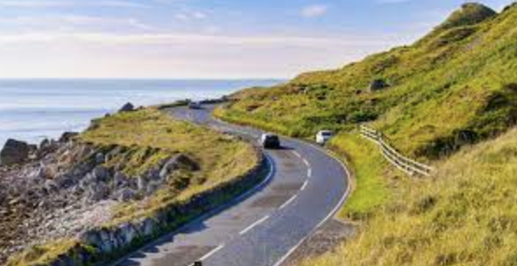
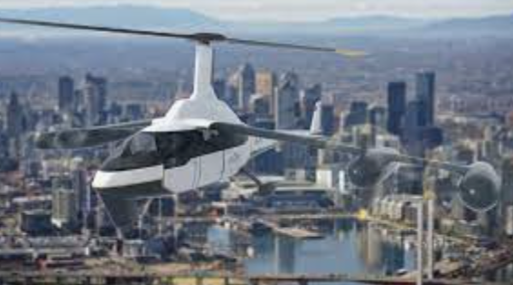
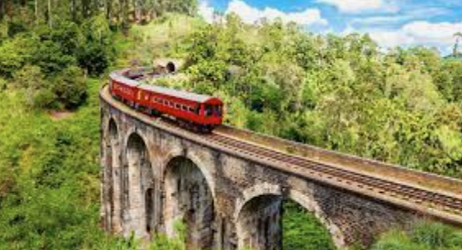
Is this what you thought of?
What kind of journey do you like the look of? Why? What picture could you add?

Slide 8

Quiz Time!
Test your partner…
Have you ever been on a journey? Where did you go?
What modes of transport can you use for a journey?
Why do people go on journeys?
Can you name different types of journey? (e.g. educational)
What might you pack for a journey?
How do you prepare for a journey?
What challenges might people face on a journey?
How has technology changed the way people go on journeys?

Slide 9

Are all journeys easy?

Slide 10
Is a journey just a physical thing?
Or can it be more personal, emotional or spiritual?
Can you add to my word wheel?
growth
journey
self-discovery
language

Slide 11
WoLLoW would like to know…
What three things have stuck in your mind from today’s lesson?
1
2
3

