Slide 1





LANGUAGES
What community means to us and how we can create it.
Notes:
The theme for Refugee Week 2025 is Community as a Superpower.

Slide 2

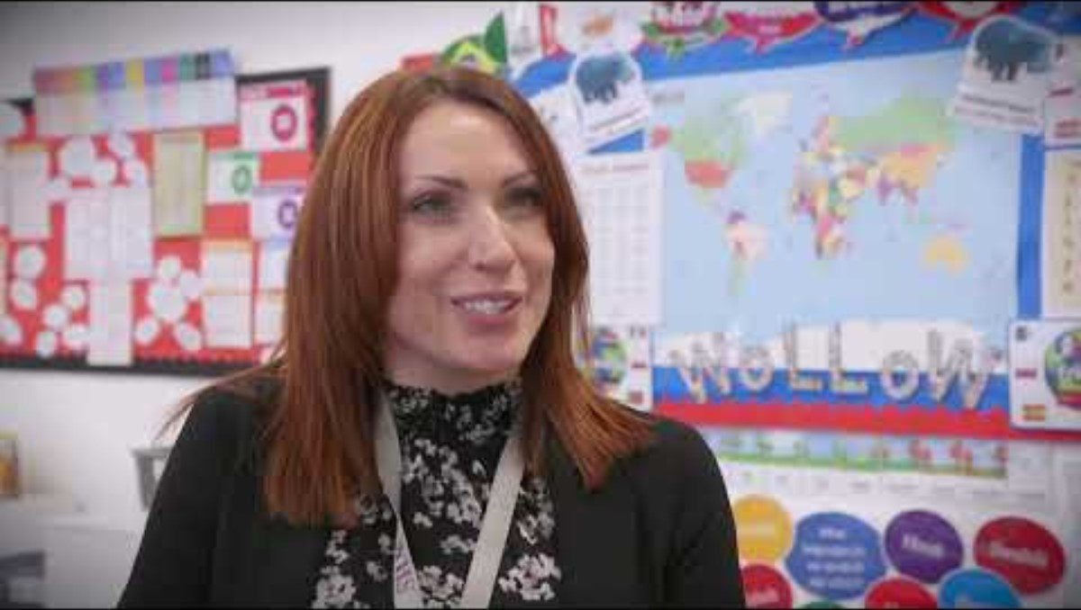

Delivery guidance
This resource was designed for Key Stage 2 but could also be used or adapted for Key Stage 3. It has been designed for the Refugee Week 2025 theme of community with A Day of Welcome scheme.
Some of the slides have notes to support the delivery of the learning and activities.
You will need sound enabled for the embedded videos
For more WoLLoW resources please visit https://theworldoflanguages.co.uk/.
Our vast range of primary and secondary resources are free and used in hundreds of schools around globally.

Slide 3

Please read and consider this guidance before delivering the lesson.
If you have refugee pupils in your school…
It is essential to be mindful of the needs of any children whose family have a refugee or asylum-seeking background before delivering this lesson.
If this applies to any of your children, it’s important to talk to them in advance of the activity and plan accordingly. .

Slide 4




Today we will...
Think about what community means to us.
Understand that community can mean many different things.
Learn about the Moomins and the they found safety and community. (Find the Moomin on every slide )
Celebrate our different communities.
Notes:
Objectives slide. We will look at Community as a Superpower through the Moomins books. The Moonins celebrates its 80th anniversary in 2025. Pupils can spot the Moomin hidden on every slide.

Slide 5

Do you recognise this book or these characters?
What language do you think these books were originally written in?
Look at the words on the front cover. What do you notice?
Where in the world do you think this language is spoken?
Notes:
Some pupils ma have heard of the Moomins. The language is Swedish as the author is Swedish-Finnish. Pupil may guess the language by spotting the author's name or recognising some of the special letters in the title. The may notice the Å, Ä, Ö. Å is a ring diacritic and is a letter in its own right. It comes after the Z in the Swedish alphabet. It changes the sound to a long a sound, like in "father". The dots in Ä, Ö are umlauts and are also considered letters. They change the sound of the vowel Ä sounds like the e in bed; Ö sounds like the e in her. Swedish is spoken in Sweden and parts of Finland. It is a Germanic language and is mutually intelligible by Norwegians and Danes.

Slide 6
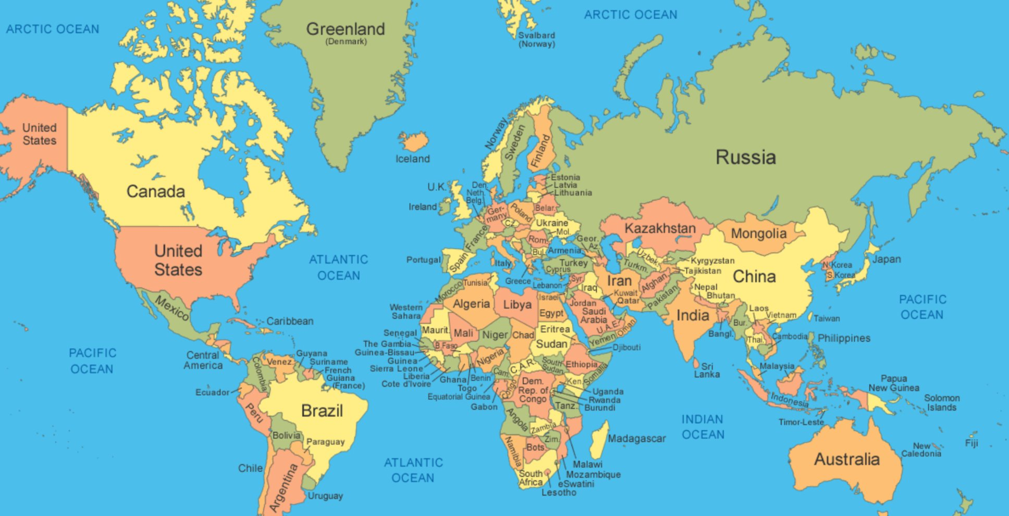
The famous Moonins books were written by Swedish-Finnish author Tove Jansson.
The original books were in Swedish.
They have been translated into over 60 languages!
Can you point to Sweden on the map?
Can you point to Finland?
Which continent are these two countries in?
Do you know the capital city?
What does the flag look like?
Notes:
Ask pupils the questions on the right hand side of the slide. Sweden and Finland appear top central of the map in green and orange respectively. They are in Europe and are considered Nordic countries. Sweden is part of Scandinavia. While Finland is often considered part of Scandinavia due to cultural similarities, Scandinavia only refers to Sweden, Denmark and Norway. The capital of Sweden is Stockholm and the capital of Finland is Helsinki. Swedish flag is blue with a yellow cross placed towards the left. Finnish flag is white with a blue cross placed towards the left. Answers for pupils on next slide.

Slide 7


Swedish Flag. These countries are in Europe. Finnish flag.
Stockholm is the capital. Helsinki is the capital.
Notes:
Sweden and Finland appear top central of the map in green and orange respectively circled in red. They are in Europe and are considered Nordic countries. Sweden is part of Scandinavia. While Finland is often considered part of Scandinavia due to cultural similarities, Scandinavia only refers to Sweden, Denmark and Norway. The capital of Sweden is Stockholm and the capital of Finland is Helsinki. Swedish flag is blue with a yellow cross placed towards the left. Finnish flag is white with a blue cross placed towards the left.

Slide 8
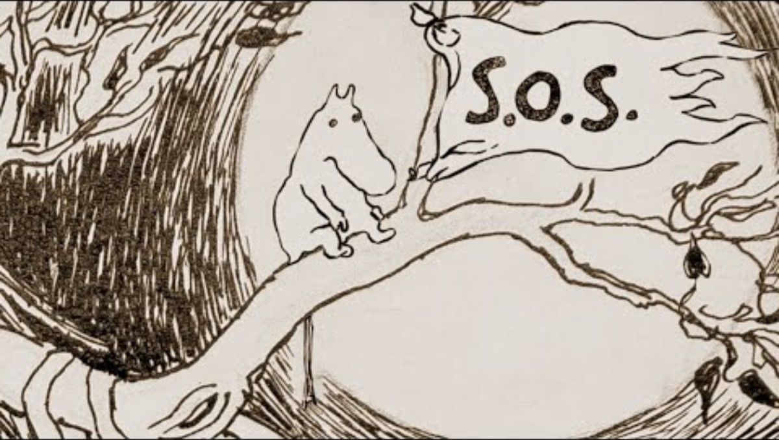

The Moomin Story
Choose 5 words to show how story links to our theme of community?
1
2
3
4
5
Notes:
This two-minute clip introduces the Moomins and their story. It mentions themes that relate to community. Pupils could have written down: shelter, friendship, together, refuge, stay, all, acceptance, love, home, tolerance, empathy, inclusiveness, compassion, belonging, the door is always open.

Slide 9
Community: what an interesting word!
It comes from Latin communitas which refers to a public spirit and willingness to serve your community.
Do you agree that the statements below create a community? What else would you add to the list?
A group with a common understanding
A group speaking the same/similar language
A group with the same laws and rules
A group with the same/similar manners
A group with same/similar traditions
A group interacting for education
A group coming together for work
A group coming together for socialising
Yes No Maybe
Yes No Maybe
Yes No Maybe
Yes No Maybe
Yes No Maybe
Yes No Maybe
Yes No Maybe
Yes No Maybe
Notes:
The word community comes from Latin communitas. Ask pupils to discuss the meanings on the board. Do they think these are important for a community? Do these words make a community? Would they add anything else to this list?
Pupils may consider language or tradition to be of lesser importance than other options. Their class may be considered a community and include people with different languages, for example. Pupils may want to add religious beliefs as an option, or perhaps a shared hobby.

Slide 10


Match the word with the language. Read and listen!
How did you decide? What do you notice? Do you know where these languages are spoken? Do you speak these languages?
English
Farsi
French
German
Hindi
Portuguese
Russian
Cantonese
Japanese
Arabic
Gemeinschaft
b. 社區 (se-fay-kuh-lee)
Comunidade
Сообщество (Soobshchestvo)
コミュニティ (Komyuniti)
समुदाय (samudaay)
مجتمع (mujtamae)
جامعه (jameh)
Communauté
Community
Notes:
Pupils may notice: Different scripts; Similarities between French, English and Portuguese as they are all languages based in Europe; French and Portuguese are Romance languages and English has influence from Latin and French and therefore uses a similar word. They may notice the accent on the e in the French communauté; the Arabic and Farsi are read from right to left and both use the Arabic script. Japanese is written in Katakana (the script used in Japan for foreign words) and they have used a loanword to represent this idea.

Slide 11

Here are the answers
English
Farsi
French
German
Hindi
Portuguese
Russian
Cantonese
Japanese
Arabic
Community
جامعه
Communauté
Gemeinschaft
समुदाय (samudaay)
Comunidade
Сообщество (Soobshchestvo)
社區
コミュニティ (Komyuniti)
مجتمع (mujtamae)
(jameh)

Slide 12
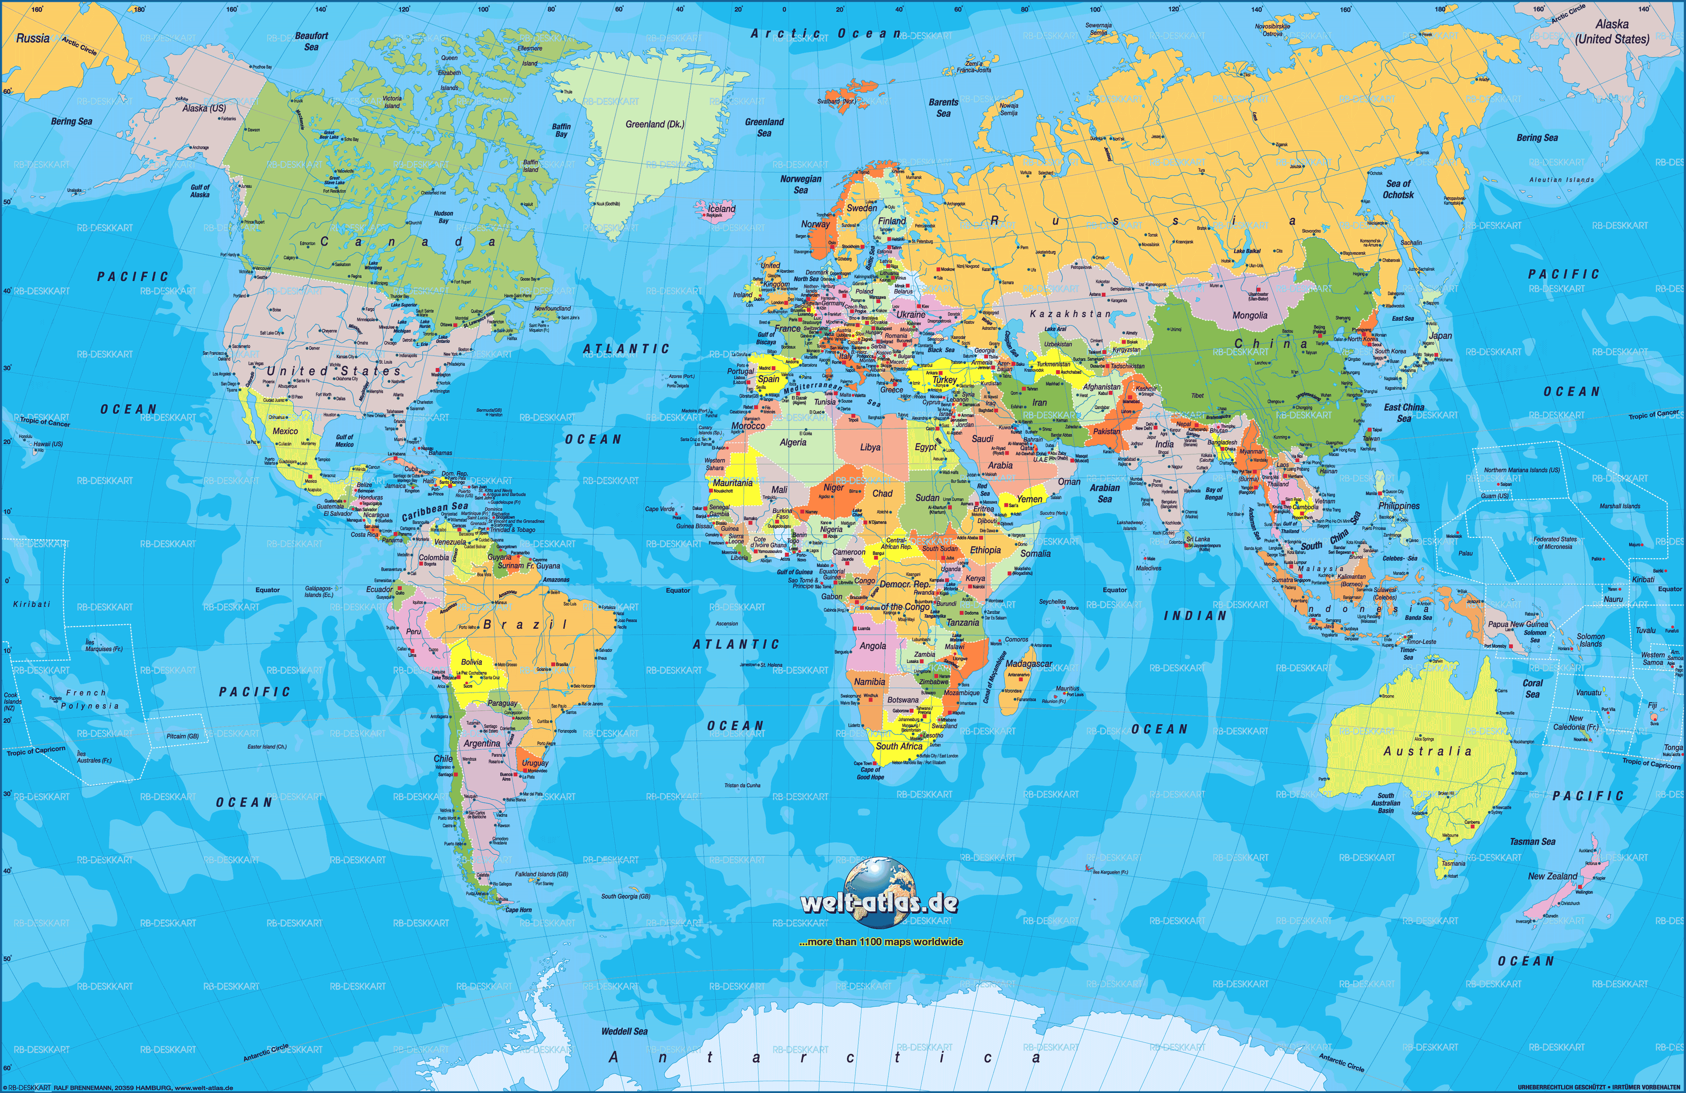
Nunalik
Nunalik
Fellesskap
Soobshchestvo
Community
Samfélag
Fællesskab
Community
Społeczność
kawimdastik
Community
Komyuniti
Comunidad
Spoločenstvo
Shèqū
Mujtama‘
Samūgam
Chumchn
Comunidad
Samūham
Abusua
Ógbè
Comunidade
Jumuiya
Masyarakat
Ayllu
Community
Uluntu
Comunidad
Hapori
Community
The word “community" around the world: What do you notice? What words can you add?
Notes:
Spoločenstvo = Slovak; Społeczność = Polish (Pupils may notice the similarities between these Eastern European languages. Comunidad = Spanish and used in Latin America; Community = England and in Australia, New Zealand, USA, Canada. Conversations could link to Empire, migration and the movement of words and languages. Jumuiya = Swahili; komyuniti = Japanese (loanword from English); Fellesskap = Norwegian; Fællesskab = Danish (similarities may be noted between these Scandinavian words). Samūham = Malayalam (spoken in India); Samūgam = Tamil (spoken in India, Sri Lamka and Singapore; . Pupils may note the similarities of these words from different languages in India) Masyarakat = Indonesian. Hapori = Māori. Pupils may note that some countries have more than one language shown – discussions may arise around multilingual nations. Nunalik – Inuktitut, spoken by the Inuit people. Samfelag = Icelandic. Kawimdastik = Kazakh spoken in Kazakhstan. Chumchn = Thai. Comunidade – Portuguese – here shown in Brazil. Ayllu = Quechua spoken by people in Peru, Ecuador and Chile as well as Spanish. Mujtama’ = Arabic, spoken in the Middle East North Africa. Uluntu = Xhosa, one spoken in South Africa. Abusua = Twi, spoken in Ghana (it also means “extended family). Ógbè = Igbo, spoke in Nigeria.

Slide 13

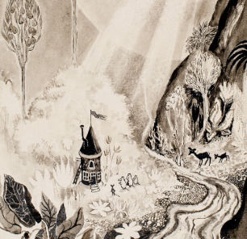
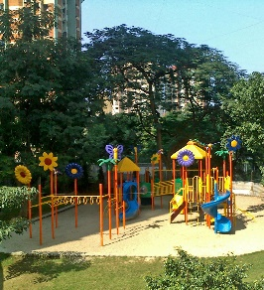
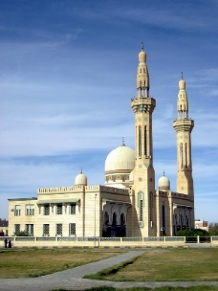
MY COMMUNITY
“Moomintroll’s mother and father always welcomed all their friends in the same quiet way, just adding another bed and putting another leaf in the dining-room table. And so, the Moominhouse was rather full – a place where everyone did what they liked and seldom worried about tomorrow” .
Where do you feel a sense of community? What pictures would you add?
Notes:
Pupils add to the Community spider diagram: where do they feel a sense of belonging to a community. I have added home (the Moominhouse), a mosque, netball club and a park. The aim is that they will see that each person in the classroom will have some of the same ideas and some different ones. Ideas may include sports clubs; religious groups; family and friendship groups; school; extra-curricular clubs; library; theatre; community centre; school council and pupil groups; your street/neighbourhood etc

Slide 14

How do you feel when you are part of a community?
Included
Safe
Isolated
Proud
Supported
Respected
Overwhelmed
Unappreciated
Connected
Valued
Notes:
Pupils choose which words they would put into the goal (words can be moved using interactive whiteboards), showing how they feel when they’re part of a community. All belong in the goal, apart from Isolated, Unappreciated and Overwhelmed. Pupils then add their own ideas to the goal. How do they feel when in their community. Pupils could add to the list of adjectives that do not belong in the goal. Sometimes it is useful to think of what something is not, in order to understand what it is.

Slide 15

1. What community do you belong to?
2. How do you feel when you’re in that community?
3. Are you part of more than one community?
4. Is your community linked to a physical place?
5. How do you feel when you enter that space?
6. Are your friends and family part of your community?
7. Do you think your community will change as you grow up?
All about you!
Notes:
Reflection activity. Think, pair, share may work for this or group discussions.

Slide 16

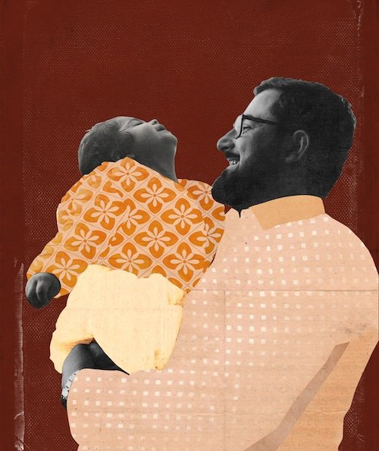




ټولنې تل زما په ژوند کې مهم رول لوبولی دی.
Community has always played an important role in my life.
Gulwali’s first language is Pashto
Meet Gulwali
“I grew up in a society where I wasn’t just raised by my parents, but by my family, uncles, aunties, and the entire village was involved in our upbringing. There was a real sense of belonging and being part of the community. In the district we lived in, we didn’t have any relatives nearby, but the wider community made us feel like we were part of theirs. Community has always played an important role in my life, and on my journey as a refugee, we supported one another, understanding we were all in the same boat – both physically and metaphorically.”
In The Lightless Sky, Gulwali shares his story of escape from the Taliban in Afghanistan to finding safety in the UK as a twelve year old child refugee.
Today he is a world-renowned author, spokesperson and international speaker on behalf of refugees globally.
Notes:
You can find out more about our partner organisation Asylum Speakers here: Asylum Speakers | Amplifying refugee voices through inspiring talks, books, and podcast Asylum Speakers like Gulwali are available to book to visit your school.

Slide 17



Community is about Connections
LEARN TO SAY ‘WELCOME’ in some of the languages spoken at your school. It’s hard to feel part of a community if you are new. A small act of kindness, such as learning a word in a friend’s language, goes a long way!
Visit here to find out how to say ‘welcome’ in hundreds of languages
Notes:
Pupils could work on a computer to find “welcome” in languages of their choice. They could ask friends in their class if they know the word in other languages – they could ask teachers and support staff in school. You could challenge them to find as many languages as possible. Pupils could learn how to say the words aloud and then write them down on a collage wall as a way to show all are welcome, included and belong in your school/your classroom.

Slide 18


WoLLoW would like to know...
3 main words that describe community for you.
1
2
3

