Slide 1


Prospective Councillor Briefing – February 2026

Slide 2
Welcome and Introduction
Julie Newman – Returning Officer

Slide 3
Topics
Who’s who​
Information on being a Councillor​
Qualifications and disqualifications
Nominations and home address forms​
Agents​
Key Dates
Electoral Commission
Security briefings
Contacts​

Slide 4
Who’s who
Julie Newman – Director of Law, Governance and Safer Communities, Returning Officer & Electoral Registration Officer​
Liz Read – Head of Electoral Services, Deputy Returning Officer​ & Deputy Electoral Registration Officer

Slide 5
Becoming a Coventry City Councillor
Serve your community
Shape the future of Coventry
Support residents and represent their interests

Slide 6
Acting for All Residents & Communities
Represent every resident in your ward
Champion inclusion and fairness
Work with communities, partners and local organisations

Slide 7
Time Commitment – What to Expect
Weekly hours vary depending on responsibilities
10+ Full Council meetings per year
Committee meetings, briefings, training and community events

Slide 8
Casework – A Core Part of the Role
Respond to resident enquiries across many issues
Work with officers to resolve concerns
You may hold ward surgeries and maintain regular contact with residents

Slide 9
Why Stand for Election?
Influence decisions affecting 345,000+ residents
Support local groups and community initiatives
Drive improvements and champion change

Slide 10
Skills That Help You Succeed
Communication and listening
Problem-solving and critical thinking
Empathy, resilience and local knowledge

Slide 11
Support You Will Receive
Comprehensive induction and ongoing training
Support from Member Services
IT equipment and guidance provided

Slide 12
Balancing the Role With Work & Life
Employers must allow reasonable time off for duties
Flexible role that fits around work and caring commitments
Develops valuable transferable skills

Slide 13
Nolan Principles – The Standards You Must Uphold
Selflessness – act solely in the public interest
Integrity – avoid obligations that conflict with public duty
Objectivity – make decisions impartially, fairly and on merit
Accountability – be accountable to the public for decisions and actions
Openness – act transparently unless lawful reasons apply
Honesty – be truthful and declare conflicts of interest
Leadership – lead by example and promote high standards

Slide 14
Predetermination – What It Means for Councillors
Approach all decisions with an open mind
You can have views, but you must not have a ‘closed mind’
Avoid publicly committing to a vote regardless of evidence
Consider all information and advice before deciding
Especially important for Planning, Licensing and other quasi‑judicial committees

Slide 15
The One Coventry Plan – Our Shared Vision
Working together to improve the city and residents’ lives
Priorities: strong economy; good health & wellbeing; tackling climate change
Enablers: sustainable finances; civic leadership and partnership working
As a councillor, your ward work and decisions contribute to these outcomes

Slide 16
Qualifications​
Candidates must satisfy criteria on the day they are nominated and on polling day
  be at least 18 years of age
  be a British, qualifying Commonwealth citizen, or national of an EU member state.
  Also at least one of the following:
    Registered local government elector for local authority area
    Occupied as owner or tenant any land or premises in the local authority area during the whole 12 months preceding nomination
    Principal or only place of work (including unpaid) during last 12 months in local authority area
    Lived in the local authority area during the last 12 months
Notes:
Explain what ‘qualifying’ means: i.e. someone who has indefinite leave to enter or remain in the UK, or does not require such leave.
The qualification to be a registered elector is an on-going qualification that must be satisfied (unless qualified under another criterion stated above) for the duration of the term of office should a candidate be elected.
Highlight that it is important to mark all of the qualifications that the candidate satisfies when completing the consent to nomination.
Highlight that someone does not need to be in paid employment in order to satisfy the principal/only place of work qualification.
At parish council elections, the qualification of living in the local authority area is extended: it includes the parish and any area within 4.8km of it.

Slide 17
Disqualifications​
A person cannot be a candidate if they:
  are employed by the local authority or hold a paid office under the authority (including joint boards or committees). Candidates may be ‘employed by the local authority’ if they work at certain schools, fire services, police or health services
  are subject of a Bankruptcy Restrictions Order (or interim restrictions order)
  have been sentenced to a term of imprisonment of three months or more (inc. suspended sentence) without option of a fine, during the 5 years before polling day
  are serving a disqualification due to being found guilty of a corrupt or illegal practice by an election court
  hold a politically restricted post
  are subject to the notification requirement under part 2 of the Sexual Offences Act 2003
Notes:
A person may also be disqualified from election if they have been disqualified from standing for election to a local authority following a decision of the First-tier Tribunal (formerly the Adjudication Panel for England).
Political restrictions do not apply at parish council elections.
This list is not comprehensive. Candidates should read Part 1 of the Commission’s guidance for further information on disqualifications.
If candidates are in doubt about whether they are disqualified, they must do everything they can to check that they are not disqualified before submitting their nomination papers. Candidates must be sure that they are not disqualified as they will be asked to sign one of the required nomination papers to confirm that they are not disqualified. It is a criminal offence to make a false statement on nomination papers as to the qualification for being elected, so if candidates are in any doubt, they should contact their employer, consult the legislation or, if necessary, take their own independent legal advice.
The Returning Officer will not be able to confirm whether or not candidates are disqualified.

Slide 18
Nomination Papers​
Nomination papers must be submitted by all candidates by 4pm – 9 April​
  the nomination form​
  the home address form
  the consent to nomination​
Party candidates will also need to submit, by 4pm – 9 April:​
  A certificate authorising the use of a party name/ registered description on the ballot paper ​
  A written request to use one of the party’s emblems on the ballot paper (optional) ​

Slide 19
Submitting Nomination Papers
Make sure the nomination papers are filled in correctly, as mistakes may invalidate your nomination.​
Complete nomination papers early and arrange for us to provide an informal check​
To arrange an informal check, book an appointment on line or contact the elections office (details provided later)​
Nomination form, home address form and consent must be delivered by hand they cannot be submitted by post, fax, email or other electronic means​
Notes:
Remind the candidates or agents that they must make sure the form is completed correctly. Take time to complete it and use the Commission’s guidance. Arrange for an informal check.
Highlight any arrangements you have put in place to carry out informal checks for example encouraging electronic/remote checks instead of in-person checks.
Remind the candidates or agents that the rules regarding the submission of nomination papers has not changed
The nomination form, home address form and consent to nomination must be delivered by hand and cannot be submitted by post, fax, e-mail or other electronic means. The certificate of authorisation and the emblem request form may be submitted by post, but may not be submitted by fax, e-mail or other electronic means.
No restrictions on who can deliver the nomination papers but should be candidate/agent or someone they trust.

Slide 20
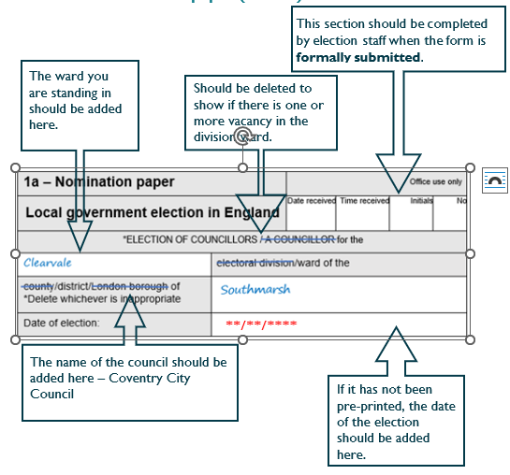
Nomination Paper

Slide 21
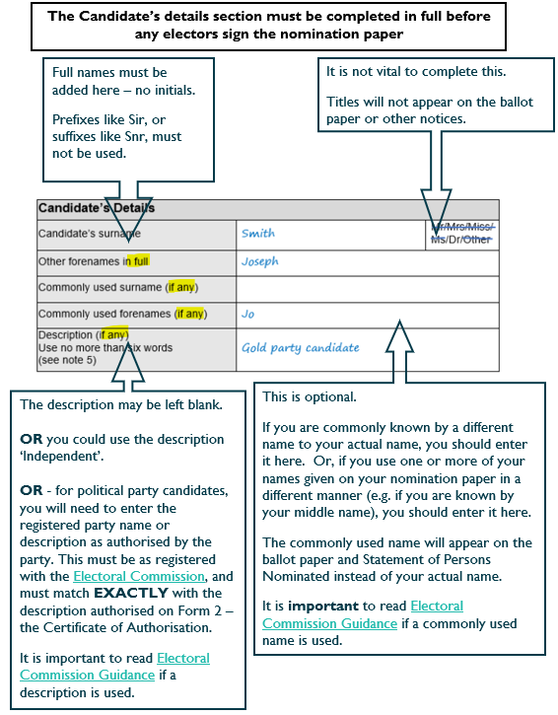
Nomination Paper cont…
Notes:
Commonly used forename and surname if used are the only names shown on official notices and ballot papers. Use of commonly used name section is optional, so that even if you are commonly known by another name, you may leave this blank and stand under your actual name.
For elections on or after 2 May 2024, the Elections Act 2022 introduced legislation which permits greater flexibility in the names a candidate can put on their nomination paper. If a candidate commonly uses a surname or forename that is different from any other surname or forename they have, or uses one or more of their forenames or surname in a different way from the way they are stated on the nomination form, the candidate may use them as a commonly used name
Need to make sure that the description/party name written on the nomination form matches the description on the certificate of authorisation from the nominating officer (or issued by someone authorised to act on their behalf).
Parish council candidates may use any description up to six words, as long as it does not confuse with a registered political party name or description. However, party candidates will need a certificate of authorisation.

Slide 22
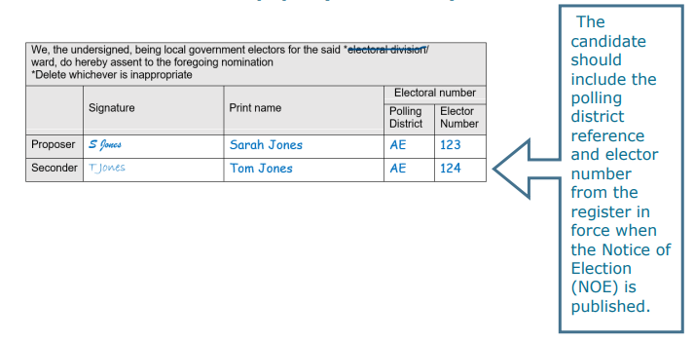
Notes:
The form must be signed by two registered electors, a proposer and seconder from the relevant division/ward.
As the Notice of Election will be published earlier than 30 March, we can help you with elector numbers if you tell us the full name and address of each subscriber. Contact us at Each subscriber must sign the nomination form in the signature column. Their name must be printed too, preferably in capitals, and does not have to exactly match the name printed in the electoral register.
An elector must not sign more nomination papers than there are vacancies in the ward. If subscribers sign more nomination papers than there are vacancies, their signature will only be valid on the first papers delivered to the Returning Officer.
For further information see the Electoral Commission guidance

Slide 23
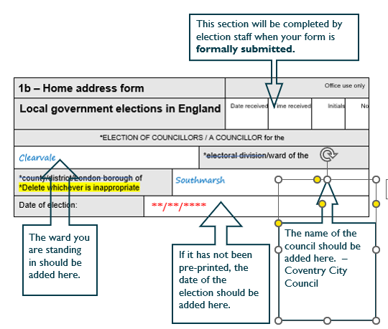
Home Address Form

Slide 24
Home Address Form – Part 1
Notes:
Part 1 of the home address form must state:
your full name and home address in full
your qualifying address, or, where you have declared on your consent to nomination that you meet more than one qualification, your qualifying addresses
which of the qualifications your qualifying address or addresses relate to (a, b, c and/or d)
the full name and the home address in full of the witness to your consent to nomination

Slide 25
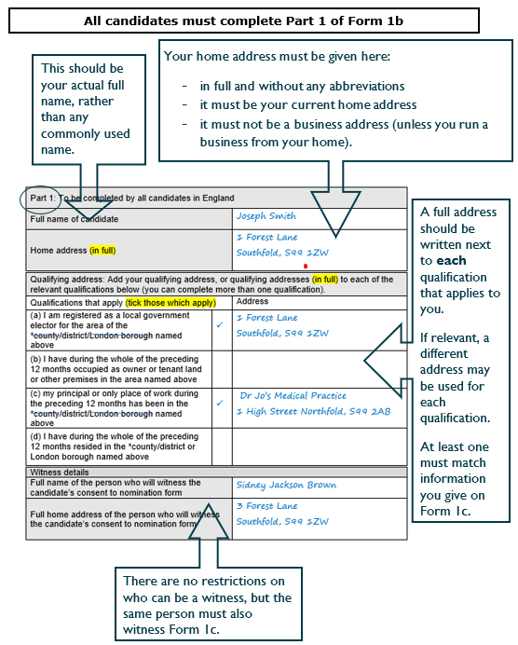
Home Address Form – Part 1
Notes:
Part 1 of the home address form must state:
your full name and home address in full
your qualifying address, or, where you have declared on your consent to nomination that you meet more than one qualification, your qualifying addresses
which of the qualifications your qualifying address or addresses relate to (a, b, c and/or d)
the full name and the home address in full of the witness to your consent to nomination

Slide 26
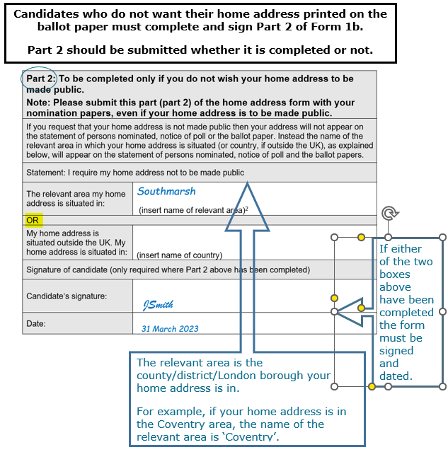
Home Address Form – Part 2
Notes:
Part 2 of the home address form must be completed if you do not want your address to be made public:​
​
The name of the relevant area in which your home address is situated (if your home address is in the UK),​
if you live outside the UK, the name of the country in which your home address is situated.​
The name of the ‘relevant area’ in which your home address is situated (if your home address is in the UK)
For home addresses in England:
if the address is within a district for which there is a district council, that district;
if the address is within a county in which there are no districts with councils, that county;
if the address is within a London borough, that London borough;
if the address is within the City of London (including the Inner and Middle Temples), the City of London; and
if the address is within the Isles of Scilly, the Isles of Scilly

Slide 27
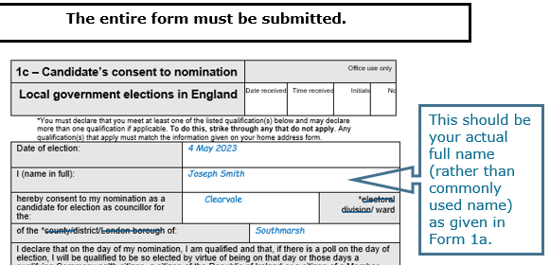
Consent to Nomination
Notes:
Must include:​
name and address ​
which area standing in​
confirmation of qualification(s) that apply (at least 1, but select all that apply)​
date of birth & signature​
date of consent​
witness’ name, address and signature​
​
Advise people that if they qualify under more than one qualification it is good practice to use them all in case any become invalid once they have become elected.
The candidate’s signature must be witnessed and the witness must sign the form. The witness should be the same person whose details you give on your home address form
Highlight that candidates must not sign the form if they are not qualified to stand. Point to Part 1 of the Commission’s guidance for candidates and agents (www.electoralcommission.org.uk).
You must not sign the consent form earlier than one calendar month before the deadline for submitting your nomination papers

Slide 28
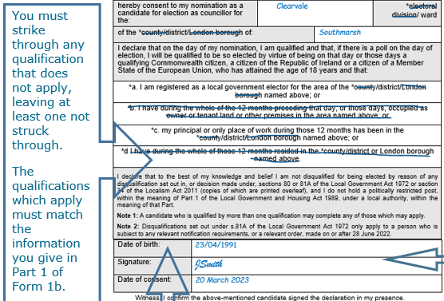
Consent to Nomination

Slide 29
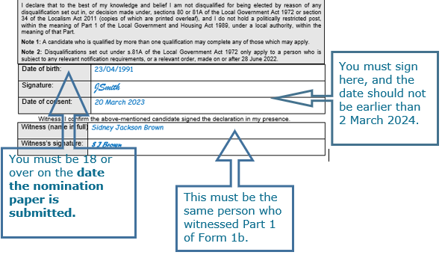
Consent to Nomination
Notes:
Must include:​
name and address ​
which area standing in​
confirmation of qualification(s) that apply (at least 1, but select all that apply)​
date of birth & signature​
date of consent​
witness’ name, address and signature​
​
Advise people that if they qualify under more than one qualification it is good practice to use them all in case any become invalid once they have become elected.
The candidate’s signature must be witnessed and the witness must sign the form. The witness should be the same person whose details you give on your home address form
Highlight that candidates must not sign the form if they are not qualified to stand. Point to Part 1 of the Commission’s guidance for candidates and agents (www.electoralcommission.org.uk).
You must not sign the consent form earlier than one calendar month before the deadline for submitting your nomination papers

Slide 30
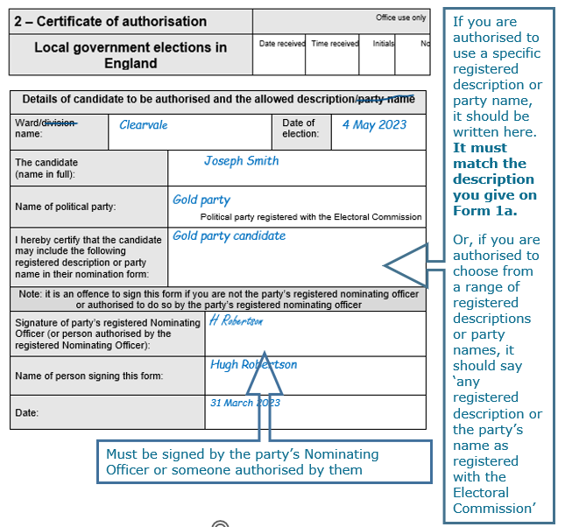
Certificate of
Authorisation/Emblem
Notes:
Party candidates must have written permission to use the party name/description from the Nominating Officer (or a person appointed to act on their behalf)​
The certificate may:​
allow the use of the party name or a particular description​
allow candidate to choose whether to use the party name or any of the descriptions registered with the Electoral Commission​
Party candidates can ask an emblem to printed on the ballot paper​
Party candidates should supply an electronic version of the emblem to the Returning Officer if required​
Must be submitted by 4pm 9 April​
If the ‘certificate of authorisation’ states a particular description or the party name to be used then that must be used by the candidate.
If the certificate allows the candidate to choose, they must choose either the party name or a description registered with the Electoral Commission. Party names and descriptions are on the Commission website and must match exactly. No alteration is permitted.
Party candidates can ask for an emblem to be printed on the ballot paper
Emblem request form must be submitted by 4pm [E-19]
Party candidates should supply an electronic version of the emblem to the Returning Officer if required

Slide 31
Joint Candidates​
Nominated by more than one party​
​
May use registered joint descriptions​
must be supported by certificate of authorisation from each party​
​
May use one emblem of one of the parties but there are no joint emblems​

Slide 32
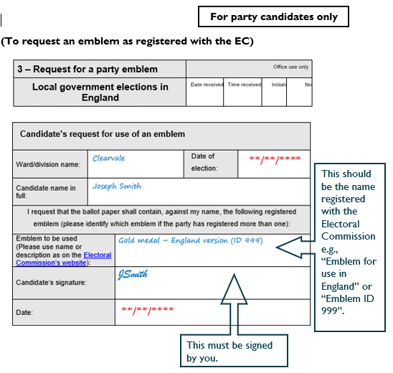
Emblem Request

Slide 33
Election Agent​
Responsible for the proper management of your election campaign; particularly its financial management.
Notification of appointment must reach the RO by 4pm – 9 April. Form is included in nomination pack.
You will become your own agent by default if none is appointed.
Notes:
Agents, including a candidate acting as their own agent, can be replaced at any time.
Remind candidates that is they act as their own agent and do not provide an office address their home address will be published on the notice of election agents, even if they have requested for this information to be withheld from the SOPN and ballot paper
No election agents for parish council elections.

Slide 34
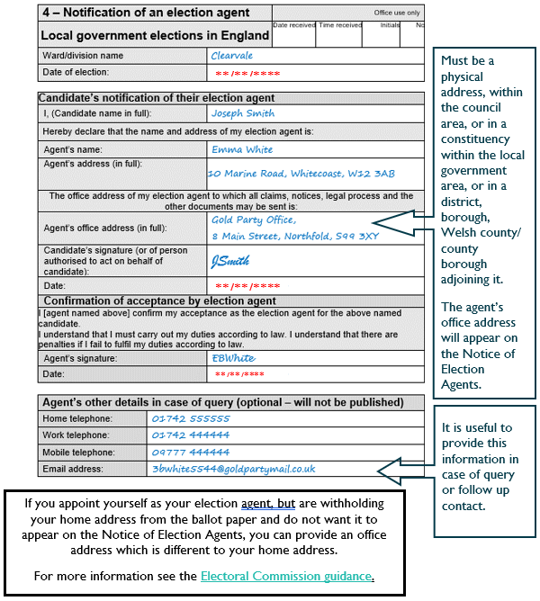
Agent Notification Form

Slide 35
Other Agents​
  Other agents can be appointed to attend postal vote openings, polling stations and the count on your behalf:
  You must give notice in writing of any people appointed as polling and counting agents by 29 April.
  The appointment of postal voting agents attending a particular opening session must be made before the start of the session. We will give 48 hours’ notice.
Notes:
Each Candidate will be able to appoint 4 counting agents

Slide 36
Access to electoral register/ absent voting lists
Access by candidates – once you officially become a candidate:
  earliest, on 30 March which is the last date for publication of the notice of election if you, or others declared yourself a candidate
  once you or others have declared yourself a candidate after this date / date you submit your nomination papers
  Make written request to the ERO – forms are available from the office / are included in your nomination pack.
Notes:
Once someone officially becomes a candidate, they are entitled to receive a free copy of the full electoral register and the lists of people voting by post or proxy (‘the absent voters’ lists’) for the ward/division that they are contesting.
Emphasise that candidates may prefer to receive the register and lists electronically, to avoid the need to collect them from the election office. Highlight any local arrangements you may have in place for collection of physical copies.
Registered political parties are entitled to receive a copy of the full electoral register at any time.

Slide 37
Access to electoral register/ absent voting lists
Only use data for permitted purposes!
  to complete the nomination form
  to help you campaign
  to check that donations/loans are permissible
Notes:
Any person found breaching the restrictions on use of the electoral register could face a fine
Refer to Access and Supply section of the Commission’s guidance for further details.

Slide 38
Key dates – Candidates & Agents​
Publication of Notice of Election | Thursday 26 March
Nominations commence | Friday 27 March
Close of nominations | 4pm Thursday 9 April
Notification of appointment of election agents | 4pm Thursday 9 April
Publication of statement of persons nominated | No later than 4pm Friday 10 April
Appoint of counting and polling agents | Wednesday 29 April
Return of election expenses | Thursday 11 June (results declared on 8 May)

Slide 39
Electoral Commission
Electoral Commission provide a full range of guidance for candidates and agents on their website
Video resource available on completing a nomination paper
Election Expenses are covered by the Electoral Commission and they are holding a briefing on 4 March if you have not received the link let me know at the end.

Slide 40
Police Support
Single Point of contact re: electoral matters
Candidates Security – Operation Ford – links to briefings, candidates details form

Slide 41
Contacts
Electoral Services Team – 024 7697 5226
  E-mail – candidates@coventry.gov.uk

Slide 42


