Slide 1



Local Outcomes Framework
Dashboard User Guide
A practical guide to navigating the LOF dashboard, exploring outcomes and interpreting insights

Slide 2
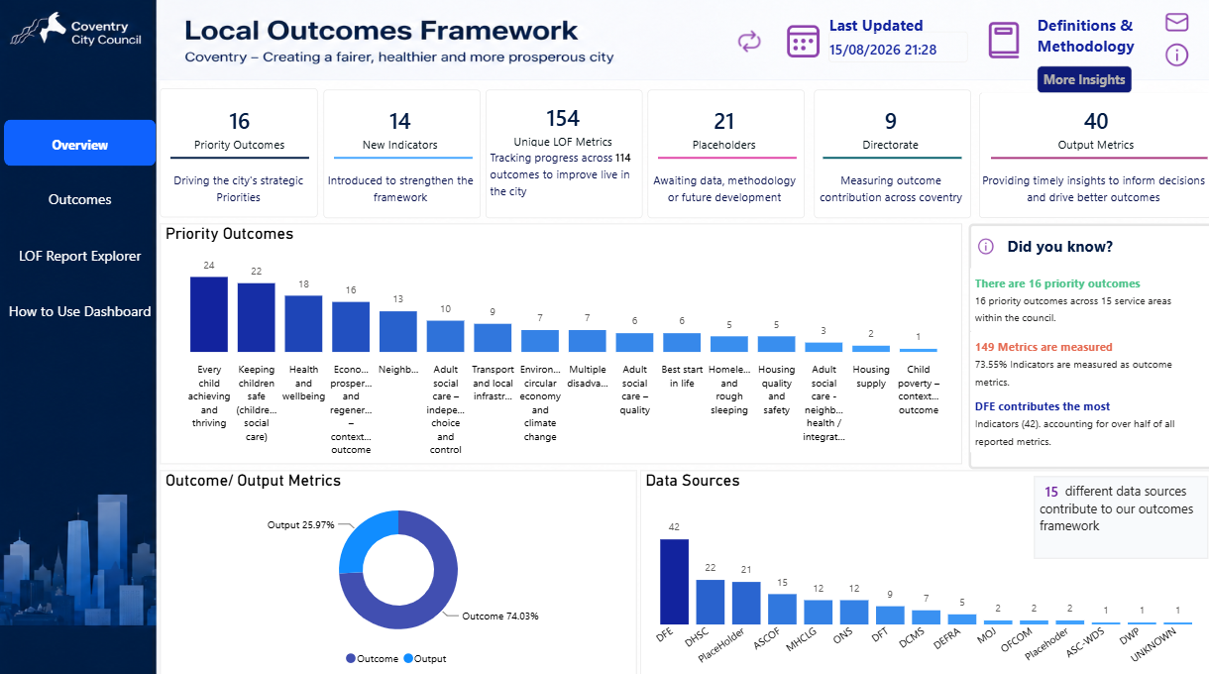
How to Navigate Dashboard
Header Toolbar
Last Updated: Shows when the data was last refreshed.
Definitions & Methodology: Explains how indicators are obtained & used.
Envelope Icon: Send an email to the Strategy & Performance team.
Info Icon: Share your feedback on the dashboard.
Page Navigation
Click any item in this sidebar to explore different views
Overview: General summary.
Outcomes: Detailed city priorities.
LOF Report Explorer: Have access to the data tables to see raw data.
Explore Priority Outcomes
1. Click a Priority Outcome bar chart to select an area you want to learn more about.
2. The "More Insights" button will light up.
3. Click "More Insights" to view all specific indicators for your chosen priority.
What is the dashboard for?
The Local Outcomes Framework dashboard brings together outcome and output measures across Coventry’s services. It is designed to help users understand progress, identify areas requiring attention and explore the evidence behind the city’s strategic priorities

Slide 3
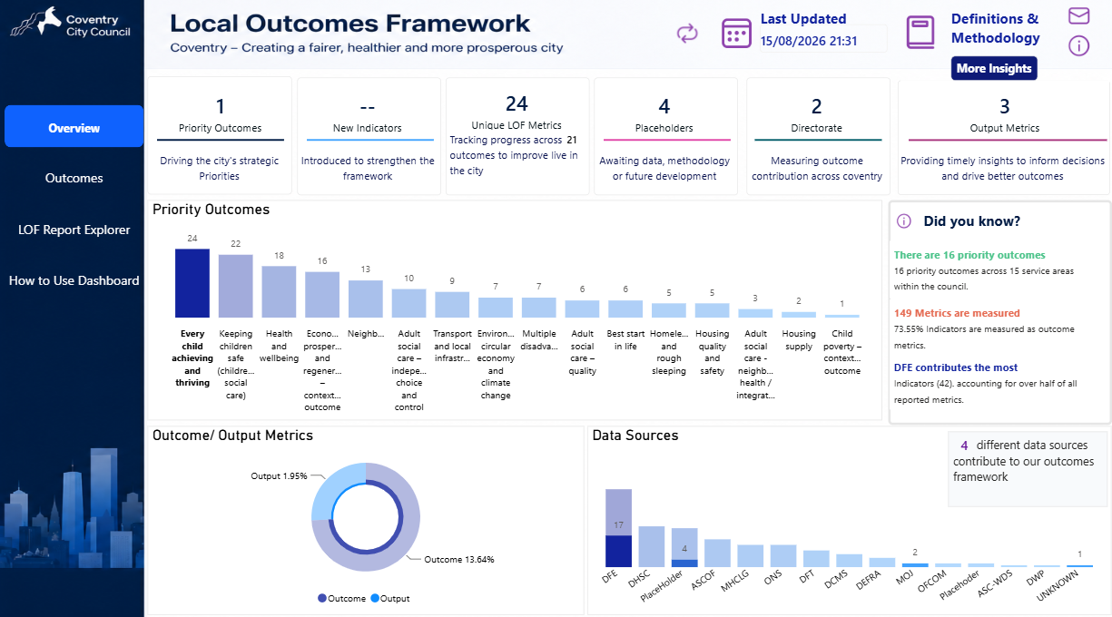
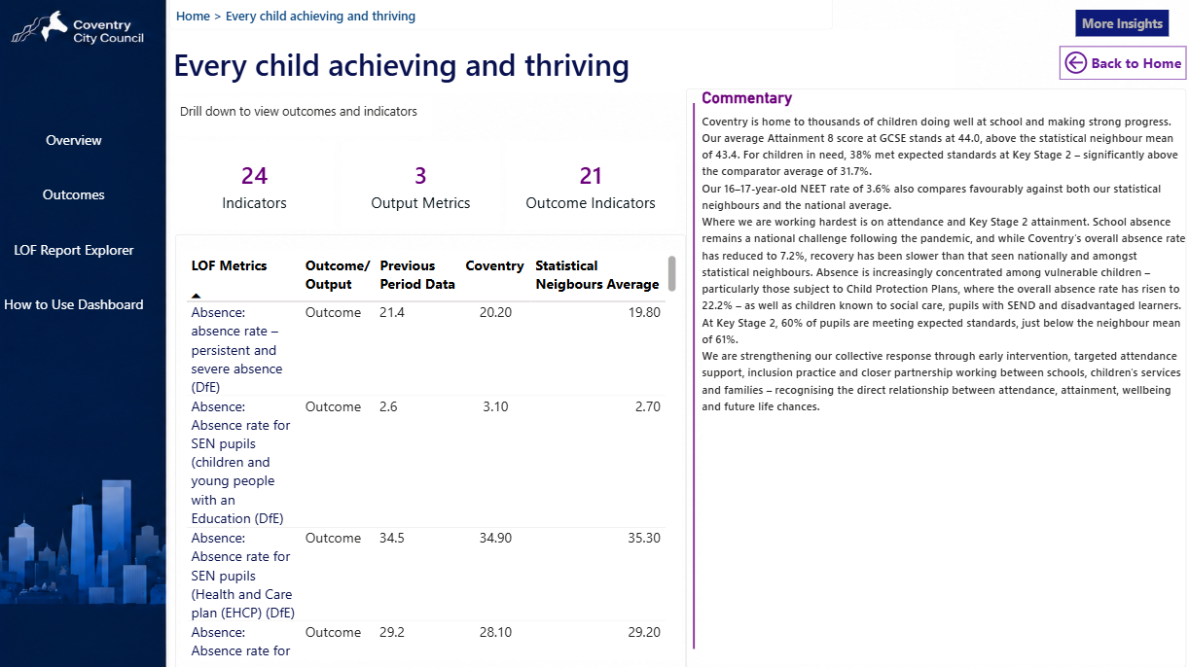
How to Navigate Priority Outcomes
Step 2: Explore Priority Outcome
1. View Details & Commentary: Here, you can read full commentaries and see all indicators. Select any item in the table and click More Insights again to dive deeper into specific measures.
2. Back to home: Takes you back to the home page at any point whilst using the drill down.
Step 1: How to Explore
1. Select a Priority Outcome: Click any bar on the Priority Outcomes chart to highlight an area of interest.
2. Click "More Insights": Once selected, the More Insights button will light up at the top right. Click it to open the detailed page.

Slide 4
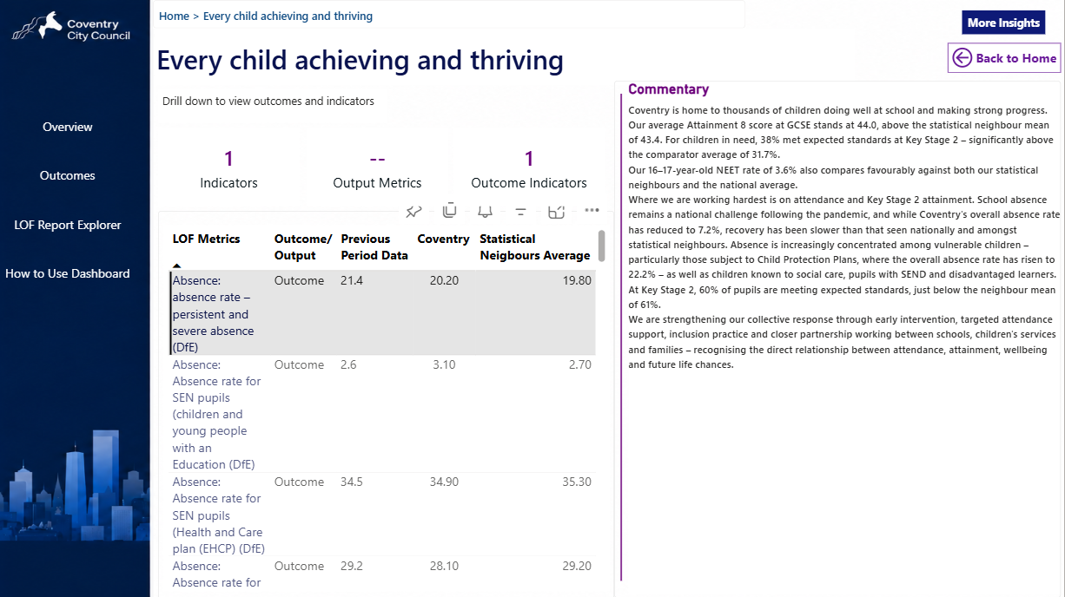
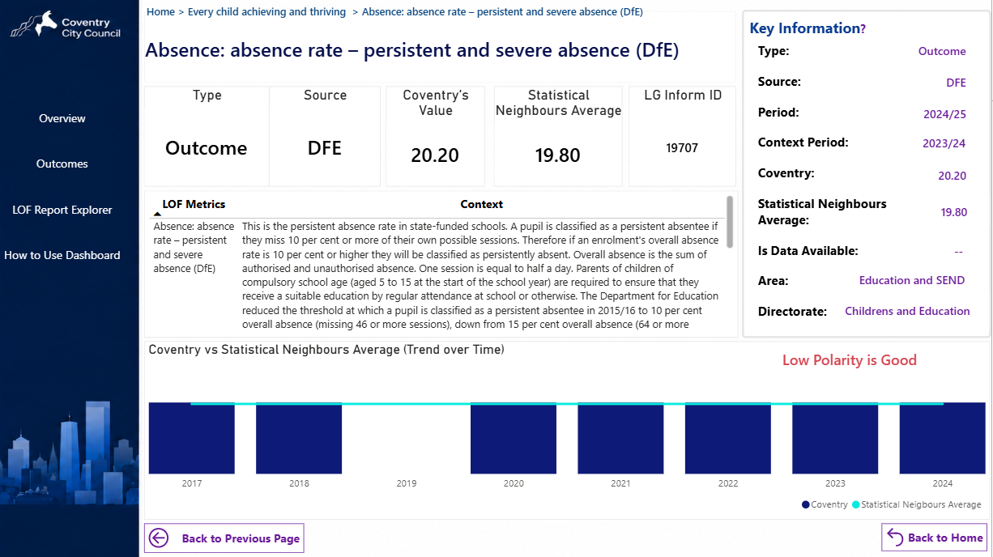
Focusing on specific Indicators
Step 4: Viewing Detailed Indicator Cont’d
1. Check Your Current Tab: Look at the breadcrumbs (navigation path) at the top of the screen to see where you are and retrace your steps easily.
2. Read Context & View Trends: Read the Context section to understand what the data means. View the bar chart at the bottom to see performance trends over time, comparing Coventry to similar councils (Statistical Neighbours Average).
3. Easy Navigation: Use the "Back to Previous Page" or "Back to Home" buttons at the bottom to return to earlier views.
Step 3: Viewing Detailed Indicator
1. Select an Indicator: Click any row in the LOF Metrics table (e.g., Absence rate). The row will highlight grey, and the "More Insights" button at the top right will light up.
2. Click "More Insights": This takes you to the detailed view page for your chosen indicator.

Slide 5
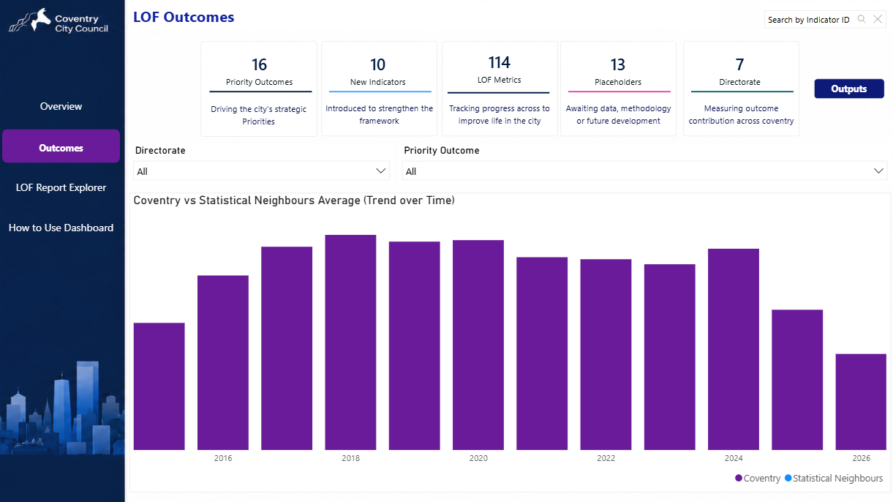
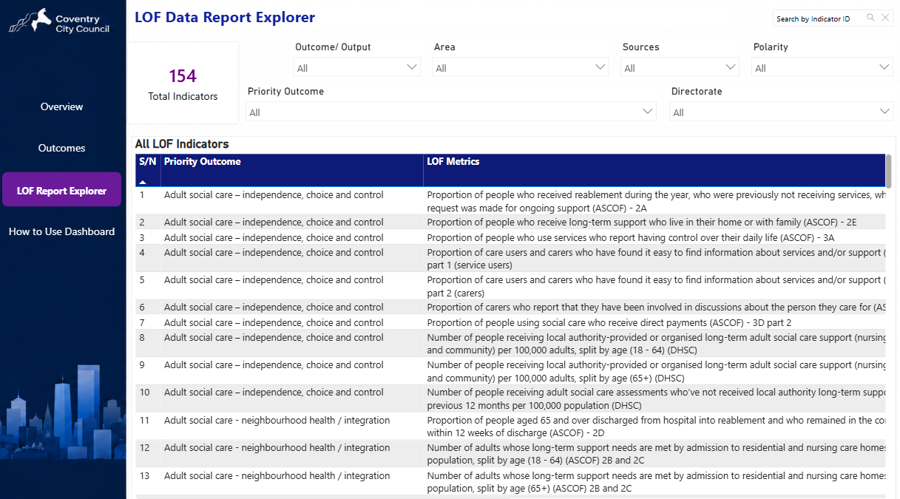
Outcomes vs. Outputs & Report Explorer
Outcomes & Outputs View
Switch to Outputs: Click the "Outputs" button at the top right to switch to the dedicated page for output metrics.
Search Bar: Use the "Search by Indicator ID" search bar at the top right to jump directly to a specific metric if you know its ID.
The bar chart compares each value from individual indicators over time for specific outcome/output measures.
LOF Data Report Explorer (Deep-Dive View)
The Report Explorer lets you inspect all 154 indicators used to build the dashboard.
Search Feature: Use the Search by Indicator ID bar at the top right to look up specific metrics.
Outcome/ Output: Filter by outcome or output type.
Area & Priority Outcome: Narrow down by specific city priority or geographic/service area.
Sources: Filter by data origin (e.g., DfE, DHSC, ASCOF).
Polarity: Filter based on direction of travel
Directorate: Filter by the responsible council department.

