Slide 1

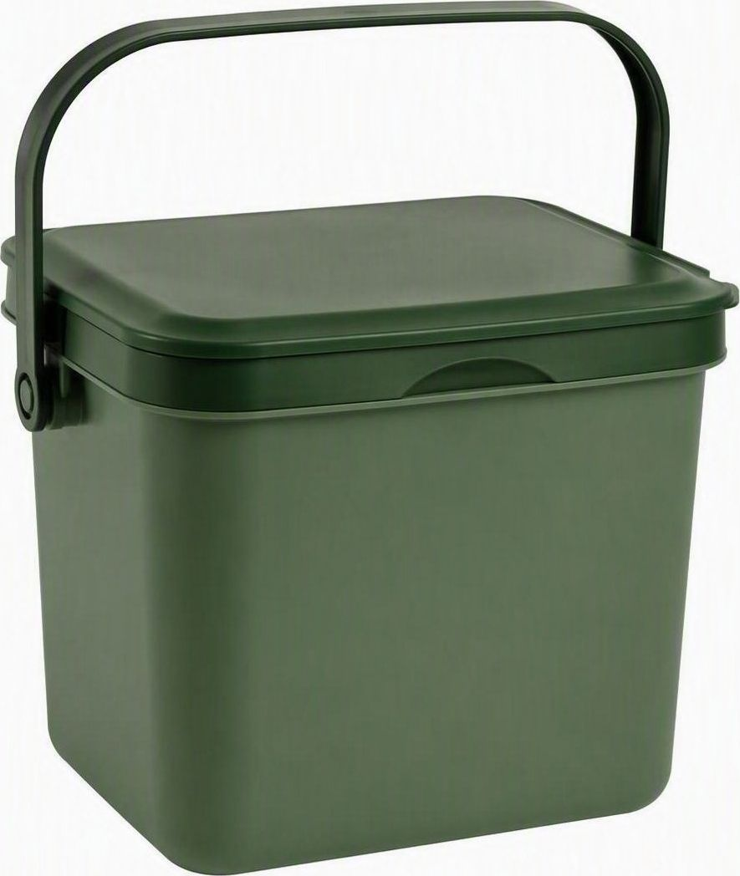
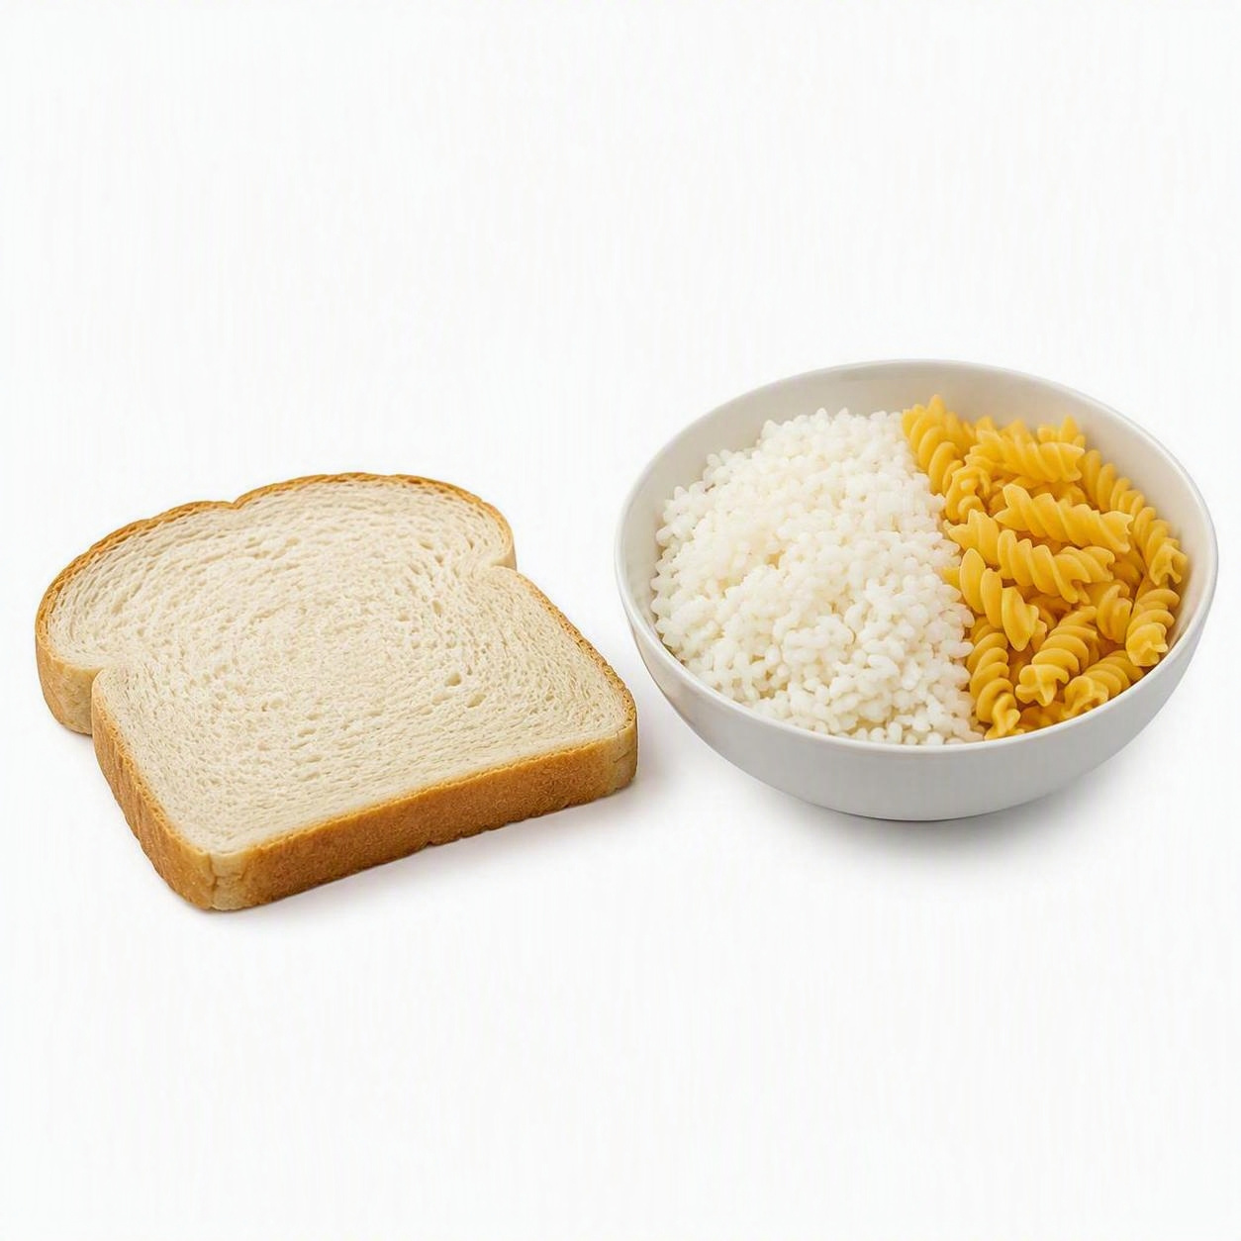
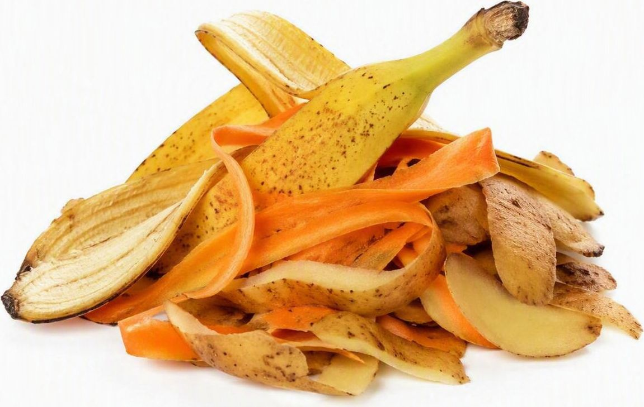
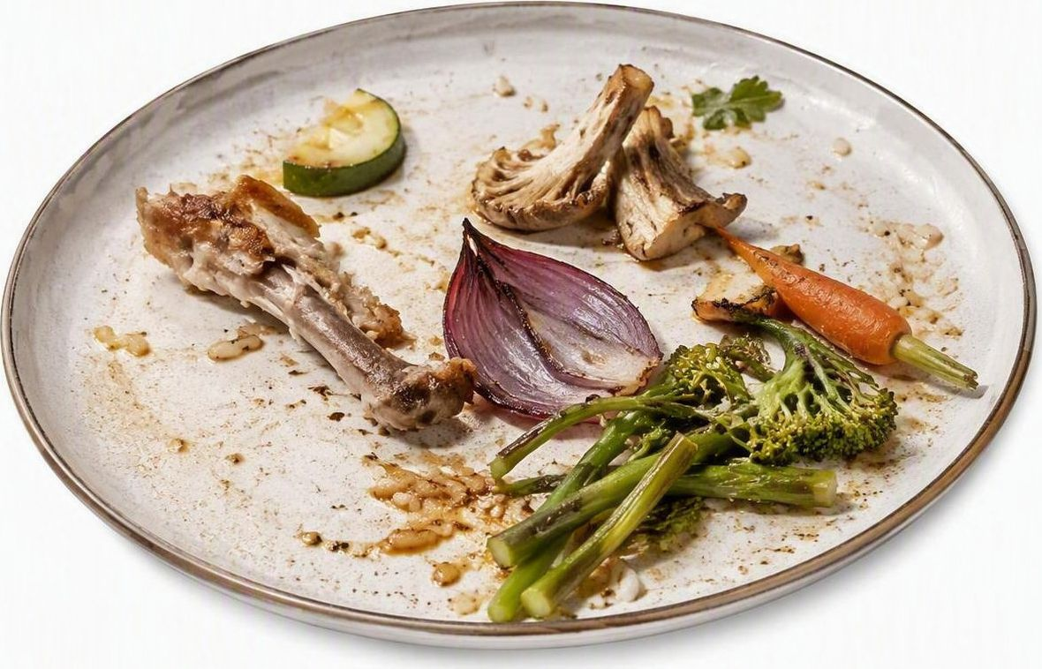
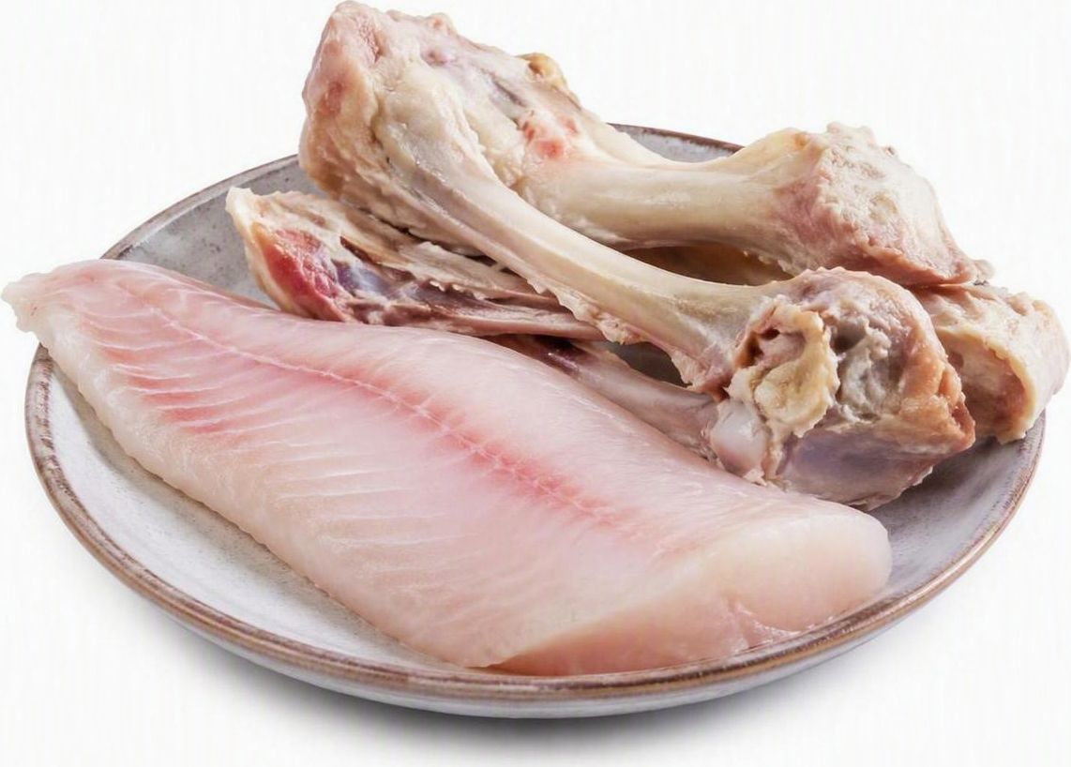

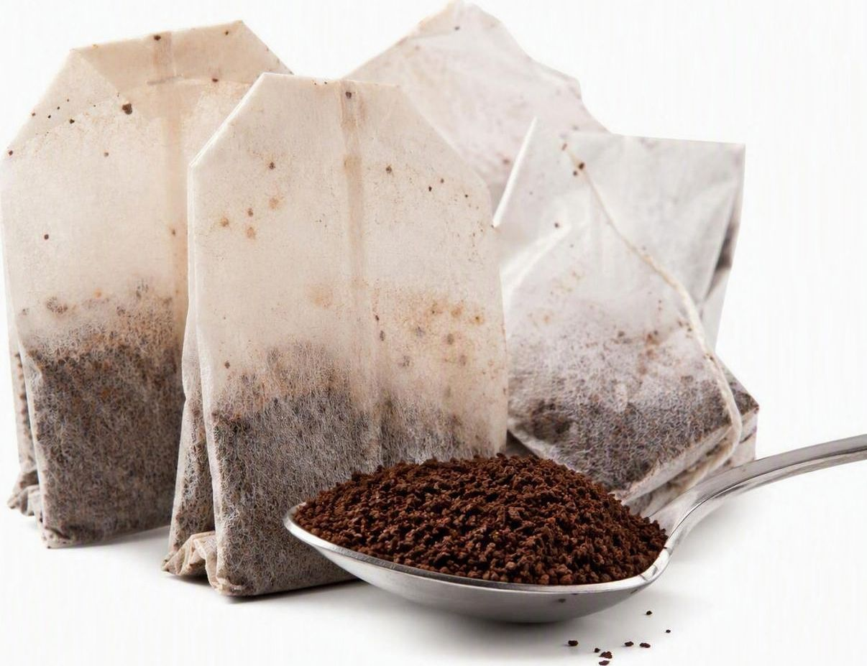
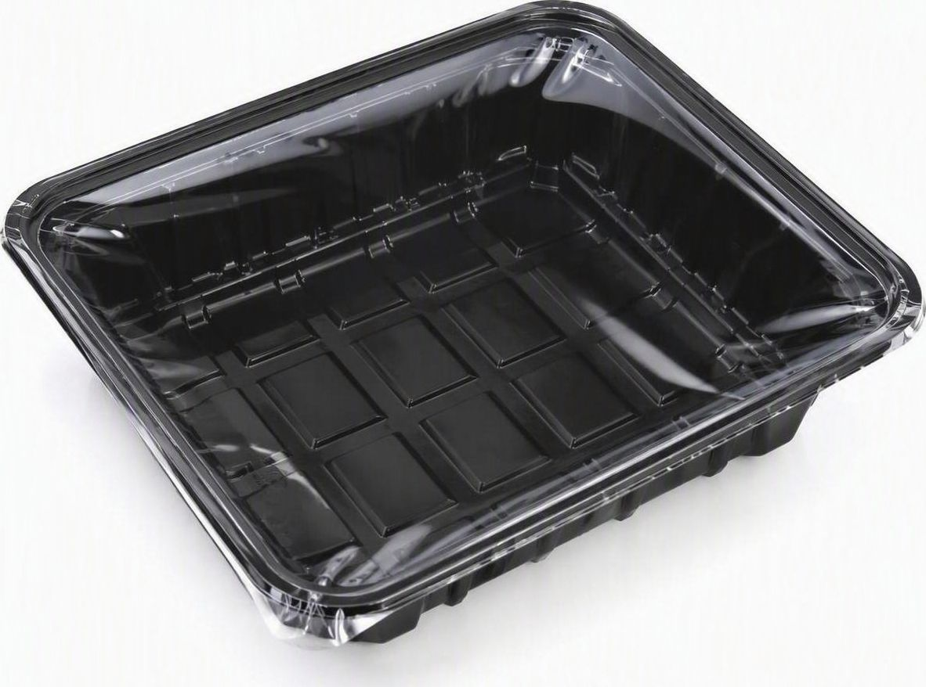


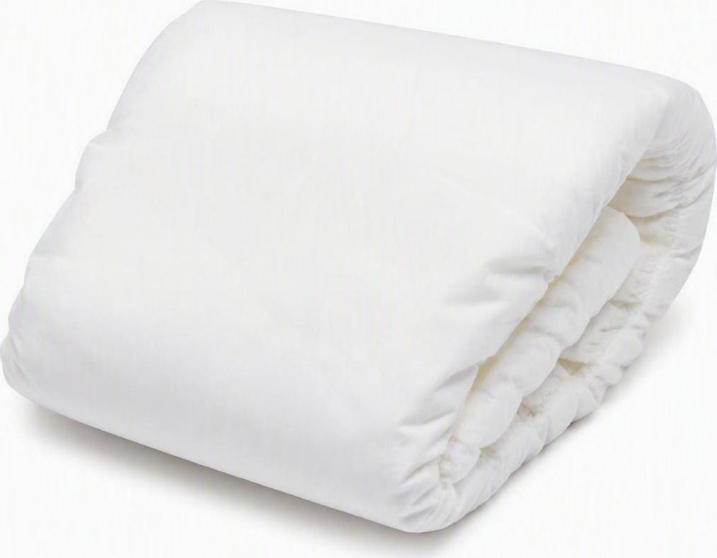

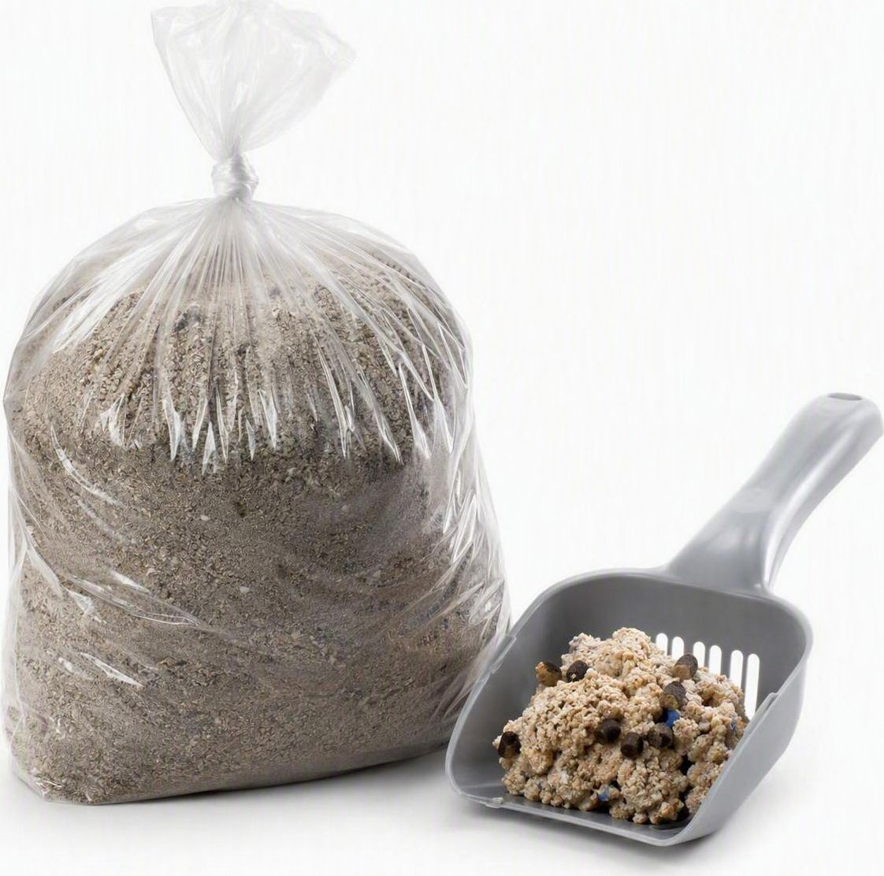
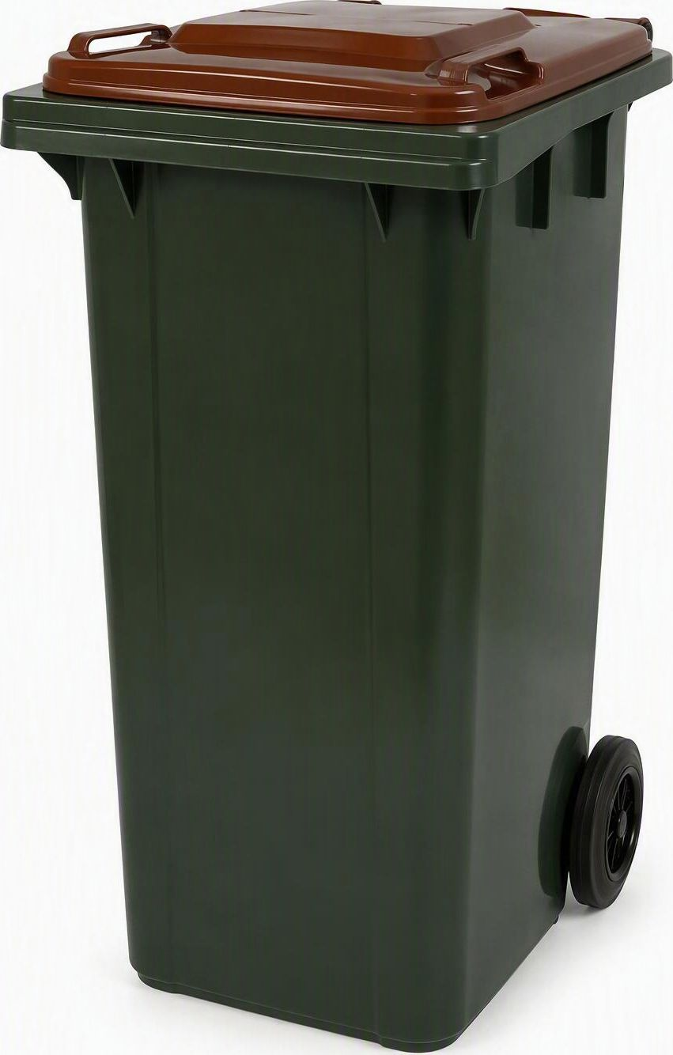
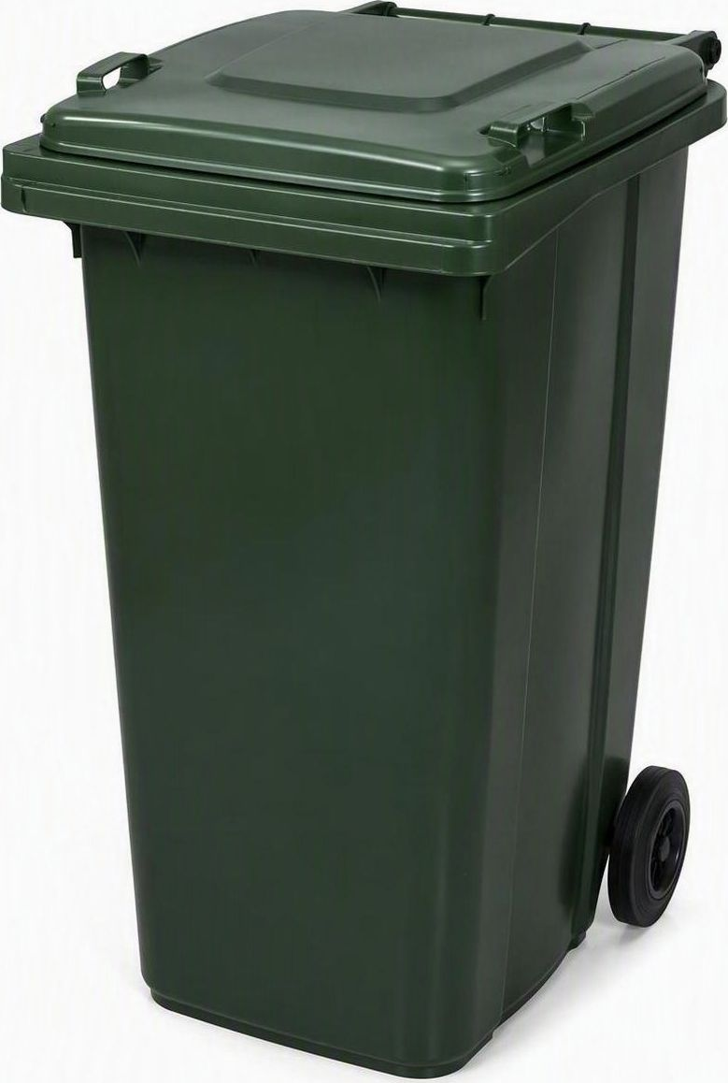
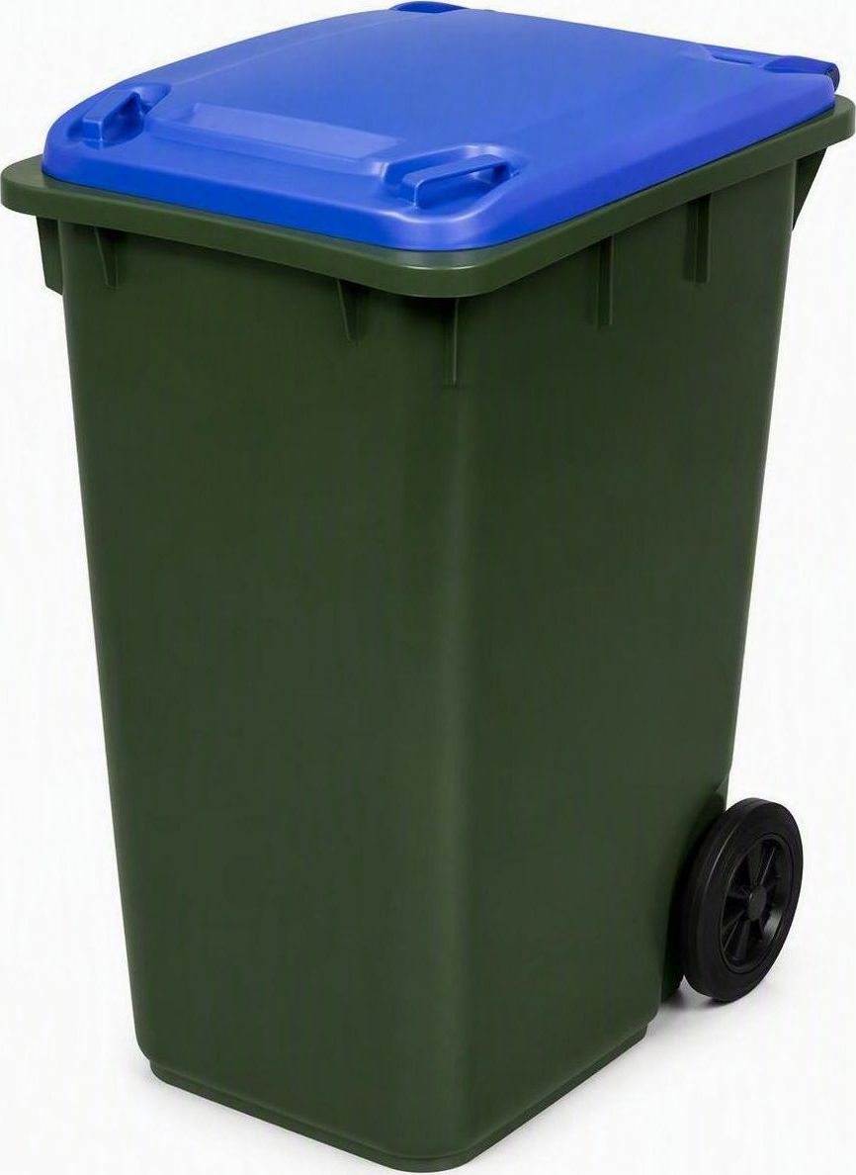



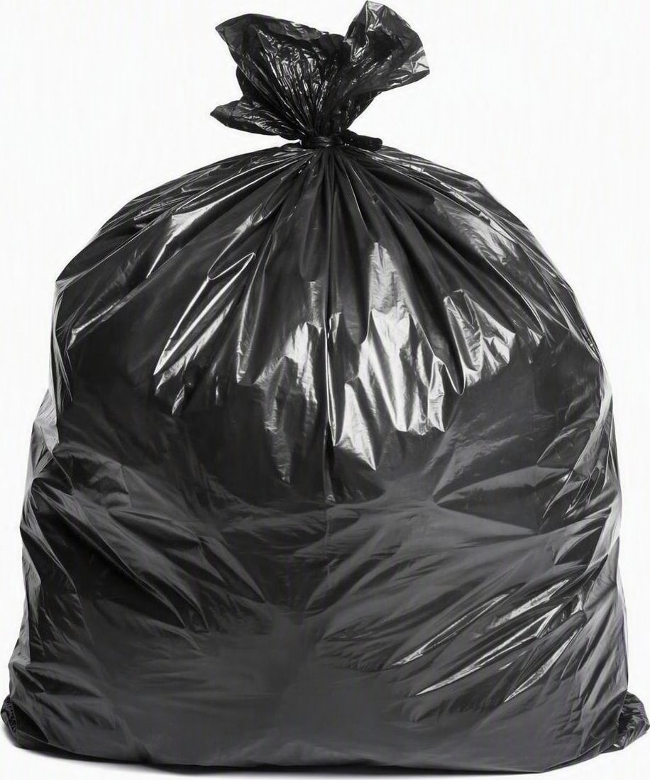
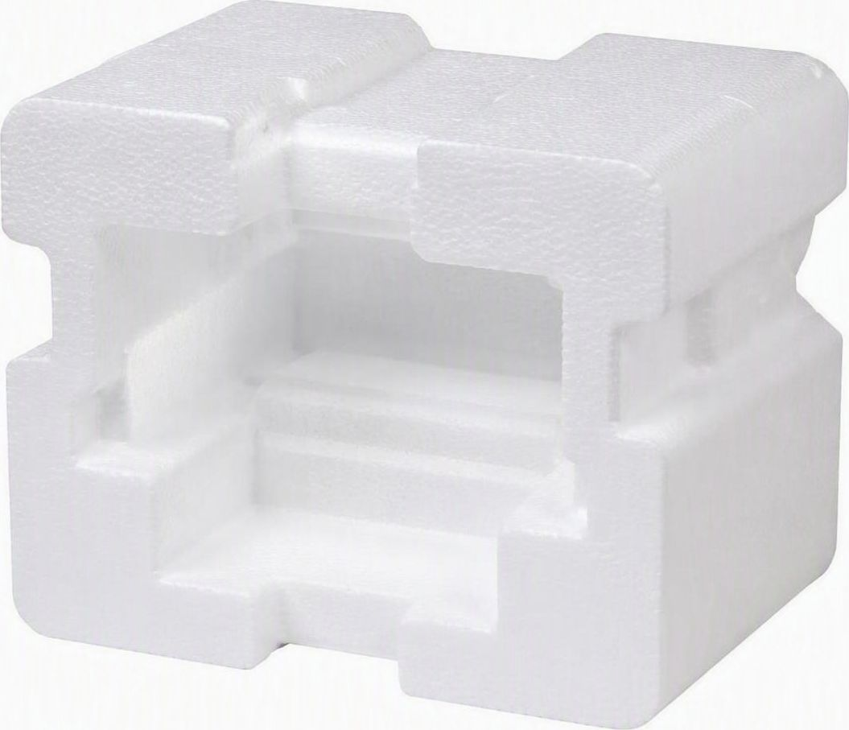

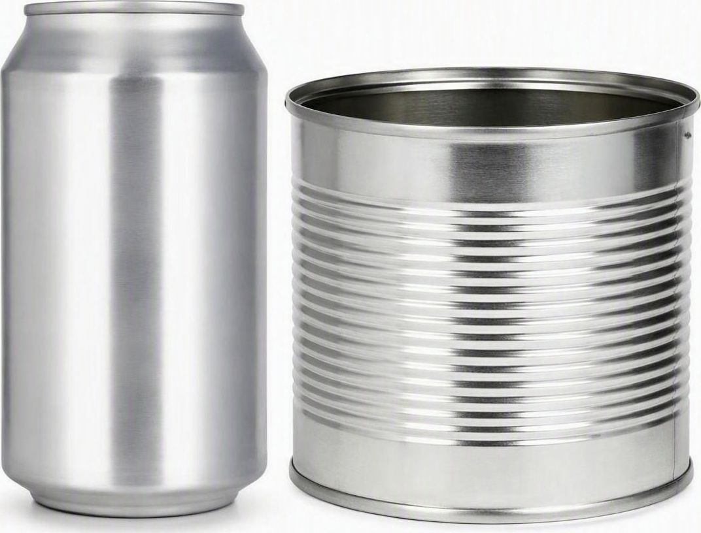



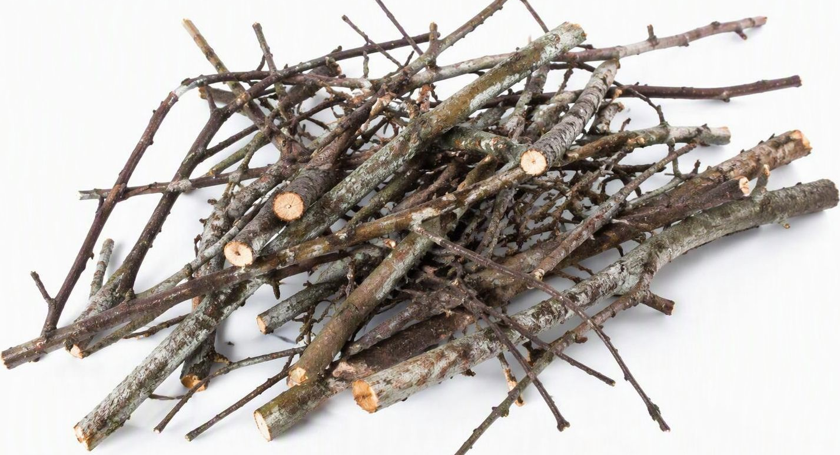
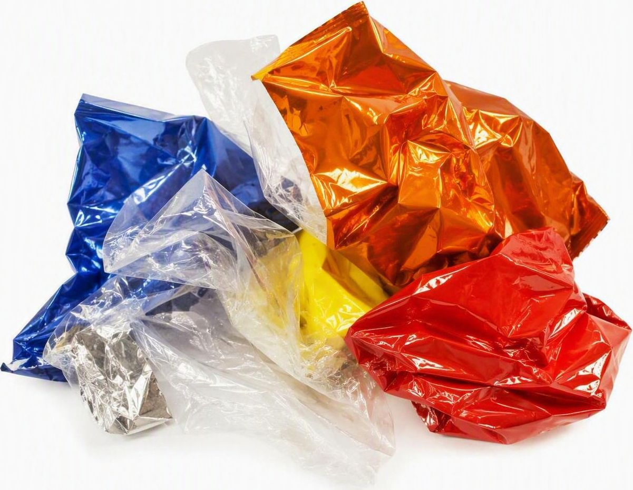
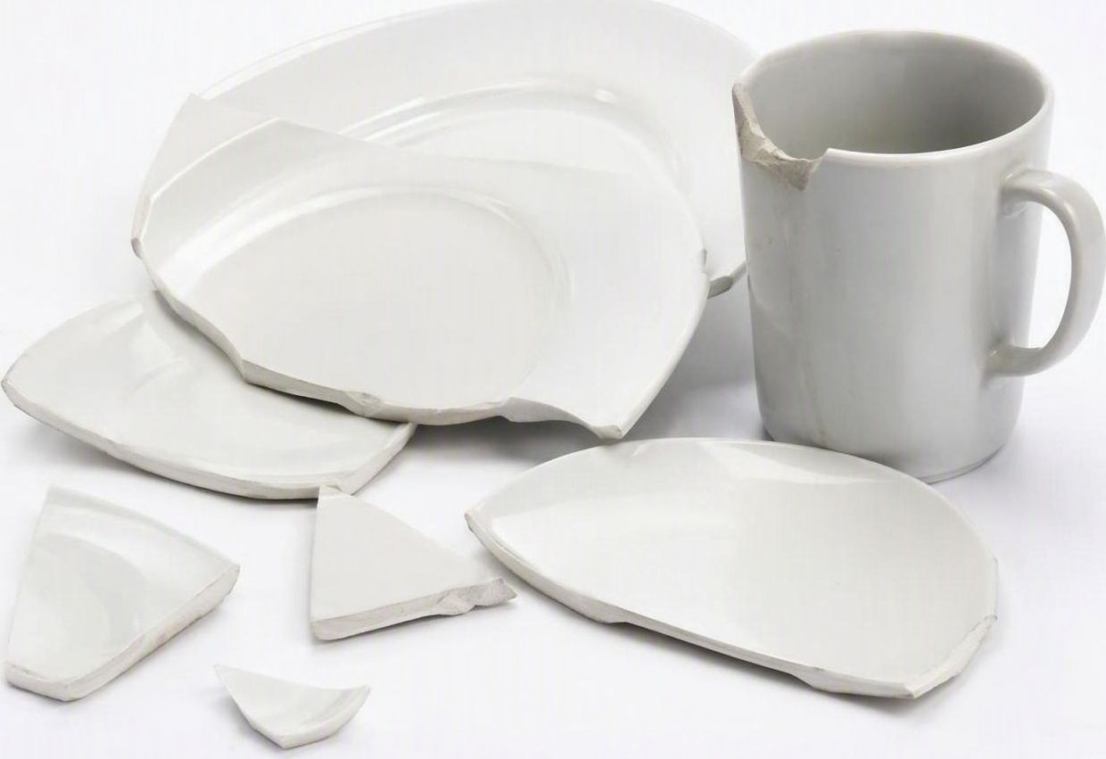
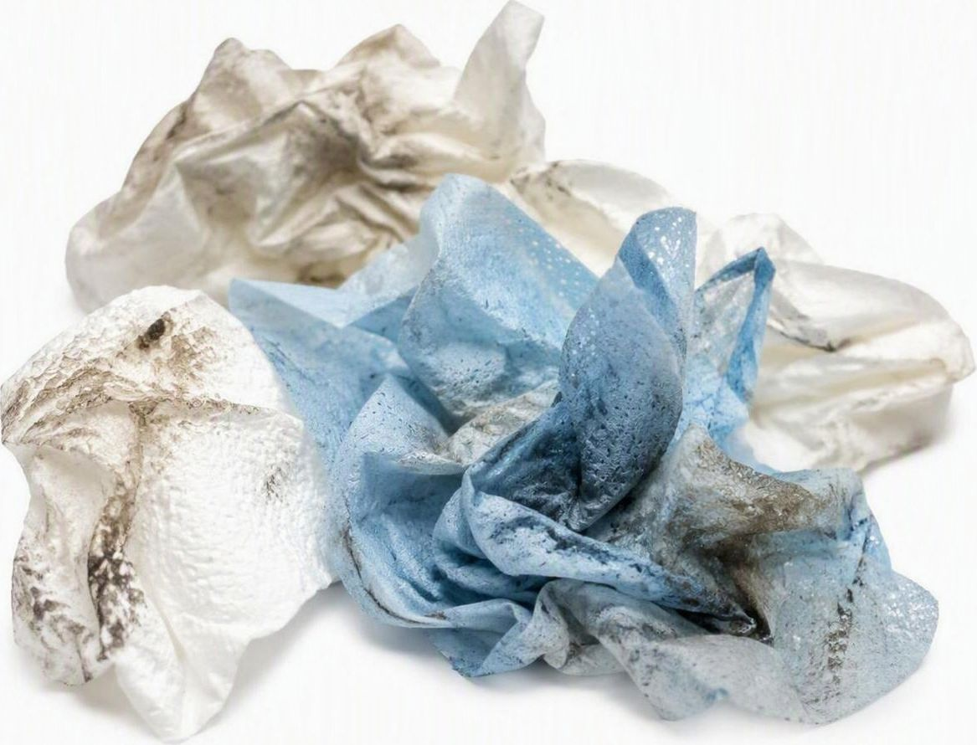
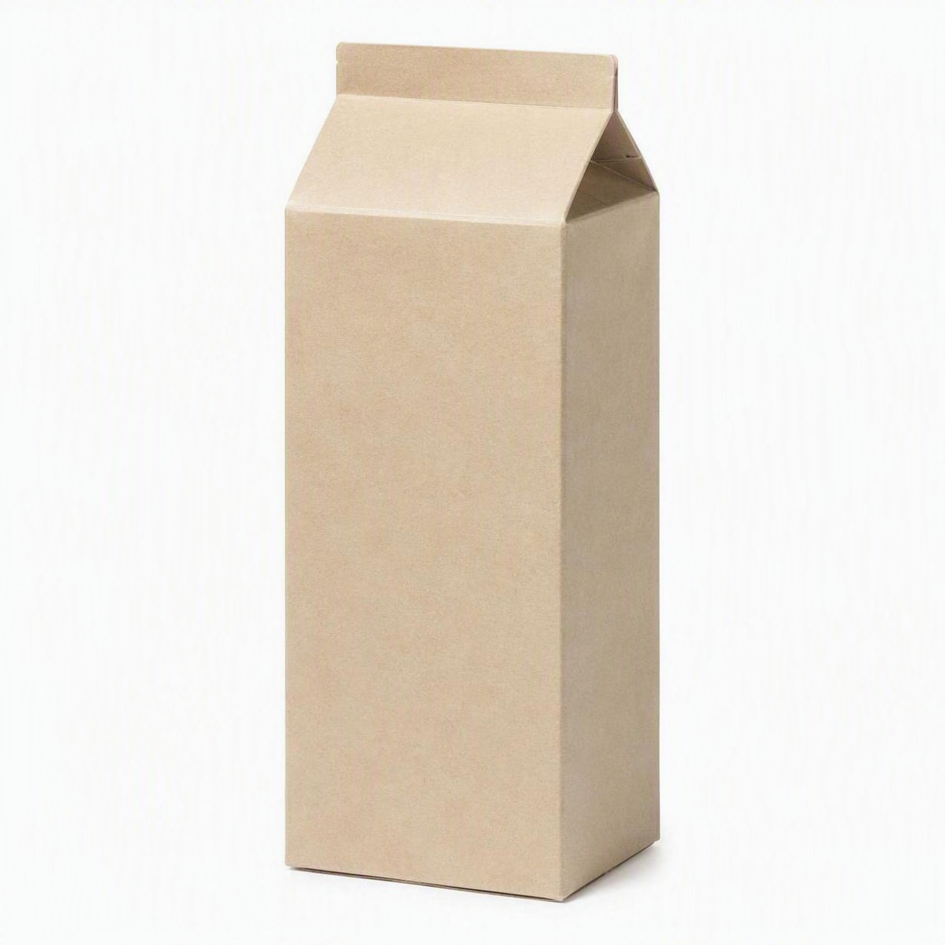
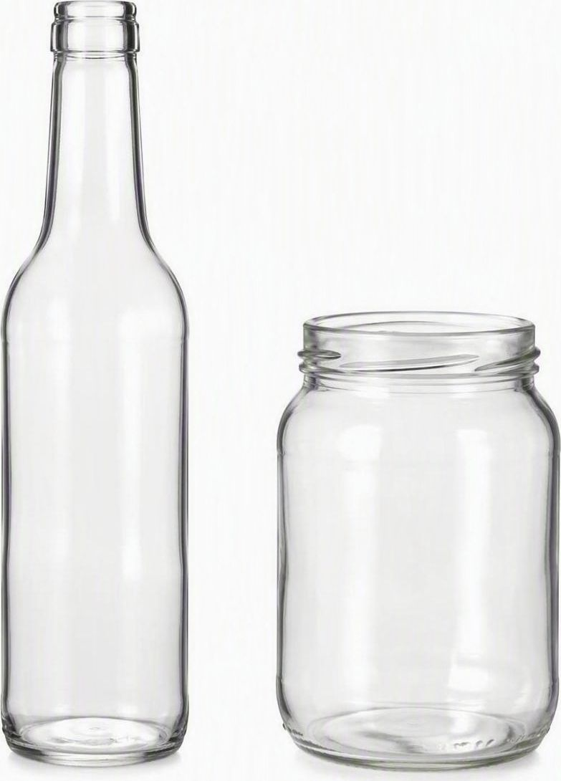
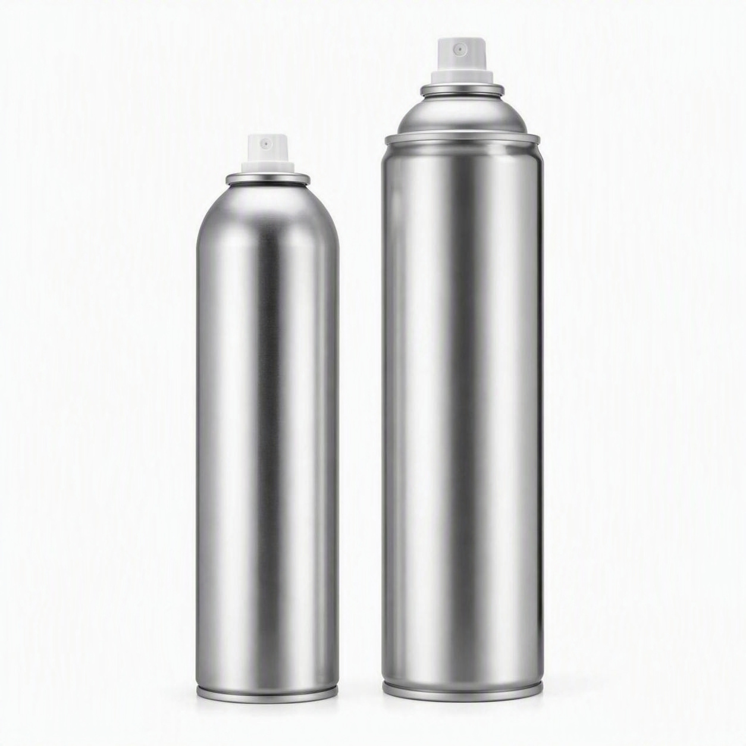
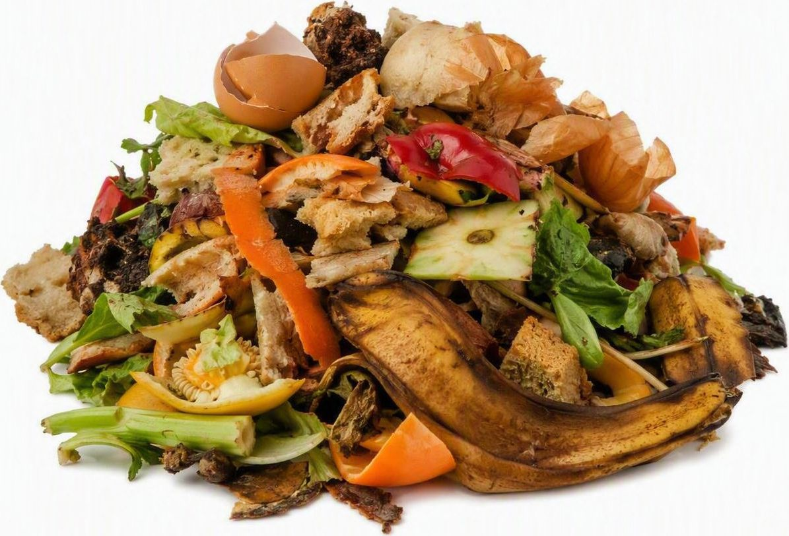

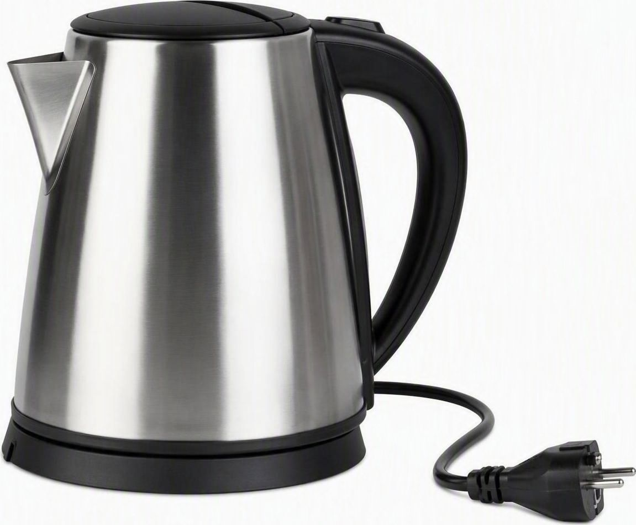
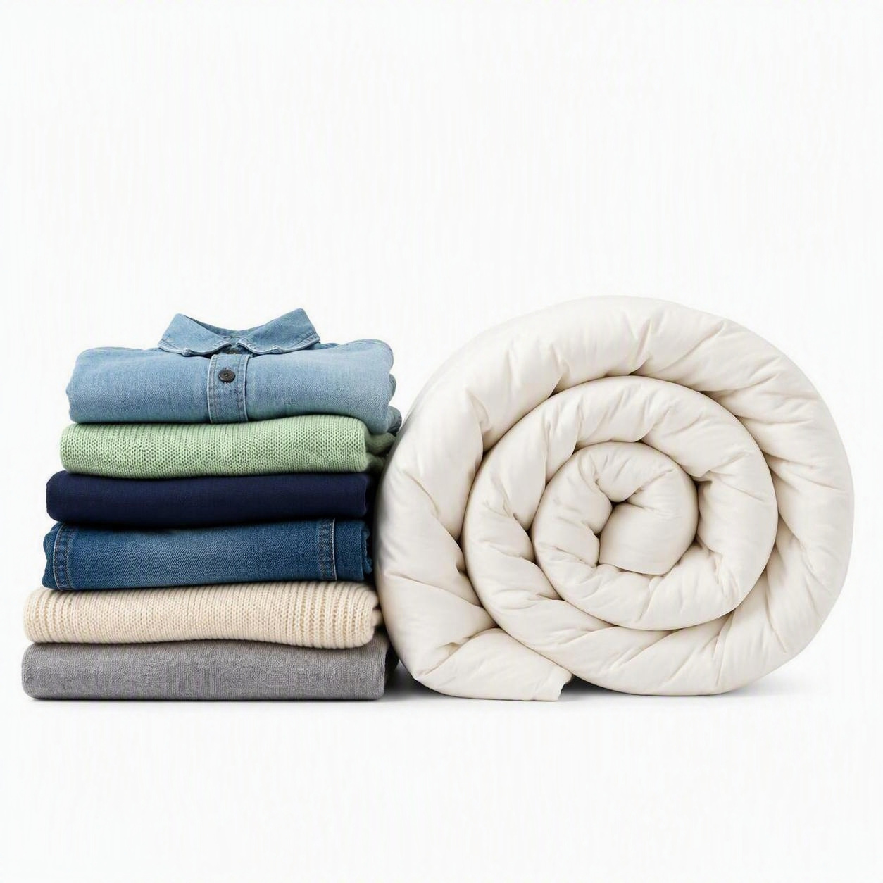

Your bins
A guide for tenants — please keep on display
Coventry City Council
coventry.gov.uk/bins
Place the Coventry City Council logo here
✓
= put it in
✗
= never put it in
NEW
Using your FOOD WASTE caddy
Emptied every week by Coventry council crews
✓ YES PLEASE — all food, cooked or raw
✓
✓
✓
✓
✓
✓
Fruit & veg peelings
Plate leftovers
Meat, fish & bones
Bread, rice & pasta
Dairy & eggshells
Tea bags & coffee
Your kitchen caddy
✗ NO THANKS
1. Keep your food waste bin next to your other bins.
2. Put your food waste in it in a compostable or paper bag.
3. Put it out next to your other bins on your collection day for Coventry council crews to empty.
✗
✗
✗
✗
✗
✗
No packaging
No liquids or oil
No garden waste
No nappies
No plastic bags
No pet waste or litter
Using your brown-lidded
GARDEN bin
Using your green-lidded
HOUSEHOLD bin
Using your blue-lidded
RECYCLING bin
Emptied fortnightly all year round. No food waste — use your caddy.
Everyday rubbish we cannot recycle or compost. Bag it and close the lid.
Put items in loose, not in bags. Wrong items = yellow tag and bin not emptied.
✓ YES PLEASE
✓ YES PLEASE
✓ YES PLEASE
✓
✓
✓
✓
✓
✓
✓
✓
✓
Flowers & weeds
Twigs & clippings
Grass cuttings
Bagged rubbish
Nappies
Polystyrene
Paper & card
Tins & cans
Plastic bottles
✓
✓
✓
✓
✓
✓
✓
✓
✓
Leaves & trimmings
Plants & roots
Hedge prunings
Wrappers & film
Broken crockery
Tissues & wipes
Cartons
Glass bottles & jars
Empty aerosols
✗ NO THANKS
✗ NO THANKS
✗ NO THANKS
✗
✗
✗
✗
✗
✗
✗
✗
✗
No food waste
No black bags
No soil or rubble
No food waste
No electricals
No rubble or soil
No food waste
No clothes/bedding
No carrier bags
Collection day here: ____________________ Food waste is collected weekly • coventry.gov.uk/bincollection
!
It is a criminal offence under regulation 11 of the Licensing and Management of Houses in Multiple Occupation (Additional Provisions) (England) Regulations 2007 not to store and dispose of waste in accordance with the arrangements made by the HMO manager.
Failure to comply may lead to enforcement action, prosecution or a civil penalty of up to £40,000, depending on the offence and circumstances.
More information: coventry.gov.uk/bins • coventry.gov.uk/foodwaste
.
Scan for bin
information

