Slide 2
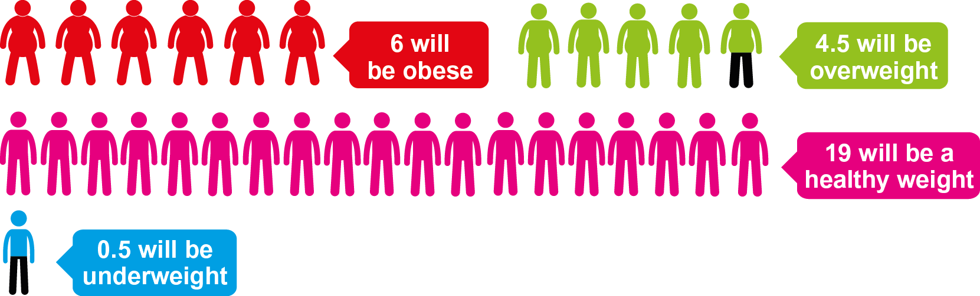
In a typical class of 30 10-11 year olds in Coventry…
Notes:
Between 2007/8 and 2014/5, more than 56,000 children have been weighed and measured in Coventry during primary school. Of these, 1 in 10 4-5 year olds and 1 in 5 10-11 year olds were obese. Over a third (35%) of 10-11 year olds are either overweight or obese.

Slide 3
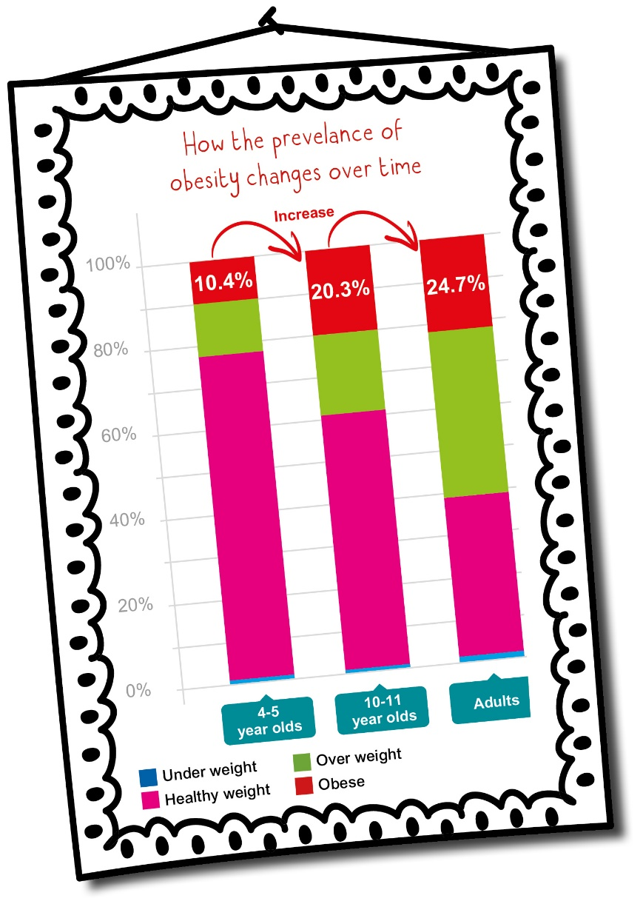
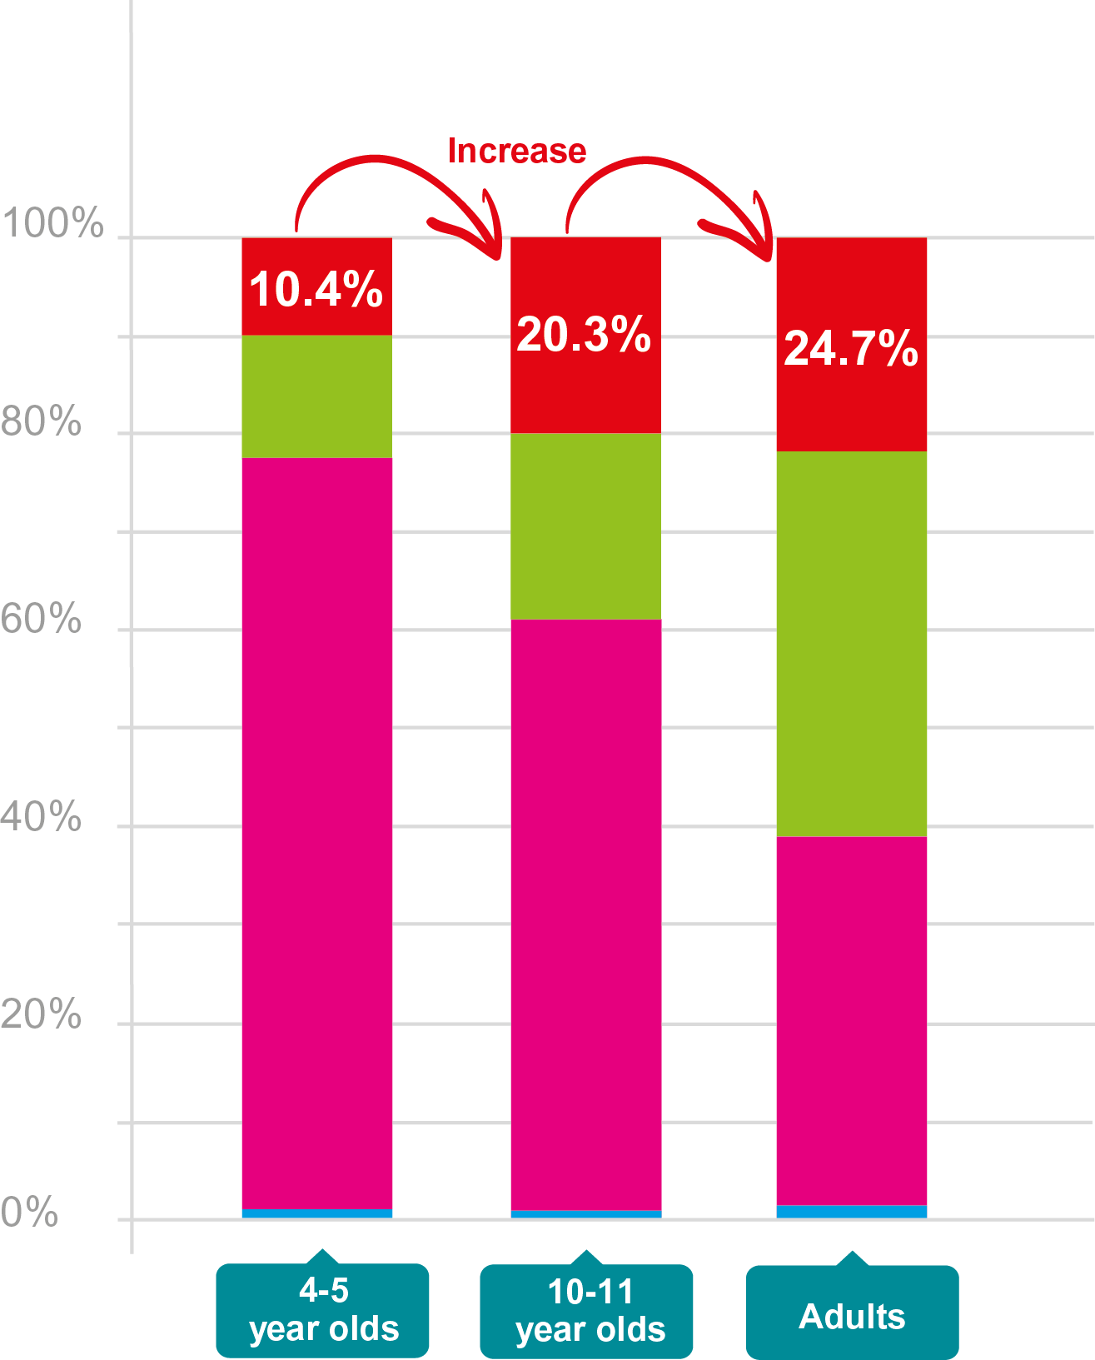
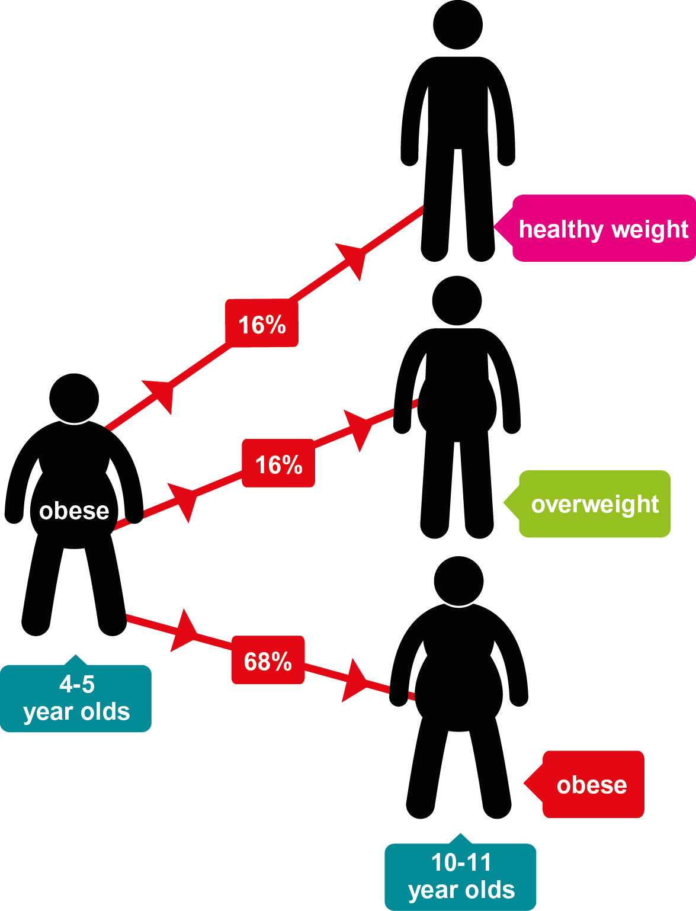
How many obese children become obese adults…?
Notes:
Growth of excess weight is most pronounced in the first years of life
The number of children in Coventry who are obese almost doubles between the age of 4-5 and 10-11 years
A recent study by PHE₁, found that among obese children in Reception Year, nearly 7 in 10 of them continued to be obese in Year 6, and nearly 2 in 10 of them were overweight
Recent national trends show that the number of obese children aged 4-5 may be falling while obesity among 10-11 year olds remains static. However, in Coventry, the number of obese 4-5 year olds is broadly unchanged over the past 8 years, while the number of obese 10-11 year olds is increasing.
Ref:
1. Changes in objectively measured BMI in children aged 4-11 years: data from the National Child Measurement Programme, Public Health England (2016)

Slide 4
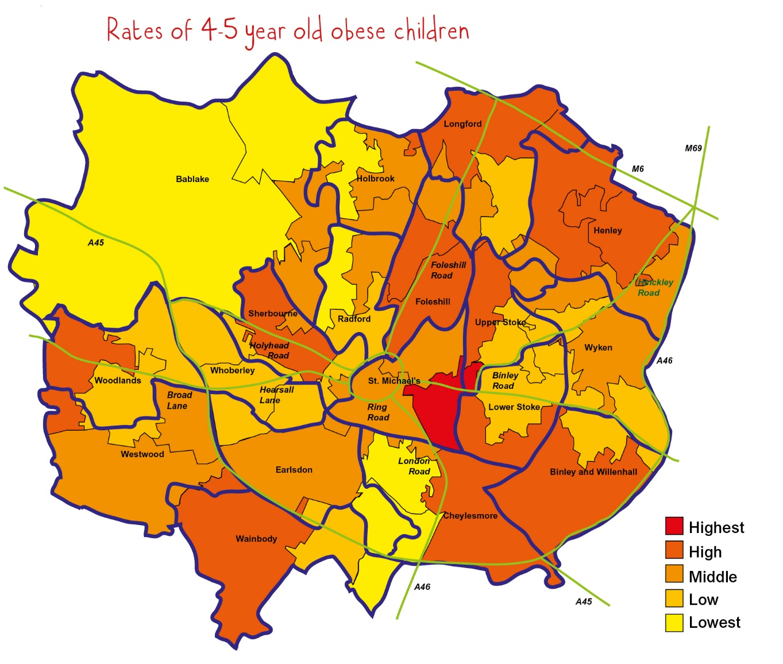
Obesity is linked to deprivation and other inequalities
Notes:
Children in the most deprived areas of the city are most likely to be obese including:
Those affected by substance misuse, divorce, domestic violence or abuse
Looked after children: more than 1 in 5 under 5 years are obese
The number of 4-5 year olds who are obese is highest in the more deprived north east and south east areas of the city
As children get older, the prevalence of obesity gets increasingly concentrated in more deprived areas
23.6% of children aged 10-11 from the 10 schools with the highest free school meal eligibility in Coventry are obese, compared to 15.1% in the 10 schools with the lowest free school meal eligibility
Although physical activity is very important, eating less food is much more effective in promoting a healthy weight than doing more physical activity.

Slide 5
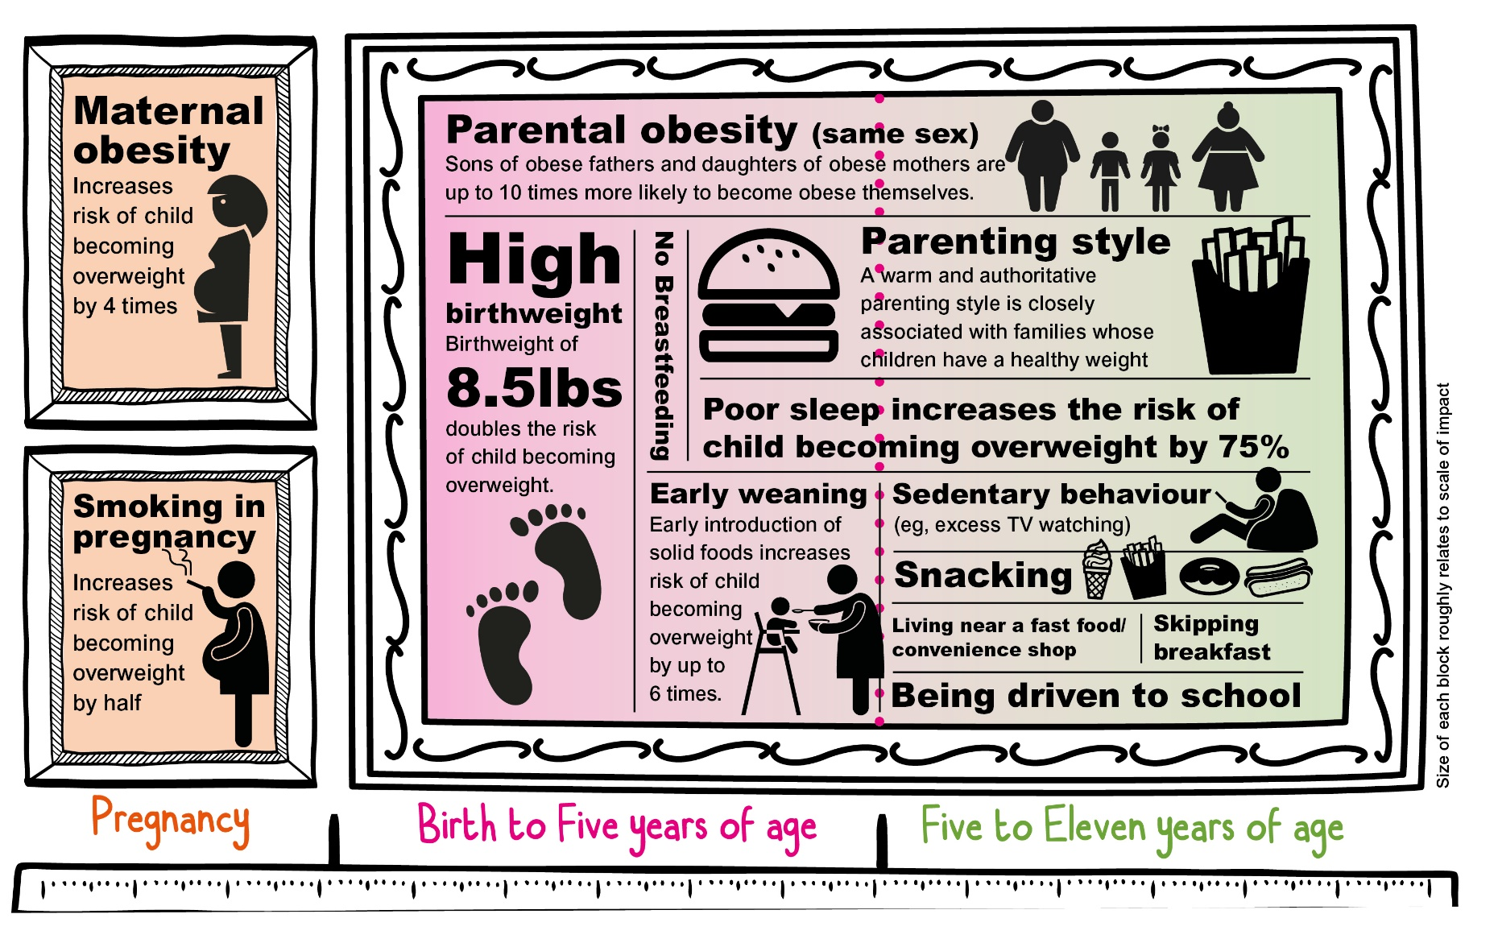
Key risk factors
Notes:
Obesity starts early in life and it is often the cumulative build-up of risk factors that means a focus by a range of partners and the community is needed in order to turn the tide of childhood obesity.
Around 82% of all children in England aged 5-15 years eat fewer than 5 pieces of fruit and veg per day. One in 20 eat none at all.
Over 11,000 boys and over 31,000 girls aged 2-15 years do less than the recommended 60 minutes of activity 7 days a week. Until the age of 9, boys and girls do a similar amount of activity, after which girls’ drops off significantly.

Slide 6

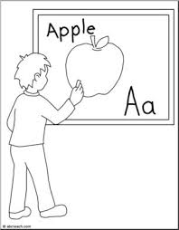
Why is childhood obesity important?
Children of a healthy weight have better physical health
Obese children grow up to become obese adults
Children of a healthy weight have better mental health
Obese children are more likely to miss school
Notes:
Obese children grow up to become obese adults: Most obese adolescents continue to be obese into adulthood and go on to be at risk of a wide range of weight related health conditions like diabetes, stroke, heart disease, some cancers, mental health problems and musculoskeletal problems. An obese woman is 13 times more likely to develop type 2 diabetes than one of a healthy weight.
Children of a healthy weight have better physical health: Obese children are 50% more likely to have seen a GP in the last 2 months and to have been prescribed antibiotics in the last year. Weight related health problems childhood can include early puberty, skin infections, some musculoskeletal disorders, childhood diabetes and asthma
Children of a healthy weight have better mental health: One in 4 young people report being bullied in the last year: half of whom think they were bullied because of their appearance. Most bullied children say the impact of bullying includes depression and skipping school
Obese children are more likely to miss school: They are 30% more likely to have missed school due to ill health in the last 2 months. We estimate that obese primary aged children in Coventry experience around 750 extra days of absence through illness every year than children of a healthy weight

Slide 7
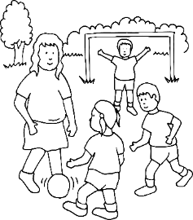
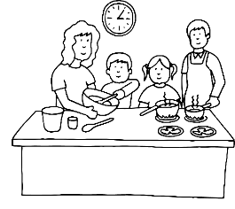
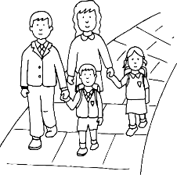
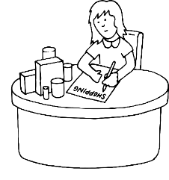
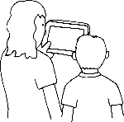
The Annual Report Family
Early years and schools
Families and communities
Physical activity environment
Food environment
Treatment
Notes:
The evidence shows there’s no single factor which will significantly reduce childhood obesity. Instead we should work to improve responses across the system.
We have broken the report down into five chapters in the life of the annual report family, which reflect the current evidence base.

Slide 8
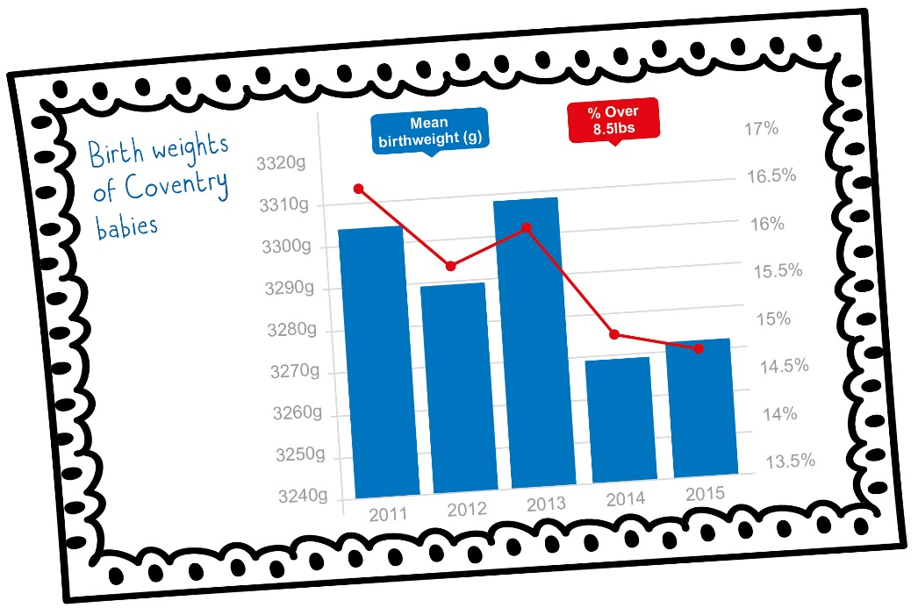
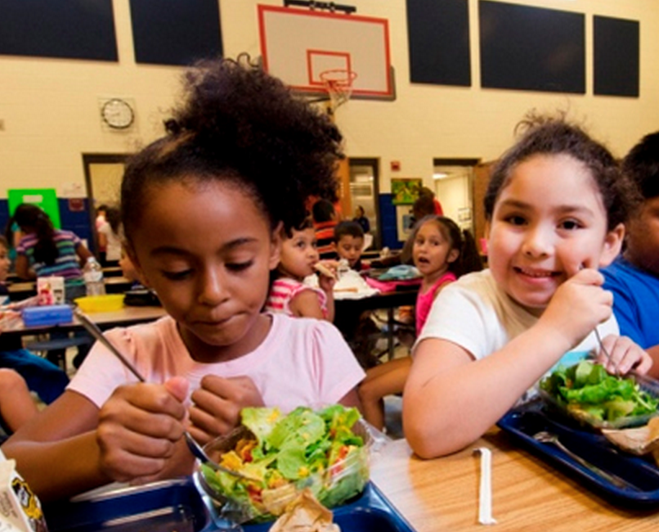
Early years and schools
Healthy birth weights
Encouraging breastfeeding
Healthy catering in schools and pre-schools
Increasing physical activity – toddlers to teens
Whole school approach - building food and physical activity into the everyday school environment
Notes:
Pregnancy and infancy:
Children of women who were obese before and during pregnancy are more likely to become obese adults themselves
A birth weight of more than 8.5lbs (3.856g.) doubles the likelihood of childhood obesity
Breastfeeding reduces the risk of obesity throughout a child’s lifetime:
Every month of breastfeeding can reduce the risk of later life obesity by 4% up to 9 months
Although initial breastfeeding figures are good in Coventry, by the time a baby is 6-8 weeks old, only around 25% or babies are totally breastfed and 17% partially breastfed
Toddlers who rapidly gain weight in the first 2 years of life, are overly sedentary or who have too little sleep in preschool years are more likely to become overweight or obese
Healthy catering in schools and pre-schools:
Many pre-school and educational settings have standards in place to ensure that children are offered foods which are “healthy, balanced and nutritious”
In 2014, universal free-school meals were introduced for Reception Years 1 and 2
Coventry uptake: 86.5%
All primary schools in Coventry take part in the national fruit and vegetable scheme which gives 4-6 yr olds 1 of their 5-a-day
Parents often mistakenly think that packed lunches are the healthiest option
Only 1% of packed lunches meet the nutritional standards that currently apply to school food
Some older children graze on snack foods served at mid-morning break e.g. panini, pizzas, cake…, or go off-site to buy their lunch (often junk food)
Physical activity:
Under 5s should be on the move for at least 3 hours a day
Nationally fewer than 10% of 2-4 yr olds meet these recommendations
Active play is vital to keeping children physically active
Children centres across Coventry host “stay and play” groups and encourage families to
visit local swimming pools and other leisure facilities
School age children should be physically active for at least an hour a day
Build into daily routines like walking or cycling to school
Children perform better academically (particularly in reading) after 20 mins of walking
In Coventry in 2016:
over 50% of primary school children walked to school
around 35% drove to school – the lowest since pre-2009
By the age of 14, roughly twice as many males as females reach the recommended activity levels
Girls cite poor experience of school sport and PE as reasons for disengaging
Whole school approach needs:
Clear leadership
Food and physical activity built into the school environment
and everyday working practices
A range of extra-curricular provision
A curriculum which provides clear education about food and
exercise
Coventry Sports Network is developing a school sports and physical activity strategy to support schools embed physical activity as well as developing talented athletes of the future
The physical school environment is also known to change behaviour
Schemes like painting colourful markings on the playground increase children’s physical play during breaks

Slide 9
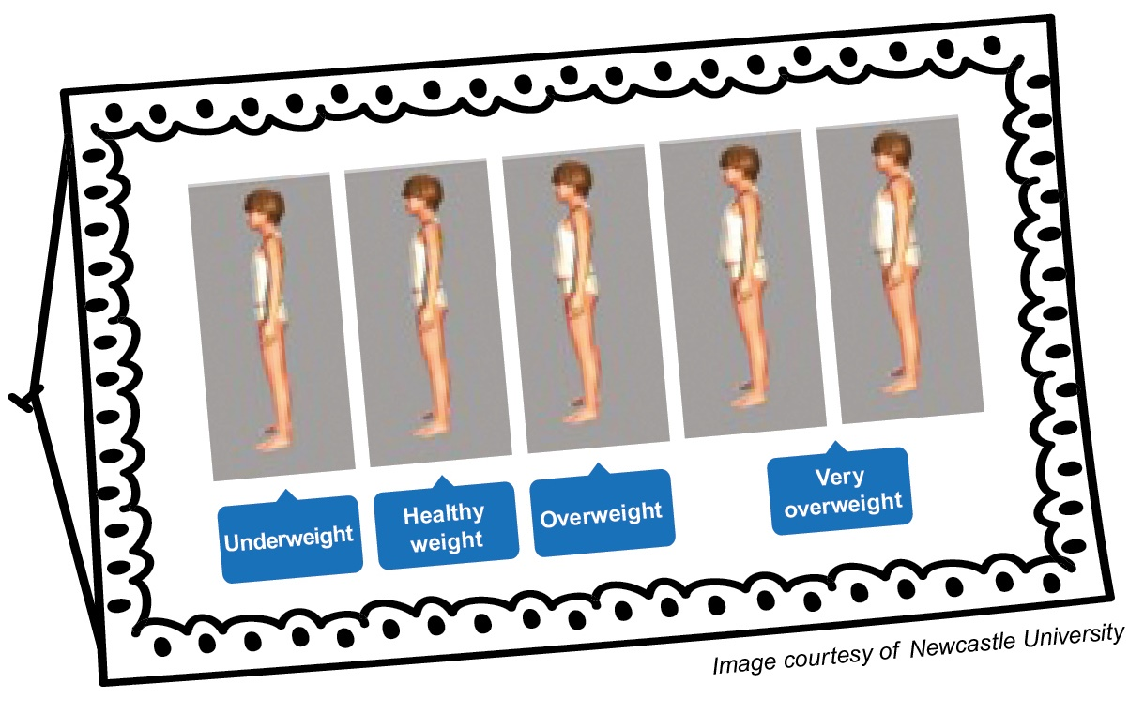
Families and communities
Parents as role models
Tackling the wider community
Challenging social norms
Improving health literacy and
health information
Beating food poverty
Partly because obesity is just so common, parents (and many professionals) are struggling to recognise when a child is carrying excess weight
Notes:
Parenting:
Parental obesity is one of the most accurate predictors of childhood obesity
Parents who adopt healthy lifestyles themselves are better role models and encourage greater levels of healthy eating and physical activity in their children
Coventry’s Triple P parenting programme helps hundreds of families every year:
Improves the way parents relate to their children
Supports families with specific food issues like establishing meal routines and tackling fussy eating
Wider Community:
As children get older, the environment and peers become more influential
Peer pressure and social norms have a powerful influence on children’s decisions to be active and eat well
Studies show that school-age friends tend to have similar eating and exercise habits and are more likely to have a similar BMI ₂
Children with positive friendships are more physically active but – unless healthy eating is common among their peers – are also more likely to eat more
Being alone, or struggling to “fit in” (which is often the case for overweight children) deters young people from being more physically active
Ref: 2. Fletcher et al, (2011) “You are what you eat: systematic review of social network analyses of young people’s behaviours and bodyweight”
Health literacy and health information:
Health advice is often complicated and difficult to understand
4 in 10 working age adults have poor health literacy
More prevalent in areas of high socio-economic deprivation₃
The numeracy and literacy skills to understand food labelling are poorest in our most deprived areas, where levels of childhood obesity are highest
Compounded by the fact that people are increasingly likely to under-report their calorie intake
Ref 3: PHE (2015) “Improving health literacy to reduce inequalities”
Food poverty:
UK households spend less than £1 in £10 on food – within the EU, only Luxembourg spends less
However the poorest 10% people in the UK spend nearly twice as much of their household income on food as the most affluent 10% (15.4% vs 8.3%)
Studies show that poorer families rely on very cheap food that is unlikely to contribute towards a healthy diet₄
Schemes to help provide healthy food:
Healthy start vouchers: for spend on milk, fresh and frozen fruit and veg
Supermarkets offer “wonky” fruit and veg at lower prices
“Cook and Eat Well”: free 9-week ‘cooking from scratch’ courses aimed at those experiencing food poverty across Coventry. 381 people completed the course in 2015/16
Food banks
There is some evidence that the buoyant local economy of recent years has reduced the scale of food poverty. Food banks fed 15 814 in 15/16 and are expected to feed considerably fewer this year
Ref: 4. Food Research Collaboration, (2014), “UK food prices: cooling or bubbling”

Slide 10
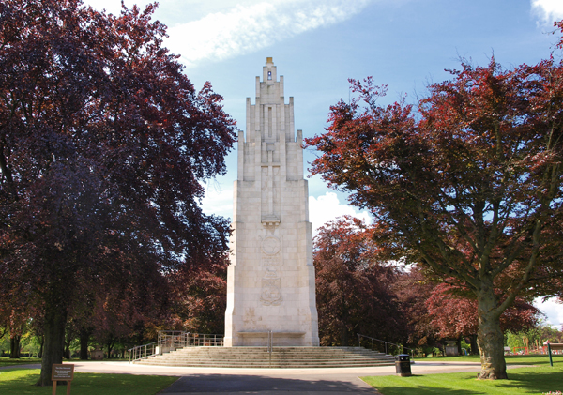
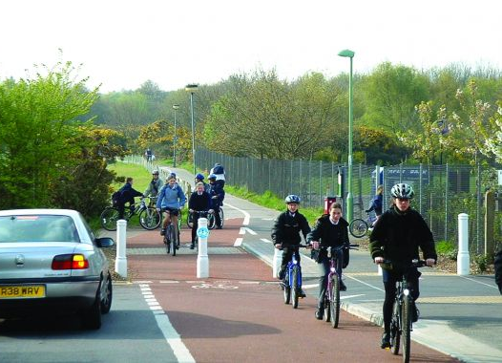
Physical activity environment
Enabling and encouraging active travel particularly to and from school
Ensuring there are places for exercise indoors and outdoors
Notes:
Places for exercise:
3 in 5 families in Coventry live within 250 metres of a green space at least the size of a football pitch
Families in the greatest deprivation generally live closer to parks and open spaces
Despite the abundance of green spaces in Coventry, residents are unlikely to use them for walking or other physical activities
Innovative projects like “Kids Run Free” encourage the use of green spaces, but more work is needed in this area to understand people’s behaviour and use of facilities
Coventry is rich in sports facilities with 419 grass pitches, 63 sports halls, 48 artificial grass pitches and 41 tennis courts
These are mainly school and college owned and too few are open to
the wider community
Active travel:
For many people, active travel represents the single biggest opportunity to be physically active on a daily basis
Evidence suggests parents’ perceptions of road safety is the single biggest factor limiting the amount of walking or cycling that children do ₅
In recent years, 44km of new cycle routes have been created by the “Cycle Coventry” initiative
In the last 3 years, 3,943 primary school ages children have undergone Bikeability training
The draft “Coventry Local Plan (2011-2031)” aims to achieve a 10% shift in travel options and focus on encouraging more walking and cycling
Urban developments should consider in depth the need for people to be physically active, and active travel should be given the highest priority.
Everyone has a responsibility for land management and the physical development of the environment. Factors like slower and less traffic on roads, safe cycle routes, safe routes to schools, walking trails in parks, and “walkable” streets all play a significant role in influencing how active we are.
Ref: 5. Timperio, (2004), “Perceptions about the local neighbourhood and walking and cycling among children

Slide 11
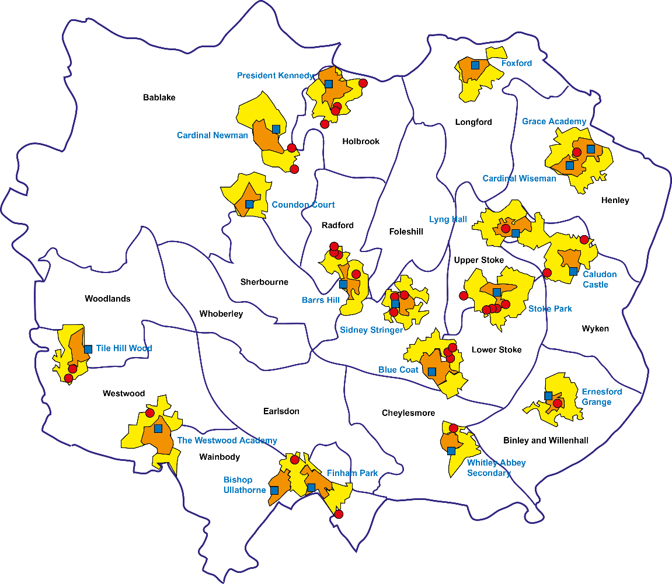
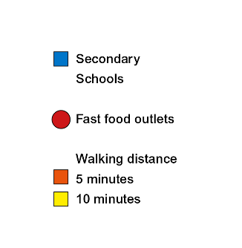
Food environment
School proximity to fast-food outlets in Coventry
Notes:
Food Outlets:
The number of fast-food purchases among teenagers is highest where there is a high density of takeaway outlets both near their home and school
Coventry’s draft local plan has introduced a limit on the growth in the number of takeaway outlets
Where takeaways are already established, schools can help control access of their students to fast food outlets e.g.
Closed gate policies
Onsite vans offering healthier food
Local businesses also have a responsibility to make their products less unhealthy including offering smaller portions and changing cooking methods
Availability of healthy foods:
The number of fast-food purchases among teenagers is highest where there is a high density of takeaway outlets both near their home and school
Coventry’s draft local plan has introduced a limit on the growth in the number of takeaway outlets
Where takeaways are already established, schools can help control access of their students to fast food outlets e.g.
Closed gate policies
Onsite vans offering healthier food
Local businesses also have a responsibility to make their products less unhealthy including offering smaller portions and changing cooking methods

Slide 12
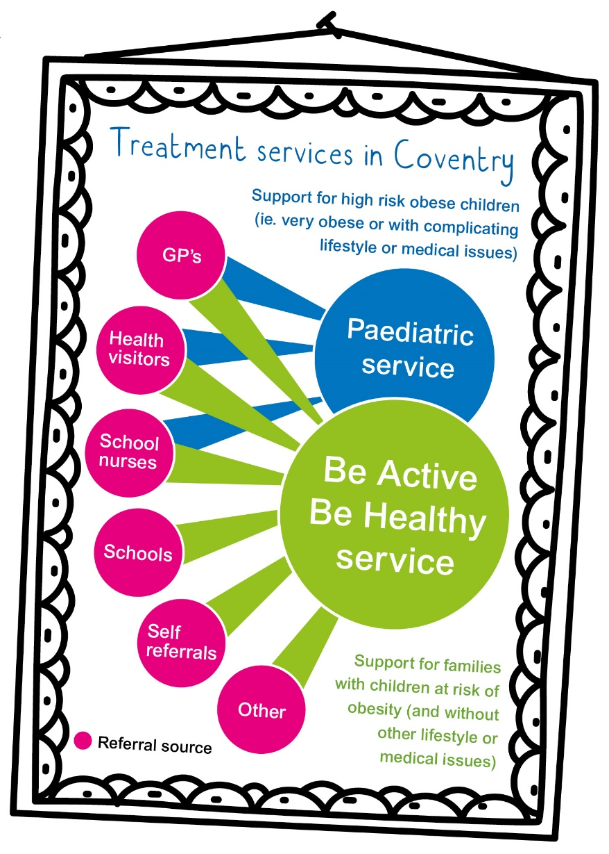
Treatment
Be Active Be Healthy:
  “I found the programme life changing in the way that I think about nutrition and exercise. I feel motivated and empowered that I can change my health and become healthy. They created an atmosphere of learning and encouragement…very welcoming, approachable and fun”
  [adult female]
Notes:
Weight loss services for children work if the whole family is involved to support changing diets and more physical activity.
“Making every contact count” initiative trains and encourages front line staff to have brief conversations to nudge people towards making healthier choices.
Be active Be healthy also delivers lifestyle services for pregnant women: Just4Mums. However, the service has struggled to engage sufficient numbers of women so work is needed to promote the scheme.
More intensive support is available in secondary care: dieticians and paediatricians often work together to tackle the most complex cases
Be Active Be Healthy:
A 10 week family behaviour change programme
Improves eating habits and physical activity levels
Focuses on those in the most deprived parts of Coventry
858 children and parents in 2015/16

Slide 13
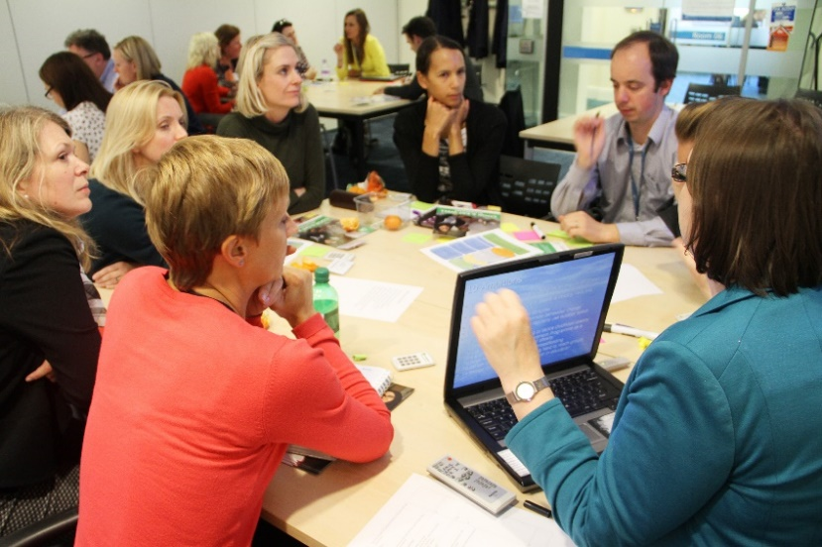
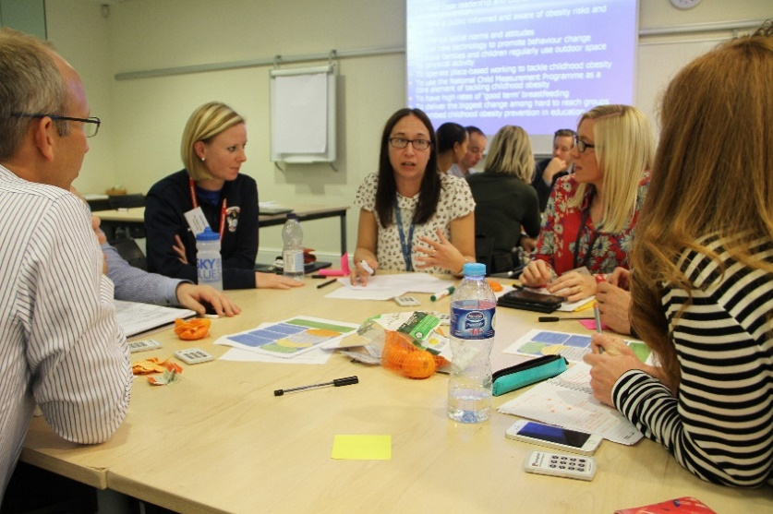
Coventry Childhood Obesity Alliance
Identifying a system
Relationships, engagement and communication
Capacity building, creativity and innovation
Monitoring & evaluation
Robust and sustainable
Embedded actions and policies
Notes:
Coventry City Council has brought together a committed working group of individuals from across the city to develop a joint strategy to tackle childhood obesity
There are over 40 stakeholders including:
school nurses, small business owners, teachers, GPs, academics, midwives, local charities – Trussel Trust, Soil Association’s Food for Life, Sky Blues in the Community…, public health, council transport, health visitors… and many more!
5 workshops so far ; 2 new live work streams now underway: schools and early years
Obesity Alliance initial recommendations:
Develop infrastructure, leadership and coordination
Embed obesity prevention during pregnancy and infancy
Create a healthy weight environment in schools
Improve out food and physical environments
Promote healthier choices in our community
Expand the local system and develop our evidence

Slide 14
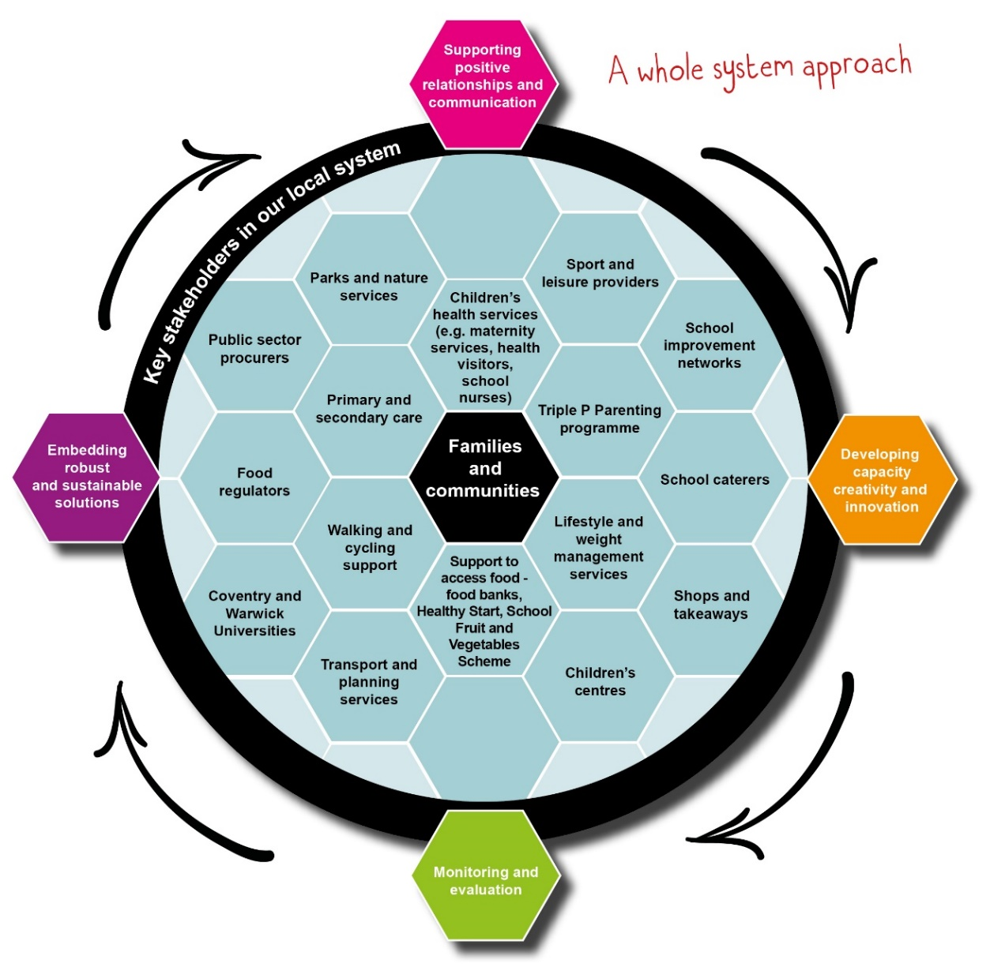
Scope of the Alliance – a Whole System Approach
Notes:
Developing a whole systems approach is crucial to the success of the alliance – move from static to dynamic action plans
Lever in more capacity / funding / volunteers
Each of the workshops so far has had focussed exercises designed to weave in the successful development of a whole systems approach

Slide 15

  What can you do to tackle childhood obesity?
Notes:
Exercises
Option 1: 10-15 mins
In groups of 2-6 (depending on total group size) spend 10-15 mins identifying and prioritising 3 things that you could do to help tackle childhood obesity. Be prepared to present them back to the group for discussion.
Option 2: 15-20 mins
Divide the room into 5 groups, allocate them each one of the 5 annual report areas (namely: early years and schools, families and communities, physical activity environment, food environment, and treatment). Spend 15 mins working on an intervention (either existing or new) to tackle childhood obesity within your topic area. Consider:
Why does/would it work well?
What would need to be in place in order to roll it out/upscale it? (Think about resources, other services and teams etc…)
What would be the potential challenges?
Option 3: 20-40 mins (depending on group size)
In groups of 4-8 people, each person to describe how they currently contribute to tackling childhood obesity.
What was the best / most interesting contribution you heard? Why? How could it be built on?
Can you identify any links between contributions of different members of the group?
How could you reinforce/create those links?
Each group to briefly feedback.

Slide 16
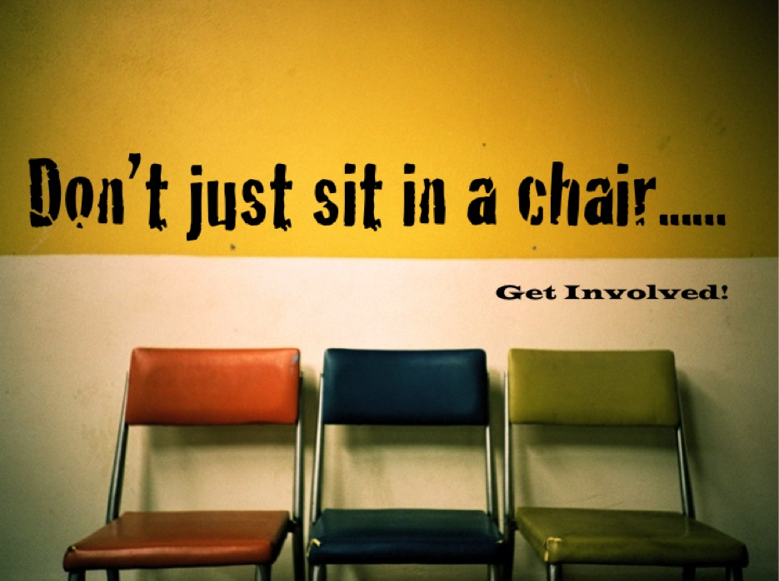
The full version of the Shape Up Coventry Annual Report is available at http://www.coventry.gov.uk/shapeupcoventry

